Slide 1
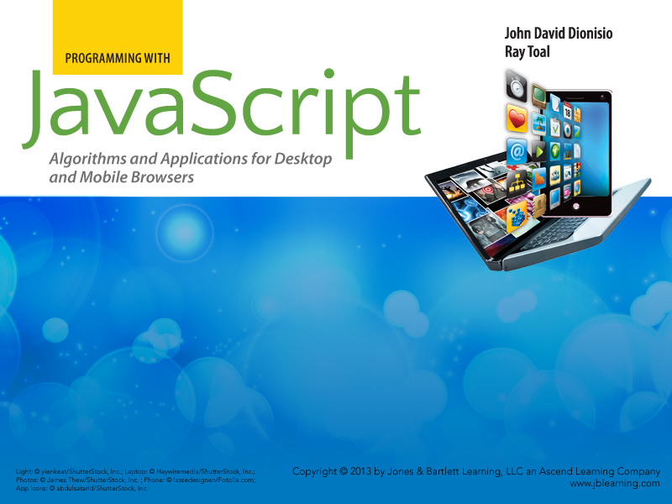
Chapter 3
Data

Slide 2

Outline
  Data types
  Undefined and null
  Booleans
  Numbers
  Strings
  Objects
  Type conversion

Slide 3
Data Types
Data types are groups of values that look and behave similarly. Examples:
Data Type | Operations
Player (in a game) | move, draw
Line of text (in a word processor) | spellcheck, hyphenate, flow around images
Search engine | interpret queries, find matching content, organize results
Image (in a photo editor) | crop, sharpen, rotate, scale

Slide 4
Data Types in JavaScript
All values in JavaScript belong to one of 6 types:
  Booleans (true and false)
  Numbers
  Strings (of characters)
  The special value undefined
  ﻿The special value null
  Objects﻿

Slide 5
undefined and null
  undefined means something may or may not exist, but no one cares or knows enough to bother with the information.
  null means that something knowingly does not exist.
var supervisor = "None"; // The supervisor's name is "None"
var supervisor = null; // There is absolutely NO supervisor,
// and we know that for sure.
var supervisor = undefined; // There might be a supervisor, we
// just don't know or care who it is.
// Or we are just refusing to say.

Slide 6
Booleans (Truth Values)
  Only two values: true and false
  Can appear as result of comparisons, expressions that compute whether two values are:
    equal (===)
    not equal (!==)
    less than (<), less than or equal (<=)
    greater than (>), greater than or equal (>=)
  Certain operators can be applied to truth values:
    && (and-also)
    || (or-else)
    ! (not)

Slide 7
Computing with Boolean Values
Logical and relational operators produce values just like arithmetic operations do. This is important!
2 + 2 | ➔ 4
2 > 2 | ➔ false
2 === 2 | ➔ true
7 !== 4 | ➔ true
true || true | ➔ true
true || false | ➔ true
false || false | ➔ false
true && true | ➔ true
true && false | ➔ false
false && false | ➔ false
! false | ➔ true
9 < 4 && 1 === 1 | ➔ false

Slide 8
Numbers
  Examples: 2, -4546, 34.8E6, -2.5573E-99, 1e100
  Hex allowed only for whole numbers, e.g., 0x4AC5
  Operators on numbers include + (addition), - (subtraction), * (multiplication), / (division), and % (modulo)
  Other operators:
    Math.floor(x), the largest integer <= to x
    Math.ceil(x), the smallest integer >= to x
    Math.sqrt(x), the square root of x
    Math.pow(x,y), producing x^{y}
    Math.random(), a random number between 0 (inclusive) and 1 (exclusive)

Slide 9
Numbers: Size and Precision Limits
  Largest finite number is ≈1.79 x 10³⁰⁸
    Number.MAX_VALUE
  Smallest finite number is ≈-1.79 x 10³⁰⁸
    Number.MIN_VALUE
  You get only about 15 or 16 decimial digits of precision
  Computations involving very large or very small numbers will often yield inexact results
  If you need to count things, it is good to know all integers from -9 quadrillion to 9 quadrillion are represented exactly

Slide 10
Numbers: NaN and Infinity
Infinity
  Used for values that are just too large
NaN
  "Not a Number"
  Appears when result of an expression is undefined
  NaN is not equal to anything, not even NaN
alert(2E200 * 73.987E150); // Alerts Infinity.
alert(0 / 0); // Alerts NaN.
alert(Infinity * Infinity); // Alerts Infinity.
alert(Infinity - Infinity); // Alerts NaN.
alert(NaN + 16); // Alerts NaN.
alert(NaN === NaN); // Alerts false.

Slide 11
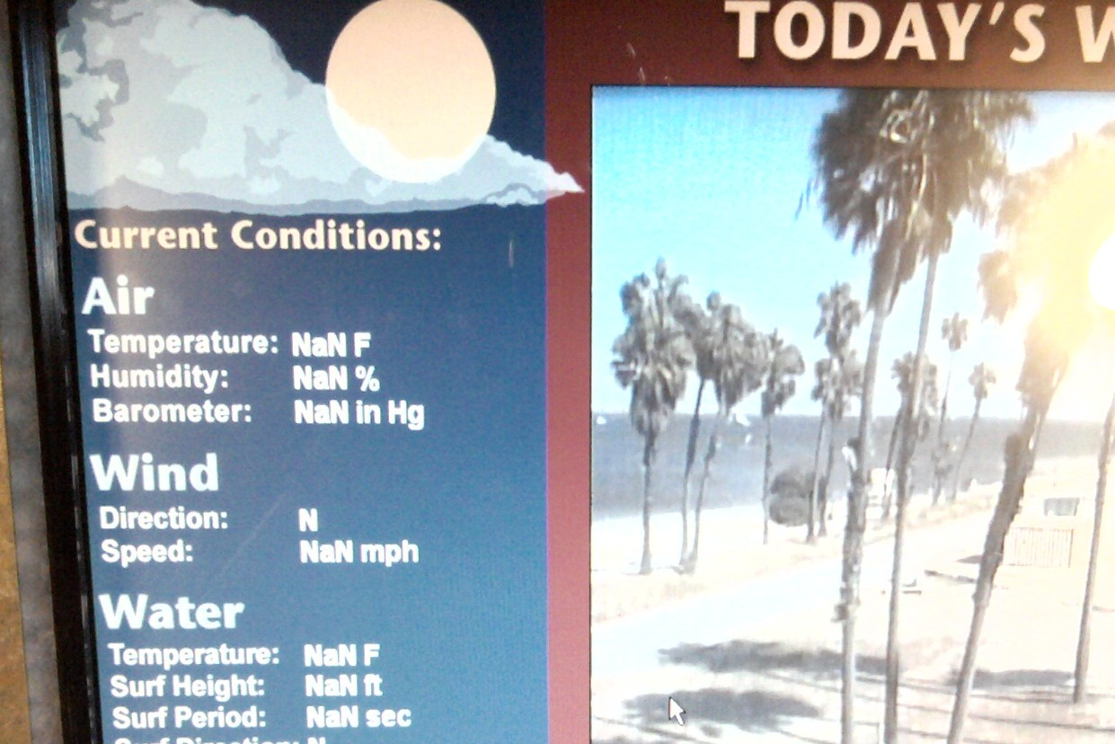
NaN in the Real World

Slide 12
Numbers: Hexadecimal
  Sometimes it is convenient to use base-16 (hexadecimal, or hex) instead of base-10 (decimal).
  Counting in hex: 0, 1, 2, 3, 4, 5, 6, 7, 8, 9, A, B, C, D, E, F, 10, 11, 12, ..., 1F, 20, 21, ... 2F, 30, ... 99, 9A, ... 9F, A0, ... FF, 100, ... FFF, 1000, 1001, ...
  To use hex in JavaScript, prefix with 0x
    0x93
    0xF00D
    0xcafe
    0x2a63
  JavaScript allows hex for whole numbers only!
(147)
(61453)
(51966)
(10851)

Slide 13
Strings (Text)
  Values of type string represent sequences of characters (TECH ALERT: actually, strings are sequences of UTF-16 codepoints but you don't really have to know that right away....)
  Written within double ("word") or single quotes ('word')
  Must fit on one line

Slide 14
Characters and Glyphs
  Character — a named symbol, e.g.,
    PLUS SIGN
    CYRILLIC SMALL LETTER TSE
    BLACK CHESS KNIGHT
    DEVANAGARI OM
    MUSICAL SYMBOL FERMATA BELOW
  Glyph — a picture of a character
  A character can have many glyphs: A, A, A, A, A, A
  Characters can share the same glyph
    Σ can represent the Greek capital letter or summation
    Ø can represent a Latin capital letter O with a stroke or the diameter sign or an empty set

Slide 15
Character Sets
  A character set is a particular set of characters, each having its own unique number (a codepoint)
  JavaScript uses the Unicode character set
  Unicode has room for over a million characters, for which 109,449 slots have been defined as of Version 6.0.0.
  Much more useful than other character sets
    ASCII has only 128 characters
    ISO8859-1, a.k.a Latin-1 has only 256 characters

Slide 16
Example Unicode Characters
Codepoint | Character
F1 3B8 95A F0A 11F4 13C9 21B7 265B 2678 FE7C 1D122 | LATIN SMALL LETTER N WITH TILDE GREEK SMALL LETTER THETA DEVANAGARI LETTER GHHA TIBETAN MARK BKA- SHOG YIG MGO HANGUL JONGSEONG KAPYEOUNPHIEUPH CHEROKEE LETTER QUO CLOCKWISE TOP SEMICIRCLE ARROW BLACK CHESS QUEEN RECYCLING SYMBOL FOR TYPE-6 PLASTICS ARABIC SHADDA ISOLATED FORM MUSICAL SYMBOL F CLEF

Slide 17
JavaScript String Values
"Hello"
"Hi, it's me"
'She said "Hello" probably'
"She said 'nyet'"
"abc\tdef\"\r\nghi"
"Olé"
"Ol\xe9"
"Backslash: \\, Slash: /"
Note how the \ does not actually represent a backslash; it instead introduces an escape sequence

Slide 18
String Operations
For strings s, t; numbers i, j, k, n; and character c:
  String.fromCharCode(c)
  s.length
  s.charCodeAt(k)
  s.charAt(k)
  s.concat(s1, s2, ... sn)
  s.indexOf(t)
  s.lastIndexOf(t)
  s.slice(i, j)
  s.split(t, n)
  s.substring(i, j)
  s.toLowerCase()
  s.toUpperCase()
  s.trim()
Strings in JavaScript are
immutable

Slide 19
Objects
An object is any value that is neither a Boolean, a number, a string, null, nor undefined value:
An object literal is an expression defining a new object and is denoted by curly brackets.
var dress = { size: 4, color: "green", brand: "DKNY", price: 834.95 }; | var part = { "serial number": "367DRT22", description: "air intake manifold", "unit cost": 29.95 };

Slide 20
Object Properties
  Objects have properties:
    Property names are strings or non-negative integers
    Property values can be any type, including objects
  Property access - dot or square brackets
  You must use square brackets for numeric properties or properties with string names (e.g. names with spaces...)
dress.price // 834.95
dress["price"] // 834.95
part["unit cost"] // 29.95
var c = "color"
dress[c] // "green"

Slide 21
Adding and Deleting Properties
You can add and delete properties at any time:
This alerts
{"sound":"acoustic", "strings":6}
Just saying alert(guitar) gives unfriendly output. Try it!
var guitar = {};
guitar.strings = 6;
guitar.composition = "mahogany";
guitar["sound"] = "acoustic";
delete guitar.composition;
alert(JSON.stringify(guitar));

Slide 22
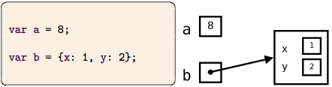
Object Values are References
The value of an object expression is not the object itself, but rather, a reference to the object. This is crucial to understanding assignment and equality testing.
  Assignment and equality testing focus on the contents of the "boxes" used for variables and object properties:

Slide 23
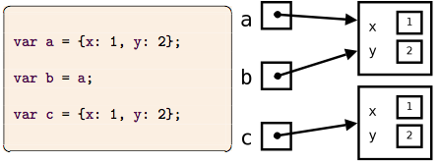
Object Assignment and Equality
  Each evaluation of an object literal creates a brand new object, distinct from all other existing objects
  Setting one object equal to another does not create a new object

Slide 24
Object Prototypes
  Every object has a hidden link to another object, called its prototype
  JavaScript looks to an object's prototype when trying to read non-existent properties
    If still not there, looks to prototype's prototype
    ... and so on until there is no prototype
  Objects therefore have two kinds of properties:
    Own properties
    Inherited properties
  You can create prototypes with Object.create()

Slide 25
Object Prototype Example
Define a prototype guitar and three guitars based on that prototype as follows:
  The prototype is six-stringed, steel-string, right-handed, acoustic, mahogany.
  The first guitar is six-stringed, steel-string, left-handed, electric, mahogany, Fender.
  The second guitar is twelve-stringed, steel-string, right-handed, electric, mahogany, 1953 Les Paul signed by Billie Joe Armstrong.
  The third guitar is a six-string, nylon-string, right-handed, acoustic, 1976 Gibson Explorer Limited Edition of unknown composition, owned by The Edge.

Slide 26
Object Prototype Example
// Prototype: six-stringed, steel- // string, right-handed, acoustic, // mahogany var plainGuitar = { strings: 6, stringType: "steel", hand: "right", sound: "acoustic". construction: "mahogany" }; var g1 = Object.create(plainGuitar); g1.hand = "left"; g1.sound = "electric"; g1.make = "Fender"; | var g2 = Object.create(plainGuitar); g2.strings = 12; g2.sound = "electric"; g2.year = 1953; g2.make = "Les Paul"; g2.signedBy = "Billie Joe Armstrong"; var g3 = Object.create(plainGuitar); g3.stringType = "nylon"; g3.year = 1976; g3.make = "Gibson"; g3.model = "Explorer Ltd Edition"; g3.construction = undefined; g3.owner = "The Edge";

Slide 27
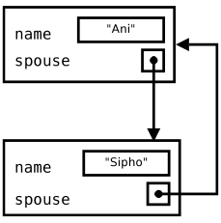
Self-referential Objects
It is possible to make an object that refers to itself or two objects that refer to each other; these are called self-referential objects:
var mom = {name: "Ani"};
var dad = {name: "Sipho", spouse: mom};
mom.spouse = dad;
Notice that it is not possible to use object literals alone in creating self-referential objects. Can you tell why?

Slide 28
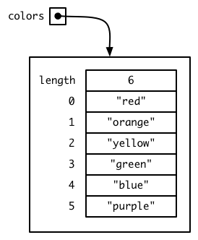
Arrays
  A special kind of object whose properties are consecutive nonnegative integers from 0 to some limit, together with a property called length
  Created with special syntax
  Changing the length property will resize the array.
var colors = [
"red", "orange",
"yellow", "green",
"blue", "purple"
];

Slide 29
Array Operations
  a.slice(i, j)
    a new array made from items in a from index i (inclusive) to j (exclusive): [3,1,4,1,5].join(2,4) ==> [4, 1]
  a.join(separator)
    a string formed by joining the string representation of a's elements with the separator: [1,2,3].join("--") ==> "1--2--3"
  a.concat(a1, a2, ...)
    a new array made from appending a, a1, a2, .... The operands can be arrays or regular values; if arrays they will be "expanded"
  a.indexOf(x)
    index of first occurrence of x in a, or -1 if not there
  A.lastndexOf(x)
    index of last occurrence of x in a, or -1 if not there

Slide 30
More Array Operations (The Mutators)
Mutators actually change the contents of the array itself:
  a.push(x, y, ...) adds items to the end of a
  a.pop() removes the item from end of a
  a.unshift(x, y, ...) adds items to front of a
  a.shift() removes the item from front of a
  a.reverse() reverses a
  a.sort() sorts a
  a.splice(i, k, e1...en) replaces the k elements at position i with e1...en. Notes: k can be 0 (pure insert); e1...en can be missing (pure deletion). If k===n it is a pure replacement. Very powerful!
You should experiment in a shell to truly understand these.

Slide 31
Type Conversion
  JavaScript is a weakly typed language — it almost never complains when operators are given values of the wrong type
  Instead, it performs type conversions to accommodate the programmer
  Many JavaScript programmers prefer to do explicit conversions, especially for string↔number conversions
  Strict equality operator : a === b if and only if same value and same type; Loose operator == behaves strangely
  The values 0, NaN, null, undefined, and the empty string ("") will be interpreted as false in a context where a Boolean value is expected

Slide 32
Automatic Conversions
 | When a boolean is expected | When a number is expected | When a string is expected
undefined | false | NaN | "undefined"
null | false | 0 | "null"
boolean | (same) | false if 0, otherwise true | "false" or "true"
number | false if 0, otherwise true | (same) | The string representation of the number
string | false if the empty string, otherwise true | The obvious number for the string, or NaN if no such number | (same)
object | true | object.valueOf() treated as a number | object.toString()

Slide 33
String to Number Conversions
Given a string s, which may be something like "42", how can you get its value as a number?
  s - 0
  s * 1
  s / 1
  Number(s)
  +s // most common idiom
Note that s + 0 does not work: "42" + 0 ⇒ "420"

Slide 34
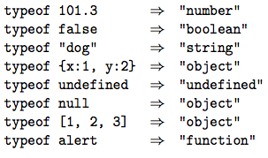
The typeof Operator
  Intended to determine the data type of a variable
  Usually makes sense, but gives the wrong answer for null
Beware!

Slide 35
Chapter Summary
  An expression is a code fragment evaluated to produce a value.
  Every JavaScript value is either null, undefined, a number, a Boolean, a string, or an object.
  JavaScript numbers have size and precision limits.
  x === y computes equality, x = y performs assignment.
  An object's value is really a reference to an object.
  An array is a special kind of object whose components are indexed by non-negative integers.
  JavaScript is a weakly typed language, which means it does a lot of automatic type conversion for the programmer.
  The values 0, NaN, null, undefined, and the empty string ("") are falsy, meaning they will taken as false in a context where a Boolean value is expected. All values that are not falsy are called truthy.

