Slide 1
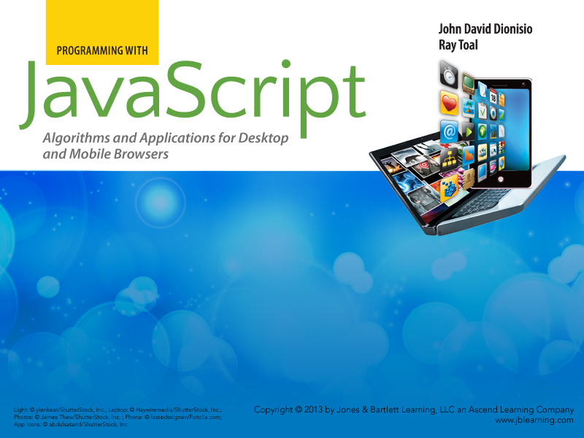
Chapter 7
Software Construction

Slide 2

Outline
  Software engineering activities
  Object oriented design and programming
  JavaScript standard objects
  Modules
  jQuery
  Performance
  Unit Testing

Slide 3
Software Engineering Activities
The task of producing a software system encompasses many activities, from making a business case for the system all the way to designing, developing, deploying, and maintaining the system itself.
JavaScript software is no exception. Experienced programmers should:
  be proficient with software components,
  understand performance implications,
  know how to test components, and
  know what solutions already exist for a given problem.

Slide 4
Object-Oriented Design and Programming
Most of the scripts seen so far focused on the algorithms for carrying out tasks, instead of the data they manipulated. Such scripts are process-oriented.
Large software systems turn the focus around and assign primary importance to data, treating algorithms as behaviors of objects. Such systems are then called object-oriented.

Slide 5
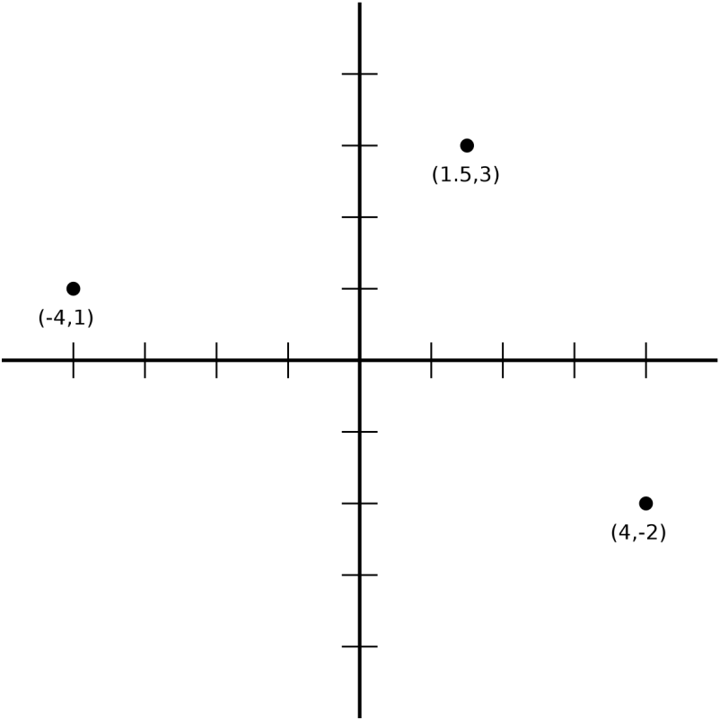
Families of Objects
We have seen how objects with the same structure and behavior can be created by using the same prototype object.
Points in a 2D plane, for example, comprise a family of objects with the same structure and behavior:
In terms of structure, each point has two coordinates, called ﻿x and y, written (x, y).

Slide 6
Points also share behavior. Here are three potentially useful methods for a given point p:
  the distance from p to the origin (0, 0)
  the distance from p to another point q, and
  the midpoint between p﻿ and another point q.
We can call these methods distanceToOrigin, distanceTo a point q, and midpointTo a point q, respectively. The point q in the latter methods becomes a parameter to those methods.

Slide 7
Here’s a first pass at a Point data type:
// The || idiom allows missing coordinates to default to zero.
var Point = function (x, y) {
this.x = x || 0;
this.y = y || 0;
};
Point.prototype.distanceToOrigin = function () {
return Math.sqrt(this.x * this.x + this.y * this.y);
};
Point.prototype.distanceTo = function (q) {
var deltaX = q.x - this.x;
var deltaY = q.y - this.y;
return Math.sqrt(deltaX * deltaX + deltaY * deltaY);
};
Point.prototype.midpointTo = function (q) {
return new Point((this.x + q.x) / 2, (this.y + q.y) / 2);
};

Slide 8
Thanks to support for default arguments, creating Points has some flexibility:
var p = new Point(5, 1); // Creates (5,1).
var q = new Point(3); // Creates (3,0), as param y is undefined.
var r = new Point(); // Creates (0,0), as both params undefined.
Another possibility for increased flexibility can be seen with the midpointTo function. As defined, it is used this way:
var p = new Point(4, 9);
var q = new Point(-20, 0);
var r = p.midpointTo(q);
But it may feel more natural to have a function that takes both points as arguments. Point is a good place for that:
Point.midpoint = function (p, q) {
return new Point((p.x + q.x) / 2, (p.y + q.y) / 2);
};

Slide 9
Now we have pretty good flexibility:
var p = new Point(4, 9);
var q = new Point(-20, 0);
var r = p.midpointTo(q);
// = OR =
var r = Point.midpoint(p, q);
alert("(" + r.x + "," + r.y + ")"); // Alerts (-8,4.5)
We can store data in the Point object too. For example, (0, 0) is known as the origin. Using this in code makes it more readable:
Point.ORIGIN = new Point(0, 0);
Notice that, through all this, we have used a single global variable. It is possible to build entire libraries under a single name — this is a good thing.

Slide 10
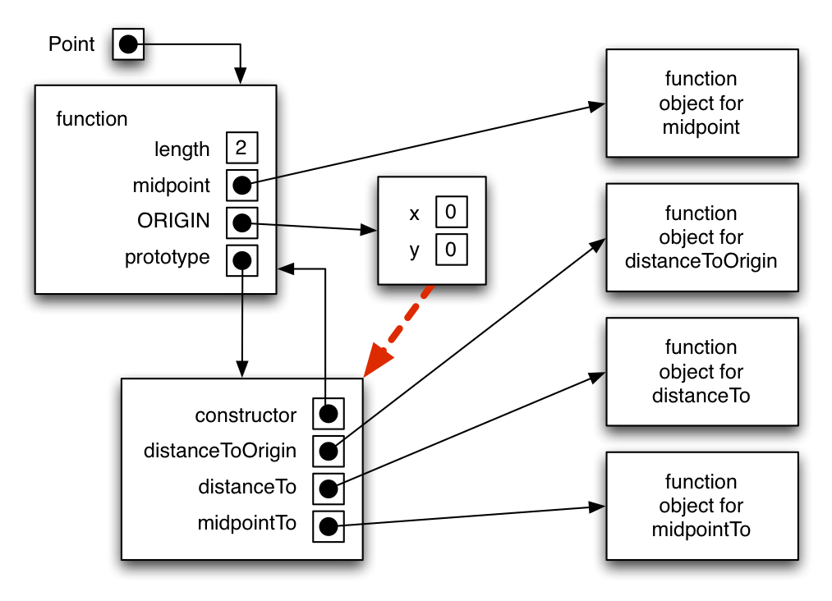
A diagram for this single-global data type for points is shown below:

Slide 11
Recall that two mechanisms are available for creating object families: Object.create and the operator new. If you prefer Object.create, remember that it is not available in all web browsers. If this is the case, you will want to define it yourself, using operator new:
if (!Object.create) {
Object.create = function (proto) {
var F = function () { };
F.prototype = proto;
return new F();
}
}
Looking ahead, note that the standard library of built-in JavaScript objects is itself built with the constructor and prototype mechanism. This will be examined later on.

Slide 12
Inheritance
Some argue that, for a programming language to be considered object-oriented, it is not enough to just be “organized around objects instead of processes.” The following tasks must also be easy for the programmer:
  Define a hierarchy of types in which subtypes inherit the structure and behavior of their ﻿supertypes
  Isolate, or protect, portions of an object’s state from interference by non-privileged parts of a system
We look at the notion of hierarchy and ﻿inheritance first.

Slide 13
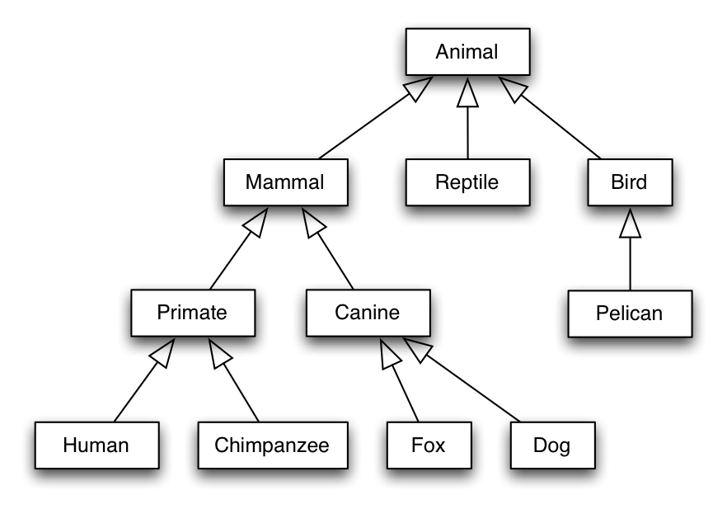
A typical diagram for a type hierarchy is shown below. Arrows from type A to type B mean that A is a ﻿subtype of B, or “every A is a B.”
Thus, every human is a primate, every primate is a mammal, and so on for the other types.

Slide 14
To illustrate how this translates to JavaScript, let’s define a Circle object then have a subtype called ColoredCircle, where a colored circle ﻿is a circle that also has a color.
Colored circles also have the behavior (function) brighten, which takes the colored circle’s current color and makes it a shade brighter. Thus:
  Each colored circle shall have its own radius, center, and color properties.
  All colored circles shall share a brighten method.
  All circle operations, including those that already exist and those that may be added in the future, shall be accessible to colored circles.

Slide 15
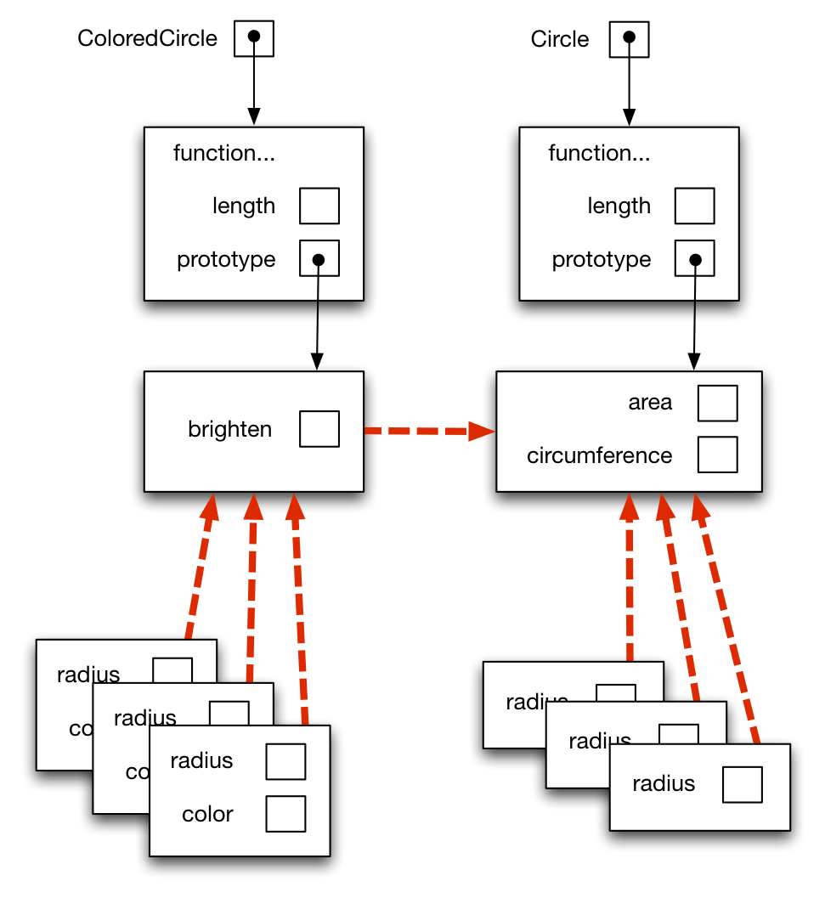
Visually, then, what we have is this (including a few instances of circles and colored circles for good measure):

Slide 16
With Object.create, the JavaScript code for these types would look like this:
var Circle = function (r) {
this.radius = r;
};
Circle.prototype.area = function () {
return Math.PI * this.radius * this.radius;
};
Circle.prototype.circumference = function () {
return 2 * Math.PI * this.radius;
};
var ColoredCircle = function (radius, color) {
this.radius = radius;
this.color = color;
};
ColoredCircle.prototype = Object.create(Circle.prototype);
ColoredCircle.prototype.brighten = function (amount) {
this.color.red *= amount;
this.color.green *= amount;
this.color.blue *= amount;
};

Slide 17
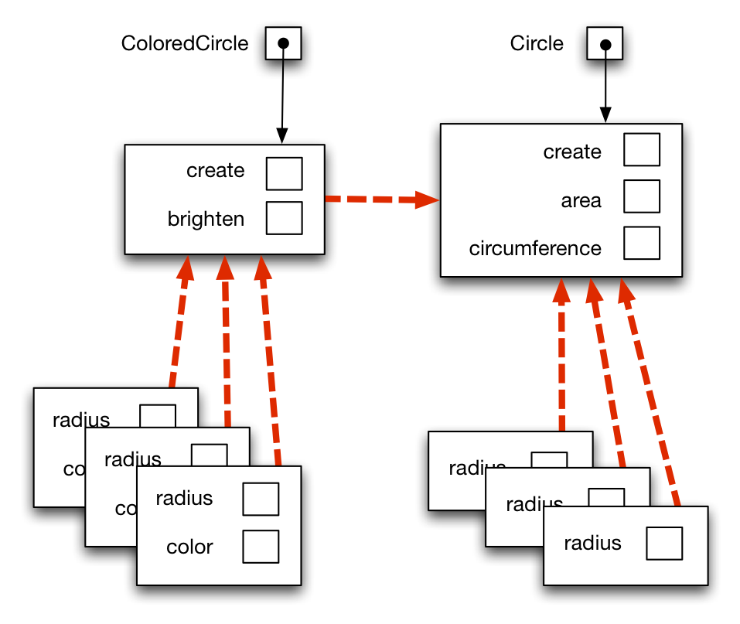
For building types without the newer Object.create, Circle and ColoredCircle would become prototypes, each with creation methods. Here they are in diagram form…

Slide 18
…and here is the code for that approach:
var Circle = { };
Circle.create = function (radius) {
var c = Object.create(this);
c.radius = radius;
return c;
};
Circle.area = function () {
return Math.PI * this.radius * this.radius;
};
Circle.circumference = function () {
return 2 * Math.PI * this.radius;
};
var ColoredCircle = Object.create(Circle);
ColoredCircle.create = function (radius, color) {
var c = Object.create(this);
c.radius = radius;
c.color = color;
return c;
};
ColoredCircle.brighten = function (amount) {
this.color.red *= amount;
this.color.green *= amount;
this.color.blue *= amount;
};

Slide 19
Information Hiding
Another common expectation in object-oriented programming is information hiding — a way to keep the internals of an object visible only to methods that are specifically designed to act on the object.
A classic example that shows the need for information hiding is a bank account. Changes to an account’s balance must go through a specific process. Direct assignment is thus unacceptable for this:
account.balance = 100000; // No no no no no!

Slide 20
To address this, one might “wrap” the account balance within a transfer method that modifies it properly:
var Account = function (id, owner) {
this.id = id;
this.owner = owner;
this.balance = 0;
};
Account.prototype.transfer = function (amount) {
// A positive value is a deposit; a negative is a withdrawal.
var tentativeBalance = this.balance + amount;
if (tentativeBalance < 0) {
throw "Transaction not accepted.";
}
this.balance = tentativeBalance;
};
Unfortunately, a misbehaving programmer can still ignore that method and change the balance directly:
var a = new Account("123", "Alice");
a.balance = -10000; // Noooo!!!

Slide 21
To enforce the use of the transfer function, we define balance as a variable within the function itself rather than a property. Functions inside Account can thus see balance, but it will be inaccessible to outside code:
var Account = function (id, owner) {
this.id = id;
this.owner = owner;
var balance = 0; // Invisible and untouchable by outside code!
this.transfer = function (amount) {
// A positive value is a deposit; a negative is a withdrawal.
var tentativeBalance = balance + amount;
if (tentativeBalance < 0) {
throw "Transaction not accepted";
}
balance = tentativeBalance;
};
this.getBalance = function () {
return balance;
};
}

Slide 22
With this approach, we do get the information hiding that we want…mostly. The following code uses the Account type defined previously:
var a = new Account("123", "Alice");
a.transfer(100);
alert(a.getBalance()); // Alerts 100
a.transfer(-20)
alert(a.getBalance()); // Alerts 80
a.transfer(-500); // Throws "Transaction not accepted"
alert(a.getBalance()); // Alerts 80 (it didn't change)
alert(a.balance); // Blank, because there's no such property
a.balance = 8; // Uh-oh!! What is someone doing here?
alert(a.getBalance()); // Alerts 80, we're still safe.
alert(a.balance); // Alerts 8. Hey! This is scary. Or is it?
While the internal balance variable is indeed protected, this does not prevent the addition of a spurious balance property to the Account.

Slide 23
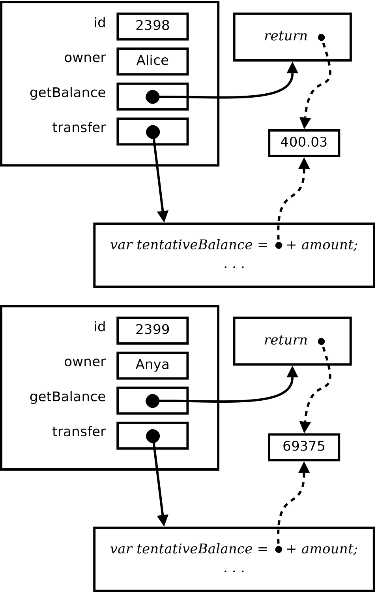
Further, this approach creates copies of the transfer and getBalance functions, as diagrammed below:
This bit of information hiding indeed does what we want, but at a cost.

Slide 24
Defensive Programming
To conclude, we note that hiding properties of an object is an example of defensive programming. Other examples include:
  Making a property of an object read-only
  Preventing the addition or deletion of object properties
  Checking arguments passed to a function

Slide 25
Defensive Programming in ES5*
JavaScript environments based on ECMAScript 5 (ES5) makes defensive programming easier:
  Object.preventExtensions disallows the addition of new properties to an object; Object.isExtensible reveals if you can add properties.
  Object.seal prevents structural changes to an object; Object.freeze makes an object’s properties read-only.
  Individual properties can be set to be read-only, nonenumerable, or nondeletable.

Slide 26
Property Descriptors*
  In ES5, every property of every object has a property descriptor that specifies how the property can be used.
  There are two kinds of descriptors: the named property descriptor and the accessor property descriptor. Their respective attributes are given in the succeeding tables.
  Object.create, Object.defineProperty, and Object.defineProperties let you set these property descriptors. Object.getOwnPropertyDescriptor retrieves them. Examples come after the property descriptor tables.

Slide 27
The Named Property Descriptor*
Attribute
Meaning
Default Value
value
The value of the property.
undefined
writable
If false, attempts to write to this property won’t succeed.
false
enumerable
If true, the property will appear in a for-in enumeration.
false
configurable
If false, attempts to delete the property or change any attribute other than "value" won’t succeed.
false

Slide 28
The Accessor Property Descriptor*
Attribute
Meaning
Default Value
get
A function of zero arguments that returns a value. Can also perform additional actions.
undefined
set
A function of one argument used to “set” a value. Can also perform other actions, such as validation.
undefined
enumerable
If true, the property will appear in a for-in enumeration.
false
configurable
If false, attempts to delete the property or change any attribute other than "value" won’t succeed.
false

Slide 29
At the cost of slightly increased verbosity, such descriptors give you fine control over your objects’ properties. This code, for example:
var dog = Object.create(Object.prototype, {
name: { value: "Spike", configurable: true, writable: true },
breed: { writable: false, enumerable: true, value: "terrier" }
});
Object.defineProperty(dog, "birthday",
{ enumerable: true, value: "2003-05-19" }
);
alert(JSON.stringify(Object.getOwnPropertyDescriptor(dog, "breed")));
…alerts the following (without the syntax coloring):
{"value":"terrier","writable":false,"enumerable":true,"configurable":false}

Slide 30
Good ol’ object literals get defaults of writeable = true, enumerable = true, and configurable = true.
var rat = { name: "Cinnamon", species: "norvegicus" };
alert(JSON.stringify(Object.getOwnPropertyDescriptor(rat, "name")));
will alert:
{"value":"Cinnamon","writable":true,"enumerable":true,"configurable":true}
The named property descriptor is a good mechanism for specifying read-only fields (quick: adapt the above code to display the property descriptor for Math.PI).
The accessor property descriptor facilitates sanity checks, validation, or requisite actions before setting a property.

Slide 31
Returning to the bank account example, the accessor property descriptor enables this:
var account = (function () {
var b = 0;
return Object.create(Object.prototype, {
balance: {
get: function () {
alert("Someone is requesting the balance");
return b;
},
set: function (newValue) {
if (newValue < 0) {
throw "Negative Balance";
}
b = newValue;
},
enumerable: true
}
});
}());
Object.preventExtensions(account);

Slide 32
The preceding account object behaves as follows:
alert(account.balance); // Calls get, (magically) alerts 0.
account.balance = 50; // Calls set
alert(account.balance); // Calls get, alerts 50.
account.balance = -20; // Calls set, throws
alert(account.balance); // Calls get, (still) alerts 50.
account.b = 500; // Has no effect
alert(account.balance); // Still alerts 50.
(The throw typically disrupts script execution, so you may need to run the last three lines separately.)

Slide 33
JavaScript Standard Objects
Objects serve as building blocks of systems, and JavaScript is no exception. JavaScript predefines a built-in set of objects useful across many different applications:
  Primitives: NaN, Infinity, undefined
  Functions: parseInt, parseFloat, isNaN, isFinite, encodeURI, encodeURIComponent, decodeURI, decodeURIComponent, eval
  Modules: Math, JSON
  Constructor functions: Object, Array, Function, Number, Boolean, String, Date, RegExp, Error, EvalError, RangeError, ReferenceError, TypeError, SyntaxError, URIError

Slide 34
Native Objects and Host Objects
Objects that you create in a JavaScript program, as well as the aforementioned built-in objects, are called native objects.
In addition to these, any given JavaScript implementation is said to be running inside some host environment, like a web browser. This environment may have additional host objects that provide capabilities specific to that environment.
Examples of host objects provided by web browsers include alert and prompt. We will see a few more shortly.

Slide 35
Primitives, Non-Constructor Functions
At this point, you have encountered Infinity, NaN, undefined, parseInt, parseFloat, and isNaN. We now describe the others:
  isFinite(n) produces false if n, when treated as a number, is Infinity, –Infinity, or NaN. Otherwise, it produces true.
  encodeURI, encodeURIComponent, decodeURI, and decodeURIComponent convert uniform resource identifiers from an encoded form and back. These will be looked at in Chapter 8.
  eval(s) treats the string s as JavaScript code and evaluates it.

Slide 36
Some examples:
alert(isFinite(-100)); // true
alert(isFinite(2E200 * 2E200)); // false
alert(isFinite("abcdef")); // false, because converts to NaN
alert(isFinite(null)); // true, because converts to 0
var s = prompt("Enter a numeric formula");
if (/[^\d()+*/-]/.test(s)) {
alert("I don't trust that input");
} else {
alert(eval(s));
}
The eval function is considered by some to be evil, which, in this context, means that it is easy to misuse and the consequences of its misuse are serious. eval will let you run arbitrary code, from possibly untrusted or malicious sources. Use with much caution…or don’t use it at all.

Slide 37
Math
You have seen the Math object in use previously. Its properties include mathematical constants (e.g., E, LN2, PI, SQRT2) and functions (e.g., cos, sin, log, random).
In the current context, the takeaway point is that Math is a built-in object just like many others.

Slide 38
Object
The standard constructor function Object may be one of the most important objects in JavaScript. It is called implicitly for every object literal:
var a = { }; // Same as var a = new Object();
var b = { x: 1, y: 2 }; // Same as var b = new Object(); b.x=1; b.y=2;
Because constructor functions define data types, the expression var a = new Object() (or var a = { }) says that:
  a is an instance of Object
  a’s prototype is Object.prototype

Slide 39
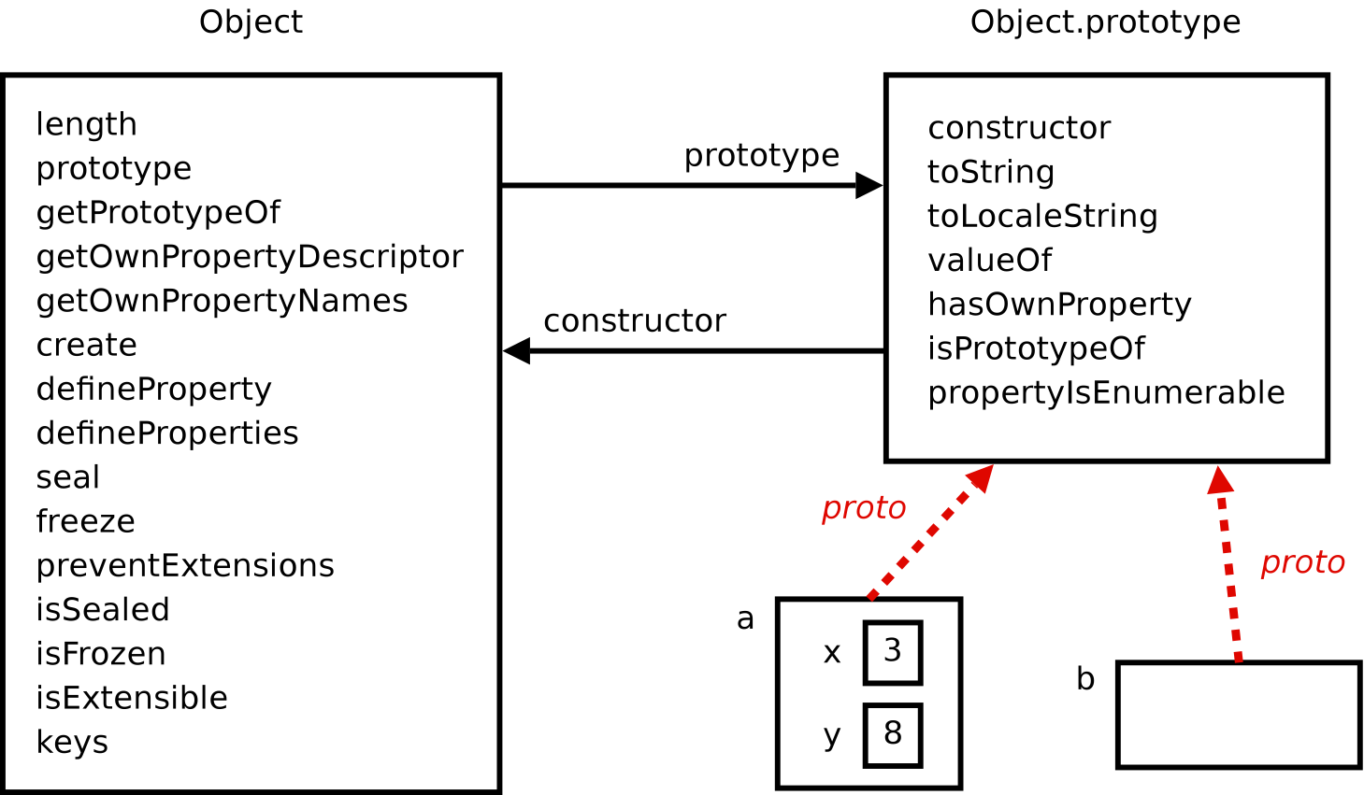
Thus, every object you create, whether using new Object() or an object literal, gets everything in Object.prototype. This is diagrammed below, alongside two example objects:
var a = { x: 3, y: 8 }; var b = { };

Slide 40
Below are the properties that every object x gets. The first three are not really useful unless overridden (up next):
  x.toString() produces a string representation of x.
  x.toLocaleString() produces a string representation of x that is locale-specific.
  x.valueOf() produces a primitive representation of x (generally a string or a number).
  x.hasOwnProperty(p) produces true if p is an own property of x and false otherwise.
  x.isPrototypeOf(y) produces true if y is the prototype of x and false otherwise.
  x.propertyIsEnumerable(p) produces true if p is an own property of x and enumerable, and false otherwise.

Slide 41
Overriding Object Properties
The toString and valueOf methods play a special role in type conversion. By defining them in Object.prototype, every JavaScript object is guaranteed to have them, so they can be used automatically in certain situations:
var p = { x: 10, y: 5 };
alert(p); // Alerts [object Object] (via toString).
alert(p - 5); // Alerts NaN (via valueOf).
Object.prototype defines default implementations of these methods. They become more useful when overridden by customized (“specialized”) versions, either for individual objects or, more typically, for new data types.

Slide 42
This code overrides toString for an individual object:
var p = { x: 10, y: 5 };
p.toString = function () {
return "(" + this.x + "," + this.y + ")";
};
alert(p); // Alerts (10, 5).
Here is a data type override, ensuring that all Points display their coordinates:
var Point = function (x, y) {
this.x = x || 0;
this.y = y || 0;
};
Point.prototype.toString = function () {
return "(" + this.x + "," + this.y + ")";
};
alert(new Point(10, 5)); // Alerts (10,5).

Slide 43
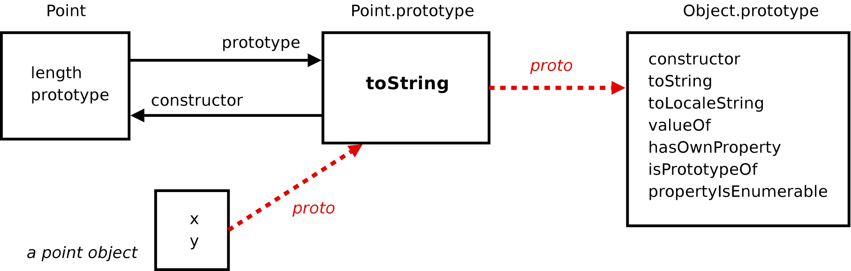
The following diagram illustrates the structure of data type overrides using the preceding Point example:

Slide 44
Boolean, Number, and String
Boolean, Number, and String are called wrappers because they create objects that contain (“wrap”) a single primitive value, enabling you to use the method-call syntax on them:
"hello".toUpperCase(); // same as new String("hello").toUpperCase()
var n = 2.7182818;
n.toFixed(4); // same as new Number(n).toFixed(4);
These constructors are “magically” called whenever you use a method with a primitive.

Slide 45
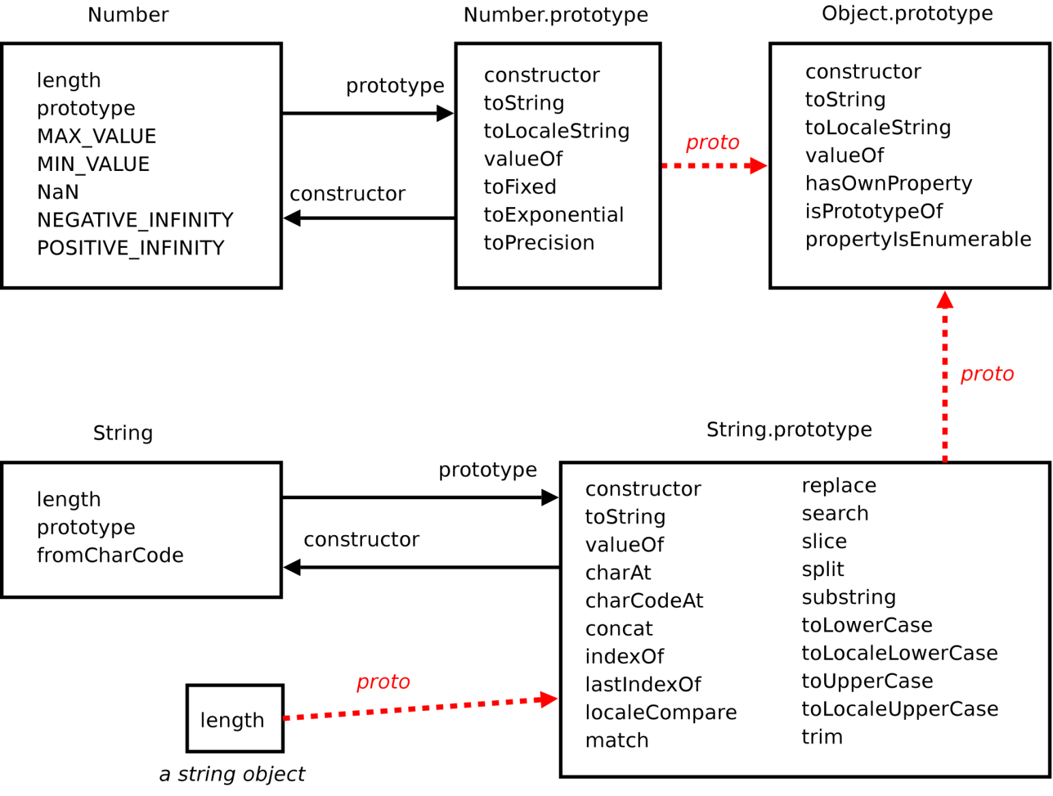
This diagram illustrates the methods and constants that are available to Number and String. Boolean does not provide anything; it seems to be defined as a constructor only for completeness.

Slide 46
Here are some examples of these constants and methods in action:
Number.MAX_VALUE ≈ 1.7997 × 10³⁰⁸
Number.MIN_VALUE ≈ 5 × 10^{–324}
The toString property does what you might expect, with a bonus version for showing a number in different bases:
var n = 500;
n.toString() ⇒ "500"
n.toString(2) ⇒ "111110100"
n.toString(16) ⇒ "1f4"
There are three methods for formatting numbers as strings:
var x = 2984.83943992;
x.toFixed(3) ⇒ "2984.839"
x.toFixed(6) ⇒ "2984.839440"
x.toExponential(5) ⇒ "2.98484e+3"
x.toPrecision(3) ⇒ "2.98e+3"
x.toPrecision(8) ⇒ "2984.8394"

Slide 47
Here are some examples of string operations:
String.fromCharCode(1063) ⇒ "Ч"
"Mississippi".charAt(1) ⇒ "i"
"Mississippi".charCodeAt(1) ⇒ 105
"Mississippi".indexOf("ss") ⇒ 2
"Mississippi".lastIndexOf("ss") ⇒ 5
"boo".concat("hoo", "hoo") ⇒ "boohoohoo"
"Mississippi".slice(3, 7) ⇒ "siss"
"Mississippi".split("ss") ⇒ ["Mi","i","ippi"]
We leave full descriptions of the complete set of Number, String, and Boolean methods to other sources.

Slide 48
Array
Array literals such as [] or [10,20,30] invoke the Array constructor, creating array objects with properties for its data items, the special length property, and over a dozen useful methods via Array.prototype.
Arrays are covered in detail elsewhere, so we conclude here with a diagram showing Array, its prototype, and, for completeness, its relationship to Object.prototype.

Slide 49
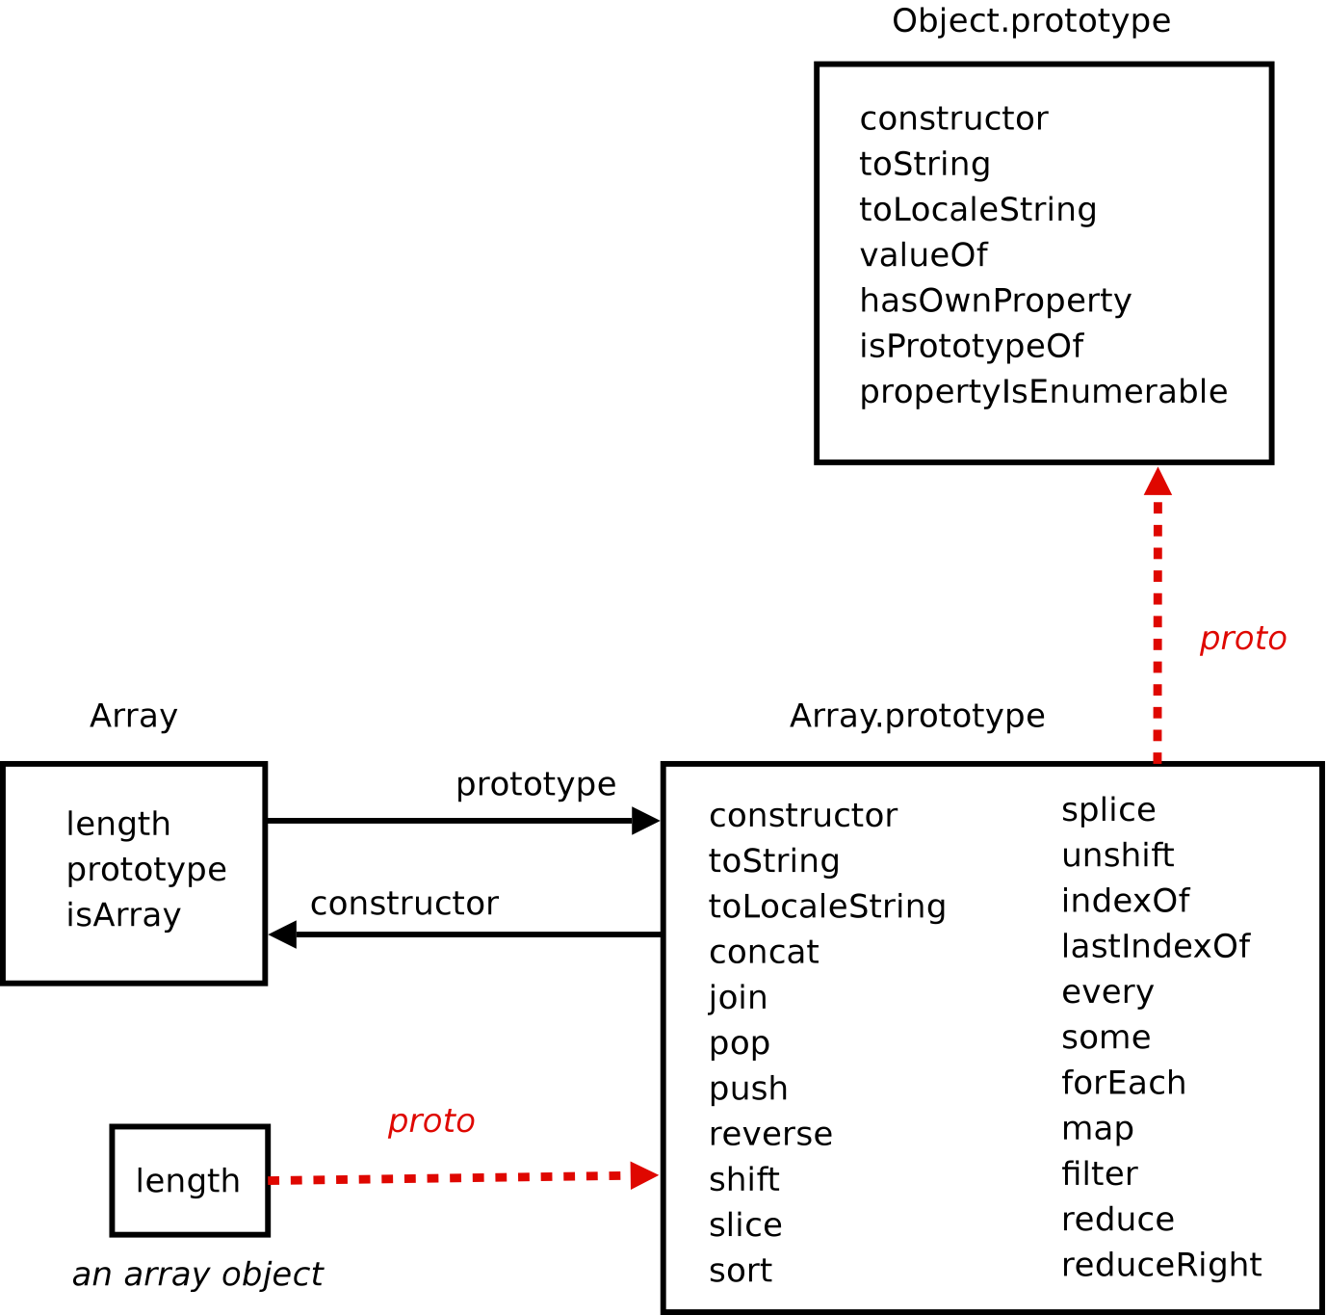

Slide 50
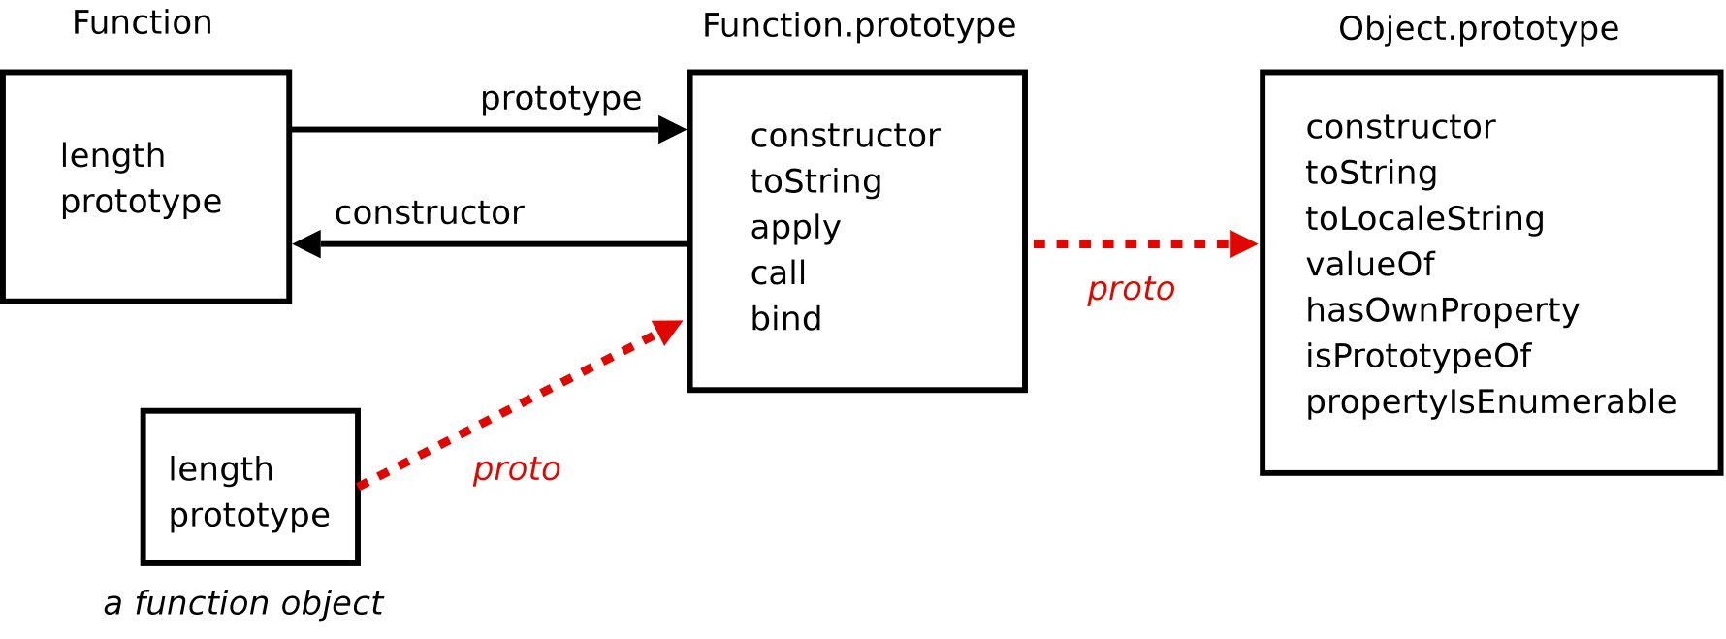
Function
It has been emphasized that JavaScript functions are JavaScript objects just like most everything else and this diagram of Function should eliminate any doubts:

Slide 51
You have seen apply and call. bind was added in ES5. To see the need for bind, recall the setTimeout function from Chapter 6:
var greet = function () { alert("Hello, finally"); };
setTimeout(greet, 5000);
This should run as expected. Now what if the function that you want to pass is a method?
var Dog = function (name) { this.name = name; };
Dog.prototype.bark = function () {
alert(this.name + " says WOOF");
};
var star = new Dog("Bolt");
star.bark();
setTimeout(star.bark, 5000);

Slide 52
The unexpected result is due to the context in which setTimeout finally calls star.bark. In that context, this no longer refers to star, but to the global object.
This is where bind comes in. Calling setTimeout like this:
setTimeout(Dog.prototype.bark.bind(star), 5000);
or this:
setTimeout(star.bark.bind(star), 5000);
makes sure that this in the delayed bark call is appropriately, well, bound to star. The need for and use of bind is relatively advanced, but keep it in mind in case methods do not produce the results you expect.

Slide 53
Date

Slide 54
Error Objects

Slide 55
JSON

Slide 56
Web Browser Host Objects

Slide 57
alert and prompt

Slide 58
document and Friends

Slide 59
DOM Objects

Slide 60
Modules

Slide 61
Simple Modules

Slide 62
The Tic-Tac-Toe Game as a Module

Slide 63
The jQuery JavaScript Library

Slide 64
Performance

Slide 65
Run-Time Efficiency

Slide 66
Space Efficiency

Slide 67
Load-Time Efficiency

Slide 68
User Interface Efficiency

Slide 69
Unit Testing

Slide 70
An Introductory Unit Testing Example

Slide 71
The QUnit Testing Framework

Slide 72
Testing in Software Development

Slide 73
Chapter Summary

