Slide 1

Chapter 8
Distributed Computing

Slide 2

Outline
  Distributed computing models
  Data interchange
  Synchronous and ansynchronous communication
  Ajax
  Designing distributed applications
  Security
  Case study

Slide 3
Distributed Computing Models
So far, all of the programs we have seen have run on a single computer. But many of the applications we use everyday — web sites, e-mail, social networks, database systems — do their work on multiple computers.
An application in which computation is split among physically separate but communicating machines is called a distributed application. The way this computation is split may vary, resulting in a number of distributed computing models.

Slide 4
  Peer-to-peer systems have multiple computers running the same program
  Grid computing systems or computational grids employ large numbers of computers to tackle a single problem
  Client-server systems have a server that runs code at the request of multiple clients
  Thin-client systems have clients that are very generic, like a web browser
  Thick-client systems have clients that are very specific — they are designed for a particular application
  Rich Internet applications, or RIAs, share aspects of both thin and thick clients: they run in web browsers like thin clients, but do a lot of work on their own, like a thick client

Slide 5
Data Interchange Formats
Distributed applications, first and foremost, involve communication among machines. Communication then begs the question: What is being communicated?
That’s where data interchange formats come in. Ideally, we choose a format that balances ease of machine processing and readability by humans (typically for debugging purposes).

Slide 6
Plain Text
Plain text is precisely what it sounds like: a sequence of characters with no additional constraints or structure.
A “fortune” service is a good match for plain text, since its output would take the form of a sentence or phrase:
It is easier to ask for forgiveness than permission.
The daytime service is also just fine for plain text:
Sunday, February 22, 2014 17:37:43-PST

Slide 7
XML
A major limitation of plain text is representing information that has structure: lists, records with properties, outlines, hierarchies, etc. A name and value format may help, but this can go only so far:
name=Acme Roadrunner Trap
manufacturer=Acme Corporation
price=$500.00
availability=in stock
XML (eXtensible Markup Language) was designed precisely to represent information that has structure.

Slide 8
XML “Look and Feel”
Here’s a block of XML:
<searchResult>
<products>
<product name="Acme Roadrunner Trap" manufacturer="Acme Corporation"
price="500.00" availability="in stock" />
<product name="Acme Roadrunner Decoy" manufacturer="Acme Corporation"
price="750.00" availability="backorder" />
</products>
<suggestions>
<product name="Ultimate Fake Tunnel"
manufacturer="Ultimate Fakers Corporation" price="200.00"
availability="in stock" />
</suggestions>
<categories>
<category>Cages</category>
<category>Traps</category>
<category>Signs</category>
</categories>
</searchResult>

Slide 9
XML resembles HTML in look and terminology — they are both “markup languages” after all. Some highlights:
  A self-contained package of XML data is a document.
  Like HTML, documents consists of elements with attributes.
  Elements are delineated by tags, which hold the name of the element between angle brackets.
  Attributes are name-value pairs within the start tag of an element (hope these last two items sound familiar).
  When an element does not have content outside of its name and/or attribute, it may be represented by a standalone tag — that is, a tag that ends in a slash (/).

Slide 10
Processing XML in JavaScript
The DOMParser host object within web browsers can convert XML text into actual objects, specifically a Document (with a capital D). Once this conversion is done, you can access the resulting Document object as needed.
// A simple XML file.
var tinyXML =
'<tinydoc name="test">' +
"<body>hello</body>" +
"</tinydoc>";
// Create the parser.
var parser = new DOMParser();
var tinyDoc = parser.parseFromString(tinyXML, "text/xml");
// Access the resulting data structure.
alert(tinyDoc.getElementsByTagName("tinydoc")[0].getAttribute("name"));
alert(tinyDoc.getElementsByTagName("body")[0].childNodes[0].nodeValue);

Slide 11
JSON
JavaScript pioneer Douglas Crockford observed that JavaScript’s own object notation can be viewed as a data representation format in its own right:
var dress = {
size: 4,
color: "green",
brand: "DKNY",
price: 834.95
};
var location = {
latitude: 31.131013,
longitude: 29.976977
};
var part = {
"serial number": "36DRT298X-785-11P",
description: "air intake manifold",
"unit cost": 29.95
};
var p = {
name: {
first: "Seán",
last: "O'Brien"
},
country: "Ireland",
birth: {
year: 1981,
month: 2,
day: 17
},
kidNames: {
1: "Ciara", 2: "Bearach",
3: "Máiréad", 4: "Aisling"
}
};

Slide 12
With a few tweaks, JavaScript Object Notation (JSON) was born:
{
"products": [
{
"name": "Acme Roadrunner Trap",
"manufacturer": "Acme Corporation",
"price": 500,
"availability": "in stock"
},
{
"name": "Acme Roadrunner Decoy",
"manufacturer": "Acme Corporation",
"price": 750,
"availability": "backorder"
}
],
"suggestions": [
{
"name": "Ultimate Fake Tunnel",
"manufacturer": "Ultimate Fakers Corporation",
"price": 200,
"availability": "in stock"
}
],
"categories": [ "Cages", "Traps", "Signs" ]
}
(Note that property names must be delimited by double quotes in JSON.)

Slide 13
Processing JSON in JavaScript
With JSON’s emergence came a new host object, JSON, for processing data formatted as JSON (that’s a lot of “JSON”s).
  The JSON.parse function accepts a string in JSON format and returns its corresponding JavaScript object.
  The JSON.stringify function accepts a JavaScript object and returns its corresponding JSON data representation.

Slide 14
var searchResultString = '{ \
"products": [ \
{ \
"name": "Acme Roadrunner Trap", \
"manufacturer": "Acme Corporation", \
"price": 500, \
"availability": "in stock" \
}, \
{ \
"name": "Acme Roadrunner Decoy", \
"manufacturer": "Acme Corporation", \
"price": 750, \
"availability": "backorder" \
} \
], \
"suggestions": [ \
{ \
"name": "Ultimate Fake Tunnel", \
"manufacturer": "Ultimate Fakers Corporation", \
"price": 200, \
"availability": "in stock" \
} \
], \
"categories": [ "Cages", "Traps", "Signs" ] \
}';
alert(searchResultString);
var searchResult = JSON.parse(searchResultString);
alert(searchResult.products[0].availability);
alert(searchResult.suggestions[0].price);
alert(searchResult.categories[1]);
alert(JSON.stringify(searchResult));
Can you predict what each alert will display?

Slide 15
YAML
YAML is what its acronym used to denote: “Yet Another Markup Language.” Its creators have since changed this to the self-referential “YAML Ain’t Markup Language,” to distinguish it from XML and its kin.
YAML seeks to combine:
  The readability of JSON
  Some advanced features of XML, such as the ability to specify links

Slide 16
Here is some sample YAML:
---
products:
- name: Acme Roadrunner Trap
manufacturer: Acme Corporation
price: 500
availability: in stock
- name: Acme Roadrunner Decoy
manufacturer: Acme Corporation
price: 750
availability: backorder
suggestions:
- name: Ultimate Fake Tunnel
manufacturer: Ultimate Fakers Corporation
price: 200
availability: in stock
categories:
- Cages
- Traps
- Signs
...

Slide 17
The Key YAML Design Characteristic
YAML distinguishes itself through its utterly minimal “verbosity,” without losing the ability to represent structures
  A key trick here is to make spacing matter (borrowing from the playbooks of programming languages such as Python and Haskell): Indenting indicates containment.
  YAML also resorts only to bare-bones “punctuation:” Three dashes (---) to separate documents, three periods (...) end a YAML stream, colons (:) to separate properties from values, and single dashes (-) to indicate arrays.

Slide 18
Cross-Platform, Work in Progress
YAML implementations are concurrently in progress, and are at different stages of maturity, across multiple platforms
  In this regard, JavaScript is a tad behind: YAML implementations in Python, C, Java, Perl, and Ruby are currently ahead of JavaScript versions
  JavaScript does have a special connection to YAML: JSON has been designated as a subset of YAML, so YAML parsers are also expected to parse JSON without issues
  YAML is definitely worth keeping in your radar

Slide 19
Synchronous vs. Asynchronous
Distributed applications can follow two basic models when communicating with each other:
  Synchronous communication involves strict, sequential exchange, with one party sending a message, waiting for a response, then possibly sending a response to that response as the other party waits.
  Asynchronous communication involves interactions that do not require waiting or the parties’ constant attention. Sending and receiving parties may move on to other things while in the middle of an exchange.

Slide 20
General Patterns
  Situations where you have to “wait your turn” or “stay on the line” tend to be synchronous in nature.
  Situations where you can “drop off” something (a message, a request) then “pick up” later tend to be asynchronous.
  As there frequently are, gray areas exist: is an online but persistent chat session synchronous or asynchronous?

Slide 21
Ajax
First, let’s get its name out of the way: “Ajax” originated as the acronym for Asynchronous JavaScript and XML.
As it turns out, this acronym has turned out not to be entirely accurate, but “Ajax” itself has stuck as the name for this computing paradigm.
What is Ajax exactly? A web application “uses Ajax” or “does Ajax” if it contacts other web servers within the life span of a single web page, lets the user continue to interact with that page while waiting for a response, then updates the page with the new data once they arrive.

Slide 22
Notes on Sample Ajax Code
For security reasons, an Ajax program may typically retrieve information only from the same server that hosted the web page that is running the Ajax code. This is due to the same-origin policy, which will be discussed later.
Because of this, Ajax code running from http://javascript.cs.lmu.edu/runner may only retrieve data from services hosted by http://javascript.cs.lmu.edu. The site does have such services, but we wanted to convey this constraint before moving on.

Slide 23
Ajax in jQuery
The jQuery library offers perhaps the most hassle-free and compact approach to using Ajax.
Here is a program for http://javascript.cs.lmu.edu/runner that accesses a “fortune” service that is hosted by http://javascript.cs.lmu.edu:
$.ajax({
url: "http://javascript.cs.lmu.edu/php/fortune.php",
success: function(response) {
$("#footer").html(response);
// Compare the above jQuery call to:
// document.getElementById("footer").innerHTML = response;
}
});

Slide 24
Notes on the Ajax Fortune Service
You can access the fortune service in its “raw” form using the web browser:
http://javascript.cs.lmu.edu/php/fortune.php
Note that the service returns a different “fortune” every time you load it.
By extension, clicking ﻿Run repeatedly on the sample Ajax script will display a new “fortune” every time.

Slide 25
Adding an Ajax “Spinner”
Because Ajax applications can continue computation and user interaction while waiting for a server to respond, they benefit from providing a visual signal that there is such a request in progress. This signal is typically an animated “spinner” icon that appears when a server connection is pending.
http://javascript.cs.lmu.edu has such a spinner available. This code adds it to the JavaScript runner page:
$("body").append("<img id='loading' \
src='../images/loadera16.gif' \
style='display: none' />");

Slide 26
Displaying the Ajax Spinner
With the spinner element added to the JavaScript runner page, we modify the Ajax fortune program to use it as follows:
$("#footer").html("");
$("#loading").show();
$.ajax({
url: "../php/fortune.php",
success: function (response) {
$("#loading").hide();
$("#footer").html(response);
}
});
This is the overall Ajax pattern: display a “spinner,” initiate the connection, process the information when it arrives, then hide the spinner when done.

Slide 27
Breaking Down jQuery’s ajax function
ajax takes a single argument: a JavaScript object whose properties specify parameters for the ajax call. Our example uses the minimal set of values to supply:
The jQuery web site lists the full range of possible options.
The function to call upon successfully receiving the service’s response (a callback)
$.ajax({
url: "../php/fortune.php",
success: function (response) {
$("#loading").hide();
$("#footer").html(response);
}
});
The URL of the web service

Slide 28
“A” is for Asynchronous
This last variation on the sample script illustrates that communication is indeed asynchronous. Note how the ajax call proceeds immediately to setting the footer, with the callback being invoked later in the life of the program:
$("#footer").html("");
$.ajax({
url: "../php/fortune.php",
success: function (response) {
$("#footer").html($("#footer").html() + response);
}
});
$("#footer").html($("#footer").html() + "Your fortune is: ");

Slide 29
A Simple Calendar Service
Our second Ajax-with-jQuery example uses another service, calendar, that is also hosted by http://javascript.cs.lmu.edu.
First, access http://javascript.cs.lmu.edu/php/calendar.php directly to see how the returned data look.
Note how the service’s output is represented in JSON.
What follows is a program that invokes the service, then tabulates the events that come back.

Slide 30
$("#footer").html("");
$.ajax({
url: "../php/calendar.php",
success: function (response) {
$("#footer").append("<table id='calendar' border='1'></table>");
for (var i = 0; i < response.length; i += 1) {
$("#calendar").append("<tr></tr>");
var addCell = function (cellValue) {
$("#calendar tr:last-child").append("<td>" +
cellValue + "</td>");
};
addCell(response[i].month);
addCell(response[i].day);
addCell(response[i].description);
addCell(response[i].movable ?
"year-to-year" :
"fixed");
}
}
});
The jQuery append function makes it easy to create HTML elements dynamically.

Slide 31
Ajax Without a Library
In practice, a JavaScript library like jQuery is almost always used for Ajax connections — it’s simply faster and less error-prone to code with these than at the “raw” API level.
Nevertheless, it is instructive to see what Ajax calls really involve, when we are interacting directly with the Ajax host object: XMLHttpRequest.

Slide 32
// Set up some objects that everyone will want to see.
var xmlHttp,
status = document.getElementById("status"),
/*
* This function handles changes to a request's state.
*/
stateChanged = function () {
// Conveniently for us, the request's state is a value from 0 to 4.
var actions = [
function () { status.innerHTML += "Not initialized."; },
function () { status.innerHTML += "Setup"; },
function () { status.innerHTML += "...Sent"; },
function () { status.innerHTML += "...In Process"; },
function () {
status.innerHTML += "...Complete";
// Deal with the data here.
}
];
// Call the function that corresponds to the new state of the request.
actions[xmlHttp.readyState]();
};
// This is the main script sequence.
status.innerHTML = "";
if (XMLHttpRequest) {
xmlHttp = new XMLHttpRequest();
xmlHttp.onreadystatechange = stateChanged;
// We expect a URL in Input 1.
xmlHttp.open("GET", document.getElementById("input1").value, true);
xmlHttp.send(null);
} else {
status.innerHTML = "Sorry, no Ajax!";
}
Ajax event handler
Ajax availability check
Event handler assignment
Connection request

Slide 33
Raw Ajax Notes
  The event handler-like design choice facilitates the asynchronous behavior.
  The event handler is actually called multiple times over the life of the selection.
  There are other, more generalized approaches to checking whether or not a web browser is Ajax-capable, but simply testing for the existence of XMLHttpRequest suffices for our needs.

Slide 34
Designing Distributed Applications
Data representations (plain text, XML, JSON) and connection mechanisms (XMLHttpRequest, jQuery ajax) are major parts of distributed web applications, but they remain parts and rely on additional concepts or definitions in order to work:
  Uniform Resource Identifiers (URIs)
  Representational State Transfer (REST)
  Separation of [distributed application] concerns (yes, separation of concerns yet again)
  Server-side technologies

Slide 35
Uniform Resource Identifiers
  In order to connect to certain resources, it is necessary to identify those resources. The standard mechanism for this is the uniform resource identifier or URI.
  URIs have two variations:
    Uniform resource names (URNs) serve solely as identifiers (e.g., full names, social security numbers).
    Uniform resource locators (or URLs) both identify a URI and encode information for reaching these resources (e.g., phone numbers, street addresses).

Slide 36
Standardized URI Scheme
A standard URI expression format has been defined:
<scheme name> : <hierarchical part> [ ? <query> ] [ # <fragment> ]
  Scheme name: Mechanism, system or category of the URI
  Hierarchical part: Identifying or location information, typically narrower in scope as you move down the string
  Query: Additional information about the resource
  Fragment: Identifier for a specific part of the resource

Slide 37
URI Examples
http://en.wikipedia.org/wiki/Uniform_resource_identifier#References
scheme name hierarchical part query fragment
http://javascript.cs.lmu.edu/php/calendar.php?date=20120728

Slide 38
Programming with URIs
When programming with URIs, your initial thought may be to “assemble” a URI through string concatenation:
var searchTerm = $("#searchField").attr("value");
$.ajax({
url: "http://www.google.com/search?q=" + searchTerm,
success: function (response) {
// Do what you want with the HTML that comes back.
}
});
This is a dangerous practice, though, especially if the variable part of the URI (as above) is taken from user input.

Slide 39
Encoding and Decoding Functions
Why would straight-up string concatenation of URIs be dangerous? The answer comes from special characters — symbols which mean something in the URI scheme itself, or which mean something in HTML (and may thus affect your content in unintended ways if parts of the URI are echoed back later on in the application).
Fortunately, there are built-in functions for rewriting (“encoding” and “decoding”) these special characters:
encodeURI encodeURIComponent
decodeURI decodeURIComponent

Slide 40
Encoding and Decoding in Action
This program, written for http://javascript.cs.lmu.edu/playground, shows what each function does to whatever is typed into the input1 text field:
var input = document.getElementById("input1").value;
var status = document.getElementById("status");
status.style.textAlign = "left";
status.innerHTML = "<b>encodeURI:</b> " + encodeURI(input) + "<br/>" +
"<b>encodeURIComponent:</b> " + encodeURIComponent(input) +
"<br/>" + "<b>decodeURI:</b> " + decodeURI(input) + "<br/>" +
"<b>decodeURIComponent:</b> " + decodeURIComponent(input);
Be sure to try full and partial URIs. Also, take the output of the encoder functions and pass those to the decoder functions.

Slide 41
REST
URIs, and their standard format, represent a micro-level, detailed aspect of distributed applications. In contrast, Representational State Transfer, or REST, is a big-picture, macro-level concept.
A distributed system is RESTful if it follows a particular set of characteristics and constraints. These characteristics and constraints were chosen to facilitate simplicity, scalability, and portability, to name a few desirable qualities.

Slide 42
REST is Not…
…“multi-tiered”: Well, REST does not feel multitiered. Conceptually, there are two layers, the client and the server. The server may rely on other servers to do this work, but this is abstracted out in RESTful systems.
…stateful: Sequences of URIs are never “connected” to perform a longer calculation or transactions, and URIs never behave differently based on prior context or state.
…action-centric: It does not view URIs as verbs but as nouns (resources). So called remote procedure call systems, for example, are not RESTful.

Slide 43
REST is…
…strictly client-server: Clients ask for resources and request modifications to them, while servers manage the storage of these resources. Period.
…stateless: We did say that REST is not stateful, so it stands to reason that what it is stateless. That is, URI accesses have no prior assumptions nor subsequent side effects (outside of the modification, addition, or deletion of a resource, if at all).
…uniform: The URIs in a RESTful system ever always stand for one thing — some resource that is needed by the application.

Slide 44
REST and the Web
REST, by design, shares many similarities with the Web. Which is not surprising, since its originator, Roy Fielding, is one of the principal creators of HTTP, the Web’s network protocol.
  URIs-as-resources map directly to web addresses-as-pages.
  Different representations of the same content (resource) can be specified in the HTTP request rather than the URI, thus keeping the URI strictly as a resource identifier.
  The primary resource operations are captured in the HTTP methods GET, PUT, POST, and DELETE, again keeping the URI itself from being “polluted,” this time by verbs.

Slide 45
Separation of Concerns, Distributed
Distributed applications benefit as much from proper separation of concerns as do other computing contexts and systems.
One particular separation strategy actually derives from user interface platforms: model-view-controller.
To illustrate this framework, we have prepared a small [non-RESTful, non-jQuery] web application that can be accessed at http://javascript.cs.lmu.edu/ajax-sample.

Slide 46
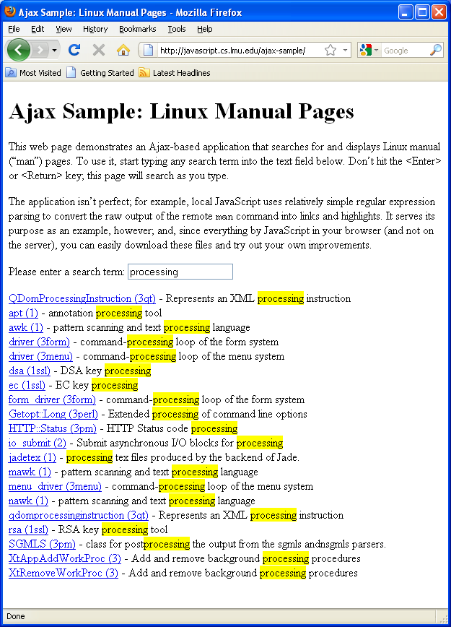
An application’s ﻿model consists of the data that it manages or displays. It includes ﻿data only, with no visual or presentational elements.
The sample application uses two primary data items: search results and individual manual page text.
In well-separated web applications, these are typically represented by URLs which return the data in “pure” form. In our sample application, they are:
http://javascript.cs.lmu.edu/php/man-keyword.php?keyword=<keyword>
http://javascript.cs.lmu.edu/php/man.php?entry=<entry>&section=<section>

Slide 47
An application’s ﻿view is a rendering of all or part of its model. There may be many views for the same model — that’s partially the point.
In our sample, most of the “rendering” is in the formatManKeywordResult function. This takes the model representation of a keyword search result and converts it into HTML and CSS:
/*
* Formats the raw keyword search result so that it includes a link to the
* manual page and highlights the found keyword.
*/
var formatManKeywordResult = function (keyword, keywordResult, resultTarget, pageTarget) {
// First, parse out the link to the actual manual page.
var formattedResult = keywordResult.replace(/^([\w\.\-\:]+) \((\w+)\)/gim,
"<a href=\"javascript:loadManPage('$1','$2'," +
"document.getElementById('" + resultTarget.id + "')," +
"document.getElementById('" + pageTarget.id + "'));\">$1 ($2)</a>");
// Highlight the keyword in each line. This assumes the existence of
// a "keyword" class in the document CSS. We only highlight the keyword
// *after* a " - " since the ones before might have the keyword text
// inside the href attribute of the <a> tag. Also, for simplicity, we only
// highlight the first occurrence of this keyword (which is frequently the
// only one in man keyword results anyway).
var keywordRegex = new RegExp("( - .*)(" + keyword + ")", "gi");
formattedResult = formattedResult.replace(keywordRegex,
"$1<span class='keyword'>$2</span>");
// Add a break tag after each line.
formattedResult = formattedResult.replace(/$/gim, "<br/>");
return formattedResult;
};

Slide 48
An application’s ﻿controller code starts with its event handlers and stops when its model gets updated. Once the model changes based on the user’s actions, the cycle starts anew: the model gets rendered into a view, and the user performs the next action, triggering the controller code once again.
var doSearch = function () {
performManKeywordSearch(document.getElementById("keyword").value,
document.getElementById("loading"),
document.getElementById("results"),
document.getElementById("manPage"));
};
window.onload = function () {
var keywordField = document.getElementById("keyword");
keywordField.onkeyup = doSearch;
keywordField.onfocus = doSearch;
};

Slide 49
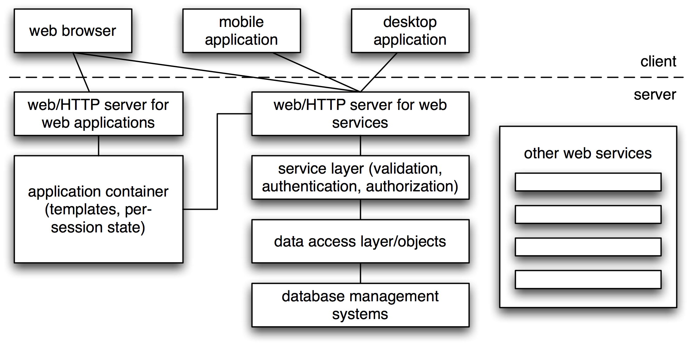
Server-Side Technologies*
In certain contexts, it may be beneficial to have some idea of what goes on on the “server side.” Here is a quick overview:

Slide 50
A Tale of Two Web Servers
Traditional web architectures used a single web (HTTP) server (conceptually single, that is; a server farm may balance the load) to host an entire web application. Browsers contact that server, get web pages back, then move on.
Modern architectures use HTTP servers in two ways: one like before, to serve web pages for browsers, but another one to host the application’s ﻿services. This service layer does not supply web pages, but data only, and all clients — including web pages — use this layer for data requests.
Yes, that is separation of concerns again.

Slide 51
Servers All the Way Down
“Behind” the web application and web service servers, a variety of other functions may be provided by the same or other hosts.
  An application container may assist in assembling web pages, particularly for common layouts or templates.
  Data access and storage layers take care of the actual CRUD (create, retrieve, update, delete) operations for managing information.
  Other services may be available depending on the application, such as interfaces to SMS texting, social APIs, and others.

Slide 52
Security
In the broad sense, security is the protection of resources against access by unauthorized parties. The types of security derive from the protection involved:
  Protection from unauthorized disclosure is confidentiality
  Protection from inappropriate modification is integrity
  Protection of a system from being rendered unusable, both intentional (denial of service) or incidental (power outages, hardware problems) is availability﻿
…and so on.

Slide 53
The Web, the Bad, and the Sandbox
Like in most other environments, web security focuses on the prevention of malicious programs from running on computer.
The trick is that, with web browsers visiting pretty much anything and everything, they are exposed to far higher risk than other platforms.
The solution: put web browser code in a sandbox. A sandbox is a “safe area” in which code can run, but with very specific, enforced limitations.

Slide 54
Sandbox Rules
  Limited reading and writing of files on the computer
  No access to browser history
  No opening of new windows
  No closing of windows that the same code did not open
  No modification of files chosen by the user
  No access to files on the server (i.e., HTTP only)
  The same origin policy
  No communicating directly with databases
  No hiding of source code or data
The limitations are all focused on preventing potentially malicious code from collecting or corrupting user data.

Slide 55
Sandbox Wrinkles
The sandbox mechanism assumes that we trust our web browsers to do the right thing.
Open source web browsers (whose code is available for all to see) gain a certain degree of trust because they are under broad scrutiny.
Another kind of sandbox has emerged of late: a process sandbox that prevents one bad web page from bringing down an entire web browser. This too is a sandbox, but remember that it is not the same thing.

Slide 56
The Same Origin Policy
One of the most significant aspects of the web browser JavaScript sandbox is the same origin policy:
JavaScript programs can interact only with resources (documents, elements, services) with the same origin as the program itself, origin being defined as the combination of network protocol, port, and host.
Without the same origin policy, malicious JavaScript programs that may be loaded into a web browser would be able to contact any host on the Internet, and send or receive anything to or from anywhere.

Slide 57
Legitimate Non-Same-Origin Situations
As well-meaning as the same origin policy may be, it also limits some non-malicious and even useful activities:
  Integration with external services such as social networks, media lockers, or photo streams
  Mashups that combine data from one site with data from another in interesting ways
  Interoperation between distinct but related services, such as a pharmacy and an electronic health record
This has led to a number of same origin policy workarounds.

Slide 58
Cross-Origin Resource Sharing
A simple way to exempt a service from the same origin policy is cross-origin resource sharing or CORS. CORS is a statement from a web service regarding what hosts are allowed to connect to it.
This is all done on the server side. Clients make Ajax calls, and for CORS services, that request will just work.

Slide 59
CORS Example
To give you a firsthand look at a CORS service, we have set up a trivial service at a site that is not http://javascript.cs.lmu.edu. This JavaScript runner code does “just work,” thanks to CORS:
$("#footer").html("");
$.ajax({
url: "http://go.technocage.com/javascript/cors",
success: function (response) {
$("#footer").html(response);
}
});

Slide 60
HTML Allows Cross-Site Requests
Another same origin policy workaround is available using HTML. Unlike JavaScript, HTML elements are not subject to the same origin policy. They can download resources that come from other hosts.
Of particular interest here are script and form elements:
  The src attribute of the script element may refer to any JavaScript file on the Internet.
  The form element may submit user-supplied data to any host on the Internet.

Slide 61
Running Scripts from Another Web Site
While it is possible to statically include, in HTML, a script element whose src is a script from another web site, it should also be noted that such an element can be created in JavaScript. Execute the following in the runner page:
var script = document.createElement("script");
script.src = "http://go.technocage.com/javascript/cross-site.js";
document.body.appendChild(script);
The same origin policy does not cover this situation, and the referenced cross-site.js script runs. But what does it do?

Slide 62
Without reloading the runner page, run this:
alert(payload);
alert(payload.username);
alert(payload.password);
Note the existence of a payload variable. Now examine that script directly in your web browser:
http://go.technocage.com/javascript/cross-site.js
You may have already guessed its contents:
var payload =
JSON.parse('{ "username": "victim", "password": "uh-oh!" }');

Slide 63
JSONP: JSON with Padding
The script element execution technique facilitates an important workaround to the same origin policy: JSONP, or JSON with Padding.
To explain JSONP, we review a typical sequence that the same origin policy prohibits:
$("#footer").html("");
$.ajax({
url: "http://api.twitter.com/1/trends/weekly.json",
success: function (response) {
$("#footer").html(response);
}
});

Slide 64
The preceding code does not work in the JavaScript runner because the Twitter service resides on a different host. But try this instead:
$("#footer").html("");
window.displayObject = function (data) {
$("#footer").append($("<pre></pre>").text(JSON.stringify(data)));
};
var script = document.createElement("script");
script.src = "http://api.twitter.com/1/trends/weekly.json?callback=displayObject";
document.body.appendChild(script);
document.body.removeChild(script);
This works! Note how we do not use ajax here but a ﻿dynamically-created script element. We refer to the Twitter service there, with an important difference: the callback parameter signals the use of JSONP.

Slide 65
Thanks to the script element, this network connection is made, and the retrieved JavaScript code is executed.
The Twitter service, upon seeing callback, adjusts its response so that, instead of a “pure” JSON object, it returns:
callback(/* Web service response as JavaScript object */);
Note, here, where “padding” originates: it refers to the function call that “wraps” (“pads”) the JavaScript object. The value of callback is expected to be the name of a function that accepts a JavaScript object as its argument. The body of the function does whatever it wants with that object, because you supply it. JSONP enables the equivalent of Ajax, if the “foreign” service supports it.

Slide 66
Sending Data to Another Web Site
The typical use for the form element is to gather user-supplied data for submission to some web site (specified as the form’s action). As with script, the form need not be pre-written into the HTML:
var form = document.createElement("form");
form.action = "http://go.technocage.com/javascript/cross-site.js";
form.method = "get";
form.submit();
Unlike script, this does not actually run code; what it does instead is make the connection specified by action and method then return that connection’s result.

Slide 67
However, what form submission does perform is anything that the action triggers on the server to which the form has been submitted — and that server also received any data within the form element.
Finally, the form can send the browser back to the original site. Thus, the intermediate connection to a non-same origin host might not even be immediately apparent:
var form = document.createElement("form");
form.action = "http://go.technocage.com/javascript/referback";
form.method = "get";
form.submit();
While not identical to an ajax function call, note how the activity is very similar (connection to the server with supplied information), and it circumvents the same origin policy.

Slide 68
Cross-Site Scripting
Despite the protections and limitations discussed so far, the possibility that a malicious party may subvert or compromise an insufficiently vigilant web site remains.
The most prevalent such exploit is known as cross-site scripting, or XSS. From its name, you may infer, correctly, that the technique involves some violation of the same origin policy, making one web site inadvertently execute scripts from a different, potentially malicious, host.
XSS is a web-specific variant of a more general exploitation technique called code injection — as will be seen shortly.

Slide 69
Injection by URL
Many web applications receive user-supplied data through their URLs, expressed as query parameters:
http://examplestore.com/search?name=trap&manufacturer=acme
In this hypothetical search URL, the user has specified search terms of “trap” for a product’s name and “acme” for that product’s manufacturer.

Slide 70
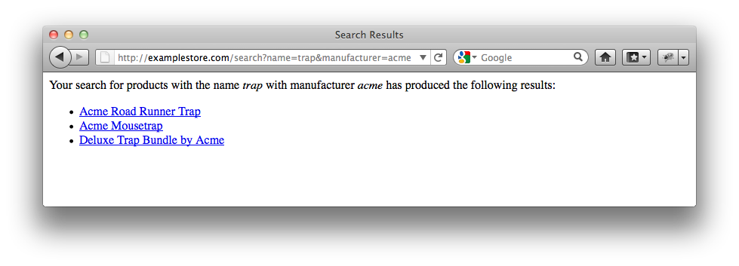
Such user-supplied data frequently emerge in subsequent pages in the web application. For example, if the user performed a search for name=trap and manufacturer=acme, the web application may respond with the following page:
Note how “trap” and “acme” have been inserted directly into this hypothetical search results page.

Slide 71
The Injection by URL Exploit
The exploit for pages like this? Supply parameters that can be interpreted as HTML.
To demonstrate this, a service that is vulnerable to this very exploit has been implemented at http://javascript.cs.lmu.edu. This URL, entered into a web browser, supplies a simulated search page, not unlike the one shown previously:
http://javascript.cs.lmu.edu/php/vulnerable.php?name=trap&manufacturer=acme
Try it yourself; try other values for name and manufacturer also, so you can see how they affect the resulting page.

Slide 72
Now, try this URL:
http://javascript.cs.lmu.edu/php/vulnerable.php?name=<u>trap</u>&manufacturer=<u>acme</u>
Note the resulting page: “trap” and “acme” are underlined, not because of the web application’s own code, but because the u tags were submitted by the URL.
And now, the final wrinkle: if any HTML tag can be “injected” through these query parameters, then script tags, complete with references to scripts outside the web site, may be injected as well. This is the culminating achievement of injection by URL.
Visit http://go.technocage.com/javascript/xss-urls.html to see additional examples of this exploit, including script element injection.

Slide 73
Injection by Form
Another possible XSS exploit is injection by form — the form element, that is. Its principle is the same: get a targeted web application to accept information that gets included in subsequent web pages as executable JavaScript. Here, the point of entry is a form submission (seen previously) instead of a URL.
Our vulnerable web service happens to be exploitable by form as well. Examples of this can be found at http://go.technocage.com/javascript/xss-form.html. Note how, again, the same origin policy does not protect us, because it does not cover form submissions.

Slide 74
Defending Against XSS Attacks
Web browsers are in a constant cat-and-mouse game to protect against XSS attacks. For web application developers, a few rules go a long way; the overarching principle is that all information that passes through web browsers might be a code injection attempt, so process it as such:
  Servers should always validate incoming requests. Hold input to the most restrictive usable format.
  All information that crosses network boundaries must be ﻿encoded. This prevents special characters such as < and > from taking on unintended meanings.

Slide 75
Mashups
Not all cross-site scripting activities are malicious — some of them are even desirable. One such web application category is the mashup: an application that retrieves two or more data sets, typically from distinct sources, and presents them in an integrated manner. Some examples:
  Restaurants overlaid on a map
  Events from multiple sources on a calendar
  Advertisements customized according to a web page’s content and what is known specifically about you

Slide 76
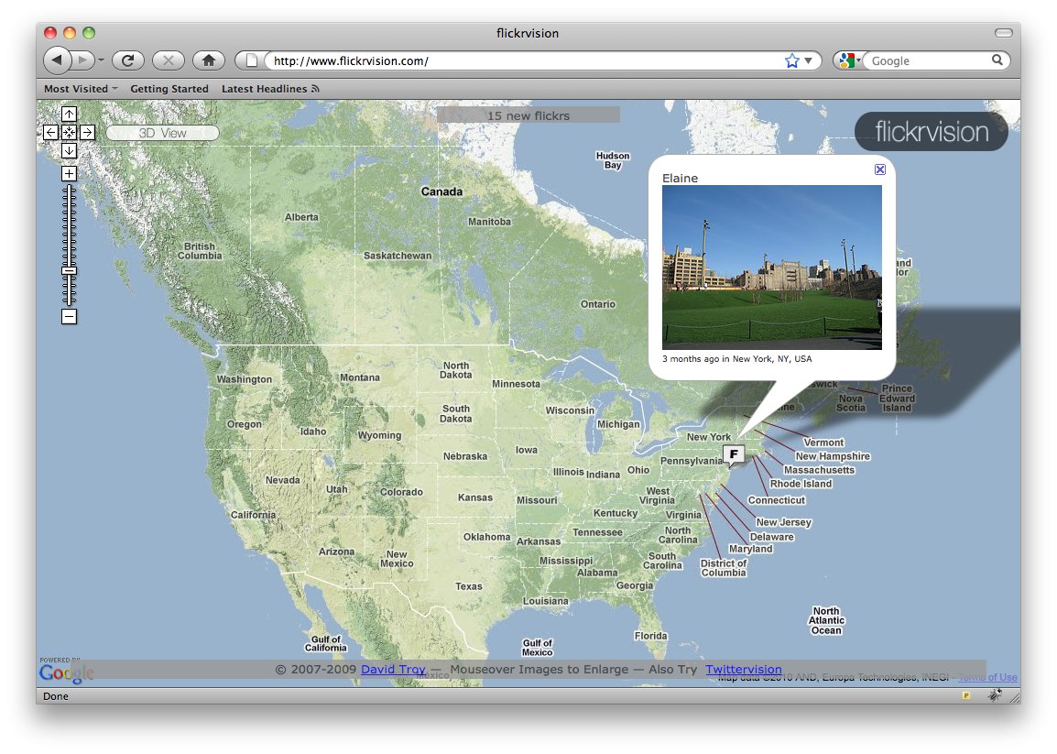
Photos-over-a-map are very popular. Here is one, flickrvision, that mashes up Flickr photo streams and Google Maps:

Slide 77
Mashup Implementation Approaches
Not surprisingly, these are the same approaches for accomplishing any kind of cross-site access:
  Server-side integration
  Cross-origin resource sharing (CORS)
  Dynamically-created script elements
  JSONP
  Benevolent use of XSS techniques: code injection by URL, got injection by form element
Mashups are “self-inflicted XSS attacks” — Douglas Crockford

Slide 78
Case Study: Events and Trending Topics
A simple mashup application is available at http://javascript.cs.lmu.edu/calendar-mashup. This application combines the homegrown calendar data provided by http://javascript.cs.lmu.edu/php/calendar.php with Twitter trending topics from http://api.twitter.com/1/trends/weekly.json.
The jQuery UI user interface library, available at http://jqueryui.com, facilitates easy entry of an event date through a pre-built, fully functional datepicker widget.

Slide 79
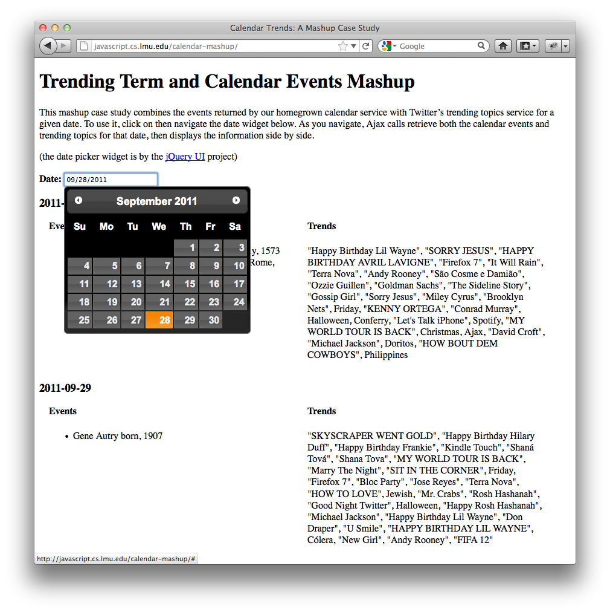
The mashup displays calendar events close to the chosen date, alongside the trending topics for each day:

Slide 80
In addition to jQuery UI for the date user interface, the mashup uses the following approaches that build upon the ideas seen in this chapter:
  Instead of ajax, the convenience function getJSON is used. getJSON is a “wrapper” for ajax that assumes JSON as the data representation. It also supports JSONP, which is necessary for contacting Twitter.
  The jQuery each function is used to perform a distinct getJSON call for every event returned by the calendar events service.
  The model for the mashup is built as a standalone JavaScript object, which a displayMashup function then “converts” into corresponding HTML.

Slide 81
Chapter Summary, Part 1
Distributed computing concerns applications that divide their work among separate physical machines.
Important aspects of distributed applications include: data representation, synchronous vs. asynchronous communication, resource identification, and separation of concerns.
Distributed web applications use Ajax to communicate with web services. For security reasons, this communication is limited by the same origin policy and requires alternative techniques in certain situations.

Slide 82
Chapter Summary, Part 2
Web application security, which concerns the protection of web applications from execution of malicious code, uses a sandbox to prohibit scripts from doing potentially dangerous actions.
Despite the sandbox, techniques do exist that may lead to exploits that execute malicious code. These techniques center on code injection that results in cross-site scripting (XSS).
XSS also has a beneficial side, in the form of mashup web applications. These applications combine data from disparate sources and process, visualize, or integrate them in new ways.

