Slide 1
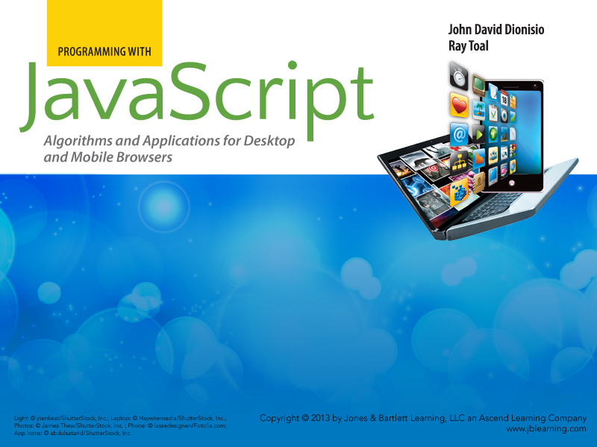
Chapter 4
Statements

Slide 2

Outline
  Expressions vs. statements
  The statements of JavaScript — the grand tour (almost)
    Declaration and expression statements
    Assignment
    Conditional statements and their alternatives
    Iteration statements
    Disruptive and labeled statements
  Technicalities

Slide 3
Expressions vs. Statements
  Expressions are evaluated to produce values
  Statements are executed to produce actions
  A script is a sequence of statements
  Statements may contain expressions

Slide 4
The Statements of JavaScript
Declaration Statement
Expression Statement
Block Statement
Try Statement
Labeled Statement
With Statement
Empty Statement
Conditionals
If Statement
Switch Statement
Iteration
While Statement
Do-while Statement
For Statement
For-in Statement
Disruption
Break Statement
Continue Statement
Return Statement
Throw Statement

Slide 5
Declaration Statements
A declaration statement, or variable statement, declares, and optionally initializes, a variable:
var count = 0;
var dogs = ["Sparky", "Spot", "Spike"];
var response;
var malta = {latitude: 35.8, longitude: 14.6};
var finished = false;
var winner = null;
Here the variable response gets the initial value undefined.

Slide 6
Expression Statements
An expression statement evaluates an expression and ignores its value, which can result in useless statements:
2 + 2;
// Adds two and two, but ignores the result.
"Hello";
// Also legal but totally useless.
Math.sqrt(100);
// Computes a value but ignores it.
"A".toLowerCase();
// Computes a new string but ignores it.

Slide 7
Expression Statements
To be useful, expression statements should have side effects: actions that produce visible results, change values of variables, or modify the structure of objects. Alerts and assignments produce side effects:
var x = 2; // Declares x, initializing to 2.
alert(x); // Alerts 2.
alert(10 * x); // Alerts 20.
var z = x; // Declares z, initializing to 2.
Note that the above declaration did not make z and x the same variable; it only initialized z to the same value as x.

Slide 8
Conditional Execution
Often you need to perform one set of actions under certain conditions and another set of actions under different conditions.
  if statement
  switch statement
and two kinds of conditional expressions:
Conditional operator ( __?__:__ )
Short-circuit operators ( && and || )
Importantly, you can often avoid either of these by just using objects for lookup.

Slide 9
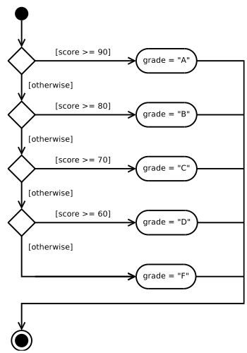
If Statements
The if statement does one of several alternative executions:
var score = Math.round(Math.random() * 100);
if (score >= 90) {
grade = "A";
} else if (score >= 80) {
grade = "B";
} else if (score >= 70) {
grade = "C";
} else if (score >= 60) {
grade = "D";
} else {
grade = "F";
}
alert(score + " is a " + grade);

Slide 10
Conditional Expressions
A conditional expression can be used in place of a simple if-else statement. So instead of:
if (latitude >= 0) {
hemisphere = "north";
} else {
hemisphere = "south";
}
write:
hemisphere = (latitude >= 0) ? "north" : "south";
Another nice example:
response = "She is"+ (present ? "" : "n't") +" here.";

Slide 11
Switch Statements
A switch statement compares a value against a sequence of cases until it finds a case equal to (===) the value, then begins executing code at that label:
switch (direction.toLowerCase()) {
case "north": row -= 1; break;
case "south": row += 1; break;
case "east": column += 1; break;
case "west": column -= 1; break;
default: alert("Illegal direction");
}
A break statement will terminate the whole switch statement. Without it, execution "falls through."

Slide 12
Using Lookup in Place of Conditionals
Using an object as a "lookup table" can save you from writing obnoxious if or switch statements (or excessively nested conditional expressions):
var state = "Brandenburg"; // (for example)
var CAPITALS = {
"Baden-Württemberg": "Stuttgart",
"Bayern": "München",
"Berlin": "Berlin",
"Brandenburg": "Potsdam",
"Mecklenburg-Vorpommern": "Schwerin",
"Niedersachsen": "Hannover",
"Nordrhein-Westfalen": "Düsseldorf",
"Schleswig-Holstein": "Kiel",
"Thüringen": "Erfurt",
// The rest of the states and their capitals would go here
};
capital = CAPITALS[state];

Slide 13
Using Lookup in Place of Conditionals
Lookups, when applicable, are better than conditional code because:
  There are no redundant code fragments; code is easier to understand.
  Keys and values appear right next to each other in the code.
  The mapping is essentially data, not code. Code and data are naturally different and shouldn't be tangled.
  The JS engine can often perform lookups faster than conditional code.

Slide 14
Short-Circuit Expressions
If x and y are booleans, the && (AND-ALSO) and || (OR-ELSE) operators have the following properties:
  x && y is true only if x and y are both true
  x || y is true only if x or y is true (or both are true)
So therefore:
  For x && y, if x is false, no need to evaluate y
  For x || y, if x is true, no need to evaluate y
And that's just what happens! If enough is known after evaluating the first part, the expression is short-circuited (the second part is skipped).

Slide 15
Short-Circuit Expressions
Short-circuit operators don't necessarily expect booleans:
alert(27 && 52); // Alerts 52
alert(0 && 52); // Alerts 0
alert(27 || 52); // Alerts 27
alert(0 || 52); // Alerts 52

Slide 16
Using Short-Circuit Expressions
Use && when it only makes sense to continue if the first part succeeds:
swim() && bike() && run();
openDoor() && enterRoom();
Use || as a backup plan in case the first part fails:
openDoor() || goThroughWindow();
car.color = favoriteColor || "black";

Slide 17
Iteration
Iteration is a way to do things over and over again.
Types of iteration statements:
  while
  do-while
  for
  for-in

Slide 18
While Statements
A while statement executes code repeatedly as long as a condition is true. The general form of a while statement is:
while (test) {body}
Example:
var numberOfTries = 1;
while (prompt("What # am I thinking of?") !== "5") {
numberOfTries += 1;
}
if (numberOfTries > 1) {
alert("Took you " + numberOfTries +
" tries to get this right");
}

Slide 19
Do-while Statements
A while statement executes the test first and the body second (if the test is truthy). The body will never be executed if the test is first falsy.
A do-while statement always executes the body at least once. The general form of a do-while statement is:
do {body} while (test);
Example:
do {
var input = prompt("Guess my favorite color:");
} while (input.toLowerCase() !== "black");

Slide 20
Classic For Statements
The for statement iterates through a range of items (numbers, elements of an array, characters in a string, etc.)
The general form of a for statement is:
for (init; test; each) { body }
Example:
// Alerts that 4, 6, 8, 10, 12, 14, and 16 are even.
for (var number = 4; number <= 16; number += 2) {
alert(number + " is even");
}

Slide 21
Another For Statement Example
This example loops through the range 10, 20, 30, ... 300.
HTML:
<canvas id="squares" width="320" height="320"></canvas>
JavaScript:
var canvas = document.getElementById("squares");
var ctx = canvas.getContext("2d");
var centerX = canvas.width / 2;
var centerY = canvas.height / 2;
for (var side = 10; side <= 300; side += 10) {
ctx.strokeRect(centerX - side / 2,
centerY - side / 2, side, side);
}

Slide 22
Looping Through Arrays
A classic for-statement can loop through the indices of an array (from 0 to the array's length):
// Alerts a string with the initial characters
// of each array item.
var words = ["as", "far", "as", "i", "know"];
var result = "";
for (var i = 0; i < words.length; i += 1) {
result += words[i].charAt(0).toUpperCase();
}
alert(result);

Slide 23
More Looping Through Arrays
Sometimes you might like to capture the array length up front instead of testing it every time:
// Alerts the number of zeros in an array.
var a = [7, 3, 0, 0, 9, -5, 2, 1, 0, 1, 7];
var numberOfZeros = 0;
for (var i = 0, n = a.length; i < n; i += 1) {
if (a[i] === 0) {
numberOfZeros += 1;
}
}
alert(numberOfZeros);

Slide 24

Linked Lists
var total = 0;
for (var p = scores; p != null; p = p.next) {
total += p.score;
}
alert(total);

Slide 25
Nested For Loops
This script generates a multiplication table in HTML:
var SIZE = 12;
document.write("<table border='1' cellspacing='0'>");
for (var i = 1; i <= SIZE; i += 1) {
document.write("<tr>");
for (var j = 1; j <= SIZE; j += 1) {
document.write("<td>" + (i * j) + "</td>");
}
document.write("</tr>");
}
document.write("</table>");

Slide 26
For-in Statements
The for-in statement allows you to iterate through the property names of an object:
// This script alerts "name", "breed", and "birthday"
var dog = {name: 'Lisichka', breed: 'G-SHEP',
birthday: '2011-12-01'};
for (var p in dog) {
alert(p);
}
The for-in statement will go through inherited properties as well as own properties, so be careful....

Slide 27
For-in Statements
Let's try enumerating the properties of an array:
// Recall an array is declared using [ ] and its
// property names are whole numbers beginning at 0
var colors = ['red', 'amber', 'green'];
for (var c in colors) {
alert(c);
}
This alerts 0, 1, and 2. But wait! Arrays also have a property called length, so why doesn't this code alert "length"?

Slide 28
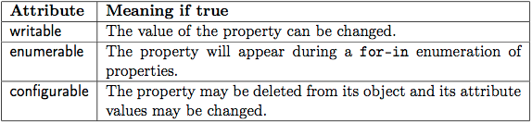
Attributes
The reason has to do with the fact that each property of an object has attributes, and among them:
The enumerable attribute for length happens to be false. The writable attribute is true. What do you think configurable is?

Slide 29
Disruption
Straight-line code is when statements are executed one at a time, in order. While conditional and iteration statements produce little deviation from straight-line code, there are some statements that disrupt the normal flow of execution:
  break statements
  continue statements
  return statements
  throw statements

Slide 30
Break
The break statement will immediately terminate a loop:
// Find the index position of the first even
// number in array.
for (var i = 0; i < array.length; i += 1) {
if (array[i] % 2 === 0) {
alert("Even number found at position " + i);
break;
}
}

Slide 31
Continue
The continue statement immediately starts the next iteration of a loop, without finishing the current one:
// Computes the sum of all positive values in array.
var sum = 0;
for (var i = 0; i < array.length; i += 1) {
if (array[i] <= 0) {
continue; // Skip nonpositives.
}
sum += array[i]; // Accumulate positives.
}
alert("Sum of positives is " + sum);

Slide 32
Labeled Statements
JavaScript statements can be labeled. The most common use for labels is to break an outer loop from an inner loop:
var hasZero = false;
findZero: for (var i = 0; i < a.length; i += 1) {
for (var j = 0; j < a[i].length; j += 1) {
if (a[i][j] === 0) {
hasZero = true;
break findZero;
}
}
}
You can also continue an outer loop from an inner loop.

Slide 33
Exceptions
If an operation makes no sense, an exception should be thrown. JavaScript has a few built in exception types.
  A ReferenceError is thrown when trying to use a variable that hasn't been declared yet.
  A RangeError is thrown when using a number that is too small or too large.
  A TypeError is thrown when using a value of such a wrong type that it can't be made to work out at all.
  A SyntaxError is thrown when trying to interpret malformed code.
You can, and will, define your own exception types.

Slide 34
Throwing Exceptions
Use the throw statement to throw your own values
alert("Welcome to my script");
throw "Ha ha ha";
alert("You will never see this message");
You can throw objects that give information about the "problem" you have identified
throw {reason: "class full", limit: 20, date: "2012-12-22"};
To throw one of the "standard" exceptions, you will need to use the new operator (to be explained in a later chapter):
throw new RangeError("No negative numbers allowed");

Slide 35
Catching Exceptions
If uncaught, a thrown exception aborts the script. To catch, use a try statement. Example:
try {
// This is a contrived example that just
// illustrates a point
alert("Welcome to my script");
throw "Ha ha ha";
alert("You will never see this message");
} catch (e) {
alert("Caught : " + e);
}

Slide 36
Technicalities
There are a few features of JavaScript statements that are probably best to avoid:
Blockless compound statements
Implicit semicolon
Implicit declarations
The with statement
You still need to know they exist because you will see them in other people's code.

Slide 37
Blockless Compound Statements
Officially, the bodies of "compound" (if and iteration) statements consist of a single statement. You can write:
if (count === 0) break;
or
if (count === 0)
break;
A sequence of statements inside curly braces is called a block statement, so we can (and always do) write:
if (count === 0) {
break;
}
Now why is it good practice to always use blocks?

Slide 38
Blockless Compound Statements
Aside from the asymmetry of sometimes having blocks for compound statement bodies and sometimes not, blockless compound statements require care when coding. Suppose you have the following working code:
for (var i = 0; i < 10; i += 1)
alert(i + " squared is " + (i * i));
which you would now like to clean up by holding i*I in a separate variable
for (var i = 0; i < 10; i += 1)
var square = i * i;
alert(i + " squared is " + square)
Oops! Forgot the braces! Best to just always have them there.

Slide 39
Implicit Semicolon
The rules of JavaScript require that the following statements be terminated with a semicolon
declaration, expression (including assignment), do-while, break, continue, return, throw
If you leave off the semicolon, JavaScript will try to insert it for you, guessing where it should have been. In some cases the guess isn't what you might expect. See Section 7.9 of the ECMAScript 5 Specification for the gory details.
Modern advice: don't rely on this "automatic semicolon insertion."

Slide 40
Implicit Declarations
Variable declarations begin with var
If you leave off the var, JavaScript will pretend you used it (more or less)
This is now considered a language design flaw
Know that a missing var will not crash your script, but always use them anyway
Horror story
If you are in strict mode, such "declarations" will throw a ReferenceError

Slide 41
The With Statement
Don't use it.

Slide 42
Chapter Summary
Expressions produce values and statements produce actions
JavaScript has declaration, expression, conditional, iteration and disruptive statements
Conditionals can use the if or switch statements, but conditional expressions, short-circuit operations, and lookups can often be used instead
Iteration is done with while, do-while, for, and for-in statements
Exceptions should be thrown when the desired computation just can't proceed
Several features of JavaScript statements are probably best avoided

