Slide 1
DIGITAL PORTFOLIO
Collage name: merit haji ismail sahib arts and science college pernambut
Tiruvallur university
Name:dilli raja.r

Slide 2
Project overview
Objective: Briefly state what the project aims to achieve. Background / Problem Statement: Explain why this project is being undertaken (the need, issue, or opportunity). Scope: Define what is included in the project (and sometimes what is excluded).

Slide 3
Problem statement
Background: Our organization relies on manual data entry to process customer orders. Problem: Manual entry is slow and error-prone, causing delays in fulfilling orders. Impact: Customers face longer wait times, errors reduce satisfaction, and the company loses potential revenue. Evidence: Recent reports show a 15% error rate and average processing delays of 48 hours.

Slide 4
Who are the end users
Education project: Students (end users), teachers (sometimes also end users). Healthcare project: Patients (end users), doctors/nurses (if they use the system). IT software project: Employees or customers who log in and use the system. Construction project (e.g., housing): Residents who will live in the buildings. E-commerce project: Shoppers buying products online.

Slide 5
Theams and techniques
1. Themes Broad focus areas or guiding ideas that shape your project. They reflect the main priorities or big picture goals. 🔹 Examples of project themes: Sustainability (eco-friendly methods, reducing waste)
2. Techniques Specific methods, tools, or approaches used to carry out the project and achieve its goals. 🔹 Examples of techniques: Brainstorming / Mind Mapping (idea generation)

Slide 6
Portfolio design and layout
1. “The portfolio has been designed with a clean and structured layout that emphasizes clarity, usability, and visual balance.”
2. “A grid-based design approach has been adopted to ensure consistency across sections, making the portfolio easy to navigate and visually appealing.”
3. “Minimalism and simplicity were chosen as the core design principles, allowing the content and projects to stand out without unnecessary distractions.”

Slide 7
Features and functionality
1. Clean and Structured Layou: Organized sections such as Home, About Me, Projects, Resume, and Contact.
2. Responsive Design: Adjusts automatically to different screen sizes (desktop, tablet, mobile).
3. Navigation Men: Easy-to-use header or sidebar for quick access to different sections.

Slide 8
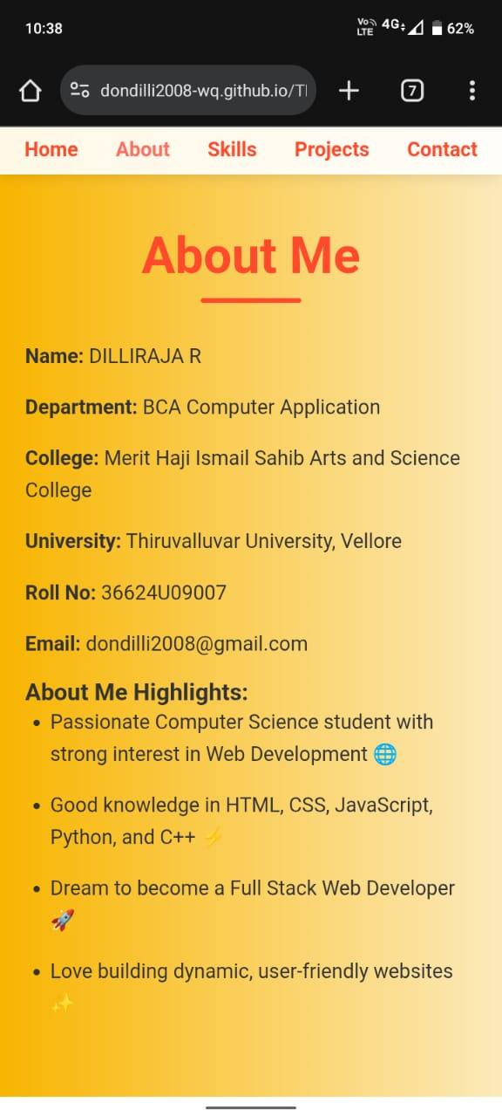
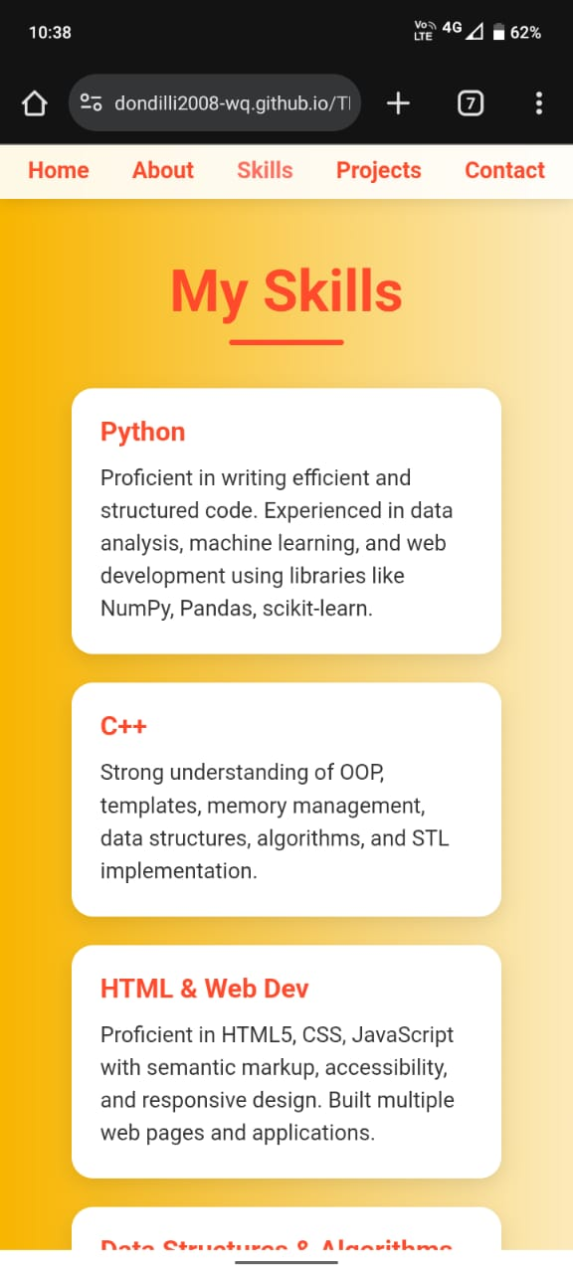
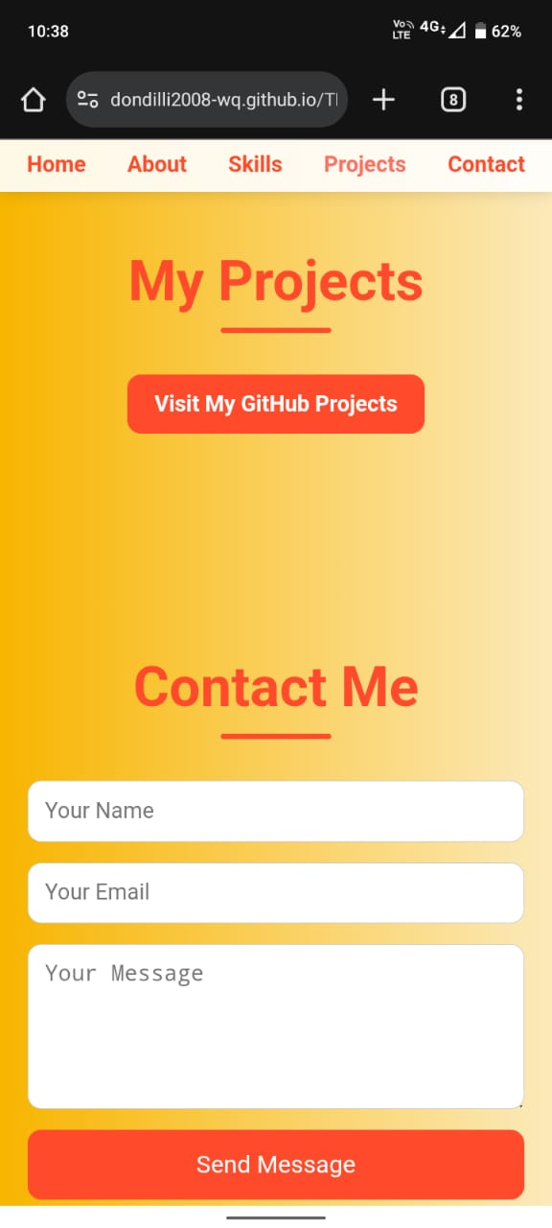
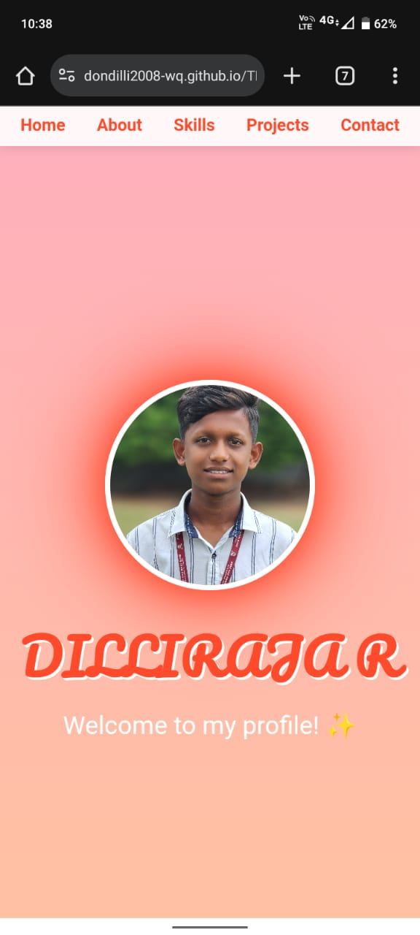
Results and screenshot
Crafted with clean code and creativity , this project is made with love to be user – friendly, fast, and scalable

Slide 9
Conclusion
My project portfolio reflects my creativity, technical skills, and design thinking. Through careful planning, layout, and execution, I have showcased my ability to combine functionality with aesthetics. Each project highlights not only my problem-solving approach but also my commitment to delivering user-friendly and visually appealing outcomes. This portfolio is not just a collection of work, but a representation of my growth, learning, and passion for design.

