Slide 1
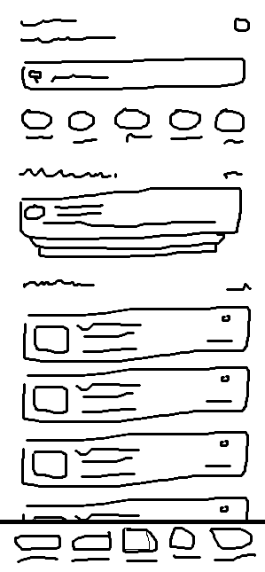
HTML-FMX SKILLS / VERSION 2
Building maintainable
FMX interfaces
with AI
Healthcare Appointment App case study
One rough wireframe, four implementation workflows
HTML-FMX / V2 healthcare study
01
Notes:
Opening: these skills address the need to build mobile FMX interfaces that remain easy to modify and navigate in the Designer. The V2 case study follows four workflows from the same wireframe. The screenshots come from the author’s experiment.
Sources: Author’s conversation, 3 October 2026; docs/result/VERSION.2.0.0

Slide 2
Why I created these skills
Personal observations on how Delphi developers build mobile FMX interfaces
Desktop design habits carry over
Control sizes, information density, and placement often follow VCL form conventions. Mobile screens require different layout decisions.
The hierarchy hides responsibilities
Layers of containers make it hard to identify which component owns an area and assess the impact of a layout change.
AI output needs project rules
Developers still need to understand, edit, and integrate the generated UI into an existing Delphi application.
HTML-FMX / V2 healthcare study
02
Notes:
Present these points as the author’s observations rather than statistics about the whole Delphi community. VCL is appropriate for desktop applications. The issue is carrying desktop layout habits into mobile development without adapting them.
Sources: Author’s conversation

Slide 3
The hierarchy follows UI responsibilities
Every container serves a purpose in layout, grouping, scrolling, or interaction
Page sections
Repeated data
The header, search, categories, appointment, doctor list, and bottom navigation each have clear component ownership.
The doctor list uses a reusable card. The page frame creates list items and populates each card instance with data.
Fixed components
TListBox
TListBoxItem
DoctorCard: TFrame
Fixed controls and layouts remain in .fmx so developers can edit them in the RAD Studio Designer.
HTML-FMX / V2 healthcare study
03
Notes:
This hierarchy describes component ownership, not a proposal to flatten every container. Component count or depth alone does not prove performance. A sound hierarchy still uses nesting when the layout requires it.
Sources: README-ID.md; .agents/skills/html-to-fmx/references/dynamic-items.md

Slide 4
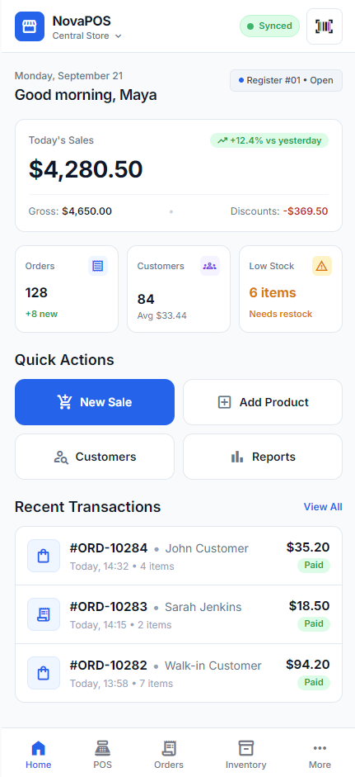
V1: NovaPOS generated with Google Stitch
An HTML/CSS design provides the visual reference for native Delphi FireMonkey UI
The first experiment
I generated NovaPOS with Google Stitch, exported the HTML, and applied the html-to-fmx workflow.
The original three skills
html-to-fmx-mapping
css-to-fmx-style
html-to-fmx
NovaPOS HTML reference
HTML-FMX / V2 healthcare study
04
Notes:
V1 provides the background to this work. Its timings are not compared with V2 because the design and conditions differ. This image shows the NovaPOS source HTML, not an FMX runtime capture.
Sources: D:\Github\MyProject\Skill\HTML-FMX\docs\result\VERSION.1.0.0\UI-HTML.png; Author’s conversation; https://github.com/dondonondon/HTML-To-Delphi-FMX

Slide 5
V2 expands input options and UI review
Six skills share native FMX rules, design-time editing, and mapping documentation
Skill | Purpose
html-to-fmx-mapping | Map HTML to an FMX component hierarchy
screenshot-to-fmx-mapping | Map a screenshot or wireframe
css-to-fmx-style | Map CSS to native FMX style resources
html-to-fmx | Implement HTML/CSS as native FMX
create-fmx-ui | Create FMX UI from a brief, screenshot, or wireframe
review-fmx-ui | Review, refine, and enhance existing FMX UI
Current package name: create-fmx-ui. Experiment notes refer to it as create-delphi-fmx-ui.
HTML-FMX / V2 healthcare study
05
Notes:
The local documentation lists six skills. For image input, create-fmx-ui invokes screenshot-to-fmx-mapping internally. review-fmx-ui supports existing FMX interfaces but is not one of the four creation workflows tested here.
Sources: README-ID.md; .agents/skills/create-fmx-ui/SKILL.md

Slide 6
Healthcare Appointment App
The rough sketch defines the information layout. The brief explains the purpose of each area.
Patient needs
Search for doctors or symptoms
Explore health categories
View upcoming appointments
Browse popular doctors
Access messages and a patient profile
Every workflow uses the same wireframe and detailed healthcare brief.
HTML-FMX / V2 healthcare study
06
Notes:
The author’s brief describes a Healthcare Appointment App that helps patients find doctors, view upcoming appointments, explore health categories, and access messaging and their profile. The sketch defines the main structure. Each workflow interprets the copy, colors, photos, and some finer details. Doctor names, dates, ratings, and facilities in the captures are illustrative demo data.
Sources: D:\Github\MyProject\Skill\HTML-FMX\docs\result\VERSION.2.0.0\wireframe.png; Author’s detailed brief

Slide 7
Four methods, one wireframe
Agent model for every workflow: GPT-6.1 Sol High
01
Google Stitch and HTML
Google Stitch MCP, export HTML, then html-to-fmx
02
Direct UI creation
Wireframe and brief directly to create-fmx-ui
03
Separate mapping before UI creation
screenshot-to-fmx-mapping, then create-fmx-ui
04
Agent-generated HTML
The agent converts the wireframe to HTML, then runs html-to-fmx
HTML-FMX / V2 healthcare study
07
Notes:
The common model is the agent running the workflow. The first method also uses Google Stitch’s design-generation service. The experiment does not identify Stitch’s internal model. This is not a comparison of AI models, and it does not assume every stage runs on the same model.
Sources: Author’s conversation

Slide 8
Preparation and wireframe description
Use the same brief for all four methods
Healthcare Appointment App brief
Before running the prompts
Build a mobile healthcare UI for patients. The app helps patients find doctors, view upcoming consultations, choose doctors for their health needs, and communicate with healthcare providers.
Follow the wireframe layout: doctor or symptom search, health categories, an upcoming appointment, a popular doctor list, and bottom navigation to messages and a profile. Use a simple, modern interface.
1. Open the Delphi FMX project and prepare the skills.
2. Give the agent wireframe.png and this brief.
3. Select GPT-6.1 Sol with High reasoning.
4. Choose one method, then run the dummy-data prompt.
Wireframe: docs/result/VERSION.2.0.0/wireframe.png
Guide prompts refined from the author’s brief and experiment workflows.
HTML-FMX / V2 healthcare study
08
Notes:
This guide refines prompts from the author’s wireframe brief and the four workflows described in this conversation. It is not a verbatim transcript of every original prompt. Clarified implementation steps provide a template for audience members to try the workflows. Use the original wireframe at docs/result/VERSION.2.0.0/wireframe.png. Experiment agent: GPT-6.1 Sol with High reasoning. The current skill name is create-fmx-ui. The purpose description comes from the author’s Healthcare Appointment App brief.
Sources: the author’s brief and workflows in this conversation. Local create-fmx-ui and html-to-fmx skill instructions. project/DESIGN.md.

Slide 9
Method 1 prompts: Google Stitch and HTML
Use the wireframe and brief from the preparation slide as prompt context
1. Create the design through Google Stitch MCP
2. Export HTML, then convert to FMX
Use Google Stitch MCP to design the Healthcare Appointment App from this wireframe and brief. Preserve the main areas and their arrangement. Follow the color rules in project/DESIGN.md and include relevant visual assets.
Export the design as HTML/CSS. Use the html-to-fmx skill to convert it into native Delphi FMX UI. Preserve the source appearance. Create the page and a reusable doctor card as .fmx and .pas pairs that remain editable in the Designer.
Workflow: Stitch design, HTML/CSS export, FMX conversion, then dummy data.
HTML-FMX / V2 healthcare study
09
Notes:
This guide refines prompts from the author’s wireframe brief and the four workflows described in this conversation. It is not a verbatim transcript of every original prompt. Clarified implementation steps provide a template for audience members to try the workflows. Use the original wireframe at docs/result/VERSION.2.0.0/wireframe.png. Experiment agent: GPT-6.1 Sol with High reasoning. The current skill name is create-fmx-ui. The purpose description comes from the author’s Healthcare Appointment App brief.
The agent can read DESIGN.md first and convey its color rules to Google Stitch. Export HTML/CSS and assets before running html-to-fmx. Export details depend on the available Stitch integration. This is workflow guidance, without a promise of identical appearance or duration.
1. Create the design through Google Stitch MCP
Use Google Stitch MCP to design the Healthcare Appointment App from this wireframe and brief. Preserve the main areas and their arrangement. Follow the color rules in project/DESIGN.md and include relevant visual assets.
2. Export HTML, then convert to FMX
Export the design as HTML/CSS. Use the html-to-fmx skill to convert it into native Delphi FMX UI. Preserve the source appearance. Create the page and a reusable doctor card as .fmx and .pas pairs that remain editable in the Designer.
Sources: the author’s brief and workflows in this conversation. Local create-fmx-ui and html-to-fmx skill instructions. project/DESIGN.md.

Slide 10
Method 2 prompts: Direct UI creation
Use the wireframe and brief from the preparation slide as prompt context
One implementation prompt
Expected outputs
Use the create-fmx-ui skill to build a Healthcare Appointment App page directly from wireframe.png and this brief. Follow the wireframe layout and the color rules in project/DESIGN.md.
Store the fixed structure as Designer-editable .fmx and .pas pairs. Create a reusable doctor card for the doctor list and prepare bindings so the page can use it. Follow the existing project structure and StyleBook.
Native .fmx + .pas page
Reusable doctor card
Data binding for the page and card
Hierarchy following the wireframe
Colors matching DESIGN.md
create-fmx-ui still performs screenshot mapping internally. This method uses a single UI creation workflow.
HTML-FMX / V2 healthcare study
10
Notes:
This guide refines prompts from the author’s wireframe brief and the four workflows described in this conversation. It is not a verbatim transcript of every original prompt. Clarified implementation steps provide a template for audience members to try the workflows. Use the original wireframe at docs/result/VERSION.2.0.0/wireframe.png. Experiment agent: GPT-6.1 Sol with High reasoning. The current skill name is create-fmx-ui. The purpose description comes from the author’s Healthcare Appointment App brief.
The local create-fmx-ui skill requires screenshot-to-fmx-mapping within the workflow for screenshot or wireframe input. Mapping still occurs even when the user submits a single UI creation request.
Use the create-fmx-ui skill to build a Healthcare Appointment App page directly from wireframe.png and this brief. Follow the wireframe layout and the color rules in project/DESIGN.md.
Store the fixed structure as Designer-editable .fmx and .pas pairs. Create a reusable doctor card for the doctor list and prepare bindings so the page can use it. Follow the existing project structure and StyleBook.
Sources: the author’s brief and workflows in this conversation. Local create-fmx-ui and html-to-fmx skill instructions. project/DESIGN.md.

Slide 11
Method 3 prompts: Separate mapping
Use the wireframe and brief from the preparation slide as prompt context
1. Run screenshot-to-fmx-mapping
2. Implement the map with create-fmx-ui
Use the screenshot-to-fmx-mapping skill to map the wireframe and brief into an FMX component hierarchy. Separate fixed areas, scrolling content, bottom navigation, and the doctor list with a reusable card. Save the result as a mapping document.
Use the create-fmx-ui skill to implement the UI from that map. Follow the color rules in project/DESIGN.md. Create Designer-editable .fmx and .pas pairs, then prepare binding for the page and doctor card.
Workflow: mapping document first, implementation from that map, then dummy data.
HTML-FMX / V2 healthcare study
11
Notes:
This guide refines prompts from the author’s wireframe brief and the four workflows described in this conversation. It is not a verbatim transcript of every original prompt. Clarified implementation steps provide a template for audience members to try the workflows. Use the original wireframe at docs/result/VERSION.2.0.0/wireframe.png. Experiment agent: GPT-6.1 Sol with High reasoning. The current skill name is create-fmx-ui. The purpose description comes from the author’s Healthcare Appointment App brief.
Separate mapping produces a Markdown document before implementation. Pass that document, the wireframe, and the brief to create-fmx-ui. Mapping and implementation durations can be recorded separately.
1. Run screenshot-to-fmx-mapping
Use the screenshot-to-fmx-mapping skill to map the wireframe and brief into an FMX component hierarchy. Separate fixed areas, scrolling content, bottom navigation, and the doctor list with a reusable card. Save the result as a mapping document.
2. Implement the map with create-fmx-ui
Use the create-fmx-ui skill to implement the UI from that map. Follow the color rules in project/DESIGN.md. Create Designer-editable .fmx and .pas pairs, then prepare binding for the page and doctor card.
Sources: the author’s brief and workflows in this conversation. Local create-fmx-ui and html-to-fmx skill instructions. project/DESIGN.md.

Slide 12
Method 4 prompts: Agent-generated HTML
Use the wireframe and brief from the preparation slide as prompt context
1. Ask the agent to create HTML/CSS
2. Convert HTML/CSS with html-to-fmx
Convert the wireframe and Healthcare Appointment App brief into a mobile HTML/CSS page. Preserve the main areas and their arrangement. Use a simple, modern interface. Include the required assets and save the HTML/CSS source.
Use the html-to-fmx skill to convert that HTML/CSS into native Delphi FMX UI. Preserve the source appearance. Create the page and a reusable doctor card as .fmx and .pas pairs that remain editable in the Designer.
This HTML-stage prompt omits DESIGN.md, consistent with the Method 4 experiment context.
HTML-FMX / V2 healthcare study
12
Notes:
This guide refines prompts from the author’s wireframe brief and the four workflows described in this conversation. It is not a verbatim transcript of every original prompt. Clarified implementation steps provide a template for audience members to try the workflows. Use the original wireframe at docs/result/VERSION.2.0.0/wireframe.png. Experiment agent: GPT-6.1 Sol with High reasoning. The current skill name is create-fmx-ui. The purpose description comes from the author’s Healthcare Appointment App brief.
The HTML prompt intentionally omits DESIGN.md to keep this guide consistent with the author’s account of the Method 4 experiment. html-to-fmx preserves HTML/CSS as the visual source, so a different palette can carry into the FMX result. The explicit DESIGN.md reference appears only as a suggested refinement for a subsequent experiment.
1. Ask the agent to create HTML/CSS
Convert the wireframe and Healthcare Appointment App brief into a mobile HTML/CSS page. Preserve the main areas and their arrangement. Use a simple, modern interface. Include the required assets and save the HTML/CSS source.
2. Convert HTML/CSS with html-to-fmx
Use the html-to-fmx skill to convert that HTML/CSS into native Delphi FMX UI. Preserve the source appearance. Create the page and a reusable doctor card as .fmx and .pas pairs that remain editable in the Designer.
Sources: the author’s brief and workflows in this conversation. Local create-fmx-ui and html-to-fmx skill instructions. project/DESIGN.md.

Slide 13
Dummy data, review, and prompt refinement
Continue after the page and reusable cards exist
Follow-up prompt for dummy data
After the data loads
Open the page in RAD Studio Designer, then run the app. Check the hierarchy, card appearance, scrolling area, and bottom navigation. Compare the result with the wireframe and DESIGN.md colors. Record only checks you actually perform.
Add fictional dummy data using the cards already created. Implement the cards on the UI page: create list items, attach card instances, and populate them through the existing bindings. Load demo data once when the page is created. Preserve later data bindings, including empty results.
Suggested refinement for Method 4
Before creating HTML/CSS, read project/DESIGN.md and use its color tokens. Preserve those color rules during FMX conversion.
This additional DESIGN.md instruction is a suggestion for the next experiment.
HTML-FMX / V2 healthcare study
13
Notes:
The author’s original follow-up prompt was: “Tambahkan Data dummy nya dengan card yang sudah anda buat”, translated as “Add dummy data using the card you have already created”. The guide makes page composition explicit: create list items, attach cards, and populate them through existing bindings. Demo data is fictional and does not validate API integration. Loading once and preserving later bindings refine the guidance using the local implementation pattern. The DESIGN.md addition for Method 4 is proposed follow-up work without newly tested results.
Sources: the author’s brief and workflows in this conversation. Local create-fmx-ui and html-to-fmx skill instructions. project/DESIGN.md.

Slide 14
Internal mapping versus a separate mapping stage
Methods 2 and 3 differ in how the workflow is executed
Direct UI creation
Mapping followed by UI creation
A single request creates UI from the image. The create-fmx-ui skill still performs screenshot mapping before implementation.
I ran mapping as a separate stage, then used the resulting component map for implementation.
Separate mapping stage: 8m 16s
Total time alone does not explain the duration differences or establish a better hierarchy.
HTML-FMX / V2 healthcare study
14
Notes:
Direct UI creation does not mean implementation without mapping. The create-fmx-ui dependency requires mapping for screenshot input. Method 3’s longer total cannot be explained solely by its 8m 16s mapping stage. Implementation itself took 41m 54s. The causes of the duration difference have not been analyzed.
Sources: .agents/skills/create-fmx-ui/SKILL.md; Author’s timing record

Slide 15
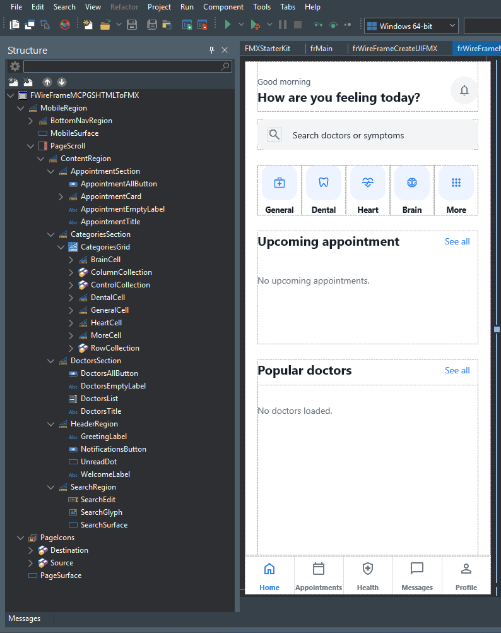
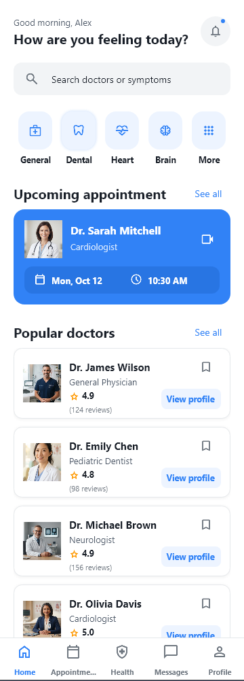
Method 1: Google Stitch and HTML
Google Stitch MCP, export HTML, then html-to-fmx
RAD Studio Designer
Runtime + dummy data
Total time to populated cards
38m 55s
Initial UI 32m 49s
Cards + dummy data 6m 06s
More polished visuals, clearer grouping, and more complete assets. Follows the wireframe and DESIGN.md color rules.
HTML-FMX / V2 healthcare study
15
Notes:
The blue appointment card, doctor photos, and View profile buttons are the most prominent visual details in this capture.
The Designer shows appointment, categories, doctors, header, and search sections inside ContentRegion.
Initial UI: 32m 49s. Additional cards and dummy data: 6m 06s. Total: 38m 55s.
The Designer capture shows fixed sections and an empty state. The runtime capture shows populated demo data. Screenshots demonstrate appearance, not all callbacks or device coverage. The runtime platform was not specified for these captures. Each runtime image is 360 x 1002 pixels.
Sources: D:\Github\MyProject\Skill\HTML-FMX\docs\result\VERSION.2.0.0\design-time\SS-STRUKTUR-HIERARKI-MCPSTITCHHTMLHTMLTOFMX.png; D:\Github\MyProject\Skill\HTML-FMX\docs\result\VERSION.2.0.0\run-time\MCPSTITCHHTMLHTMLTOFMX.png; Author’s recorded timings
More polished visuals, clearer grouping, and more complete assets. Follows the wireframe and DESIGN.md color rules.
Source: the author’s follow-up assessment.

Slide 16
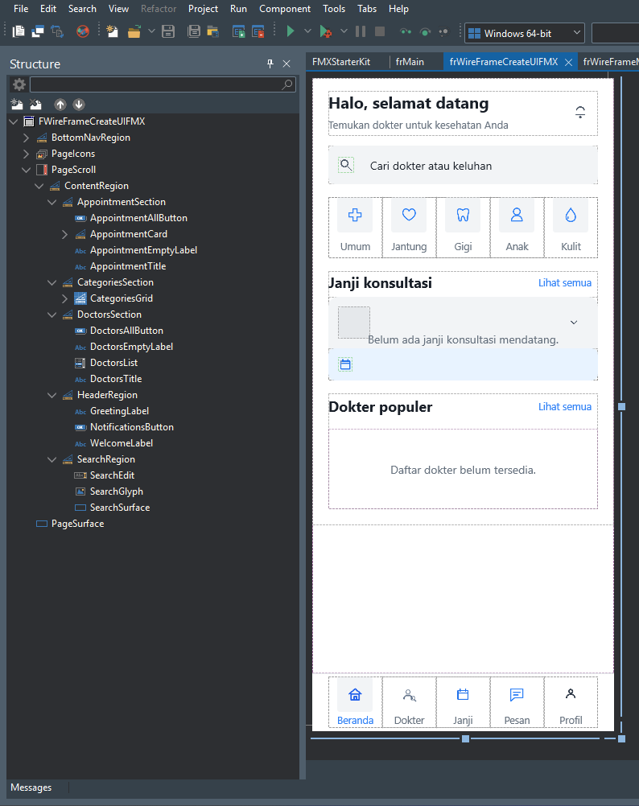
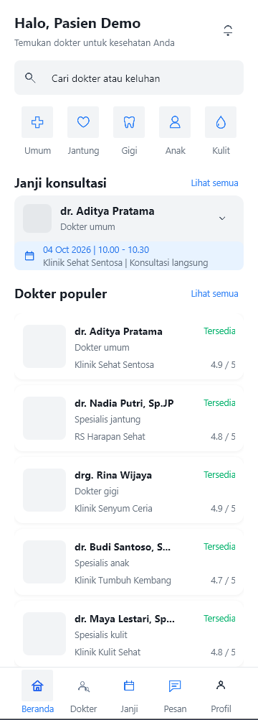
Method 2: Direct UI creation
Wireframe and brief directly to create-fmx-ui
RAD Studio Designer
Runtime + dummy data
Total time to populated cards
25m 52s
Initial UI 23m 25s
Cards + dummy data 2m 27s
Second fastest overall. Follows the wireframe and DESIGN.md colors. Rough visuals, similar to Method 3.
HTML-FMX / V2 healthcare study
16
Notes:
The UI uses Indonesian labels. Doctor rows show a name, facility, availability, and rating, with a photo placeholder.
PageScroll contains ContentRegion. BottomNavRegion is separate from the scrollable sections.
Initial UI: 23m 25s. Additional cards and dummy data: 2m 27s. Total: 25m 52s.
The Designer capture shows fixed sections and an empty state. The runtime capture shows populated demo data. Screenshots demonstrate appearance, not all callbacks or device coverage. The runtime platform was not specified for these captures. Each runtime image is 360 x 1002 pixels.
Sources: D:\Github\MyProject\Skill\HTML-FMX\docs\result\VERSION.2.0.0\design-time\SS-STRUKTUR-HIERARKI-CREATEUI.png; D:\Github\MyProject\Skill\HTML-FMX\docs\result\VERSION.2.0.0\run-time\CREATEUI.png; Author’s recorded timings
Second fastest overall. Follows the wireframe and DESIGN.md colors. Rough visuals, similar to Method 3.
Source: the author’s follow-up assessment.

Slide 17
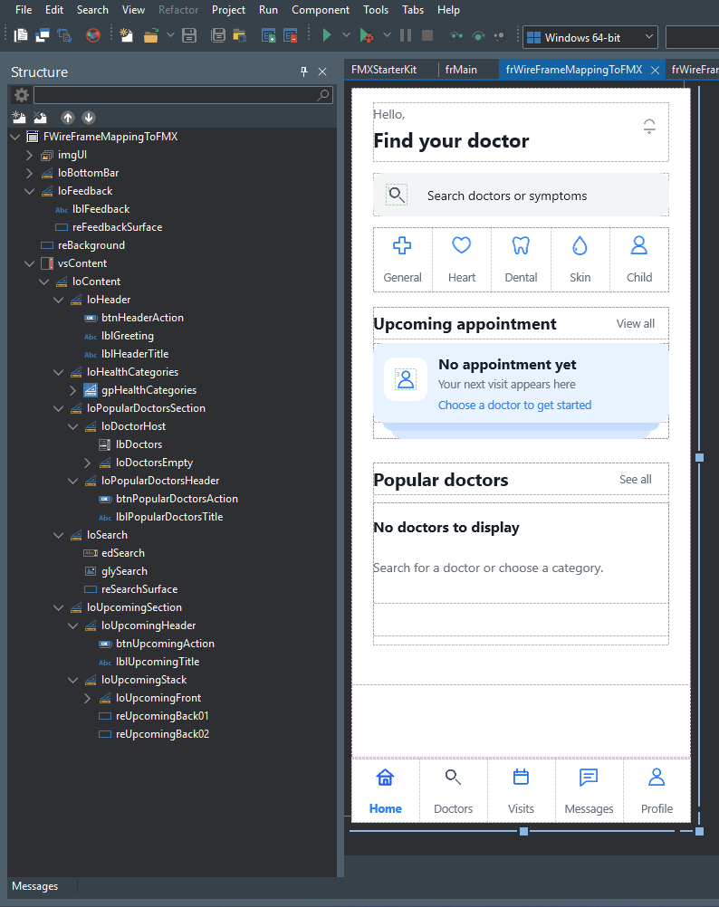
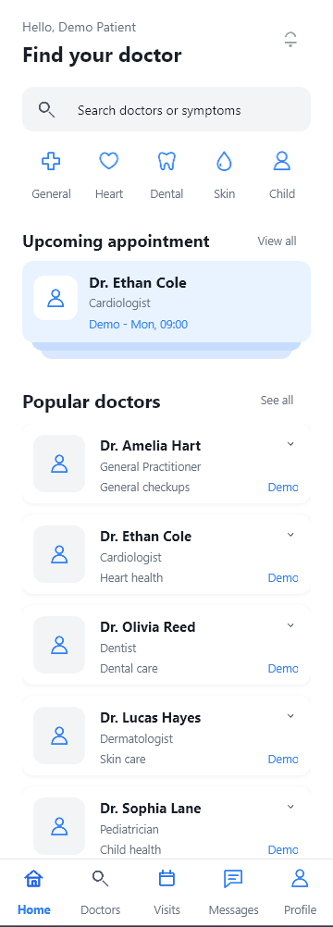
Method 3: Separate mapping before UI creation
screenshot-to-fmx-mapping, then create-fmx-ui
RAD Studio Designer
Runtime + dummy data
Total time to populated cards
55m 22s
Initial UI 50m 10s
Cards + dummy data 5m 12s
Initial UI = 8m 16s mapping
+ 41m 54s implementation
Closest to the wireframe in the author’s assessment. Rough visuals and the longest total time, with no visible polish gain from separate mapping.
HTML-FMX / V2 healthcare study
17
Notes:
The appointment uses stacked cards, as in the original sketch. Doctor rows use icons and a Demo label.
The Designer shows loHeader, loSearch, loHealthCategories, loUpcomingSection, and loPopularDoctorsSection.
Initial UI: 50m 10s. Additional cards and dummy data: 5m 12s. Total: 55m 22s.
The Designer capture shows fixed sections and an empty state. The runtime capture shows populated demo data. Screenshots demonstrate appearance, not all callbacks or device coverage. The runtime platform was not specified for these captures. Each runtime image is 360 x 1002 pixels.
Sources: D:\Github\MyProject\Skill\HTML-FMX\docs\result\VERSION.2.0.0\design-time\SS-STRUKTUR-HIERARKI-MAPPINGCREATEUI.png; D:\Github\MyProject\Skill\HTML-FMX\docs\result\VERSION.2.0.0\run-time\MAPPINGCREATEUI.png; Author’s recorded timings
Closest to the wireframe in the author’s assessment. Rough visuals and the longest total time, with no visible polish gain from separate mapping.
Source: the author’s follow-up assessment.

Slide 18
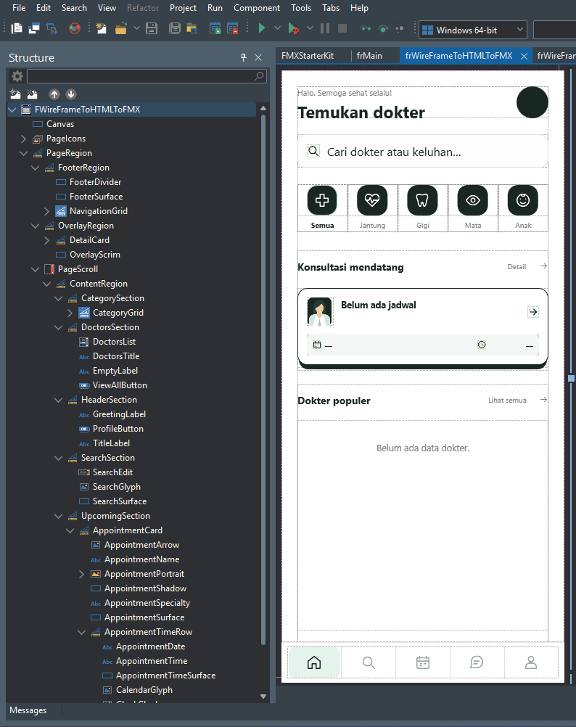
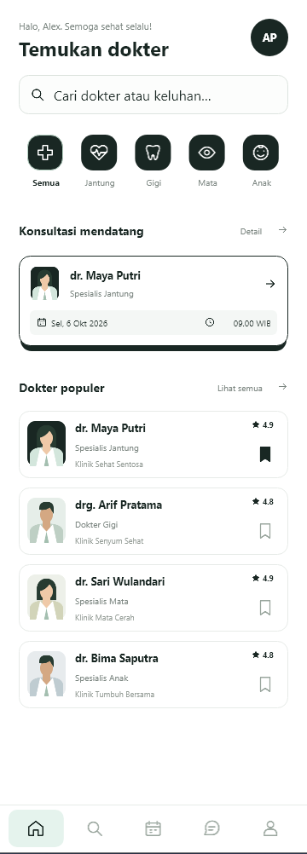
Method 4: Agent-generated HTML
The agent converts the wireframe to HTML, then runs html-to-fmx
RAD Studio Designer
Runtime + dummy data
Total time to populated cards
23m 33s
Initial UI 14m 40s
Cards + dummy data 8m 53s
Fastest overall, with satisfactory visuals. The palette differs because the HTML prompt did not explicitly reference DESIGN.md.
HTML-FMX / V2 healthcare study
18
Notes:
A dark green palette, doctor illustrations, bookmarks, and a layered appointment card create a distinct visual interpretation.
PageRegion separates FooterRegion, OverlayRegion, and PageScroll. DoctorsSection contains DoctorsList.
Initial UI: 14m 40s. Additional cards and dummy data: 8m 53s. Total: 23m 33s.
The Designer capture shows fixed sections and an empty state. The runtime capture shows populated demo data. Screenshots demonstrate appearance, not all callbacks or device coverage. The runtime platform was not specified for these captures. Each runtime image is 360 x 1002 pixels.
Sources: D:\Github\MyProject\Skill\HTML-FMX\docs\result\VERSION.2.0.0\design-time\SS-STRUKTUR-HIERARKI-HTMLHTMLTOFMX.png; D:\Github\MyProject\Skill\HTML-FMX\docs\result\VERSION.2.0.0\run-time\HTMLHTMLTOFMX.png; Author’s recorded timings
Fastest overall, with satisfactory visuals. The palette differs because the HTML prompt did not explicitly reference DESIGN.md.
Source: the author’s follow-up assessment.

Slide 19
Time to a populated doctor list
Two stages: initial UI and additional card composition with dummy data
Agent HTML + FMX: 23m 33s. Direct UI creation: 25m 52s. Total difference: 2m 19s.
Recorded experiment timings. Chart values are in minutes, rounded to one decimal place.
HTML-FMX / V2 healthcare study
19
Notes:
Original values are recorded in seconds and converted to minutes for the chart. Initial UI series: 1969, 1405, 3010, and 880 seconds. Additional card-work series: 366, 147, 312, and 533 seconds. The mapping workflow’s initial stage includes 496 seconds for mapping plus 2514 seconds for implementation. Chart categories retain their source sequence and are not ranked by quality. The horizontal chart displays that sequence from bottom to top. Durations do not establish visual quality, application performance, or the causes of timing differences.
Sources: Author’s timing record in the conversation

Slide 20
Complete timing record
Totals include the initial UI and a follow-up prompt to populate the cards with dummy data
Method | Initial UI | Cards + dummy data | Total
Google Stitch + HTML | 32m 49s | 6m 06s | 38m 55s
Direct UI creation | 23m 25s | 2m 27s | 25m 52s
Mapping + Create UI | 8m 16s + 41m 54s | 5m 12s | 55m 22s
Agent HTML + FMX | 14m 40s | 8m 53s | 23m 33s
Agent-generated HTML had the shortest total time in this experiment. Direct UI creation needed the least additional work: 2m 27s.
These timings are not a general benchmark. API integration is not included.
HTML-FMX / V2 healthcare study
20
Notes:
Totals: (32m 49s + 6m 06s) = 38m 55s. (23m 25s + 2m 27s) = 25m 52s. (8m 16s + 41m 54s + 5m 12s) = 55m 22s. (14m 40s + 8m 53s) = 23m 33s. All timings were supplied by the author. Findings apply only to this recorded experiment. The table is a native PowerPoint object.
Sources: Author’s timing record

Slide 21
The card exists, but the page has not populated it
The same gap appeared in all four workflows in this experiment
Initial result
Follow-up prompt
The reusable doctor card already exists. The page frame has not yet instantiated and populated it for the doctor list.
“Add dummy data using
the card you have
already created”
The demo screen is complete when the page creates list items, adds the cards, and populates them with sample data.
This finding points to card consumers and demo fixtures as the next refinement area.
HTML-FMX / V2 healthcare study
21
Notes:
The author considered all four initial UI results reasonably good, but each required this follow-up prompt. The reusable card already existed. The gap was in page-frame composition and loading dummy data. Sample data serves only as a local fixture. Do not generalize this gap to every use of the skill or present its proposed remedy as an already implemented change. The slide shows an English translation of the original prompt: “Tambahkan Data dummy nya dengan card yang sudah anda buat”.
Sources: Author’s report in the conversation

Slide 22
Lessons for FMX UI development
The experiment produced four reasonably good interfaces, each with a different visual interpretation
Review the structure alongside the screenshots
Sections, scrolling areas, bottom navigation, and reusable cards shape how developers continue work on the screen.
Completing a screen includes data composition
When a demo requires sample data, the page needs to populate the existing cards so the complete result can be reviewed.
Timing provides context for each workflow
Duration helps compare workflows. Maintainability, callbacks, API integration, and device behavior need further checks.
HTML-FMX / V2 healthcare study
22
Notes:
“Reasonably good” reflects the author’s assessment, not an objective score. Designer and runtime captures show visible layout and hierarchy. They do not validate all interactions, API integration, device coverage, or performance. The separate mapping workflow is not claimed to be better simply because it took longer. No claim is made that V2 has already been published as a formal GitHub Release.
Sources: Author’s conversation; VERSION.2.0.0 screenshots

Slide 23
Conclusions on hierarchy and color
The author’s assessment of the four results in this experiment
The component hierarchies are nearly identical
About 90%
The clearest differences are visual polish, asset completeness, and development time.
overall similarity in
component hierarchy
Color compliance with DESIGN.md
The author’s estimate from reviewing the results.
Methods 1, 2, and 3 follow the color rules. Method 4 uses a different palette. The HTML generation prompt did not explicitly reference DESIGN.md.
These assessments apply to the recorded experiment.
HTML-FMX / V2 healthcare study
23
Notes:
After reviewing the four results, the author estimates about 90% overall similarity in component structure and hierarchy. This is an observational estimate, without a defined measurement method or a formal component-tree comparison. The author reports that Methods 1, 2, and 3 follow the DESIGN.md color rules. Method 4 uses a different palette because its HTML-generation prompt did not explicitly reference DESIGN.md. This claim concerns colors and does not assert an audit of every design rule. project/DESIGN.md defines Toss color tokens, including primary #3182f6. The conclusions apply to this experiment and its prompt context.
Sources: the author’s follow-up assessment in this conversation. project/DESIGN.md.

Slide 24
Assessment of Methods 1 and 2
Total time includes card composition and loading dummy data
Method 1: Google Stitch + HTML
Method 2: Direct UI creation
38m 55s
25m 52s
Third fastest overall
Second fastest overall
More polished visuals and a more complete set of assets. Visual grouping is clear, and the result follows the wireframe.
The result follows the wireframe, but the visuals remain rough, much like Method 3. It provides a UI foundation that needs further polish.
Colors follow DESIGN.md.
Colors follow DESIGN.md. Cards + dummy data needed the least extra time: 2m 27s.
Method 1 offers more visual polish. Method 2 finishes sooner, with visuals that still need refinement.
HTML-FMX / V2 healthcare study
24
Notes:
The visual judgments come from the author. For Method 1, “more structured” is refined to clearer visual grouping, consistent with the estimated 90% hierarchy similarity. Google Stitch provides a more complete design and set of assets. Method 1: initial UI 32m 49s + cards and dummy data 6m 06s = 38m 55s total, third fastest. Method 2: 23m 25s + 2m 27s = 25m 52s, second fastest. Method 2 follows the wireframe but has rough visuals, much like Method 3. It requires the least additional card and dummy-data work. Both follow the DESIGN.md color rules in the author’s assessment.
Source: the author’s follow-up assessment and recorded timings in this conversation.

Slide 25
Assessment of Methods 3 and 4
Total time includes card composition and loading dummy data
Method 3: Separate mapping
Method 4: Agent-generated HTML
55m 22s
23m 33s
Longest total time
Shortest total time
The closest match to the wireframe layout in the author’s assessment. The visuals remain rough. Separate mapping did not improve visual polish in this experiment.
The visuals are satisfactory, with the shortest total time. The palette differs from the color rules in DESIGN.md.
Colors follow DESIGN.md. Initial UI: 8m 16s mapping + 41m 54s implementation.
The HTML prompt did not explicitly reference DESIGN.md. Color compliance needs an explicit instruction at the HTML stage.
Wireframe fidelity, visual polish, and color compliance lead to different assessments.
HTML-FMX / V2 healthcare study
25
Notes:
The author considers Method 3 the closest match to the wireframe layout, while finding its visuals rough and less satisfactory. Wireframe fidelity and visual polish are different dimensions. Separate mapping did not produce a visible gain in polish in this experiment. Initial UI: 8m 16s mapping + 41m 54s implementation = 50m 10s. Additional cards and dummy data: 5m 12s. Total: 55m 22s, the longest duration. Implementation alone also took longer than the other methods, so the extra time cannot be attributed solely to the 8m 16s mapping stage. Method 4: 14m 40s + 8m 53s = 23m 33s, the shortest total. The author finds its visuals satisfactory, although its palette departs from DESIGN.md. The author explains that the HTML prompt did not explicitly reference DESIGN.md. A subsequent prompt refinement could name the file at the HTML stage, then check color consistency after FMX conversion. This is proposed follow-up work, not a newly tested result.
Source: the author’s follow-up assessment and recorded timings in this conversation.

Slide 26
AI-generated FMX UI
remains the developer’s
responsibility
Skills help preserve the hierarchy, styles, and reusable card patterns.
Developers review the result and complete its integration.
HTML-To-Delphi-FMX
github.com/dondonondon/HTML-To-Delphi-FMX
HTML-FMX / V2 healthcare study
26
Notes:
Closing discussion: introduce the repository as the source of the skills. The package contains instructions, references, and examples. Repository: https://github.com/dondonondon/HTML-To-Delphi-FMX. This presentation uses the author’s original screenshots and recorded timings.
Sources: README-ID.md; https://github.com/dondonondon/HTML-To-Delphi-FMX

