Slide 1
Project 2 – Simple Distance Vector Routing Protocol in C++
CS3D3 - Computer Networks
Group 15: Jason Boyle, Ciaran Donegan, Samprati Jain

Slide 2
1. Design & Implementation
Used Object-Oriented C++ Programming
DV_Router: Class to create a router by reading the network data from the topology file and storing the relevant Distance Vector data in a set of arrays.
DataSegment: Class to create a header for a UDP message with the following structure:
Used the C++ Boost Library for Asynchronous UDP Socket Programming
The main program, my-router runs two threads, each running the following process:
Parent Process: Listens for DV advertisements from neighbouring routers
Child Process: Sends DV advertisements to neighbouring routers every 5 seconds
Status | Src. Port | Dest. Port | Payload Length
Payload

Slide 3
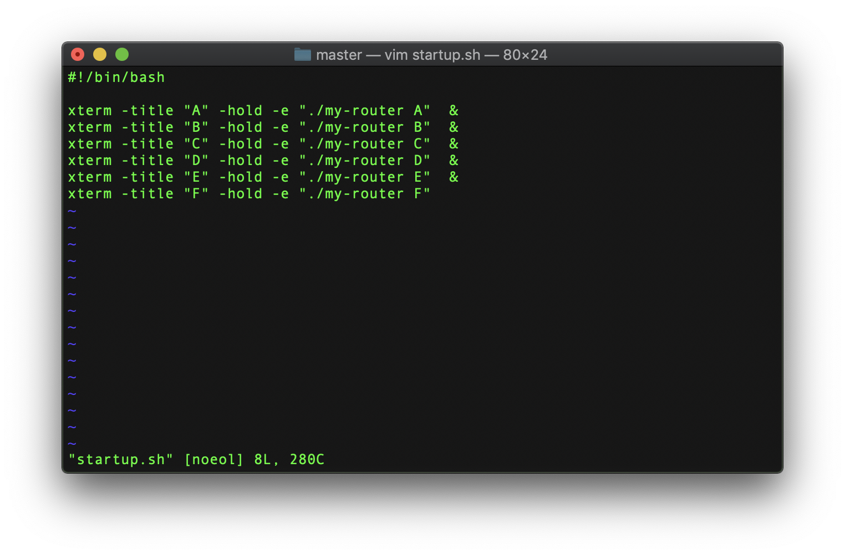
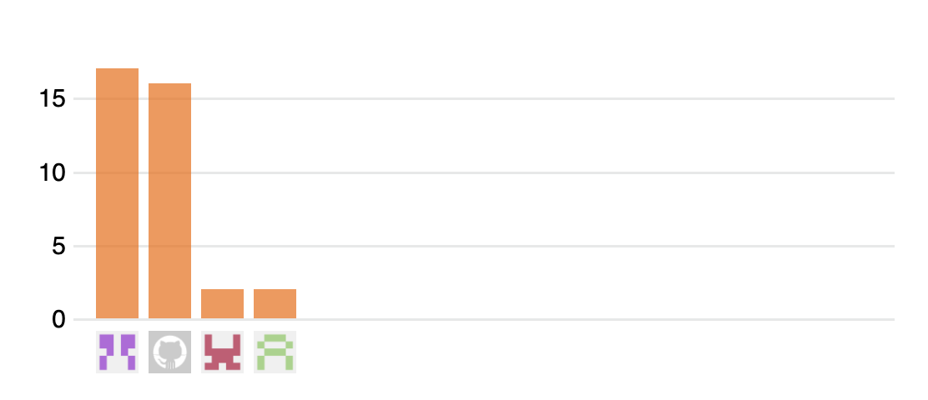
2. Experiences Gained
Before this project, none of us had any experience with socket programming, other than Project 1, so many aspects of socket programming were still new to us.
Gained Experience with:
Using the C++ Boost library.
Using Shell scripts to run a program
Using Git in a team

Slide 4
3. Future Work
Make the Program more Dynamic
By using a linked list of routers instead of arrays, the program would be able to adopt a topology with any number of routers by reading from the topology file.
Running the routers in different hosts
Boost library makes this a very easy task.

