Slide 1

Advanced college of engineering and management
Kalanki , kathmandu
Presented on:
Tree
Presented by
Presented to
Neha Gupta
Roll no=)48
BCT-A
DP sir
Department of electronics and computer engineering

Slide 2
Contents
Definition
Terminology
Binary Tree
Binary search tree and it’s operation
Algorithm for Searching , Inserting and Deletion of a node

Slide 3
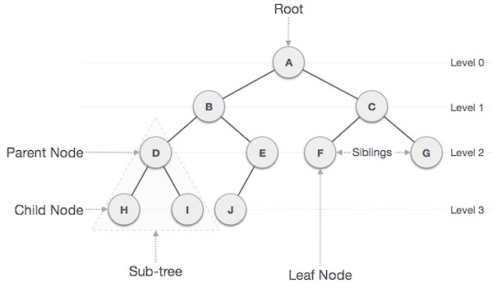
A Tree is a non-linear data structure that models a hierarchical organization. It consists of a finite set of elements called nodes and a finite set of directed lines called branches that connect the nodes.
Terminology
Parents : one edge upward a node except root
Children : Node below given node connected by it’s edge downward
Root node : starting node(A)
Leaf/Terminal nodes : Having no children(H,I,J,F,G)
Non-terminal nodes : Having at least one children(A,B,C,D,E)

Slide 4
6. Degree : no. of sub-trees of a node
Degree of A:3
Degree of H:0
Degree of B:2
Levels : Represents generation of a node.
Depth :
Depth of a node : length of path from the root of the node
Depth of a tree : Length of largest path from root to terminals(3)
Height :
height of a node : length of path from deepest leaf of that node
height of a tree : largest path from terminals to root (3)
9. Siblings : children of same parent
10. Cousins : children from different parents but same grand parents
11. Keys : a value of a node based on which a search operation is carried out for a node
12. Sub-tree : The descendents of a node
13. Traversing : Traversing means passing through nodes in a specific order
Binary Tree: A binary tree is a tree-type non-linear data structure with a
maximum of two children for each parent.
Degree of a tree : Max.degree of nodes(4)
Degree of a tree :Max. degree of nodes (4)

Slide 5
Binary Search Tree(BST)
A binary search tree exhibits a special behaviour . A node’s left child
Must have a value less than it’s parent value and the node’s right child must have a value greater than it’s parent value.
BST Basic Operations
Insert : Inserts an element in a tree/create a tree
Search : Searches an element in a tree
Preorder Traversal : Traverses a tree in a in-order manner
Post-order Traversal : Traverses a tree in a post-order manner
We shall learn creating(inserting into) a tree structure and searching a data item in a tree in this chapter.
Algorithm for inserting a new node in BST
Allocate memory for node
new node=(struct node*) malloc (size of(struct node))
Set the data part to the value and set the left and right pointer of node , point to NULL
new node-> info=data;
new node->left=NULL;
new node->right=NULL;
Assign pointer ‘tree’ as ‘root’ node of the tree.
tree= root;
4. If(tree==NULL)

Slide 6
set tree= newnode ;
5. Else if(data> tree-> info)
if(tree->left=NULL) then
tree->left= newnode;
Else
tree=tree->left;
Repeat step 4
Else if(data>tree-> info)
if( tree->right== NULL) then
tree->right= newnode;
II. else
tree=tree->right;
III. Repeat step from 4
7. Else if(data== tree-> info)
8. Display “duplicate data”
9. End

Slide 7
Algorithm for BST searching
Start
Compare the element with the root of the tree
If the item is matched then return the location of the node
Otherwise check if item is less than the element present on root , if so then move to the left sub-tree
If not , then move to the right sub-tree
Repeat this procedure recursively until match found
If element is not found then return NULL
Stop
Algorithm for deletion of node
If( root== NULL)
item not found in tree and return NULL
2. If(data< root -> info)
set root->left= delete_node(root->left , info);
3. Else if ( data> root->info)
set root->right=delete_node(root->right,info);
Else
1. if(root->left==NULL && root->right== NULL)
I. Set free(root)
II. Return NULL
2. Else if(root-> left== NULL)then
I. ptr =root->left
II. free(root)
III. Return ptr;

Slide 8
3.Else if (root->right=NULL)
ptr = root->left
free(root)
return ptr;
4. Get the in_order successor(smallest in the right sub-tree)
ptr= root-> right;
While(ptr->left!=NULL)
ptr= ptr-> left;
5. root->info=ptr->info
6. Return root and End

