Slide 1
Database Project
Hlib Donets

Slide 2

Overview
Objective: Design, implement, and manipulate a relational SQL database
  Database for a Xiaomi online store
  Tables include Customers, Orders, Products, Suppliers, Categories, Payments

Slide 3
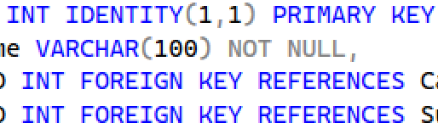

Database Design
7 main tables created
  Primary keys are auto-increment
  Foreign keys enforce relationships
  Data types include INT, VARCHAR, DATETIME, DECIMAL

Slide 4
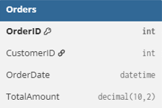
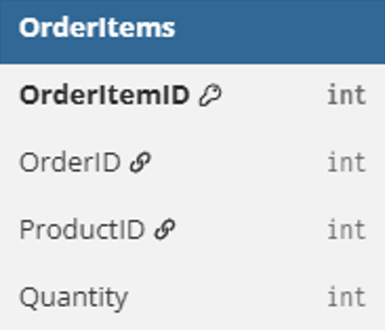
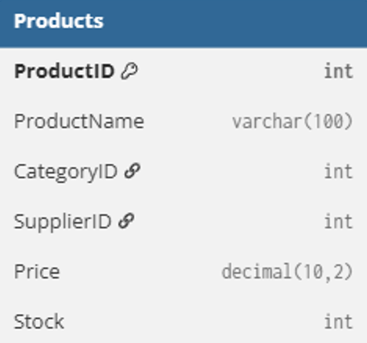
Many-to-Many Relationship
Implemented via the OrderItems junction table
Connects Orders and Products
  Supports multiple products per order

Slide 5
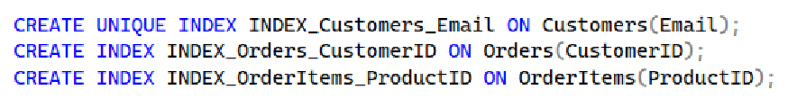
Indexes
01
02
03
Unique email index for Customers
Index on CustomerID in Orders
Index on ProductID in OrderItems

Slide 6
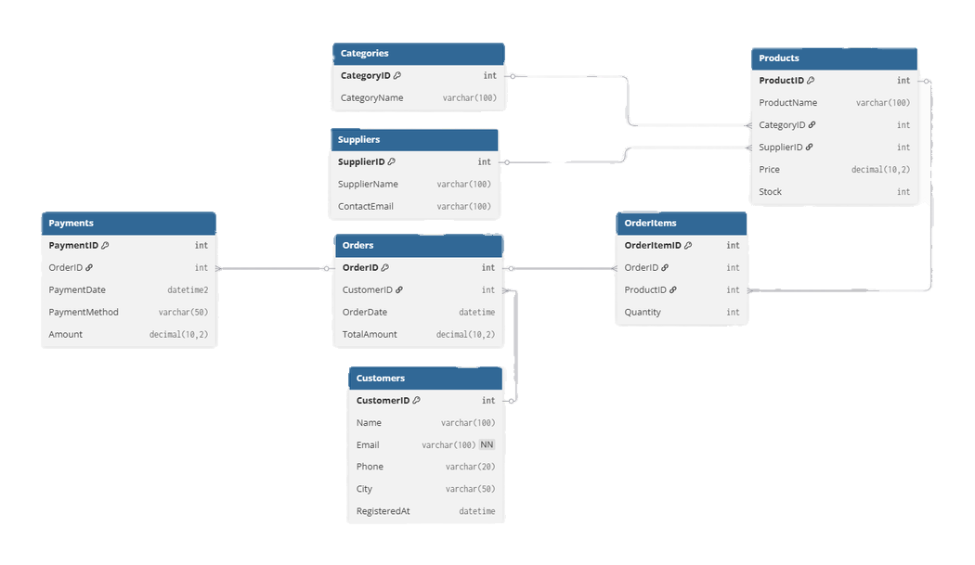
Diagram

Slide 7
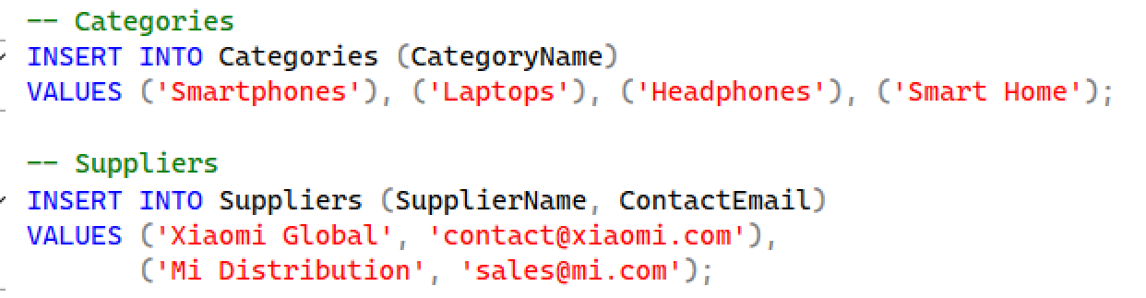



Data Manipulation
  INSERT statements populate all tables
  UPDATE examples modify prices and stock
  DELETE example removes customers by city
  TRUNCATE statement clears all records from the Payments table

Slide 8
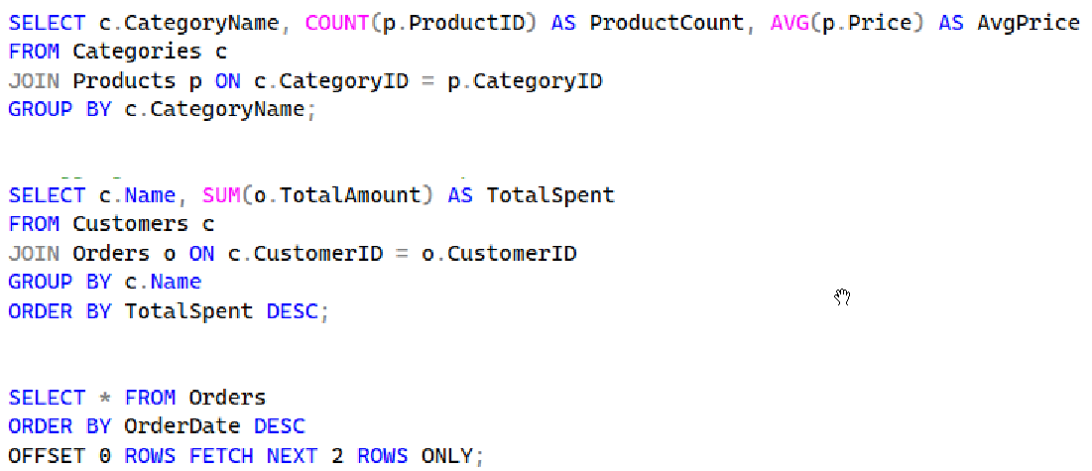
SELECT Queries
Aggregations using COUNT, AVG, SUM
Ordering results with ORDER BY
  GROUP BY category, customer
Pagination using OFFSET and FETCH NEXT

Slide 9
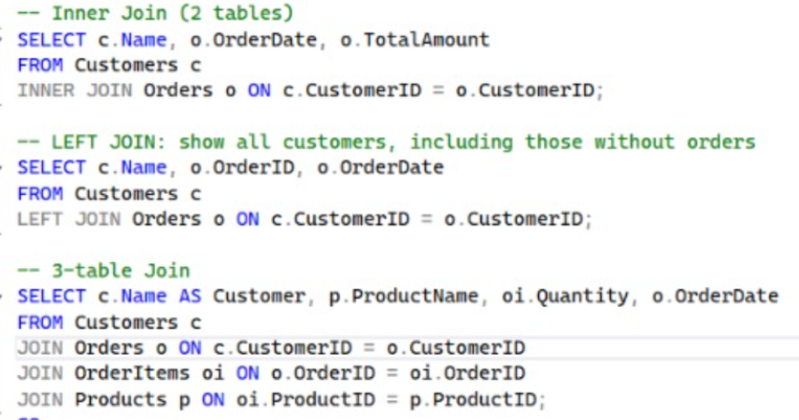
JOIN Examples
  INNER JOIN customers with orders
  LEFT JOIN customers including those without orders
  Multi-table JOIN: Customers, Orders, OrderItems, Products

Slide 10
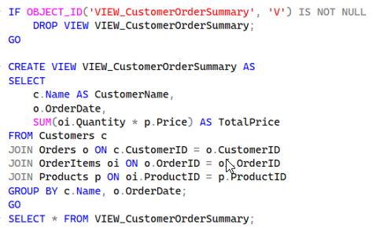
View
  VIEW_CustomerOrderSummary
  Aggregates order value per customer
  Combines 4 tables using JOIN

Slide 11
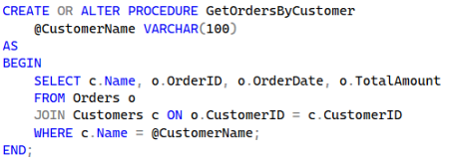
Stored Procedure
GetOrdersByCustomer
Returns all orders placed by a given customer name

Slide 12
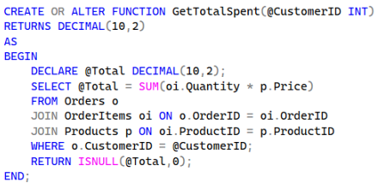
Function
GetTotalSpent
Calculates total spending based on ordered products

Slide 13
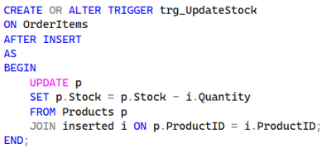
Trigger
trg_UpdateStock on OrderItems
Automatically decreases product stock after insert

Slide 14

Transaction Example
01
Manual deletion wrapped in TRANSACTION
  Ensures data consistency during complex operations

Slide 15
Conclusion
Project meets all technical requirements
Includes design, implementation, queries, indexes, views, procedures and triggers
ERD and code prepared for final defense
Please keep this slide for attribution

