Slide 1
Boomerang: Redundancy Improves Latency and Throughput in Payment-Channel Networks

Slide 2
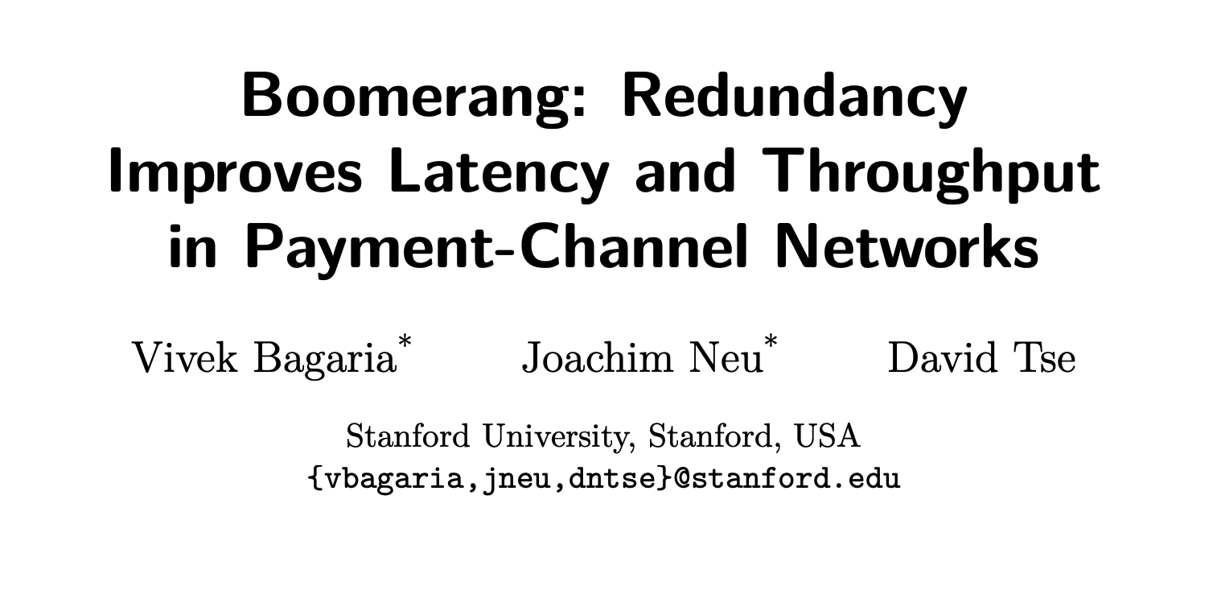
Paper
arXiv:1910.01834v2 [cs.CR] 29 Mar 2020

Slide 3


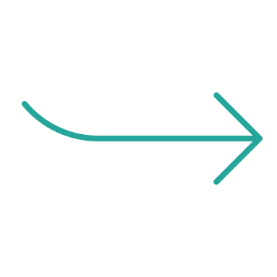


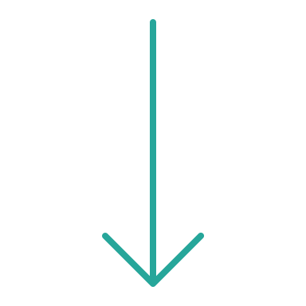



Idea: Trustless overpaying
E.g. payment of 0.03 BTC
0.01 BTC
0.01 BTC
0.01 BTC
0.01 BTC
0.01 BTC

Slide 4
Idea: Trustless overpaying
The recipient can claim up to the exact payment amount,
but if she claims more, the sender will receive a full refund.

Slide 5
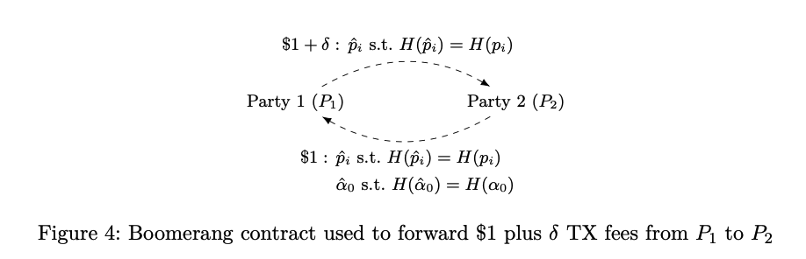

Building blocks
Send equality weighted payment increments
Claiming of payment increments follows special payment preimage $p_{i}$
Establish a refund transaction for each payment increment
Claiming of refund follows special payment preimage $α_{0}$

Slide 6

Building preimages
Receiver creates $w=5$ preimages $p_{1},p_{2},…,p_{5}$ based on 5 equations.
$p_{1}$
$p_{2}$
$p_{3}$
$p_{4}$
$p_{5}$

Slide 7

Building preimages
Receiver creates $w=5$ preimages $p_{1},p_{2},…,p_{5}$ based on 5 equations.
$p_{1}=1 α_{0}+1 α_{1}+ 1 α_{2}+ 1 α_{3}$
$p_{2}=1 α_{0}+2 α_{1}+ 4 α_{2}+ 8 α_{3}$
$p_{3}=1 α_{0}+3 α_{1}+ 9 α_{2}+ 27 α_{3}$
$p_{4}=1 α_{0}+4 α_{1}+16 α_{2}+ 64 α_{3}$
$p_{5}=1 α_{0}+5 α_{1}+25 α_{2}+125 α_{3}$
($p_{i}=\sum_{j=0}^{v}{ i^{j} α_{j}}$)

Slide 8

Building preimages
Receiver creates $w=5$ preimages $p_{1},p_{2},…,p_{5}$ based on 5 equations.
$v=3$ payments are supposed to go through.
There are $u=w−v=2$ redundant payments.
The equations must contain $v+1=4$ independent variables $α_{0},…,α_{3}$.
$p_{1}=1 α_{0}+1 α_{1}+ 1 α_{2}+ 1 α_{3}$
$p_{2}=1 α_{0}+2 α_{1}+ 4 α_{2}+ 8 α_{3}$
$p_{3}=1 α_{0}+3 α_{1}+ 9 α_{2}+ 27 α_{3}$
$p_{4}=1 α_{0}+4 α_{1}+16 α_{2}+ 64 α_{3}$
$p_{5}=1 α_{0}+5 α_{1}+25 α_{2}+125 α_{3}$
($p_{i}=\sum_{j=0}^{v}{ i^{j} α_{j}}$)

Slide 9

Building preimages
Receiver creates $w=5$ preimages $p_{1},p_{2},…,p_{5}$ based on 5 equations.
$v=3$ payments are supposed to go through.
There are $u=w−v=2$ redundant payments.
The equations must contain $v+1=4$ independent variables $α_{0},…,α_{3}$.
The receiver commits to $α_{0},…,α_{3}$ by providing $H(α_{j})=α_{j}∙G$ to the sender.
$p_{1}=1 α_{0}+1 α_{1}+ 1 α_{2}+ 1 α_{3}$
$p_{2}=1 α_{0}+2 α_{1}+ 4 α_{2}+ 8 α_{3}$
$p_{3}=1 α_{0}+3 α_{1}+ 9 α_{2}+ 27 α_{3}$
$p_{4}=1 α_{0}+4 α_{1}+16 α_{2}+ 64 α_{3}$
$p_{5}=1 α_{0}+5 α_{1}+25 α_{2}+125 α_{3}$
($p_{i}=\sum_{j=0}^{v}{ i^{j} α_{j}}$)

Slide 10
The Boomerang contract
Transfer 0.01 BTC back from $P_{2}$ to $P_{1}$ upon revelation of two preimages $p_{i}$and $α_{0}$ such that $H(p_{i})=p_{i}∙G$ and $H(α_{0})=α_{0}∙G$

Slide 11

Requirements for implementation
Option 1:
New Bitcoin Opcode which allows to provide $x$ and $H(x)$ and checks $H(x)=x∙G$.
Option 2:
Using adaptor signatures.
Option 3:
Using Eltoo.

Slide 12
Implementation with adaptor signatures
The receiver creates his adaptor for the refund transaction 𝑚_{R} with 𝑘_{R} and 𝑅_{R} = 𝑘_{R} ⋅ 𝐺, 𝛢₀ = 𝛼₀ ⋅ 𝐺)
𝑒_{R} := H(𝑅_{R} + 𝛢₀ ∥ 𝑌_{R} ∥ 𝑚_{R})
𝑠_{R}’ := (𝑘_{R} + 𝛼₀ + 𝑥_{R} 𝑒_{R})
The receiver’s adaptor 𝑠_{R}’ is not a valid signature according to BIP340:
𝑠 ⋅ 𝐺 ≟ 𝑋 + H( 𝑋 ∥ 𝑌 ∥ 𝑚 ) ⋅ 𝑌
She gives her adaptor to the sender: 𝑠_{R}’, 𝑅_{R}, 𝛢₀
If the sender learns 𝛼₀, he can claim the refund by
( 𝑠_{R}’ + 𝛼₀ ) ⋅ 𝐺 ≟ 𝑅_{R} + 𝛢₀ + 𝑒_{R} ⋅ 𝑌_{R}

Slide 13
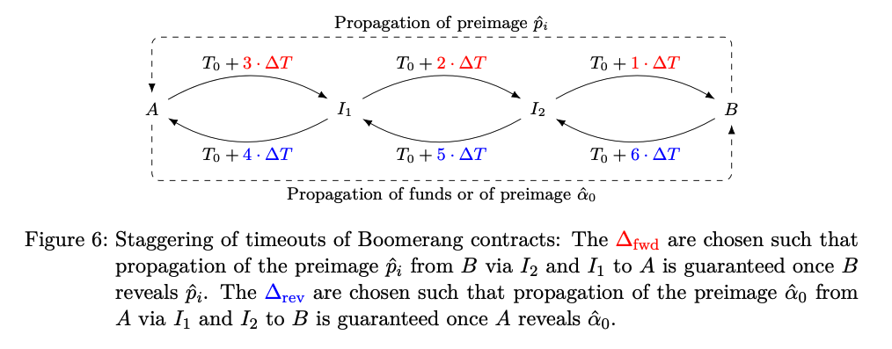
Routing of preimages

Slide 14
Auction scheme
Boomerang usage for trustless auctions

Slide 15

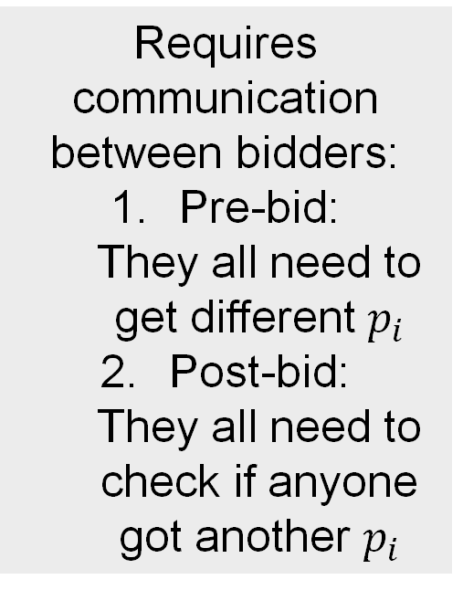





Possible usage for auctions
If seller overdraws (reveals more than one $p_{i}$), the bidders can cooperate to refund their bid.
Requires communication between bidders:
Pre-bid: They all need to get different $p_{i}$
Post-bid: They all need to check if anyone got another $p_{i}$
$$H\left(p_{1}\right) \& H(α_{0})$$
$$H(p_{1})$$
$$H\left(p_{2}\right) \& H(α_{0})$$
$$H(p_{2})$$
$$H\left(p_{3}\right) \& H(α_{0})$$
$$H(p_{3})$$
An additional punishment could be put in place if the seller has something at stake in the channels with the bidders.

Slide 16


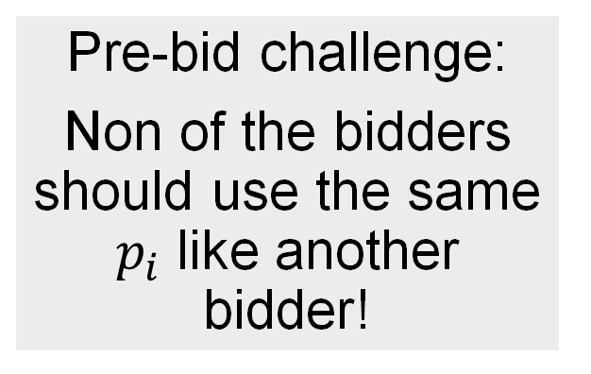
The equation system
There must be a $p_{i}$ for each bidder.
Only one bid shall be accepted.
⇒ $α_{0}$ and $α_{1}$ are needed.
Pre-bid challenge:
Non of the bidders should use the same $p_{i}$ like another bidder!
$p_{1}=1 α_{0}+1 α_{1}$
$p_{2}=1 α_{0}+2 α_{1}$
$p_{3}=1 α_{0}+3 α_{1}$
$p_{4}=1 α_{0}+4 α_{1}$
$p_{5}=1 α_{0}+5 α_{1}$
...

Slide 17

1. Pre-bid challenge
Solution:
The seller commits to $H(α_{0})$ and $H(α_{1})$.
Any bidder can draw a random $i$ and calculate their own
$$H\left(p_{i}\right)=1 H\left(α_{0}\right)+i H(α_{1})$$
When forwarding the payment with $H\left(p_{i}\right)$, the bidder must reveal $i$ to the seller as well.
Pre-bid challenge:
Non of the bidders should use the same $p_{i}$ like another bidder!

Slide 18






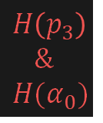
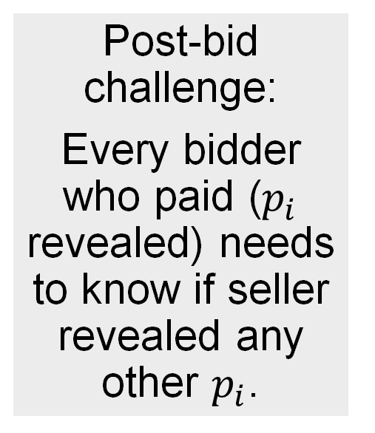
2. Post-bid challenge
An auctioneer channels the transactions and frees overbid channels to bidders.
Post-bid challenge:
Every bidder who paid ($p_{i}$ revealed) needs to know if seller revealed any other $p_{i}$.
$$H\left(p_{1}\right) \& H(α_{0})$$
$$H(p_{1})$$
$$H\left(p_{3}\right)$$
$$\&$$
$$H(α_{0})$$
$$H\left(p_{2}\right) \& H(α_{0})$$
$$H(p_{2})$$
$$H(p_{3})$$
auctioneer
$$H\left(p_{3}\right) \& H(α_{0})$$
Auctioneer reduces possibility of communication (if he is trusted). If he is not honest, communication between bidders is last resort.
$$H(p_{3})$$

Slide 19
2. Post-bid challenge
The process ends up like a simple payment with a preimage from the highest bidder which the seller has the option to resolve. It has
a timeout if the seller does not react and
a preimage which serves as a payment proof
$$H\left(p_{3}\right)$$
$$\&$$
$$H(α_{0})$$
$$H(p_{3})$$
auctioneer
$$H\left(p_{3}\right) \& H(α_{0})$$
$$H(p_{3})$$

Slide 20

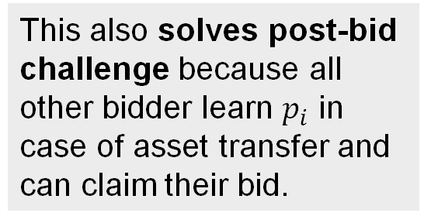




Asset transfer
Using asset transfers on the blockchain (Taro tree possible, too)
Bidder reveals $i$ and $H(p_{i})$ and sends it to auctioneer (= seller)
Auctioneer creates asset transfer transaction (ATT, which allows the bidder to claim the asset) based on $H(p_{i})$ and sends it to bidder
If auctioneer claims payment with $p_{i}$, bidder can claim asset
$$H(p_{i})$$
(Taro) asset transfer
This also solves post-bid challenge because all other bidder learn $p_{i}$ in case of asset transfer and can claim their bid.
$$H\left(p_{i}\right) \& H(α_{0})$$
$$H(p_{i})$$

