Slide 1
BIP 118 SIGHASH_ANYPREVOUT for Taproot Scripts

Slide 2
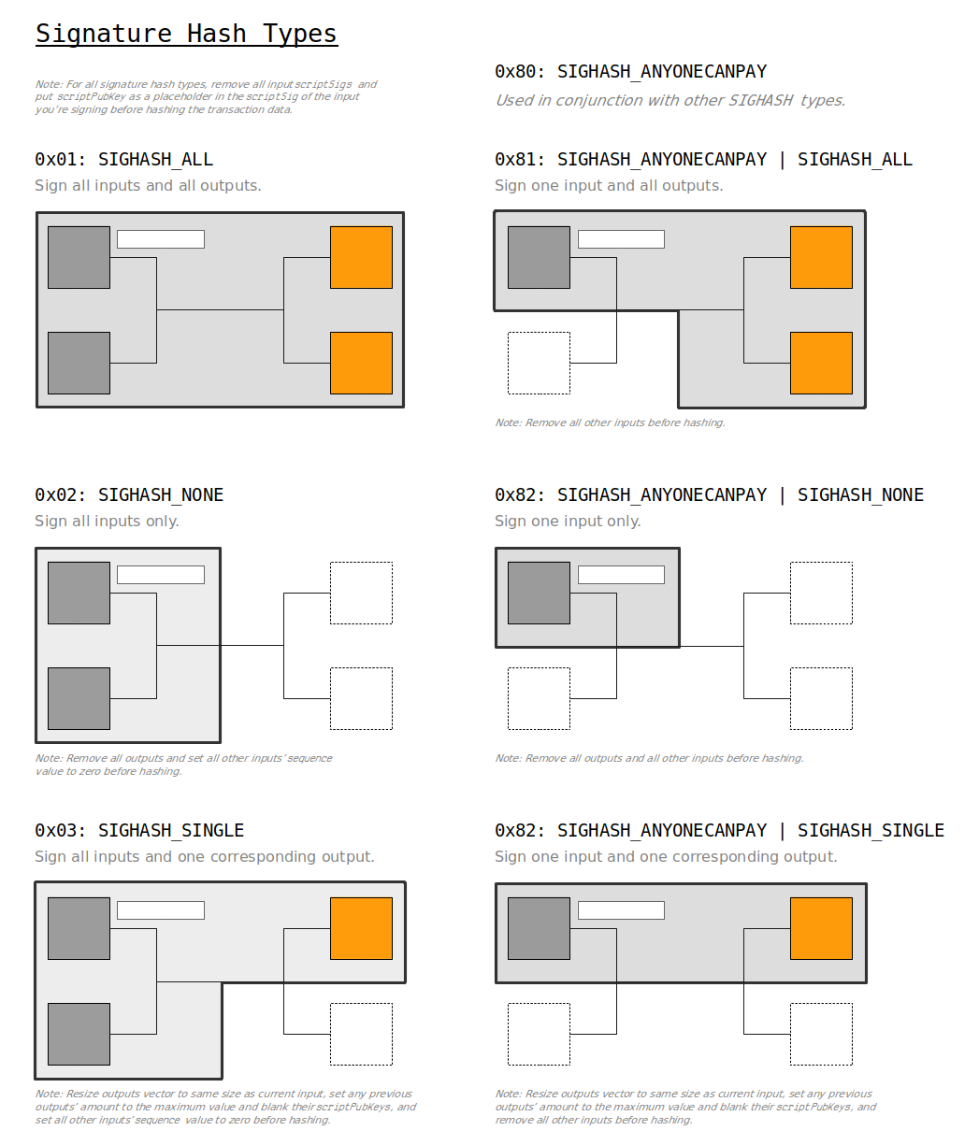
Sighash Flags
A UTXO specifies an amount and a script to spend it.
This script (usually) contains a public key and an opcode instruction to compare it to a signature.
To spend the UTXO, the spender must provide a redeem script which includes the corresponding signature (provided at a different part of the TX).
The ‘message’ which is signed is a hash of (a part of) the TX’s specifics - the ‘sighash’.
The sighash flag tells the verifier which part of the TX has been hashed.
https://learnmeabitcoin.com/technical/ecdsa

Slide 3
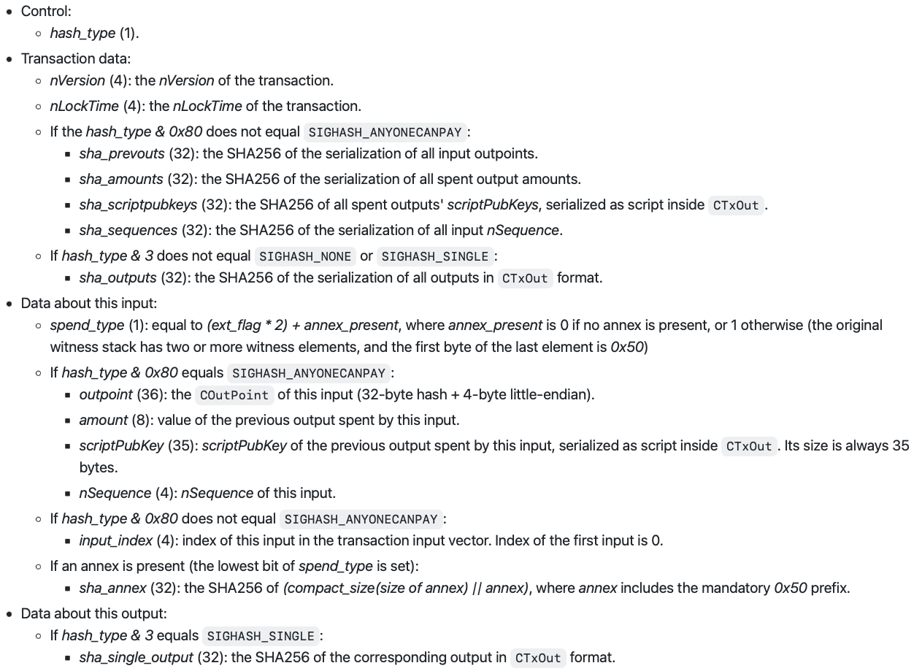
BIP 341
BIP title:
Taproot: SegWit version 1 spending rules
Taproot soft-fork created new algorithm for how to hash the TX’s specifics depending on the sighash flag.
https://github.com/bitcoin/bips/blob/master/bip-0341.mediawiki#signature-validation-rules

Slide 4
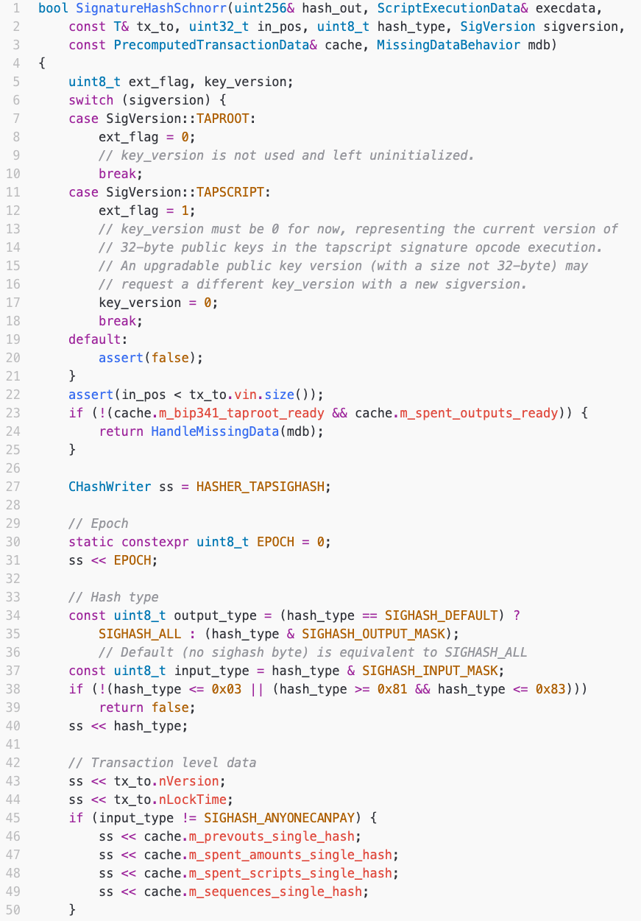
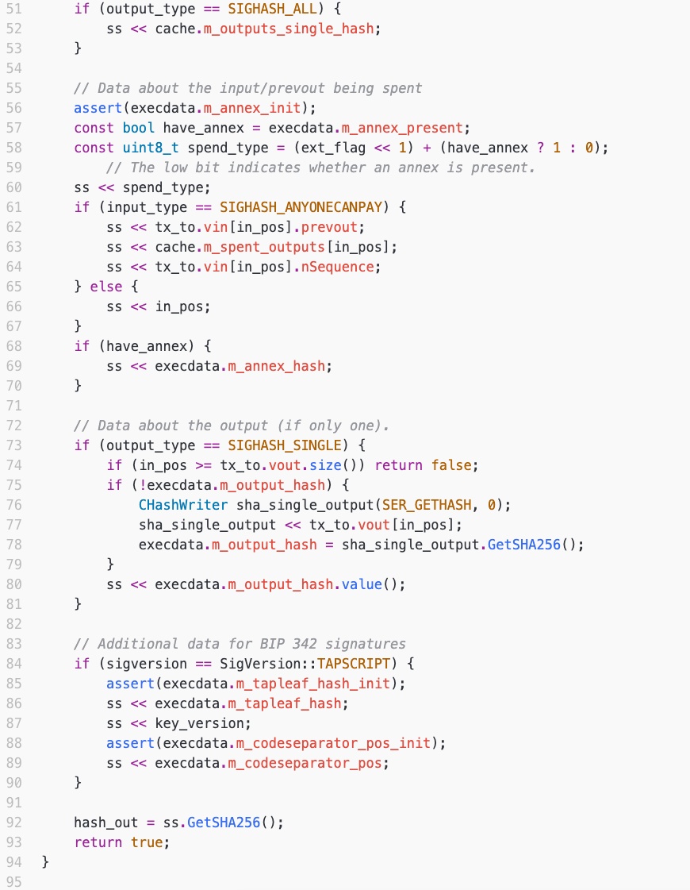
BIP 341
Commitment to:
General:
epoch
hash type
Prevout:
Outpoints
TX-IDs & output indexes
values
scriptPubKeys
nSequences
Outpoint amount
Current TX:
nVersion
nLockTime
Outpoint
TX-ID & output index
value
scriptPubKey
nSequence
annex
output hash
Taproot:
tapleaf hash
key version
code separator pos
https://github.com/bitcoin/bitcoin/blob/master/src/script/interpreter.cpp
Implementation in Bitcoin Core

Slide 5
BIP 188
BIP title: SIGHASH_ANYPREVOUT for Taproot Scripts
General:
epoch
hash type
Prevout:
Outpoints
TX-IDs & output indexes
values
scriptPubKeys
nSequences
Outpoint amount
Current TX:
nVersion
nLockTime
Outpoint
TX-ID & output index
value
scriptPubKey
nSequence
annex
output hash
Taproot:
tapleaf hash
key version
code separator pos
Two new opcodes:
SIGHASH_ANYPREVOUT = 0x40 SIGHASH_ANYPREVOUTANYSCRIPT = 0xc0
https://github.com/bitcoin/bips/blob/master/bip-0118.mediawiki
Neglected for SIGHASH_ANYPREVOUT colored red
Neglected for SIGHASH_ANYPREVOUTANYSCRIPT includes the same as for SIGHASH_ANYPREVOUT plus colored green

Slide 6
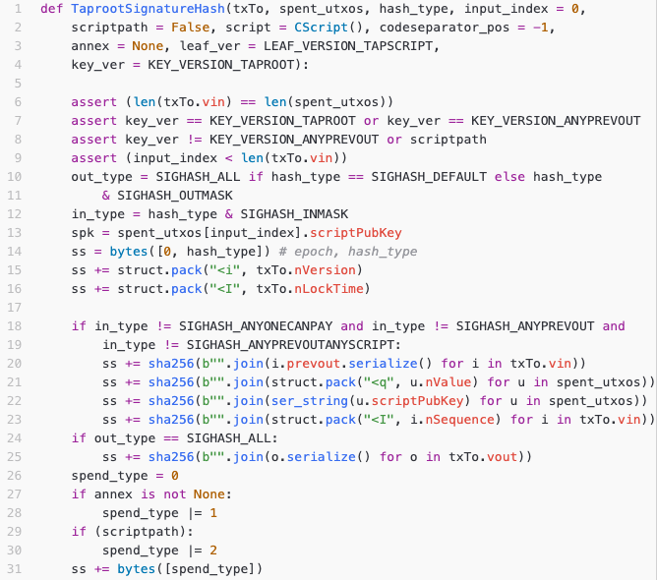
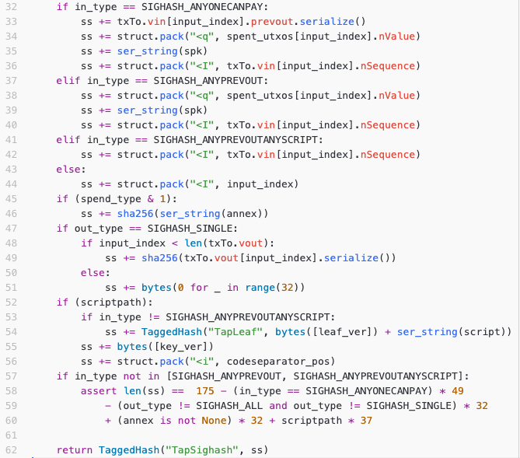
BIP 188
Exemplary implementation:
General:
epoch
hash type
Prevout:
Outpoints
TX-IDs & output indexes
values
scriptPubKeys
nSequences
Outpoint amount
Current TX:
nVersion
nLockTime
Outpoint
TX-ID & output index
value
scriptPubKey
nSequence
annex
output hash
Taproot:
tapleaf hash
key version
code separator pos
https://github.com/remyers/bitcoin/blob/eltoo-anyprevout-ptlc/test/functional/test_framework/script.py

Slide 7
BIP 188: SIGHASH_ANYPREVOUT for Taproot Scripts
This proposal introduces a new public key type that modifies the behavior of the transaction digest algorithm used in the signature creation and verification, by excluding the commitment to the previous output (and, optionally, the witness script and value). Removing this commitment allows dynamic rebinding of a signed transaction to another previous output that requires authorisation by the same key. The dynamic rebinding is opt-in due to using a separate public key type.

Slide 8
Risks
Pinning attacks
Overall fee vs. fee rate

