Slide 1
Taro

Slide 2
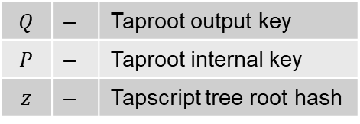


Nested MS-SMTs inside Taproot output
$$Q=P+{hash}_{tag}(P∥z)$$
$$Q$$ | ‒ | Taproot output key
$$P$$ | ‒ | Taproot internal key
$$z$$ | ‒ | Tapscript tree root hash
Root hash $z$
MS-SMT
MS-SMT
Hash leaf
Script hash 3
asset_tree_root
asset_id_tree_root
Script hash 1
Script hash 2
Hash node 1
Sum 1
Hash node 2
Sum 2
Hash node 1
Sum 1
Hash node 2
Sum 2
… 256 levels / 2²⁵⁶ leaves
… 256 levels / 2²⁵⁶ leaves
Leaves
Key: asset_id (or asset_key_family)
Value:
Sum_value asset_sum
Leaves
Key: asset_script_key
Value: asset_leaf || leaf_sum
Sum_value leaf_sum
asset_id_tree_root
asset_leaf (TLV blob)
taro_version, asset_id, asset_type, amt, lock_time, prev_asset_witnesses, split_commitment, asset_script_version, asset_script_key, asset_family_key

