Slide 1

JavaScript
Fundamentals
We'll be using Visual Studio and Chrome on Windows today.

Slide 2
History
Created in 1995 by Brandon Eich at Netscape Communications.
Inspired by Java, Scheme and Self.
Original purpose was to bring dynamic content to the Web, which in 1995 was exclusively static HTML.
Source: A Brief History of JavaScript

Slide 3
Where is it used today?
Everywhere!
Client-side scripting for frontend dev, making web pages interactive and dynamic
Also used for backend, NodeJS is a popular example of a server-side runtime

Slide 4
Strengths
Ubiquity. JavaScript is used everywhere in the web.
Simplicity. JavaScript is relatively simple to learn and implement.
Versatility. It's possible to develop an entire app from front to back using only JavaScript.
Source: freeCodeCamp

Slide 5
Weaknesses
Client-Side Security. Because the code executes on the users’ computer, in some cases it can be exploited for malicious purposes.
This is one reason some people choose to disable JavaScript.
Mitigated by browser sandboxing.
Sources: freeCodeCamp

Slide 6
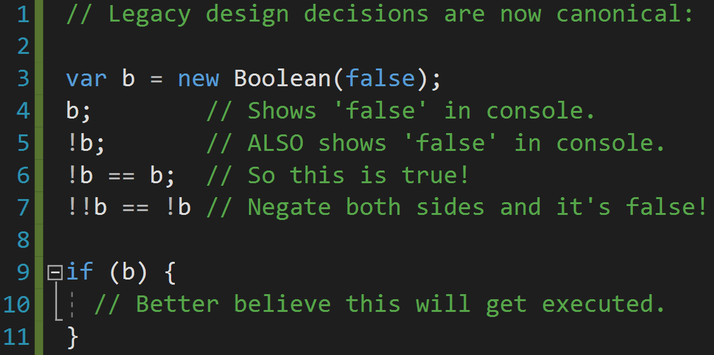
Weirdness

Slide 7
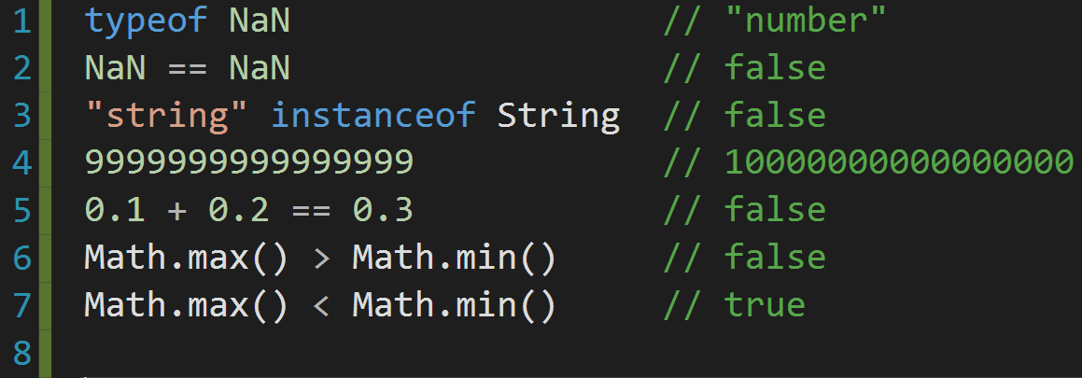
Weirdness
Unintuitive behavior:

Slide 8




Popular apps using JS

Slide 9
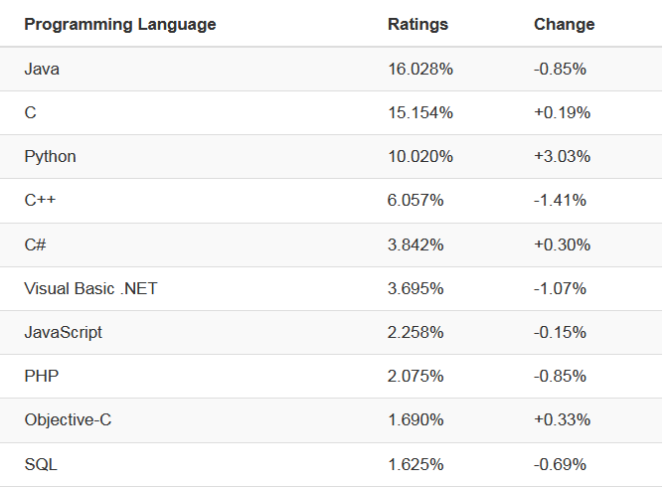
Popularity: 7th in 2019

Slide 10
Language Basics
Interpreted
V8
NodeJS
Modern browsers use a technology known as Just-In-Time (JIT) compilation, which compiles JavaScript to executable bytecode just as it is about to run

Slide 11
Language Basics: Syntax
Very similar to Java, C/C++
Follows most Java expression syntax, naming conventions and basic control-flow constructs (we'll see this shortly)
JavaScript is dynamically typed, lacks Java's static types and strong type checking.

Slide 12

w3schools: Hello JS!
w3schools.com/js/
Navigate to the above link and click:
We will be trying several examples from this site to learn the fundamentals of JavaScript.

Slide 13
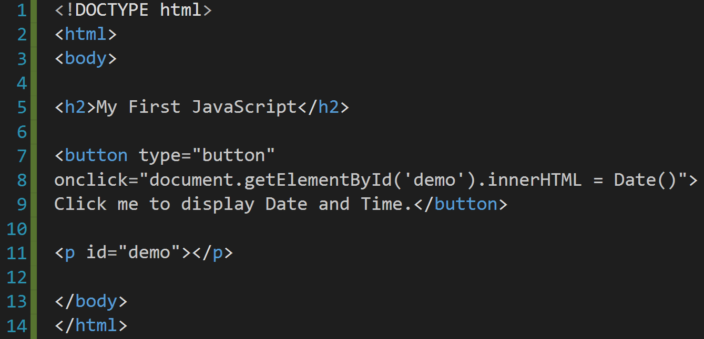
w3schools: Hello JS!
Can you spot the JavaScript in this HTML?

Slide 14
w3schools: Hello JS!
It's the string assigned to the 'onclick' attribute of the button element:
"document.getElementById('demo').innerHTML = Date()"
When the button is clicked, an onclick event is triggered and the JavaScript is run.

Slide 15
w3schools: Hello JS!
What is the JavaScript doing? Let's break it down.
"document.getElementById('demo').innerHTML = Date()"
document
an object representing the HTML document being displayed
Part of the DOM (document object model), a hierarchy of objects comprising a Web document.

Slide 16
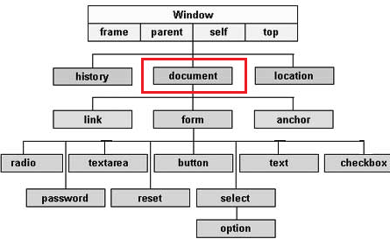
w3schools: Hello JS!
Simple example of DOM

Slide 17
w3schools: Hello JS!
getElementById('demo')
will return an object representing the paragraph element
<p id="demo"></p>
innerHTML
the HTML between the <p> tags
<p>innerHTML</p>
Date()
Creates a JavaScript Date instance that represents a single moment in time in a platform-independent format

Slide 18
w3schools: Hello JS!
Putting it all together:
document.getElementById('demo').innerHTML = Date()
This will change the inner HTML of the paragraph element to the current date and time.
Let's try another example.

Slide 19
Variables
https://www.w3schools.com/js/js_variables.asp
In order to create variables in JS you must declare them like so:
Var name = "Joe";
Var pi = 3.14;
Using the var keyword whatever variable you declare can be of any type.
You can also add values together and immediately assign them to a variable. Though caution should be exercised when adding a string to a number.
For example, the number 2 is treated as a string and will be concatenated to "5" in this case:
Var x = "5" + 2 //result: x = "52"

Slide 20
Operators
https://www.w3schools.com/js/js_operators.asp
Many of the operators in JS are just as you would see in any other language with some exceptions. Most notably:
Exponentiation: **
10 ** 5 = 100,000
Strict Equality: ===
5 === '5' returns false, whereas 5 == '5' would return true.
Not equal value/type: !==
The inverse of the === operator
Return the type of a variable: typeof
console.log(typeof 42); //outputs: "number"
Return true if an object is an instance of an object type: instanceof
Assume we have a car object and auto is an instance of car:
Console.log(auto instanceof car); //true

Slide 21
Data Types
https://www.w3schools.com/js/js_datatypes.asp
JavaScript has dynamic types (the same variable can hold different types) for instance:
var x; // Now x is undefined x = 5; // Now x is a Number x = "John"; // Now x is a String
Arrays are familiar:
Var numbers = [5, 6, 7];
Objects are declared with curly braces:
var person = {firstName:"John",
lastName:"Doe",
age:50,
eyeColor:"blue"};

Slide 22
Functions
https://www.w3schools.com/js/js_functions.asp
Defined with the function keyword, a name, and parenthesis
function name(parameter, parameter, parameter)
{
Code;
}
Can make use of a return statement
Functions can be used as variables
Var x = name();

Slide 23
Objects
https://www.w3schools.com/js/js_objects.asp
Objects can be declared as such:
var car = {type:"Fiat", model:"500", color:"white"};
Object properties can be accessed in two ways:
ObjectName.propertyName
objectName["propertyName"]
Object methods (functions) can be implemented like this:
var person = { firstName: "John", lastName : "Doe", id : 5566, fullName : function() { return this.firstName + " " + this.lastName; } };

Slide 24
Objects (cont.)
You access an object method with the following syntax:
objectName.methodName()
Or without parentheses like this:
name = person.fullName;
In a function definition, this refers to the "owner" of the function.
In other words, this.firstName means the firstName property of this object.

Slide 25
Scope
https://www.w3schools.com/js/js_scope.asp
Local
Variables inside functions stay inside functions.
Global
Works the same as you would think BUT, if you assign a value to a variable that has not been declared, it will automatically become a GLOBAL variable. This is an example of hoisting in JS.
Hoisting: JS Hoists all variables to the top of the current scope, meaning you can use a variable before its declared or even assigned a value!
Try this: console.log(x+y)
Define the values x and y after this statement.
Then declare both x and y with var x,y;

Slide 26
Scope (cont.)
Your code should look something like this:
console.log(x+y); //outputs 9
x = 4;
y = 5;
var x, y;
You can see how this can get sort of confusing when trying to find out the values of x or y in a large block of code!

Slide 27
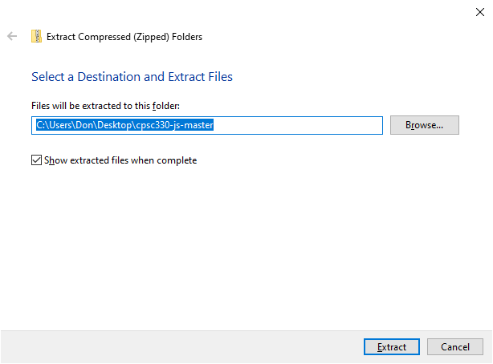
Example 01: The Colors
Download our example code by holding CTRL and clicking:
https://github.com/donfreiday/cpsc330-js/archive/master.zip
Once downloaded, navigate to the file in Windows Explorer and extract the contents by right clicking and selecting "Extract all..."

Slide 28

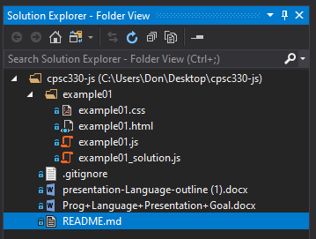
Example 01: The Colors
Open Visual Studio and click:
Then browse to the extracted files in Solution Explorer.
We'll look at example01.html first.
If Solution Explorer isn't open, hold CTRL+ALT and tap the L key.

Slide 29
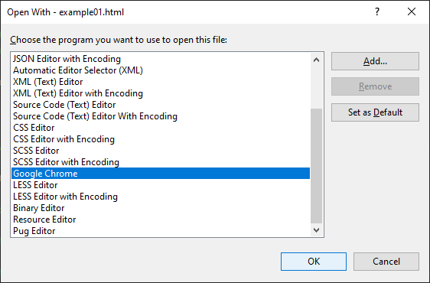
Example 01: The Colors
To view the HTML in a web browser, right click example01.html in the Solution Explorer, and click Open with...
In the resulting dialog, select Google Chrome.

Slide 30
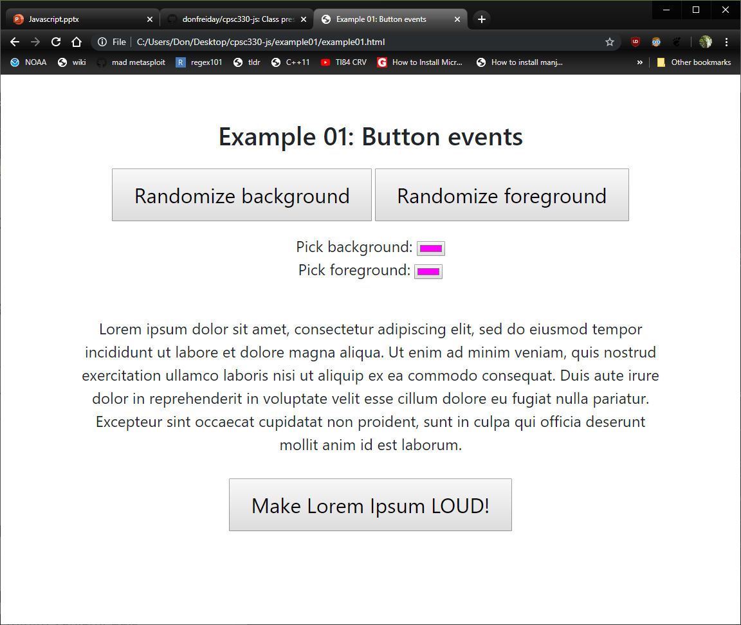
Example 01: The Colors
You'll notice some features of the page don't work.
Don't worry, you'll be fixing that soon.
First, let's take a moment to revisit the debugger.

Slide 31
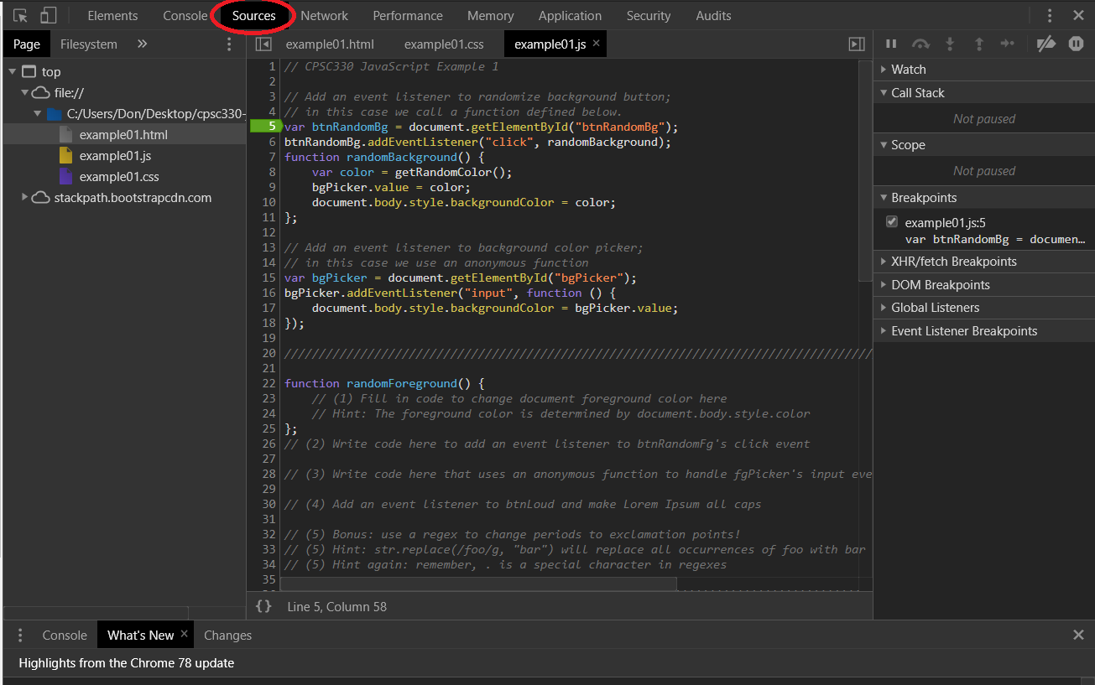
The Debugger
In Chrome, hit the F12 key to open the debugger.
Click on the Sources tab to see our code loaded in the browser.

Slide 32

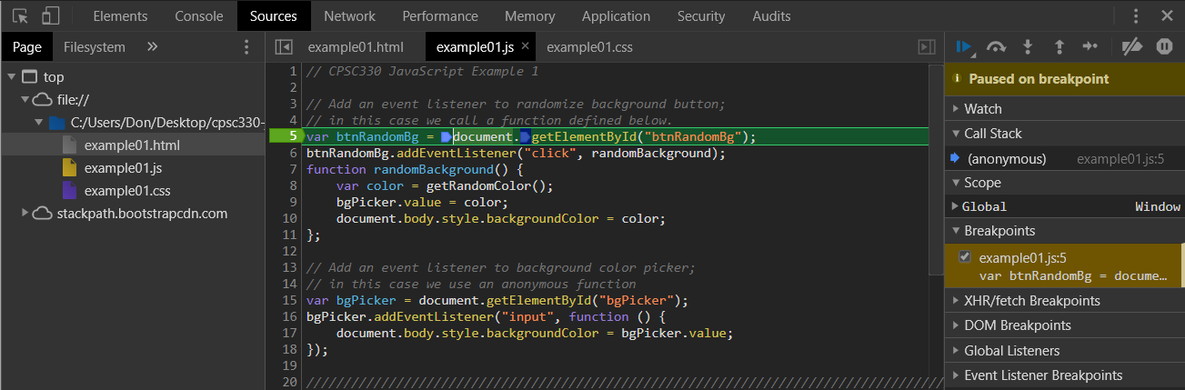
The Debugger
Double click example01.js, and try setting a breakpoint on Line 5 by clicking on the '5'. Hit F5 to reload the page and it should trigger.
You'll notice the page shows:

Slide 33
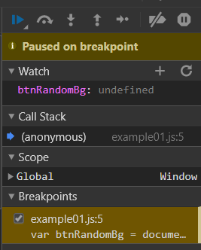
The Debugger
You can step line by line using the F10 key, or continue running by pressing F8.
There are also button controls in the top right of the debugger. Hover the mouse over them for details.
Try setting a watch on a variable:
Then hit F8 to see the assignment.

Slide 34
Example 01: The Colors
The debugger is an invaluable tool.
However, changes made to the files in the editor don't persist through page reload, so we'll be working in Visual Studio.
There are 5 problems for you to solve in example01.js
Remember to save your changes in Visual Studio, then reload the HTML in Chrome (hit F5) to see them applied.
There are solutions in example01_solutions.js, but we encourage you to try the problems on your own first.

Slide 35
Hands-on: Syntax
Create 3 variables, x, y, z
X and y should be integers
Z should be x and y added together
Create a variable that holds the string "hello world"
Finally, create an array [] with the integers 1,2,3, and 4.
Output them all to the screen using your html
Use comments to describe what your doing
// for single line
/* for multi-line */

Slide 36
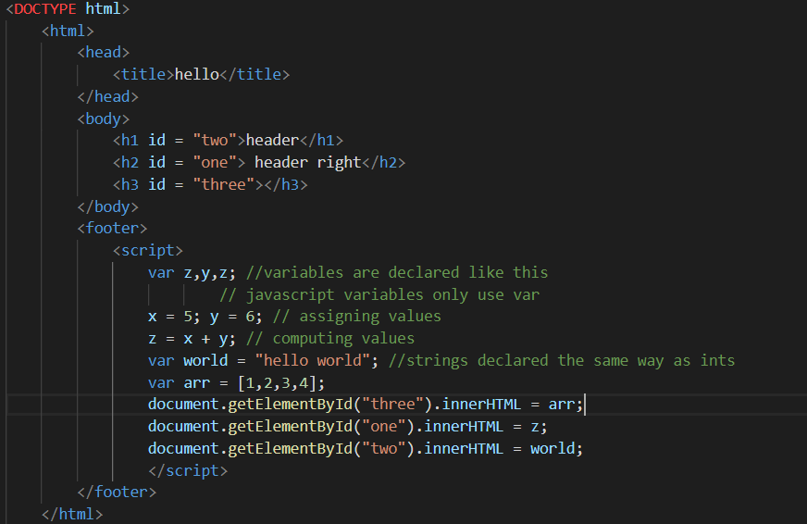
Hands-on: syntax and variables
Remember that where you put your script matters, you cannot edit a tag that doesn’t exist yet!

Slide 37
Hands-on: functions
Write a function that adds two variables declared outside the function and outputs it to the screen.

