Slide 1

JavaScript
Fundamentals
Don Freiday
Tanner Oliver
Robert Vansolkema
We'll be using Windows today.

Slide 2
History
Created in 1995 by Brandon Eich at Netscape Communications.
Original purpose was to bring dynamic content to the Web.
Inspired by Java, Scheme and Self.
Source: A Brief History of JavaScript

Slide 3
Where is it used today?
Everywhere!
Client-side scripting to make web pages interactive and dynamic (the frontend)
Also used for server-side processing, for example NodeJS (the backend)

Slide 4
Strengths
Simplicity. JavaScript is relatively simple to learn and implement
Availability. Modern JavaScript engines are available for virtually every platform
Versatility. It's possible to develop an entire app from front to back using only JavaScript
Source: freeCodeCamp

Slide 5
Weaknesses
Speed. JavaScript is still slower than most compiled languages
Client-Side Security.
Malicious JavaScript can be embedded in web pages
This is one reason some people choose to disable JavaScript in the browser
Mitigated by browser sandboxing
Sources: freeCodeCamp

Slide 6
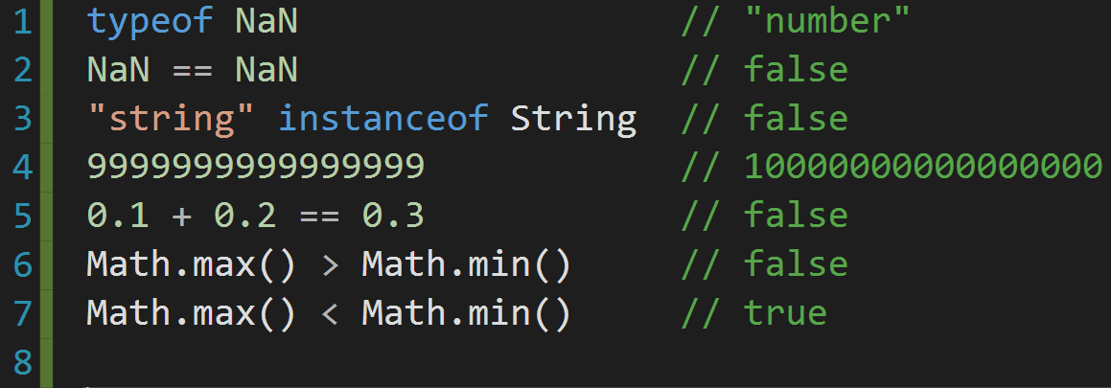
Weirdness
Unintuitive behavior:

Slide 7
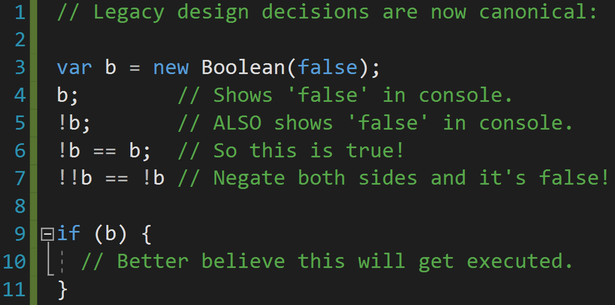
MORE Weirdness

Slide 8






Major companies using JavaScript

Slide 9
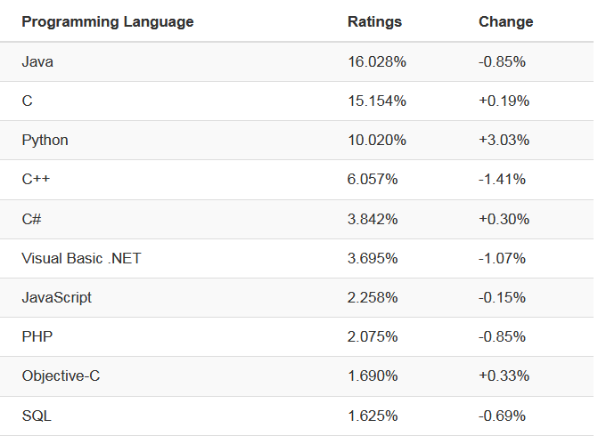
Popularity: 7th in 2019

Slide 10
Language Basics
Interpreted, runs in JavaScript engines:
V8
NodeJS
JIT: Modern browsers use a technology known as Just-In-Time compilation, which compiles JavaScript to executable bytecode just as it is about to run

Slide 11
Language Basics
The syntax is very similar to Java, C/C++
Dynamically typed
var foo = 7;
foo = "hello js!"; // OK
Lacks Java's static types and strong type checking

Slide 12
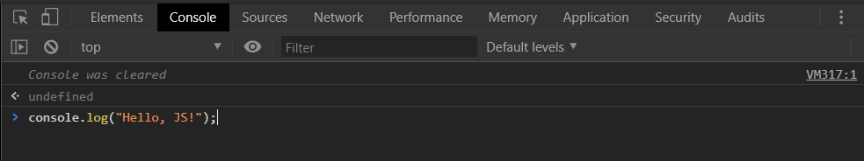
Hello JS: The developer console
Open Google Chrome and press F12
Click on the Console tab
Type:
console.log("Hello, JS!")
Hit enter

Slide 13
Hello JS: The developer console
The developer console will allow us to debug our JavaScript
We can also run arbitrary JavaScript in Chrome's interpreter
The next slide demonstrates how JavaScript can be used to interact with an existing web page.

Slide 14
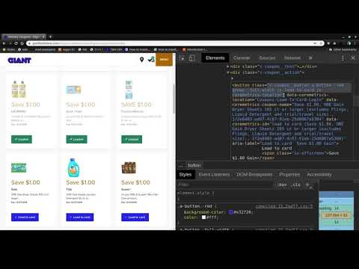
https://www.youtube.com/watch?v=6qeDCTcdfmg

Slide 15

Introduction
w3schools.com/js/
Navigate to the above link and click:

Slide 16
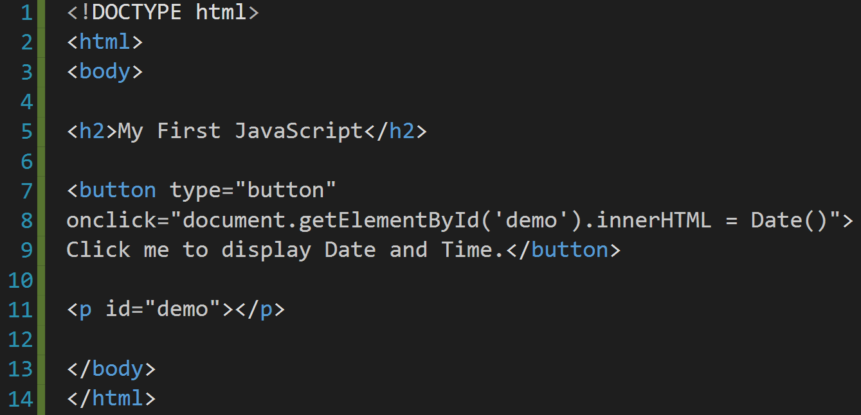
Introduction
Can you spot the JavaScript in the HTML?

Slide 17
Introduction
The JavaScript is contained in the string assigned to the 'onclick' attribute of the button element:
"document.getElementById('demo').innerHTML = Date()"
When the button is clicked, a click event triggers and the JavaScript assigned to the onclick attribute runs.

Slide 18
Introduction
document.getElementById('demo').innerHTML = Date()
What is the JavaScript doing? Let's break it down.
document
an object representing the HTML document being displayed
Part of the DOM (Document Object Model)

Slide 19
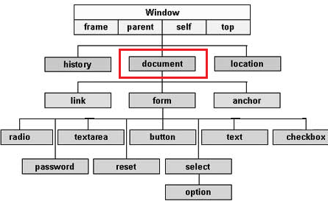
Introduction
Simple example of DOM

Slide 20
Introduction
getElementById('demo')
returns an object representing the paragraph element
<p id="demo"></p>
innerHTML
the HTML between the <p> tags
<p>innerHTML</p>
Date()
Creates Date instance that represents a single moment in time

Slide 21
Introduction
Putting the pieces together:
document.getElementById('demo').innerHTML = Date()
This will change the inner HTML of the paragraph element to the current date and time.

Slide 22
Variables
In order to create variables in JS you must declare them like so:
Var name = "Joe";
Var pi = 3.14;
Using the var keyword whatever variable you declare can be of any type.
You can also add values together and immediately assign them to a variable.
Adding two string variables together will concatenate them.
https://www.w3schools.com/js/js_variables.asp

Slide 23
VARIABLES AND SCOPE
Inside a function, all undeclared variables are "global".
Only those declared with var are "local".
Using var outside a function is optional; assigning a value to an undeclared variable implicitly declares it as a global variable

Slide 24
Operators
Many of the operators in JS are just as you would see in any other language with some exceptions. Most notably:
Exponentiation: **
10 ** 5 = 100,000
Strict Equality: ===
5 === '5' returns false, whereas 5 == '5' would return true.
Not equal value/type: !== (inverse of the === operator)

Slide 25
Operators
Return the type of a variable: typeof
console.log(typeof 42); //outputs: "number"
Return true if an object is an instance of an object type: instanceof
Assume we have a car object and auto is an instance of car:
Console.log(auto instanceof car); //true

Slide 26
Data Types
In JavaScript there are 5 different data types that can contain values:
string
number
boolean
object
Function
There are 6 types of objects:
Object
Date
Array
String
Number
Boolean
And 2 data types that cannot contain values:
null
undefined

Slide 27
Data Types (cont.)
JavaScript has dynamic types (the same variable can hold different types) for instance:
var x; // Now x is undefined x = 5; // Now x is a Number x = "John"; // Now x is a String
Arrays are familiar:
Var numbers = [5, 6, 7];
Objects will be discussed in the coming slides

Slide 28
Functions
Defined with the function keyword, a name, and parenthesis
function name(parameter, parameter, parameter)
{
Code;
}
Can return values
Functions can be used as variables
Var x = name();
Try the example:
https://www.w3schools.com/js/tryit.asp?filename=tryjs_functions

Slide 29
OBJECTS
Objects can be declared as such:
var car = {type:"fiat", model:"500", color:"white"};
Object properties can be accessed in two ways:
objectName.propertyName
objectName["propertyName"]
Object methods (functions) can be implemented like this:
var person = { firstName: "John", lastName : "Doe", id : 5566, fullName : function() { return this.firstName + " " + this.lastName; } };
Try the example, make a simple object method and call it.
https://www.w3schools.com/js/tryit.asp?filename=tryjs_objects_object

Slide 30
Objects (cont.)
You access an object method with the following syntax:
objectName.methodName()
Or without parentheses like this:
name = person.fullName;
In a function definition, this refers to the "owner" of the function.
In other words, this.firstName means the firstName property of this object.

Slide 31
Events
Events are JavaScript reacting to certain happenings in html
Example events:
Onclick – for buttons
Onchange – for forms
Onmouseover- to change part of html while the cursor is over an object
These events are used with JavaScript code to change elements of the html document.

Slide 32
Scope
Local
Variables inside functions stay inside functions.
Global
Works the same as you would think BUT, if you assign a value to a variable that has not been declared, it will automatically become a GLOBAL variable. This is an example of hoisting in JS.

Slide 33
Scope (cont.)
Hoisting: JS hoists all variables to the top of the current scope, meaning you can use a variable before its declared or even assigned a value!
Try this: console.log(x+y)
Define the values x and y after this statement.
Then declare both x and y with var x,y;
Try the above exercise here:
https://www.w3schools.com/js/tryit.asp?filename=tryjs_hoisting1

Slide 34
Scope (cont.)
Your code should look something like this:
console.log(x+y); //outputs 9
x = 4;
y = 5;
var x, y;
You can see how this can get sort of confusing when trying to find out the values of x or y in a large block of code!

Slide 35
Strings
Strings can be objects
Normally, JavaScript strings are primitive values, created from literals:
var firstName = "John";
But strings can also be defined as objects with the keyword new:
var firstName = new String("John");
Strings have useful attributes like str.length
You can use quotes inside a string, as long as they don't match the quotes surrounding the string:
var answer2 = "His name is 'Johnny'"; var answer3 = 'His name is "Johnny"';
https://www.w3schools.com/js/js_strings.asp

Slide 36
Formatting strings
Like in java, there are escape characters which change how a string looks
Code | Result
\b | Backspace
\f | Form Feed
\n | New Line
\r | Carriage Return
\t | Horizontal Tabulator
\v | Vertical Tabulator

Slide 37
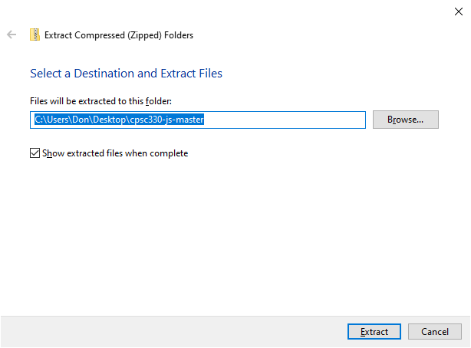
EDITING AND DEBUGGING
Download our example code by holding CTRL and clicking:
https://github.com/donfreiday/cpsc330-js/archive/master.zip
Once downloaded, navigate to the file in Windows Explorer and extract the contents by right clicking and selecting "Extract all..."

Slide 38

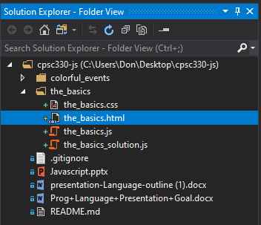
EDITING AND DEBUGGING
Open Visual Studio and click:
Then browse to the extracted files. We'll look at the_basics.html first:
If Solution Explorer isn't open, hold CTRL+ALT and tap the L key.

Slide 39
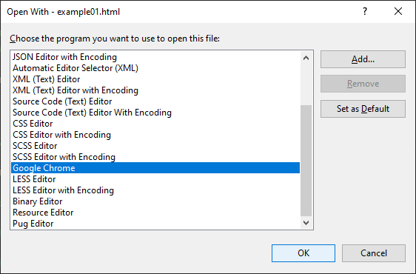
EDITING AND DEBUGGING
To view the HTML in a web browser, right click the_basics.html in the Solution Explorer, and click Open with...
In the resulting dialog, select Google Chrome.

Slide 40
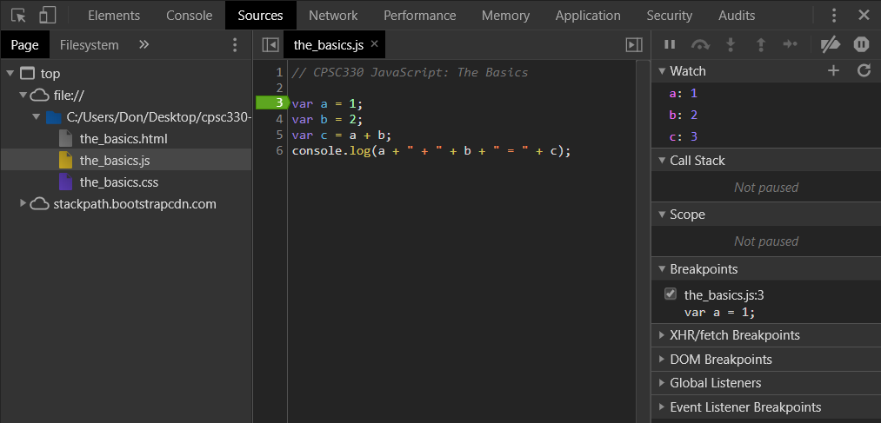
The Debugger
In Chrome, hit the F12 key.
Clicking the Sources tab displays our code

Slide 41

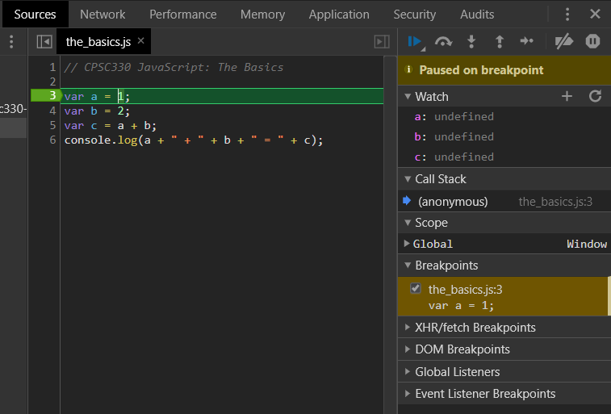
The Debugger
Try setting a breakpoint on Line 3 of the_basics.js by clicking on the '3'. Add watches for a, b, and c. Press F5 to reload.
You'll notice the page shows:

Slide 42

The Debugger
Press F9 a few times to step through the code, observe what happens.
Debugger controls:
From left to right:
Resume execution (F8)
Step over next function call (F10)
Step into next function call (F11)
Step out of current function (Shift+F11)
Step (F9)

Slide 43
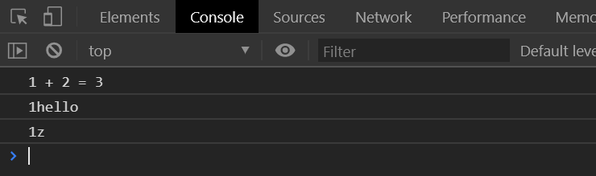
Example: THE BASICS
Leave the_basics.html open in Chrome
We'll be adding code to the_basics.js using Visual Studio and seeing the results in Chrome.
Fill in the exercises in the comments in the_basics.js now. Expected output:

Slide 44
String Methods
Call these with str.method();
length() // Returns length of string
indexOf(substr) // Returns index of 1st occurrence of substr
search(expr) // Returns index of 1st occurrence, allows the use of regex
toUpper() // Makes the string uppercase
substr(start, end) // Returns a substring
Several other methods as well.
https://www.w3schools.com/js/js_string_methods.asp

Slide 45
Numbers
Numbers in JS are always 64bit floating point
NaN is a reserved word indicating that a number is not a legal number
The toString() method returns a number as a string
toFixed() returns a string, with the number written with a specified number of decimals:
var x = 9.656; x.toFixed(0); // returns 10 x.toFixed(2); // returns 9.66
There are numerous other methods as well:
https://www.w3schools.com/js/js_numbers.asp

Slide 46
Arrays
Arrays in JS are objects
Declaration:
var food = ["Pizza", "Candy", "Veggies"];
Elements can be accessed through subscripting:
food[2] == "Pizza"; // true
You can tell if a variable is an array using
food instanceof Array; // true
https://www.w3schools.com/js/js_arrays.asp

Slide 47
Arrays
The sort() method sorts an array alphabetically
The reverse() method reverses the elements in an array.
The forEach() method calls a function (a callback function) once for each array element.
Try the forEach() example:
https://www.w3schools.com/js/tryit.asp?filename=tryjs_array_foreach

Slide 48
The MATH Object (cont)
Math.PI; // returns 3.141592653589793
Math.round(4.7); // returns 5 Math.round(4.4); // returns 4
Math.sqrt(64); // returns 8
Math.abs(-4.7); // returns 4.7
Math also has has ceil(), floor(), sin(radians), cos(radians), and others.
https://www.w3schools.com/js/js_math.asp

Slide 49
The MATH Object: Random
Math.random() returns a random number between 0 (inclusive), and 1 (exclusive)
This can be combined with floor() to produce random numbers:
Math.floor(Math.random() * 10);
// returns a random integer from 0 to 9
You can see an example of this in our example file colorful_events.js
https://www.w3schools.com/js/js_random.asp

Slide 50
Booleans
You can use the Boolean(expr) function to find out if an expression (or a variable) is true
Everything with a value is true:
100 3.14 -15 "Hello" "false"
Everything without a value is false:
0 // zero
"" // empty quotes
undefined // uninitialized variable
null // keyword meaning 'no value'
NaN // Not a Number
https://www.w3schools.com/js/js_booleans.asp

Slide 51
Comparisons
The standard comparison operators (==, !=, >, >=, <, <=) behave as expected
However, there are a couple of new operators:
Operator | Meaning
== | Equal to
=== | Equal to, same type
!= | Not equal to
!=== | Not equal to OR not equal type
x === 5​ | true​ | Try it »​
x === "5"​ | false​ | Try it »​
https://www.w3schools.com/js/js_comparisons.asp

Slide 52
Conditional Statements
If, else if, and else all behave exactly as in Java/C++:
if (a) { // a is true } else if (b) { // a is false and b is true } else { // both a and b are false }
https://www.w3schools.com/js/js_if_else.asp

Slide 53
Switch Statements
Switch statements also behave exactly as in Java/C++:
switch(expression) { case x: // executed if x is true
break; case y: // executed if y is true break; default: // executed if neither x nor y is true }
https://www.w3schools.com/js/js_switch.asp

Slide 54
For Loops
JavaScript supports several types of for loop
The traditional, Java-style iteration:
for (i = 0; i < 100; i++) { console.log("Number" + i); }
https://www.w3schools.com/js/js_loop_for.asp

Slide 55
For Loops
Iterating over properties of an object
var person = {fname:"John", lname:"Doe", age:25}; var text = ""; var x; for (x in person) { text += person[x]; }
Give it a try:
https://www.w3schools.com/js/tryit.asp?filename=tryjs_object_for_in

Slide 56
For Loops
Iterating over the values of an iterable object
var cars = ['BMW', 'Volvo', 'Mini']; var x; for (x of cars) { document.write(x + "<br >"); }
Give it a try:
https://www.w3schools.com/js/tryit.asp?filename=tryjs_object_for_of

Slide 57
Example: More BASICS
Open more_basics.html in Chrome and open the Console (F12).
We'll be adding code to more_basics.js using Visual Studio and seeing the results in Chrome.
Fill in the code in the comments in the_basics.js now.
Expected output is on the next slide.

Slide 58
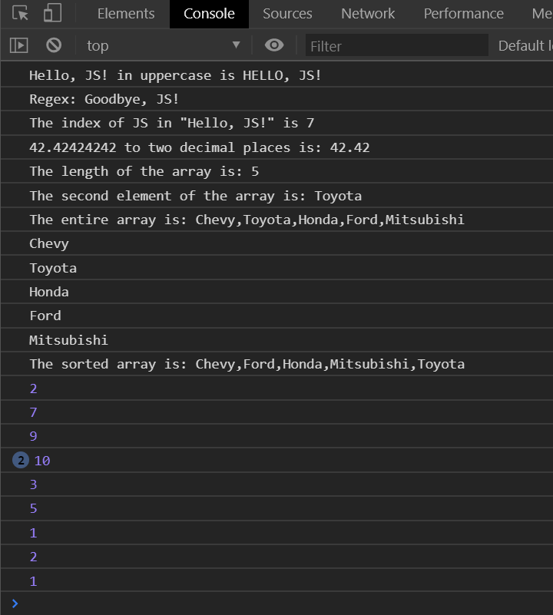
Example: More BASICS (EXPECTED OUTPUT)

Slide 59
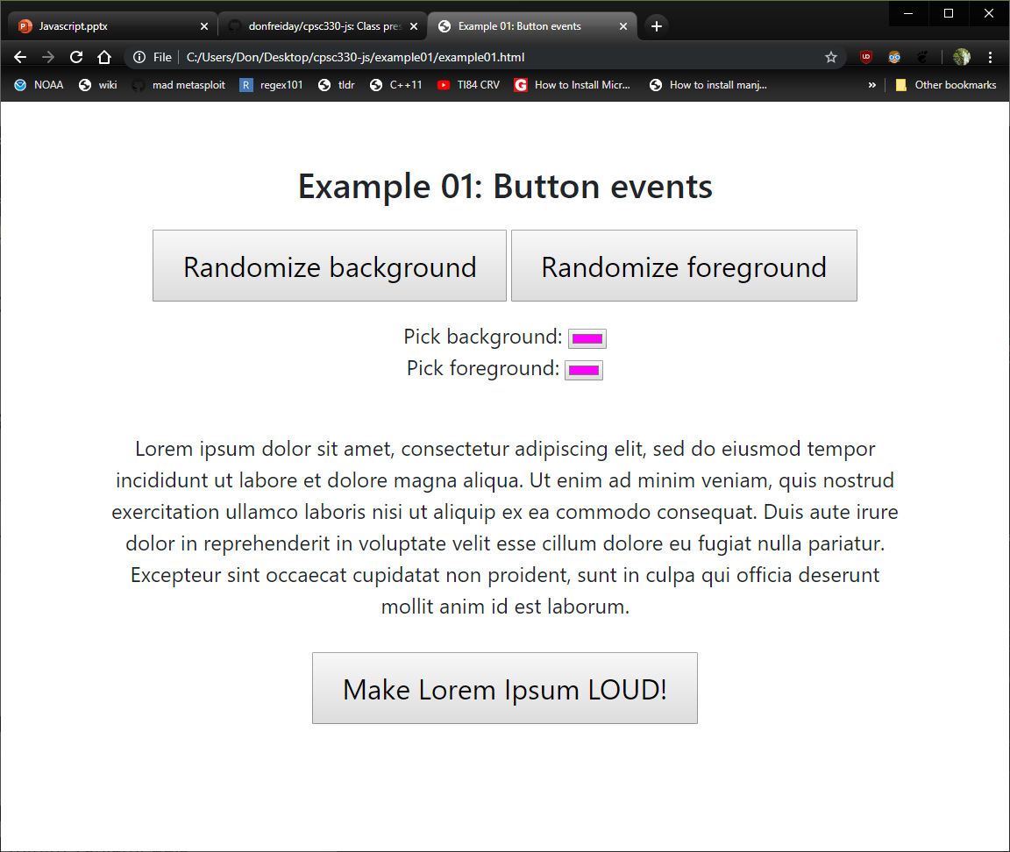
Example: The Colors
Open colorful_events.html in Chrome.
Some features of the page don't work.
Let's fix this page by editing the_colors.js

Slide 60
While Loops
In the following example, the code in the loop will run, over and over again, as long as a variable (i) is less than 10:
while (i < 10) { text += "The number is " + i; i++; }
JS also has do-while loops
do { text += "The number is " + i; i++; } while (i < 10);

Slide 61
BREAK
The break statement "jumps out" of a loop.
This break statement breaks the loop and continues executing the code after the loop (if any)
for (i = 0; i < 10; i++) { if (i === 3) { break; } text += "The number is " + i + "<br>"; }
The continue statement "jumps over" one iteration in the loop.
This example skips the value of 3:
for (i = 0; i < 10; i++) { if (i === 3) { continue; } text += "The number is " + i + "<br>"; }

Slide 62
Type conversion
Number() converts to a Number, String() converts to a String, Boolean() converts to a Boolean, etc. This works for most data types.
You can use the typeof operator to find the data type of a JavaScript variable.
typeof "John" // Returns "string" typeof 3.14 // Returns "number" typeof NaN // Returns "number" typeof false // Returns "boolean" typeof [1,2,3,4] // Returns "object" typeof {name:'John', age:34} // Returns "object" typeof new Date() // Returns "object" typeof function () {} // Returns "function" typeof myCar // Returns "undefined" typeof null // Returns "object"

Slide 63
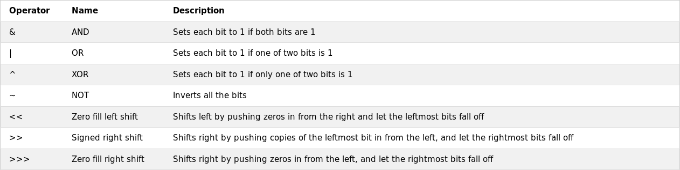
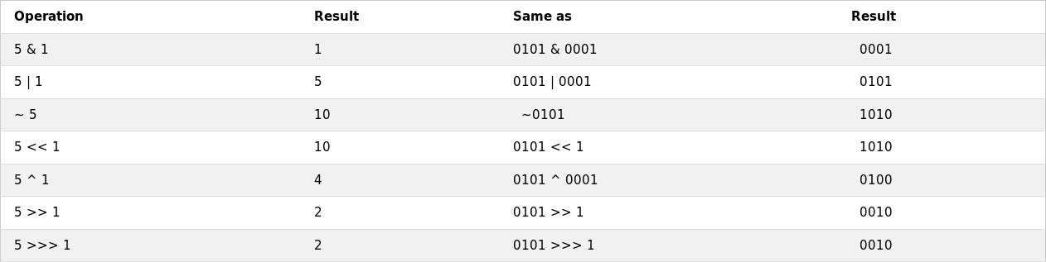
Bitwise operators

Slide 64
Regex
Regular expressions can be used to perform all types of text search and text replace operations with the syntax:
/pattern/modifiers;
Example:
var pattern = /w3schools/i;
/w3schools/i is a regular expression.
w3schools is a pattern (to be used in a search).
i is a modifier (modifies the search to be case-insensitive).

Slide 65
Regex (cont.)
In JavaScript, regular expressions are often used with the two string methods: search() and replace().
The search() method uses an expression to search for a match, and returns the position of the match.
The replace() method returns a modified string where the pattern is replaced.
Try this example and search for text in a string:
https://www.w3schools.com/js/tryit.asp?filename=tryjs_string_search

Slide 66
Forms
Forms are used to collect information from the user
Typically, forms would specify an "action" attribute and use the "submit" input type to submit the data to a program written in a language like PHP running on a server
Our example will just use JavaScript to update a list
https://www.w3schools.com/html/html_forms.asp

Slide 67
Example: Forms
Open forms.html in Chrome and open the Console (F12).
We'll be adding code to forms.js using Visual Studio and seeing the results in Chrome.
Fill in the code in the comments in forms.js now.

