Slide 1

JavaScript
Fundamentals
We'll be using Windows today.

Slide 2
History
Created in 1995 by Brandon Eich at Netscape Communications.
Original purpose was to bring dynamic content to the Web.
Inspired by Java, Scheme and Self.
Source: A Brief History of JavaScript

Slide 3
Where is it used today?
Everywhere!
Client-side scripting for frontend dev, making web pages interactive and dynamic
Also used for backend, NodeJS is a popular example of a server-side runtime

Slide 4
Strengths
Simplicity. JavaScript is relatively simple to learn and implement
Runs on anything. Modern JavaScript engines are available for virtually every platform
Versatility. It's possible to develop an entire app from front to back using only JavaScript
Source: freeCodeCamp

Slide 5
Weaknesses
Speed. JavaScript is still slower than most compiled languages
Client-Side Security. Because the code executes on the users’ computer, it can be exploited for malicious purposes.
This is one reason some people choose to disable JavaScript
Mitigated by browser sandboxing
Sources: freeCodeCamp

Slide 6
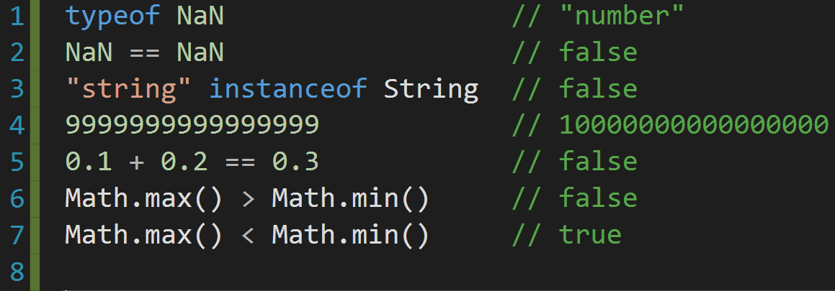
Weirdness
Unintuitive behavior:

Slide 7
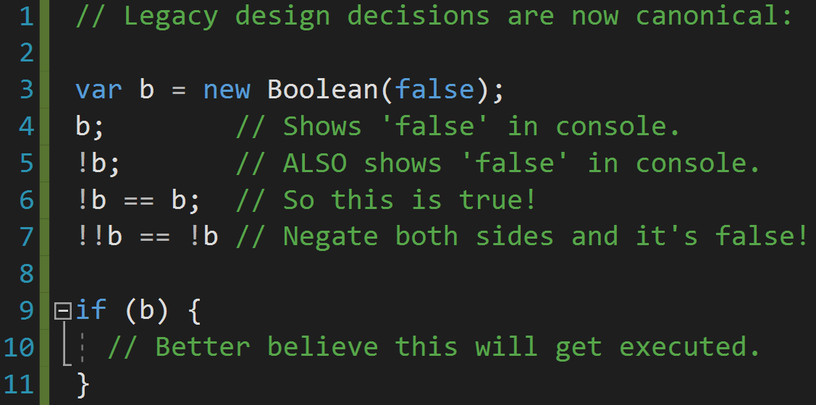
MORE Weirdness

Slide 8






Major companies using JavaScript

Slide 9
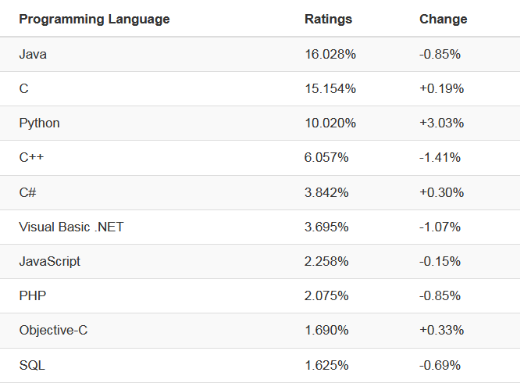
Popularity: 7th in 2019

Slide 10
Language Basics
Interpreted
V8
NodeJS
Modern browsers use a technology known as Just-In-Time (JIT) compilation, which compiles JavaScript to executable bytecode just as it is about to run

Slide 11
Language Basics
Very similar to Java, C/C++
Follows most Java expression syntax, naming conventions and basic control-flow constructs
JavaScript is dynamically typed, lacks Java's static types and strong type checking

Slide 12
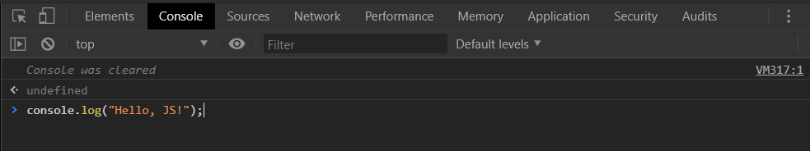
Hello JS: The developer console
Open Google Chrome and press F12
Click on the Console tab
Type:
Console.log("Hello, JS!")
Hit enter. Congratulations, JS dev!

Slide 13
Hello JS: The developer console
The developer console will allow us to debug our JavaScript
We can also run arbitrary JavaScript in Chrome's interpreter

Slide 14
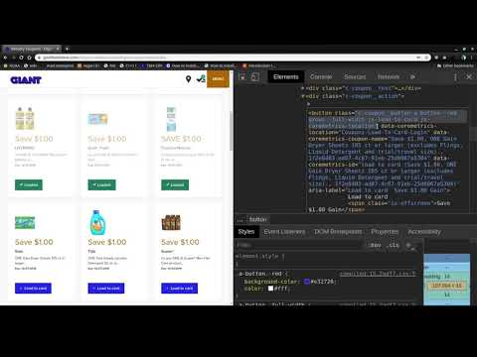
https://www.youtube.com/watch?v=6qeDCTcdfmg

Slide 15

w3schools
w3schools.com/js/
Navigate to the above link and click:
We will be trying several examples from this site to learn the fundamentals of JavaScript.

Slide 16
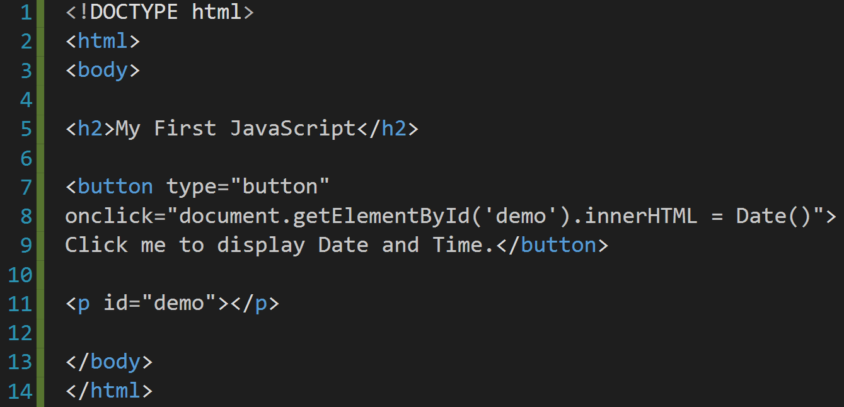
w3schools
Can you spot the JavaScript in this HTML?

Slide 17
w3schools
The JavaScript is contained in the string assigned to the 'onclick' attribute of the button element:
"document.getElementById('demo').innerHTML = Date()"
When the button is clicked, a click event triggers and the JavaScript runs.

Slide 18
w3schools
document.getElementById('demo').innerHTML = Date()
What is the JavaScript doing? Let's break it down.
document
an object representing the HTML document being displayed
Part of the DOM (document object model), a hierarchy of objects comprising a Web document.

Slide 19
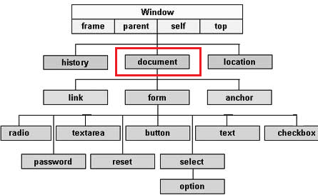
w3schools
Simple example of DOM

Slide 20
w3schools
getElementById('demo')
will return an object representing the paragraph element
<p id="demo"></p>
innerHTML
the HTML between the <p> tags
<p>innerHTML</p>
Date()
Creates JavaScript Date instance that represents a single moment in time in a platform-independent format

Slide 21
w3schools
Putting it all together:
document.getElementById('demo').innerHTML = Date()
This will change the inner HTML of the paragraph element to the current date and time.
Let's try some more examples.

Slide 22
Hands-on: Syntax
Create 3 variables, x, y, z
X and y should be integers
Z should be x and y added together
Create a variable that holds the string "hello world"
Finally, create an array [] with the integers 1,2,3, and 4.
Output them all to the screen using your html
Use comments to describe what your doing
// for single line
/* for multi-line */

Slide 23
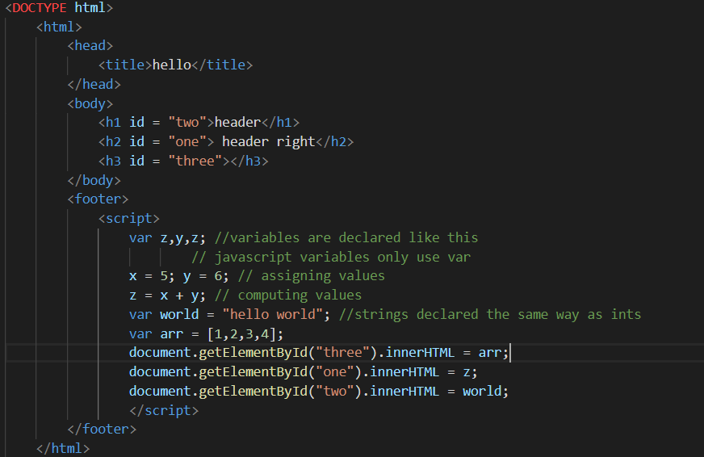
Hands-on: syntax and variables
Remember that where you put your script matters, you cannot edit a tag that doesn’t exist yet!

Slide 24
Variables
https://www.w3schools.com/js/js_variables.asp
In order to create variables in JS you must declare them like so:
Var name = "Joe";
Var pi = 3.14;
Using the var keyword whatever variable you declare can be of any type.
You can also add values together and immediately assign them to a variable. Though caution should be exercised when adding a string to a number.
For example, the number 2 is treated as a string and will be concatenated to "5" in this case:
Var x = "5" + 2 //result: x = "52"

Slide 25
Operators
https://www.w3schools.com/js/js_operators.asp
Many of the operators in JS are just as you would see in any other language with some exceptions. Most notably:
Exponentiation: **
10 ** 5 = 100,000
Strict Equality: ===
5 === '5' returns false, whereas 5 == '5' would return true.
Not equal value/type: !==
The inverse of the === operator
Return the type of a variable: typeof
console.log(typeof 42); //outputs: "number"
Return true if an object is an instance of an object type: instanceof
Assume we have a car object and auto is an instance of car:
Console.log(auto instanceof car); //true

Slide 26
Data Types
https://www.w3schools.com/js/js_datatypes.asp
JavaScript has dynamic types (the same variable can hold different types) for instance:
var x; // Now x is undefined x = 5; // Now x is a Number x = "John"; // Now x is a String
Arrays are familiar:
Var numbers = [5, 6, 7];
Objects are declared with curly braces:
var person = {firstName:"John",
lastName:"Doe",
age:50,
eyeColor:"blue"};

Slide 27
Functions
https://www.w3schools.com/js/js_functions.asp
Defined with the function keyword, a name, and parenthesis
function name(parameter, parameter, parameter)
{
Code;
}
Can make use of a return statement
Functions can be used as variables
Var x = name();

Slide 28
Hands-on: functions
Write a function that adds two variables declared outside the function and outputs it to the screen.

Slide 29
Objects
https://www.w3schools.com/js/js_objects.asp
Objects can be declared as such:
var car = {type:"Fiat", model:"500", color:"white"};
Object properties can be accessed in two ways:
ObjectName.propertyName
objectName["propertyName"]
Object methods (functions) can be implemented like this:
var person = { firstName: "John", lastName : "Doe", id : 5566, fullName : function() { return this.firstName + " " + this.lastName; } };

Slide 30
Objects (cont.)
You access an object method with the following syntax:
objectName.methodName()
Or without parentheses like this:
name = person.fullName;
In a function definition, this refers to the "owner" of the function.
In other words, this.firstName means the firstName property of this object.

Slide 31
Scope
https://www.w3schools.com/js/js_scope.asp
Local
Variables inside functions stay inside functions.
Global
Works the same as you would think BUT, if you assign a value to a variable that has not been declared, it will automatically become a GLOBAL variable. This is an example of hoisting in JS.
Hoisting: JS Hoists all variables to the top of the current scope, meaning you can use a variable before its declared or even assigned a value!
Try this: console.log(x+y)
Define the values x and y after this statement.
Then declare both x and y with var x,y;

Slide 32
Scope (cont.)
Your code should look something like this:
console.log(x+y); //outputs 9
x = 4;
y = 5;
var x, y;
You can see how this can get sort of confusing when trying to find out the values of x or y in a large block of code!

Slide 33
NOTE TO US
Cover the following on w3schools before moving to the editing and debugging slide that follows!
//JS Statements
//JS Syntax
//JS Comments
//JS Variables
//JS Operators
//JS Arithmetic
//JS Assignment
//JS Data Types
//JS Functions
//JS Objects
//JS Scope – review global
//JS Events
//JS Strings

Slide 34
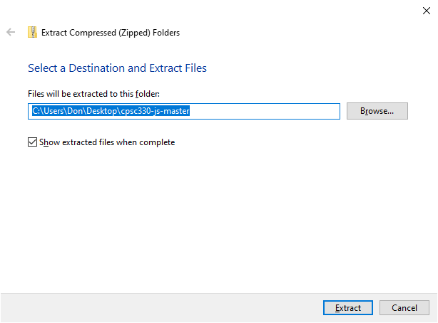
EDITING AND DEBUGGING
Download our example code by holding CTRL and clicking:
https://github.com/donfreiday/cpsc330-js/archive/master.zip
Once downloaded, navigate to the file in Windows Explorer and extract the contents by right clicking and selecting "Extract all..."

Slide 35

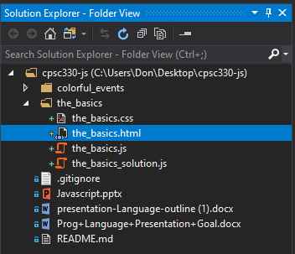
EDITING AND DEBUGGING
Open Visual Studio and click:
Then browse to the extracted files. We'll look at the_basics.html first:
If Solution Explorer isn't open, hold CTRL+ALT and tap the L key.

Slide 36
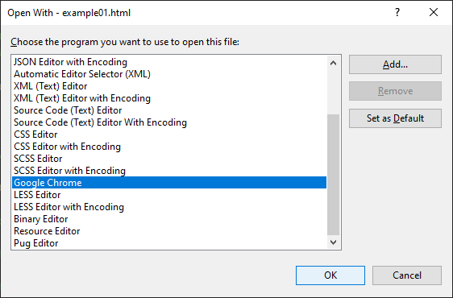
EDITING AND DEBUGGING
To view the HTML in a web browser, right click the_basics.html in the Solution Explorer, and click Open with...
In the resulting dialog, select Google Chrome.

Slide 37
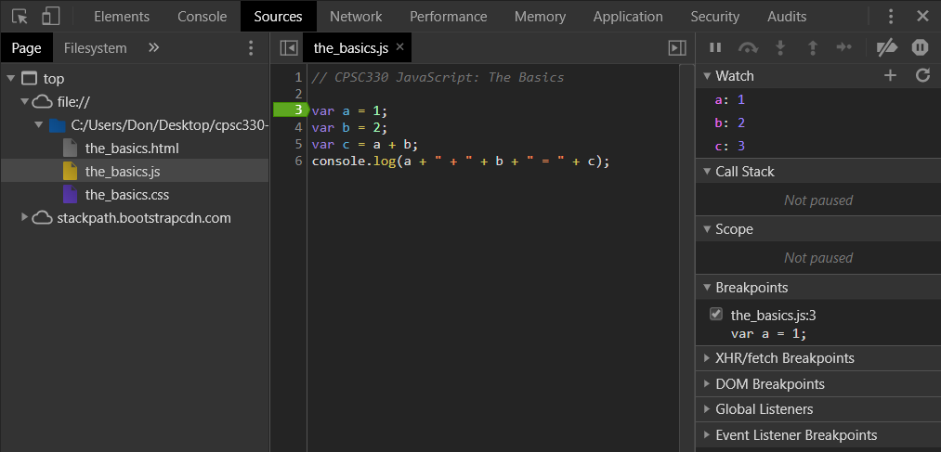
The Debugger
In Chrome, hit the F12 key.
Click on the Sources tab to see our code loaded in the browser.

Slide 38

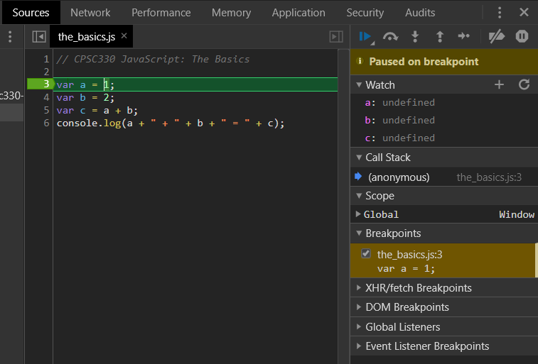
The Debugger
Try setting a breakpoint on Line 3 of the_basics.js by clicking on the '3'. Add watches for a, b, and c. Press F5 to reload.
You'll notice the page shows:

Slide 39

The Debugger
Press F9 a few times to step through the code, observe what happens.
Debugger controls:
From left to right:
Resume execution (F8)
Step over next function call (F10)
Step into next function call (F11)
Step out of current function (Shift+F11)
Step (F9)

Slide 40
Example: The Basics
Code changes in the debugger won't persist upon page reload, so we'll be working in Visual Studio
Remember to save your changes in Visual Studio, then reload the HTML in Chrome (hit F5) to see them applied
Try the exercises in the_basics.js now
There are solutions in the_basics_solution.js, but try the problems on your own first

Slide 41
NOTE TO US
Cover the following on w3schools before moving to the 'MORE BASICS' slide that follows!
//JS String Methods
//JS Numbers
//JS Number Methods
//JS Arrays
//JS Array Methods
//JS Array Sort
//JS Dates
//JS Date Formats
//JS Date Get Methods
//JS Date Set Methods
//JS Math
//JS Random
//JS Booleans
//JS Comparisons
//JS Conditions
//JS Switch
//JS Loop For
//JS Loop While
//JS Break
//JS Type Conversion
//JS Bitwise
//JS RegExp

Slide 42
Example: MORE BASICS
Open more_basics.html in Chrome and open the Console (F12).
We'll be adding code to more_basics.js

Slide 43
NOTE TO US
Cover the following on w3schools before moving to the 'THE COLORS' slide that follows!
Object Methods
Object Constructors
Object Prototypes
JS Functions go through these using the site, try this:
Function Definitions
Function Parameters
Function Invocation
Function Call

Slide 44
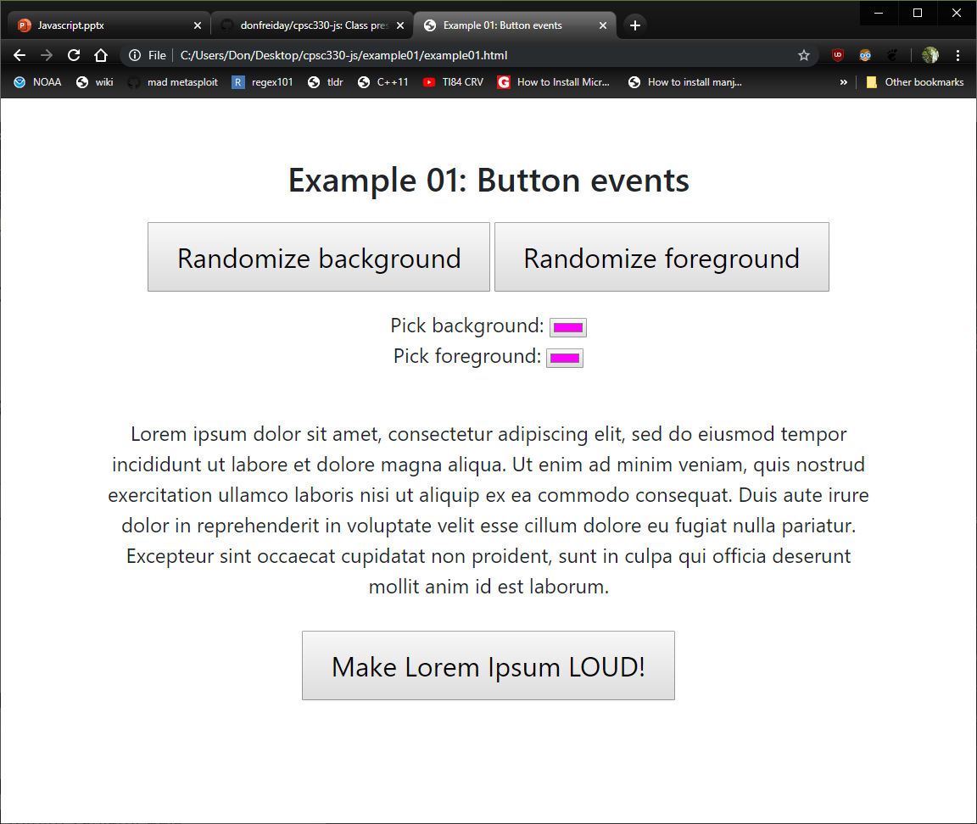
Example: The Colors
Open colorful_events.html in Chrome.
Some features of the page don't work.
Let's fix this page by editing the_colors.js

Slide 45
NOTE TO US
Cover the following on w3schools before moving to the 'FORMS' slide that follows!
JS Forms
Forms API

Slide 46
Example: Forms
Open forms.html in Chrome and open the Console (F12).
We'll be adding code to forms.js

