Slide 1
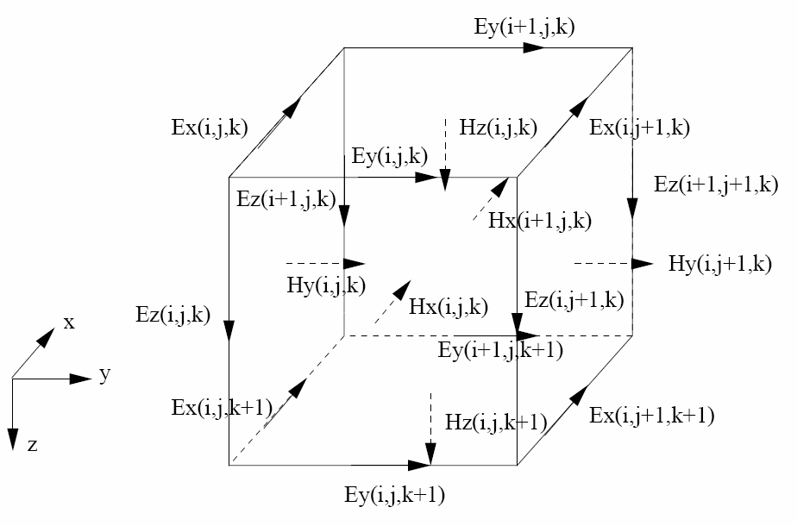

Slide 2


B_{x}
B_{x}
B_{x}
B_{x}
B_{x}
B_{x}
B_{x}
B_{x}
B_{x}

Slide 3
Level I
NLCG
(etc)
DataSpace
d
MeasComb
L
SensMatrix
J
Level II
SolnRHS
e,b
DataFunc
EMsolver
S⁻¹
Pmult
P
Forward Solver
Model Parameter
m
EMeval
Numerical Discretization
Grid
EMfield
Figure 3: Overview of modular inversion system, including module usage dependency (arrows). Dashed lines delineate three major groups: (a) Level I, generic inversion routines; (b) Level 2, application specific interface to (c) numerical discretization module, which are applicable to multiple EM problems with similar numerical treatment.

Slide 4
Level I
NLCG etc
DataSpace
DataSens
SensMatrix
d
L
J
Level II
DataFunc
ModelSens
EMsolver
TX
DT
RX
TX
DT
P, Q
TX
S⁻¹
SolnRHS
TX
e,b
Level III
EMfieldInterp
Forward Solver
Grid
EMfield
ModelSpace
m

