Slide 1
01
Test-Time Training
Learning from an unlabeled test image
Sun et al. / ICML 2020
Unlabeled image
Adapt feature extractor
Predict class
Online Learning - The Human Way
Notes:
[About 35 seconds]
This review focuses on the original Test-Time Training paper by Sun and colleagues. A trained classifier usually keeps its weights fixed during testing. TTT first uses the current image to adapt the shared feature extractor, then predicts that image's class. The adaptation does not receive its class label. I will explain the rotation task, the source training that makes it useful, and what would have to change in our team's pipeline. Published results in this presentation come from the paper. Our proposed experiment has not been run.
Sources: https://proceedings.mlr.press/v119/sun20b/sun20b.pdf; https://yueatsprograms.github.io/ttt/home.html

Slide 2
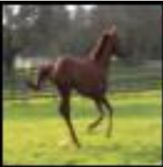
Rotation self-supervision
02
One unlabeled image, four known targets
0°
90°
180°
270°
We know the rotation because we applied it.
Rotation illustration: VID-Robust sample from Sun et al., Figure A7
Notes:
[About 45 seconds]
The learning signal is four-way rotation prediction. We make views at zero, ninety, one hundred eighty, and two hundred seventy degrees. The rotation target records the transformation we applied. It does not require the object's class label. The rotation head predicts the applied angle, and cross-entropy gives a rotation loss. Here I reused one horse sample from the paper's appendix and rotated it as a visual illustration. This illustration does not show a measured model prediction. The actual method also uses augmented views, such as crops and horizontal flips.
Sources: https://proceedings.mlr.press/v119/sun20b/sun20b.pdf (Section 2 and Figure A7). Image source: VID-Robust sample reproduced within the paper; rotations applied for illustration.

Slide 3
Source training: two tasks, shared features
03
Class labels
Classification head
θm
Class loss
Feature extractor
θe
Source views
Rotation head
θs
Rotation loss
Known angles
Classification loss + rotation loss
Sun et al., Section 2, Equation 2
Notes:
[About 65 seconds]
Before deployment, we train the model on labeled source data. The feature extractor is a sequence of CNN layers that produces numerical feature maps. It feeds two branches: a classification head and a rotation head. Each branch can contain several layers. Classification uses the source image's class label. Rotation uses the known angle of a transformed view. We add the two losses. The extractor learns from both, while each head learns from its own task. The paper uses a ResNet-26 split after its second group for CIFAR-10. Simply adding an untrained rotation head to our current checkpoint would not supply a useful adaptation signal.
Sources: https://proceedings.mlr.press/v119/sun20b/sun20b.pdf (Section 2, Equations 2-3; network details).

Slide 4
Test-time updates
04
ADAPT
Feature extractor
updates
Rotation head
frozen
Rotated views
Rotation loss
Backpropagation through the frozen head
PREDICT
Updated extractor
Classification head
frozen
Original image
Class prediction
Sun et al., Section 2, Equation 3 formulation
Notes:
[About 75 seconds]
This slide follows Equation 3: only the shared feature extractor changes. Both heads keep their trained parameters. In the upper path, rotated views pass through the extractor and rotation head to produce rotation loss. Backpropagation computes how that loss depends on the extractor. A frozen rotation head still transmits gradients to its inputs. It does not need to change its own weights for the extractor to learn. The lower path then classifies the original image using the updated extractor and frozen classification head. The extractor's two boxes depict the same component at different stages. Class labels never enter adaptation. The paper also reports little empirical difference when the rotation head is adapted too.
Sources: https://proceedings.mlr.press/v119/sun20b/sun20b.pdf (Equation 3 and adjacent discussion).

Slide 5
Standard and online TTT
05
Standard TTT
Source θ0
Adapt image 1
Reset to θ0
Adapt image 2
Independent adaptation
Online TTT
Source θ0
Adapt image 1
Carry θ1
Adapt image 2
Persistent adaptation
Sun et al., Section 2; both versions predict after adapting
Notes:
[About 45 seconds]
Standard TTT starts each image from the jointly trained source model. It adapts, predicts, and discards that image's parameter changes. Online TTT carries changes from the first image into the second. That can accumulate information about a coherent target distribution. It also makes image order and reset rules important. The paper assumes the stream has a stable or smoothly changing shift. Its standard version takes ten gradient steps per image, while its online version takes one. Online TTT is different from our current supervised online loop because it uses rotation targets rather than the arriving images' class labels.
Sources: https://proceedings.mlr.press/v119/sun20b/sun20b.pdf (Online Test-Time Training; optimization details).

Slide 6
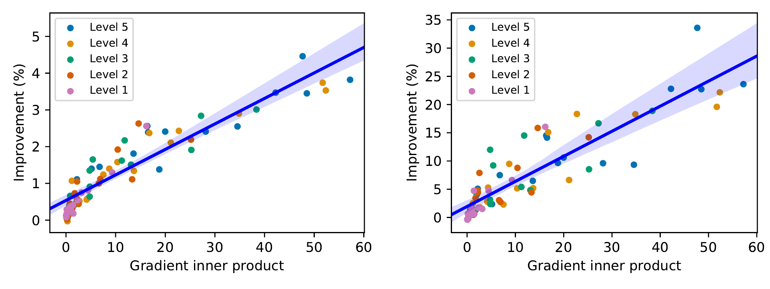
When rotation helps classification
06
Standard TTT
Online TTT
Alignment requires class labels to measure.
Sun et al., Figure 4. Original plots, cropped from the paper.
Notes:
[About 60 seconds]
The important question is why rotation updates should improve classification. If both task gradients point in compatible directions, a sufficiently small rotation update can also reduce classification loss. The original plots show a relationship between gradient inner product and improvement. Each point averages one corrupted test set. There are seventy-five sets, and the reported correlations are 0.93 for standard TTT and 0.89 for online TTT. These are aggregate measurements using class labels for analysis. The model cannot directly check this alignment on an unlabeled deployment image. The theorem has smoothness, convexity, bounded-gradient, and learning-rate assumptions. It does not guarantee that every CNN update helps.
Sources: https://proceedings.mlr.press/v119/sun20b/sun20b.pdf (Section 4, Theorem 1 and Figure 4). Figure crop preserves both plots, axes, legends, and source colors.

Slide 7
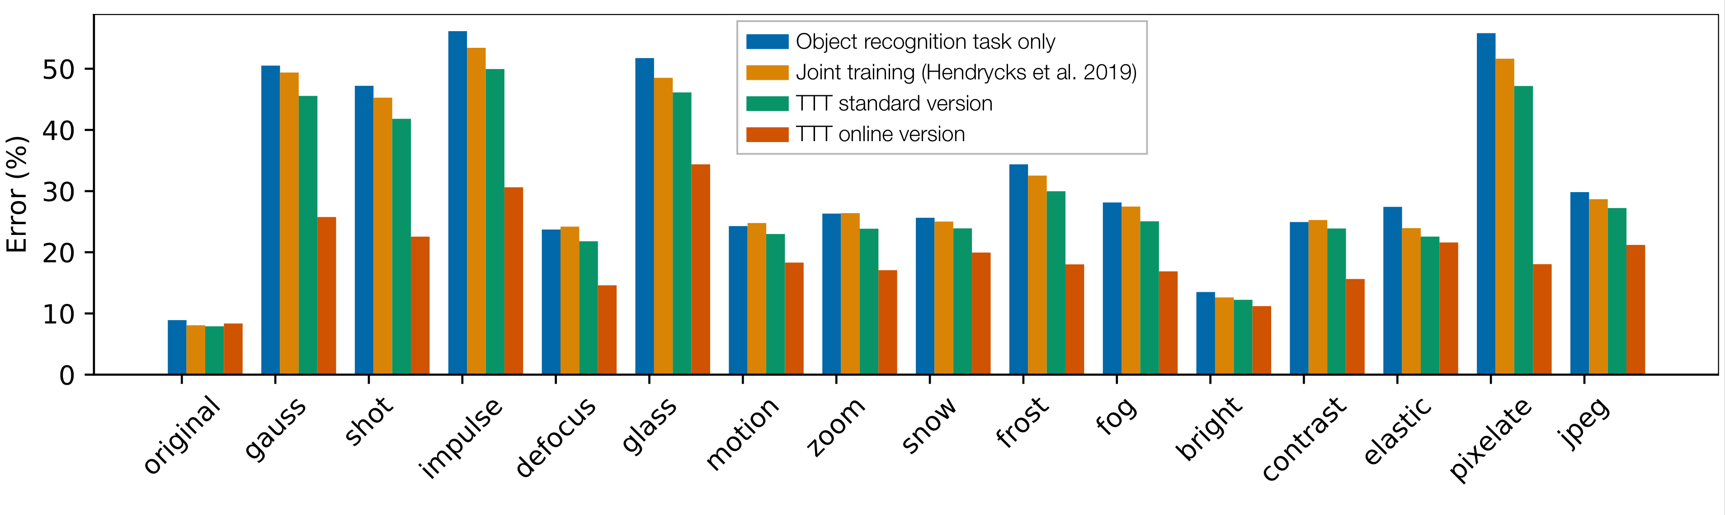
Published results on CIFAR-10-C
07
Severity 5 corruptions
Joint training frozen is the key comparison.
Sun et al., Figure 1. Author-provided web version; lower error is better.
Notes:
[About 50 seconds]
These are the paper's results, rather than results from our team. The plot reports error on CIFAR-10-C at the highest corruption severity. Lower bars are better. It compares a supervised-only model, joint training without test updates, standard TTT, and online TTT. Joint training already helps in many conditions. Comparing TTT against the jointly trained frozen model isolates the additional benefit of adaptation. The paper also reports a smaller gain on CIFAR-10.1: error falls from 16.7 percent with joint training to 15.9 percent with standard TTT. That is 0.8 percentage points, and it cautions against assuming the same gains everywhere.
Sources: https://proceedings.mlr.press/v119/sun20b/sun20b.pdf (Figure 1, Section 3.1 and Table 4); https://yueatsprograms.github.io/ttt/home.html; original web figure: https://yueatsprograms.github.io/ttt/histograms.png

Slide 8
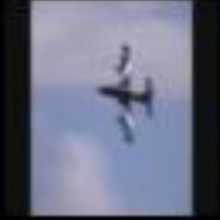
Assumptions and limitations
08
Ambiguous rotations
Weak learning signal
Conflicting task gradients
Classification can worsen
Weak orientation clues
Abrupt stream changes
Online updates can drift
Small batches and extra computation also matter.
Sun et al., Sections 2-4 and Figure A7; pipeline implications in the report
Notes:
[About 50 seconds]
Rotation must be meaningful for the images we encounter. Symmetric objects, unusual viewpoints, or border cues can make rotation ambiguous or allow a shortcut. The paper discusses airplane examples with these problems. Even a lower rotation loss can accompany worse classification if the gradients conflict. Online carryover can also drift after abrupt shifts. For our SmallResNet, a weak source representation and low image resolution may limit the rotation signal. Batches containing views of only one image also make normalization important, which is why the paper uses GroupNorm. Extra gradient steps add inference cost, and adapting on twenty classes does not teach the model the other eighty class identities.
Sources: https://proceedings.mlr.press/v119/sun20b/sun20b.pdf (Sections 2-4 and Figure A7); /Users/jasonpham/PycharmProjects/acm-online-learning-human-way/src/rawsgd-cifar-100.ipynb (cells 3-5). Image is a crop from Figure A7.

Slide 9
Our pipeline and the proposed change
09
Current
Labeled batches
Classification loss
Update model
Proposed
Source joint training
Unlabeled adaptation
Class prediction
Rotation branch + GroupNorm + separate scoring
Current pipeline: team training notebook, cells 3-6. Proposed TTT adaptation, not an implemented result.
Notes:
[About 60 seconds]
Our notebook currently starts SmallResNet from random weights and makes one labeled pass. It has three feature stages, BatchNorm, dropout, and an unmasked one-hundred-output head. It trains on classes zero through nineteen and checks frozen validation accuracy. For TTT, first train a source model for classification and rotation together. A natural split shares the first two stages and gives each task its own final-stage branch. Train with GroupNorm and use matched frozen baselines. Keep input normalization applied once and dropout disabled at deployment. Then add an images-only adaptation evaluator, with class labels held outside it. Record source-training and adaptation budgets separately.
Sources: /Users/jasonpham/PycharmProjects/acm-online-learning-human-way/src/rawsgd-cifar-100.ipynb (cells 3-6, zero-based); /Users/jasonpham/PycharmProjects/acm-online-learning-human-way/docs/experiment_protocol.md; https://proceedings.mlr.press/v119/sun20b/sun20b.pdf (Sections 2-3). Repository snapshot: 5b88dc4d9e4da93bd2fe7c13d29cabbe00495f7a, November 5, 2026.

Slide 10
Recommended first experiment
10
Condition | Test updates | State
Supervised frozen | None | Fixed
Joint frozen | None | Fixed
Standard TTT | Rotation loss | Reset per image
Online TTT | Rotation loss | Carry forward
20 classes. Fixed noise and a clean control.
Does adaptation beat the same jointly trained model?
Proposal: class labels remain outside adaptation. No TTT experiment has been run in this review.
Notes:
[About 60 seconds]
My recommendation is a controlled pilot on the same twenty classes, using one fixed Gaussian-noise condition and a clean control. Compare the four conditions shown here. Joint-frozen, standard TTT, and online TTT must begin from the same jointly trained checkpoint. Keep the target images, image order, preprocessing, and seeds matched. Retain the existing one-hundred-output head. Select settings on separate development data, then lock them before the official test. Reset between independent conditions and runs. Class labels serve only the outer scorer. Report accuracy and harm against joint-frozen, update counts, runtime, hardware, and variability over three seeds. The question is whether adaptation helps at an acceptable cost, rather than whether rotation loss decreases.
Sources: https://proceedings.mlr.press/v119/sun20b/sun20b.pdf (method and baselines); /Users/jasonpham/PycharmProjects/acm-online-learning-human-way/docs/1_7_assignment.md (literature-review expectations and label separation); report section 3 for the proposed protocol.

