Slide 1
Parallel Ranges:
Heterogeneous Programming in Style
Christopher Di Bella – Staff Software Engineer, ComputeCpp Runtime
Pacific++ 2018 – 2018-10-18

Slide 2
Agenda
About me
Motivation: Heterogeneous programming
Motivation: Ranges
SAXPY
Problems with the parallel algorithms
Crash course: Range adaptors
Ranges to the rescue

Slide 3
Thanks
Gordon Brown
Michael Haidl
Toomas Remmelg
Ruyman Reyes
Michel Steuwer
Michael Wong

Slide 4
About me

Slide 5
Motivation:
Heterogeneous Programming

Slide 6
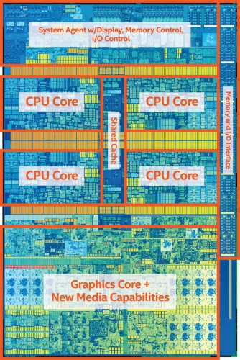
What is parallel programming?
Notes:
Intel Core i7 7th Gen
4x CPU cores
Each with hyperthreading
Each with 8-wide AVX instructions
GPU
With 1280 processing elements
Serial C++ code alone only takes advantage of a very small amount of the available resources of the chip.
Using vectorisation allows you to fully utilise the resources of a single hyperthread.
Using multi-threading allows you to fully utilise all CPU cores.
Using heterogeneous dispatch allows you to fully utilise the entire chip.

Slide 7
What is ‘heterogeneous dispatch’?
One main program
Multiple devices
CPU
GPU
Embedded SoC
FPGA
DSP
Notes:
CPUs:
Few ‘large’ processors
More control
Capable of performing complex logic
Power-hungry
Latency-optimised: minimise the amount of time taken for a single task
GPUs:
Many ‘small’ processors
Less control
Can’t do complex logic
Power-efficient
Throughput-optimised: maximise the amount of work per unit of time (hence FLOPS)

Slide 8
What is heterogeneous programming?
Device code
(kernel)
Host code
CPU
(host)
Co-processor
of host
GPU
(device)
CPU memory
GPU memory
Notes:
The CPU allocates memory on the GPU
The CPU copies data from CPU to GPU
The CPU launches kernel(s) on the GPU
The CPU copies data to CPU from GPU

Slide 9
What is SYCL?
class hello;
int main()
{
auto ints = array<int, 1024>{};
{
auto work = queue{};
auto in = buffer<int>(data(ints), range<1>(size(ints)));
work.submit([&](handler& cgh){
auto out = result.get_access<access::mode::discard_write>(cgh);
cgh.parallel_for<hello>(range<1>(1024), [](id<1> i){
out[i] = i[0];
});
});
}
copy(begin(ints), end(ints), ostream_iterator<int>(cout, "\n");
}
Notes:
OpenCL is a Standard C API and language
Allows you to offload code to a wide range of heterogeneous devices.
SYCL is a high level single source programming model based on standard C++.
Enables programming heterogeneous devices such as GPUs using standard C++.
Provides a high-level abstraction for development of complex parallel software applications
Provides efficient data dependency analysis and task scheduling and synchronisation

Slide 10
Motivation: Ranges

Slide 11
Linear search (array)
template <typename T>
std::ptrdiff_t linear_search(std::vector<T> const& t, T const& val)
{
for (std::ptrdiff_t i = 0; i < distance(t); ++i) {
if (t[i] == val) {
return i;
}
}
return distance(t);
}
template <typename T>
std::ptrdiff_t linear_search(std::deque<T> const& t, T const& val)
{
for (std::ptrdiff_t i = 0; i < distance(t); ++i) {
if (t[i] == val) {
return i;
}
}
return distance(t);
}
template <typename T, std::ptrdiff_t N>
std::ptrdiff_t linear_search(std::array<T, N> const& t, T const& val)
{
for (std::ptrdiff_t i = 0; i < distance(t); ++i) {
if (t[i] == val) {
return i;
}
}
return distance(t);
}
template <typename T, std::ptrdiff_t N>
std::ptrdiff_t linear_search(T const(& t)[N], T const& val)
{
for (std::ptrdiff_t i = 0; i < distance(t); ++i) {
if (t[i] == val) {
return i;
}
}
return distance(t);
}
template <typename T>
std::ptrdiff_t linear_search(T const* t, std::ptrdiff_t n, T const& val)
{
for (std::ptrdiff_t i = 0; i < n; ++i) {
if (t[i] == val) {
return i;
}
}
return n;
}
template <typename T>
std::ptrdiff_t linear_search(gsl::span<T const> const t, T const& val)
{
for (std::ptrdiff_t i = 0; i < distance(t); ++i) {
if (t[i] == val) {
return i;
}
}
return distance(t);
}

Slide 12
Linear search (linked-list)
template <template <typename> Node, typename T>
Node<T>* linear_search(Node<T>* n, T const& val)
{
for (Node<T>* i = n; i != nullptr; i = i->next) {
if (i->value == val) {
return i;
}
}
return nullptr;
}

Slide 13
Compare the pair
template <class T>
auto linear_search(span<T const> const s,
T const& val)
{
for (auto i = 0; i < size(s); ++i) {
if (s[i] == val) {
return i;
}
}
return distance(s);
}
template <template<class> class Node,
class T>
auto linear_search(Node<T> const* s,
T const& val)
{
for (; s != nullptr; s = s->next) {
if (s->value == val) {
return s;
}
}
return nullptr;
}

Slide 14
Compare the pair
template <class T>
auto linear_search(span<T const> const s,
T const& val)
{
for (auto i = 0; i < size(s); ++i) {
if (s[i] == val) {
return i;
}
}
return distance(s);
}
template <template<class> class Node,
class T>
auto linear_search(Node<T> const* s,
T const& val)
{
for (; s != nullptr; s = s->next) {
if (s->value == val) {
return s;
}
}
return nullptr;
}
Notes:
Same guage

Slide 15
Compare the pair
template <class T>
auto linear_search(span<T const> const s,
T const& val)
{
for (auto i = 0; i < size(s); ++i) {
if (s[i] == val) {
return i;
}
}
return distance(s);
}
template <template<class> class Node,
class T>
auto linear_search(Node<T> const* s,
T const& val)
{
for (; s != nullptr; s = s->next) {
if (s->value == val) {
return s;
}
}
return nullptr;
}
Notes:
Same increment

Slide 16
Compare the pair
template <class T>
auto linear_search(span<T const> const s,
T const& val)
{
for (auto i = 0; i < size(s); ++i) {
if (s[i] == val) {
return i;
}
}
return distance(s);
}
template <template<class> class Node,
class T>
auto linear_search(Node<T> const* s,
T const& val)
{
for (; s != nullptr; s = s->next) {
if (s->value == val) {
return s;
}
}
return nullptr;
}
Notes:
Same… exit condition

Slide 17
Compare the pair
template <class T>
auto linear_search(span<T const> const s,
T const& val)
{
for (auto i = 0; i < size(s); ++i) {
if (s[i] == val) {
return i;
}
}
return distance(s);
}
template <template<class> class Node,
class T>
auto linear_search(Node<T> const* s,
T const& val)
{
for (; s != nullptr; s = s->next) {
if (s->value == val) {
return s;
}
}
return nullptr;
}
Notes:
This one (span) uses array-like syntax.
This one (list) uses struct-like syntax.

Slide 18
Iterators
A generalisation of pointers
Abstraction of addressing elements in a container
Uniform element access
Notes:
Iterators are a generalization of pointers that allow a C++ program to work with different data structures (for example, containers and ranges) in a uniform manner.
To be able to construct template algorithms that work correctly and efficiently on different types of data structures, the library formalizes not just the interfaces but also the semantics and complexity assumptions of iterators.

Slide 19
Iterators
N algorithms
M generalised data structures
≈
N * M algorithm implementations
N algorithms
K data structures
≈
N algorithm implementations

Slide 20
Iterators
 | Requires | Array | List | Iterator
Successor | - | ++i | n = n->next | ++i
Source | Readability | a[i] | n->value | *i
Sink | Writability | a[i] | n->value | *i
Only one required.

Slide 21
Linear search revisited
template <typename InputIterator, typename T>
InputIterator find(InputIterator first, InputIterator last, T const& val)
{
for (; first != last; ++first) {
if (*first == val) {
return first;
}
}
return last;
}

Slide 22
Linear search revisited
template <InputIterator I, Sentinel<I> S, typename T, class Proj = identity>
requires IndirectRelation<ranges::equal_to<>, projected<I, Proj>, const T*>
I find(I first, S last, T const& val)
{
for (; first != last; ++first) {
if (*first == val) {
break;
}
}
return first;
}

Slide 23
Ranges
An iterator paired with a sentinel
Let r be a range
begin(r) returns an iterator
end(r) returns a sentinel
[begin(r), end(r))
[begin(r), n)
Where n >= 0
Notes:
Most of the library’s algorithmic templates that operate on data structures have interfaces that use ranges.
A range is an iterator and a sentinel that designate the beginning and end of the computation, or an iterator and a count that designate the beginning and the number of elements to which the computation is to be applied.
An iterator and a sentinel denoting a range are comparable.
A sentinel s is called reachable from an iterator i if and only if there is a finite sequence of applications of the expression ++i that makes i == s.

Slide 24
Usage
C++98 to present | Proposed (C++20 onward)
auto v = vector{/* ... */}; // ... if (auto i = find(cbegin(v), cend(v), x); x != cend(v)) { cout << *i << '\n'; } else { cout << "Not found.\n"; } | auto v = vector{/* ... */}; // ... if (auto i = find(v, x); x != cend(v)) { cout << *i << '\n'; } else { cout << "Not found.\n"; }

Slide 25
SAXPY
Notes:
BLAS Level 1 primitive

Slide 26
y = αx + y
auto const x = vector<float>{/* ... */};
auto const y = vector<float>{/* ... */};
auto const a = float{/* ... */};
auto out = vector<float>(size(x));

Slide 27
y = αx + y
transform(
cbegin(x), cend(x),
begin(temp),
[a](auto const x) noexcept { return a * x; }
);
transform(
cbegin(temp), cend(temp),
cbegin(y),
begin(out),
plus<>{}
);

Slide 28
y = αx + y
transform(std::execution::par,
cbegin(x), cend(x),
begin(out),
[a](auto const x) noexcept { return a * x; }
);
transform(std::execution::par_unseq,
cbegin(out), cend(out),
cbegin(y),
begin(out),
plus<>{}
);

Slide 29
y = αx + y
transform(
cbegin(x), cend(x),
cbegin(y),
begin(temp),
[a](auto const x, auto const y) noexcept {
return a * x + y;
}
);

Slide 30
Problems with this interface
{
auto work = sycl::queue{};
auto temp = vector<float>(size(x));
auto scale_kernel = sycl::sycl_execution_policy<scale>(work);
transform(scale_kernel,
cbegin(x), cend(x),
begin(temp),
[a](auto const x) noexcept { return a * x; }
);
auto add_kernel = sycl::sycl_execution_policy<add>(work);
transform(add_kernel,
cbegin(temp), cend(temp),
cbegin(y),
begin(out),
plus<>{}
);
}

Slide 31
Problems with this interface
{
auto work = sycl::queue{};
auto temp = vector<float>(size(x));
auto scale_kernel = sycl::sycl_execution_policy<scale>(work);
transform(scale_kernel,
cbegin(x), cend(x),
begin(temp),
[a](auto const x) noexcept { return a * x; }
);
auto add_kernel = sycl::sycl_execution_policy<add>(work);
transform(add_kernel,
cbegin(temp), cend(temp),
cbegin(y),
begin(out),
plus<>{}
);
}
Notes:
Scale operation:
The data in x and temp are copied from the host to the device.
The computation is performed.
The data on the device is copied from the device back to the host.

Slide 32
Problems with this interface
{
auto work = sycl::queue{};
auto temp = vector<float>(size(x));
auto scale_kernel = sycl::sycl_execution_policy<scale>(work);
transform(scale_kernel,
cbegin(x), cend(x),
begin(temp),
[a](auto const x) noexcept { return a * x; }
);
auto add_kernel = sycl::sycl_execution_policy<add>(work);
transform(add_kernel,
cbegin(temp), cend(temp),
cbegin(y),
begin(out),
plus<>{}
);
}
Notes:
Sum operation:
The data from temp, y, and out are copied from the host to the device.
Note that temp was just copied from the device to the host and is suddenly being sent back to the device.
The summation is computed.
The data on the device is coped from the device back to the host.

Slide 33
Problems with this interface
{
auto work = sycl::queue{};
auto temp = vector<float>(size(x));
auto scale_kernel = sycl::sycl_execution_policy<scale>(work);
transform(scale_kernel,
cbegin(x), cend(x),
begin(temp),
[a](auto const x) noexcept { return a * x; }
);
auto add_kernel = sycl::sycl_execution_policy<add>(work);
transform(add_kernel,
cbegin(temp), cend(temp),
cbegin(y),
begin(out),
plus<>{}
);
}
Notes:
Two uses of transform means that we need two different kernels.
Two kernels means that we need to have a temporary buffer so that the kernels can communicate.
It’s being pong-ed across a bus by the host and device.

Slide 34
A… solution?
{
auto work = sycl::queue{};
auto x_buffer = sycl::buffer<float>(data(x), size(x));
auto y_buffer = sycl::buffer<float>(data(y), size(y));
auto temp_buf = sycl::buffer<float>(size(temp));
auto scale_kernel = sycl::sycl_execution_policy<scale>(work);
transform(scale_kernel,
cbegin(x_buffer), cend(x_buffer),
begin(temp_buf),
[a](auto const x) noexcept { return a * x; }
);
auto out_buffer = sycl::buffer<float>(data(out), size(out));
auto add_kernel = sycl::sycl_execution_policy<add>(work);
transform(add_kernel,
cbegin(temp_buf), cend(temp_buf),
cbegin(y_buffer),
begin(out_buffer),
plus<>{}
);
}

Slide 35
A… solution?
{
auto work = sycl::queue{};
auto x_buffer = sycl::buffer<float>(data(x), size(x));
auto y_buffer = sycl::buffer<float>(data(y), size(y));
auto temp_buf = sycl::buffer<float>(size(temp));
auto scale_kernel = sycl::sycl_execution_policy<scale>(work);
transform(scale_kernel,
cbegin(x_buffer), cend(x_buffer),
begin(temp_buf),
[a](auto const x) noexcept { return a * x; }
);
auto out_buffer = sycl::buffer<float>(data(out), size(out));
auto add_kernel = sycl::sycl_execution_policy<add>(work);
transform(add_kernel,
cbegin(temp_buf), cend(temp_buf),
cbegin(y_buffer),
begin(out_buffer),
plus<>{}
);
}
Notes:
We allocate four distinct buffers on the device, and indicate that two of them are read from the host, and one is written to the host.
The temp_buf has no interaction with the host.
From the point of declaration until they go out of scope, the buffers retain an opaque ownership of the data that it is constructed with.
Upon destruction, the buffers return ownership to the vectors.

Slide 36
A… solution?
{
auto work = sycl::queue{};
auto x_buffer = sycl::buffer<float>(data(x), size(x));
auto y_buffer = sycl::buffer<float>(data(y), size(y));
auto temp_buf = sycl::buffer<float>(size(temp));
auto scale_kernel = sycl::sycl_execution_policy<scale>(work);
transform(scale_kernel,
cbegin(x_buffer), cend(x_buffer),
begin(temp_buf),
[a](auto const x) noexcept { return a * x; }
);
auto out_buffer = sycl::buffer<float>(data(out), size(out));
auto add_kernel = sycl::sycl_execution_policy<add>(work);
transform(add_kernel,
cbegin(temp_buf), cend(temp_buf),
cbegin(y_buffer),
begin(out_buffer),
plus<>{}
);
}
Notes:
We iterate over the buffers, not the host data.
Iterators to SYCL buffers contain information about where the data resides.
The data flow execution rules guarantee that data is available on the different processing units.

Slide 37
A… solution?
{
auto work = sycl::queue{};
auto x_buffer = sycl::buffer<float>(data(x), size(x));
auto y_buffer = sycl::buffer<float>(data(y), size(y));
auto temp_buf = sycl::buffer<float>(size(temp));
auto scale_kernel = sycl::sycl_execution_policy<scale>(work);
transform(scale_kernel,
cbegin(x_buffer), cend(x_buffer),
begin(temp_buf),
[a](auto const x) noexcept { return a * x; }
);
auto out_buffer = sycl::buffer<float>(data(out), size(out));
auto add_kernel = sycl::sycl_execution_policy<add>(work);
transform(add_kernel,
cbegin(temp_buf), cend(temp_buf),
cbegin(y_buffer),
begin(out_buffer),
plus<>{}
);
}
Notes:
Buffers are copied to the device exactly once: at their first point of use.

Slide 38
A… solution?
{
auto work = sycl::queue{};
auto x_buffer = sycl::buffer<float>(data(x), size(x));
auto y_buffer = sycl::buffer<float>(data(y), size(y));
auto temp_buf = sycl::buffer<float>(size(temp));
auto scale_kernel = sycl::sycl_execution_policy<scale>(work);
transform(scale_kernel,
cbegin(x_buffer), cend(x_buffer),
begin(temp_buf),
[a](auto const x) noexcept { return a * x; }
);
auto out_buffer = sycl::buffer<float>(data(out), size(out));
auto add_kernel = sycl::sycl_execution_policy<add>(work);
transform(add_kernel,
cbegin(temp_buf), cend(temp_buf),
cbegin(y_buffer), cend(y_buffer),
begin(out_buffer),
plus<>{}
);
}
Look! RAII!
Notes:
Similarly, buffers are only copied back when the buffer destructor is called.

Slide 39
A… solution?
{
auto work = sycl::queue{};
auto x_buffer = sycl::buffer<float>(data(x), size(x));
auto y_buffer = sycl::buffer<float>(data(y), size(y));
auto temp_buf = sycl::buffer<float>(size(temp));
auto scale_kernel = sycl::sycl_execution_policy<scale>(work);
transform(scale_kernel,
cbegin(x_buffer), cend(x_buffer),
begin(temp_buf),
[a](auto const x) noexcept { return a * x; }
);
auto out_buffer = sycl::buffer<float>(data(out), size(out));
auto add_kernel = sycl::sycl_execution_policy<add>(work);
transform(add_kernel,
cbegin(temp_buf), cend(temp_buf),
cbegin(y_buffer), cend(y_buffer),
begin(out_buffer),
plus<>{}
);
}

Slide 40
Nope! Still problematic ☹
{
auto work = sycl::queue{};
auto x_buffer = sycl::buffer<float>(data(x), size(x));
auto y_buffer = sycl::buffer<float>(data(y), size(y));
auto temp_buf = sycl::buffer<float>(size(temp));
auto scale_kernel = sycl::sycl_execution_policy<scale>(work);
transform(scale_kernel,
cbegin(x_buffer), cend(x_buffer),
begin(temp_buf),
[a](auto const x) noexcept { return a * x; }
);
auto out_buffer = sycl::buffer<float>(data(out), size(out));
auto add_kernel = sycl::sycl_execution_policy<add>(work);
transform(add_kernel,
cbegin(temp_buf), cend(temp_buf),
cbegin(y_buffer), cend(y_buffer),
begin(out_buffer),
plus<>{}
);
}

Slide 41
Kernel fusion
{
auto work = sycl::queue{};
auto x_buffer = sycl::buffer<float>(data(x), size(x));
auto y_buffer = sycl::buffer<float>(data(y), size(y));
auto out_buffer = sycl::buffer<float>(data(out), size(out));
auto saxpy_kernel = sycl::sycl_execution_policy<saxpy>(work);
transform(saxpy_kernel,
cbegin(x_buffer), cend(x_buffer),
cbegin(y_buffer),
begin(out_buffer),
[](auto const x, auto const y) noexcept { return a * x + y; }
);
}

Slide 42
Kernel fusion
{
auto work = sycl::queue{};
auto x_buffer = sycl::buffer<float>(data(x), size(x));
auto y_buffer = sycl::buffer<float>(data(y), size(y));
auto out_buffer = sycl::buffer<float>(data(out), size(out));
auto saxpy_kernel = sycl::sycl_execution_policy<saxpy>(work);
transform(saxpy_kernel,
cbegin(x_buffer), cend(x_buffer),
cbegin(y_buffer),
begin(out_buffer),
[](auto const x, auto const y) noexcept { return a * x + y; }
);
}

Slide 43
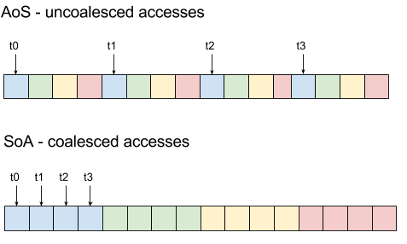
Problems with this interface
Not composable
Potential performance hits
Not always a predefined operation on-hand
Notes:
Standard algorithms are not really composable:
If transform_reduce didn’t exist as a numeric algorithm, it wouldn’t be possible to compute the dot product of two vectors without temporary storage.
Both transform and transform_reduce are limited to at most two input ranges.
This is problematic for people who utilise heterogeneous programming.
Combining multiple ranges into a single call requires transposing the data into an array of structures before applying transform.
AoS hinders a compiler’s ability to perform CPU vectorisation.
Vector registers can typically only hold homogeneous data.
AoS causes uncoalesced memory-access on GPUs due to the non-contiguous memory access.
This can cause performance hits.

Slide 44
Crash Course:
Range Adaptors

Slide 45
What is a range adaptor?
“… range adaptors… are utilities that transform a Range into a View with custom behaviors. These adaptors can be chained to create pipelines of range transformations that evaluate lazily as the resulting view is iterated.”
– P0896 The One Ranges Proposal
Notes:
Utilities that transform a range into a view with custom behaviour.
Range adaptors can be chained to compose transformations that describe what we intend to achieve.
The transformations are lazily evaluated, which means that they require an eager operation to request that they do computation.
Think about template instantiation: no template is instantiated until you use it wit a particular type..

Slide 46
Examples of views
View
Not a view
string_view
span
iota_view
reverse_view
string
vector<T>

Slide 47
Better composition: populating integers
auto const ints = []{
auto result = vector<int>(0, 100);
auto value = 0;
for (auto& i : result) {
i = value++;
}
return result;
}();

Slide 48
Better composition: populating integers
auto const ints = []{
auto result = vector<int>(0, 100);
iota(begin(result), end(result), 0);
return result;
}();

Slide 49
Better composition: populating integers
namespace view = ranges::view;
auto ints = view::iota(0);
for (auto i : view::iota(0, 100)) {
cout << i << '\n';
}

Slide 50
First 100 even integers
auto even_ints = ints | view::filter(is_even);
auto first_100_even = even_ints
| view::take(100);

Slide 51
SAXPY with ranges
auto scale = [](auto const& ax){
return get<0>(ax) * get<1>(ax); };
auto ax = view::zip(view::repeat(a), x)
| view::transform(scale);
auto plus = [](auto const& ax_y){
return get<0>(ax_y) + get<1>(ax_y); };
auto saxpy = view::zip(ax, y)
| view::transform(plus);
auto out = vector(begin(saxpy), end(saxpy));

Slide 52
SAXPY with ranges
auto scale = [](auto const& ax){
return get<0>(ax) * get<1>(ax); };
auto ax = view::zip(view::repeat(a), x)
| view::transform(scale);
auto plus = [](auto const& ax_y){
return get<0>(ax_y) + get<1>(ax_y); };
auto saxpy = view::zip(ax, y)
| view::transform(plus);
auto out = vector(begin(saxpy), end(saxpy));

Slide 53
SAXPY with ranges
auto scale = [](auto const& ax){
return get<0>(ax) * get<1>(ax); };
auto ax = view::zip(view::repeat(a), x)
| view::transform(scale);
auto plus = [](auto const& ax_y){
return get<0>(ax_y) + get<1>(ax_y); };
auto saxpy = view::zip(ax, y)
| view::transform(plus);
auto out = vector(begin(saxpy), end(saxpy));

Slide 54
SAXPY with ranges
auto scale = [](auto const& ax){
return get<0>(ax) * get<1>(ax); };
auto ax = view::zip(view::repeat(a), x)
| view::transform(scale);
auto plus = [](auto const& ax_y){
return get<0>(ax_y) + get<1>(ax_y); };
auto saxpy = view::zip(ax, y)
| view::transform(plus);
auto out = vector(begin(saxpy), end(saxpy));

Slide 55
WARNING: NOT FOR C++20
Ranges to the rescue

Slide 56
SYCL Parallel STL fused with Ranges
Uses
ComputeCpp SYCL implementation
C++11-compatible range-v3
GitHub: https://git.io/vA5H9

Slide 57
Parallel Ranges SAXPY
auto exec = gstorm::sycl_exec{};
auto ax = view::zip(view::repeat(a), copy(exec, x))
| view::transform(mult);
auto saxpy = view::zip(ax, copy(exec, y))
| view::transform(plus);
copy(exec,
saxpy,
copy(exec, out),
);

Slide 58
Parallel Ranges SAXPY
auto exec = gstorm::sycl_exec{};
auto ax = view::zip(view::repeat(a), copy(exec, x))
| view::transform(mult);
auto saxpy = view::zip(ax, copy(exec, y))
| view::transform(plus);
copy(exec,
saxpy,
copy(exec, out),
);

Slide 59
Parallel Ranges SAXPY
auto exec = gstorm::sycl_exec{};
auto ax = view::zip(view::repeat(a), copy(exec, x))
| view::transform(mult);
auto saxpy = view::zip(ax, copy(exec, y))
| view::transform(plus);
copy(exec,
saxpy,
copy(exec, out),
);
Notes:
Provides some metadata:
Abstracts away a SYCL queue attached to a device
Use of gstorm::sycl_exec is deliberate, because the standard execution policies aren’t heterogeneous system-aware.

Slide 60
Parallel Ranges SAXPY
auto exec = gstorm::sycl_exec{};
auto ax = view::zip(view::repeat(a), copy(exec, x))
| view::transform(mult);
auto saxpy = view::zip(ax, copy(exec, y))
| view::transform(plus);
copy(exec,
saxpy,
copy(exec, out),
);
Notes:
Copy internally creates SYCL buffers to keep track of the memory usage and updates the metadata.
We have a special gvector type that allocates buffers and registers them with the execution policy.
Access is provided to the buffers via special SYCL types.

Slide 61
Parallel Ranges SAXPY
auto exec = gstorm::sycl_exec{};
auto ax = view::zip(view::repeat(a), copy(exec, x))
| view::transform(mult);
auto saxpy = view::zip(ax, copy(exec, y))
| view::transform(plus);
copy(exec,
saxpy,
copy(exec, out)
);

Slide 62
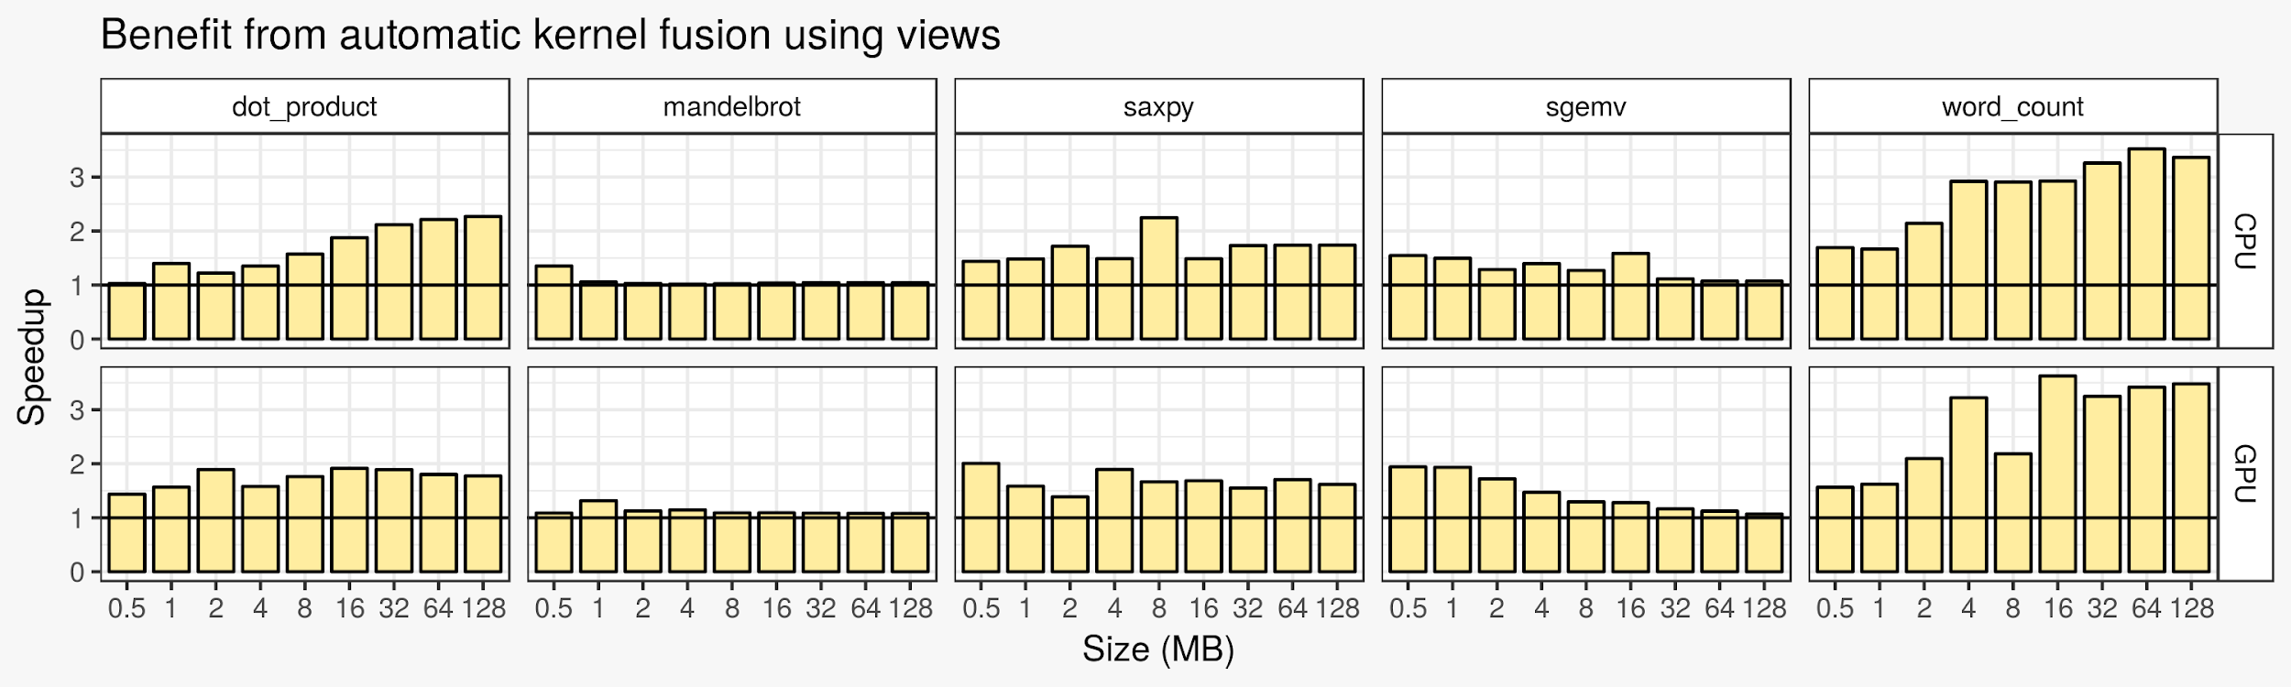
Results of SAXPY
Intel i7-6700K CPU and Intel HD Graphics 530 GPU
Execution time includes buffer creation and queuing overheads
Speedups calculated from median execution times of 100 runs per experiment
Notes:
Here are some benchmarks that we've run
Intel CPU (top)
Intel Integrated GPU (bottom)
Five different algorithms (graphs left-to-right)
Increasing data sizes (bars from left-to-right per chart)
Baseline is SYCL without kernel fusion
Speedups
Higher is better
We've observed speedups of up to 3.5x

Slide 63
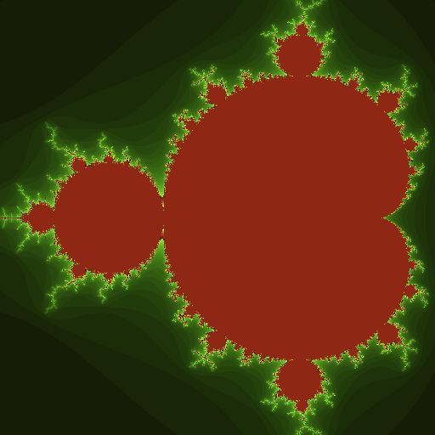
What if there is no predefined function?
constexpr auto width = 512;
constexpr auto iterations = 100;
auto image = vector<pixel>(width * width);
{
auto exec = gstorm::sycl_exec{};
auto gpu_image = copy(exec, image);
auto indices = view::iota(0, size(image));
transform(exec,
indices,
gpu_image,
calculate_pixel{width, iterations}
);
}
Notes:
Example: calculating and visualising the Mandelbrot set.
We start by allocating some memory for the output image.
Notice that we do this on both the host and the device.
Our algorithm input are indices to pixels.
We generate this input from view::iota
We say “n times” through view::take
The function object CalculatePixel calculates a colour for the input pixel
Depends on how long it takes to decide whether or not the point is in the set
CalculatePixel is the functor that we apply to transform, which behaves as it did before.

Slide 64
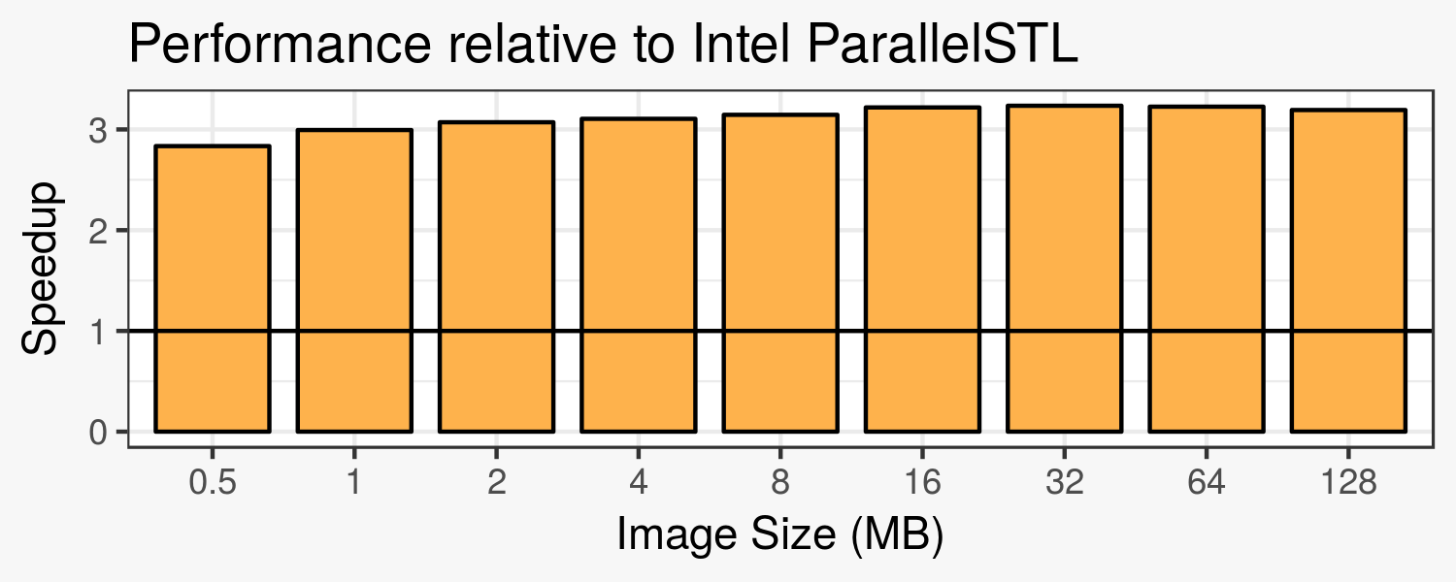
What if there is no predefined function?
Notes:
There is no combined algorithm for doing std::iota and std::transform in the same library call.
Even worse, there is no parallel version of std::iota.
Results of our prototype compared against the Intel Parallel STL.
Based on Intel Threading Building Blocks.
Is highly optimised for CPUs.
Because there is no suitable predefined function, we get speedups ~3x just by using views.

Slide 65
What now?
Standardising range adaptors
Continuing to explore range adaptor fusion
Plans to research:
Data layout transformation
Concepts for parallel algorithms
Refining types to be standard-layout
GitHub: https://git.io/vA5H9
Proposals:
https://wg21.link/p0836 https://wg21.link/p0896
https://wg21.link/p0898 https://wg21.link/p1035
Notes:
Heterogeneous code runs on multiple devices, and each device needs to communicate with other devices.
There is no common ABI for C++, which makes it difficult for programs compiled for different architectures, using different toolchains, to marshall data.
For example, a host CPU program might be compiled with…
Types that adhere to standard-layout can be trivially used across devices.
Non-standard-layout types require manually restructuring the data, which can be quite costly.
Refining types to be standard-layout isn’t an easy process, and not everything can be prescribed to be standard-layout.

Slide 66
Parallel Ranges:
Heterogeneous Programming in Style

Slide 67





Contact
Me
Codeplay
@cjdb_ns
cjdb.ns@gmail.com
www.cjdb.com.au
@cjdb
@codeplaysoft
info@codeplay.com
www.codeplay.com
@codeplaysoft

