Slide 1
“Review-1 of Major Project”
for E-4 2018 Admitted Batch
Submitted as part of Major Project.
1. D.Keerthi- S180532
2. P.Kumari- S180192
3. Sk.Haseena Begum- S180720
4. J.Leela Satyasri- S180543
Under the Supervision of:
Mrs.Ch.Lakshmi Bala ,M.Tech(Ph.D)
Assistant Professor
Department of Computer Science and Engineering
Rajiv Gandhi University of Knowledge Technologies
Srikakulam – 532402

Slide 2
Project Title “Speech Based Automated Note-Making System”

Slide 3
AGENDA
INTRODUCTION
PROBLEM STATEMENT
ABSTRACT
SCOPE OF THE PROJECT
GOAL AND OBJECTIVE
EXISTED AND PROPOSED SYSTEMS
ADVANTAGES AND DISADVANTAGES
INTERFACE
CONCLUSION
REFERENCES

Slide 4
INTRODUCTION
With automatic speech recognition, the goal is to simply input any continuous audio speech and output the text equivalent.
We want our Speech Recognition system to be speaker-independent and have high accuracy.
The objective is to propose a system that takes speech as input and converts into a required text(like documents, mails etc).

Slide 5
PROBLEM STATEMENT
Manual note-taking can be difficult, especially while making documents, during meetings or lectures. It is a time consuming task for humans to make notes, prepare documents and writing the emails. To address this challenge, a Speech-Based Automated Note-Taking System is proposed. This system leverages speech recognition technology to seamlessly convert spoken words into written text, eliminating the need for manual note-making and document preparation using machine-learning.

Slide 6
ABSTRACT
In an increasingly digital and fast-paced world, efficient note-taking remains a fundamental skill for information retention and productivity. However, manual note-taking can be difficult, especially while making documents, during meetings or lectures. To address this challenge, a Speech-Based Automated Note-Taking System is proposed. This system leverages speech recognition technology to seamlessly convert spoken words into written text, eliminating the need for manual note-taking using machine-learning. The system begins by capturing audio input from a user's microphone or a designated source. A speech recognition engine is employed to transcribe the spoken words into text accurately and efficiently. The resulting text is then processed and organized as notes, which can be saved for future reference. Users are provided with a user-friendly interface that enables them to initiate the speech recognition process, start recording, and manage their notes effortlessly. This Speech-Based Automated Note-Taking System, users gain a valuable tool for capturing and organizing information quickly and accurately, freeing them from the limitations of manual note-making and document preparation.
Keywords:
Automated, interface, Speech recognition, machine learning.

Slide 7
SCOPE :
Develop an advanced speech recognition system capable of accurately transcribing spoken words into text.
Create an efficient mechanism to organize the transcribed and processed text into well-structured documents based on predefined templates or user-defined formatting rules.
Aim to provide real-time transcription and document creation to enhance productivity and efficiency in dynamic settings.

Slide 8
GOALS :
With automatic speech recognition, the goal is to simply input any continuous audio speech and output the text equivalent.
Our Speech Recognition system to be speaker-independent and have high accuracy, efficiency with user-friendly interface.
OBJECTIVES:
Enable real-time speech-to-text transcription during live events, meetings, or conversations for immediate access to written content.
Develop an accurate speech recognition system to minimize transcription errors and improve the reliability of the generated text.
.

Slide 9
Existed systems :
Manual document preparation : where we manually creates a document.
Document preparation using M.S.word : Document preparation using Microsoft Word refers to the creation, editing, formatting, and finalization of written documents using the Microsoft Word software application.
Microsoft speech to text : Microsoft speech to text is a SBANS that can be used to transcribe audio from a variety of sources including microphones , webcam and dictation.
Google Assissant : google assistant is a virtual assiasant that can be transcribe spoken audio.

Slide 10
Proposed system:
It encourages digital note taking system i.e. speech based automatic note-making system.
It is Used to create the customized document preparation or organizing the notes.
It is ued to write the E-mails.
It is used to transulate the speech into text Accurately and efficiently.

Slide 11
ADVANTAGES
Like all forms of technology, speech to text has many benefits that help us improve daily processes. These are some of the main advantages of using speech to text:
Save time:Automatic speech recognition technology saves time by delivering accurate transcripts in real-time.
Cost-efficient:Most speech to text software has a subscription fee, and a few services are free. However, the cost of the subscription is far more cost-efficient than hiring human transcription services.
Enhance audio and video content: Speech to text capabilities mean that audio and video data can be converted in real-time for subtitling and fast video transcription.
Streamline the user experience: The user experience is transformed through ease, accessibility, and seamlessness.

Slide 12
DISADVANTAGE
New technologies like speech to text don't come without imperfection, and these are some of the main limitations of speech to text:
Requires Human Input: Because speech to text lacks complete accuracy, some human edits to the speech data are required for optimal usage.
Requires Clean recordings: To get a quality transcript from voice recognition software, you need to ensure the recorded audio is clear and intelligible. This means there needs to be no background noise, adequate pronunciation, no accents, and one person speaking at a time. You also need to provide voice commands for punctuation.

Slide 13
Methodologies :
Speech Recognition : Utilizes state-of-the-art automatic speech recognition (ASR) models trained on large datasets to accurately convert spoken words into text . Employs deep learning architectures such as recurrent neural networks (RNNs) or transformer models for robust and context-aware transcription
Natural Language Processing (NLP): Applies NLP techniques to understand the semantic meaning of transcribed text, enabling the system to extract key information and context from spoken content . Implements named entity recognition and sentiment analysis to identify entities and sentiments expressed in the spoken content.
Machine Learning Summarization : Utilizes machine learning algorithms, including supervised and unsupervised methods, for automatic summarization of transcribed text . Trains models to identify important sentences and generate concise summaries, providing users with a quick overview of the content.
Categorization and Organization: Notes are automatically categorized based on topics, enabling users to quickly locate and reference information. This feature enhances the organization of notes, making it easier to manage and retrieve specific details.

Slide 14
Technologies :
Python libraries : Python libraries are pre-written sets of code, functions, and modules that enhance the capabilities of the Python programming language, enabling developers to efficiently perform various tasks without having to build everything from scratch.
Deep Learning : Deep learning is a subfield of machine learning that involves training artificial neural networks on large amounts of data to enable them to make complex decisions and predictions.
Front end development : javascript , HTML ,CSS

Slide 15
INTERFACE
The proposed system enables user to give speech as input through an user interface created with frontend-development technologies like CSS, HTML, JavaScript.
The “start recording” button enables the microphone to recognize speech.
The interface makes choice of selecting language to speak.
We can download the generated text from the interface.
A clear button is created to clear the generated text through speech.

Slide 16
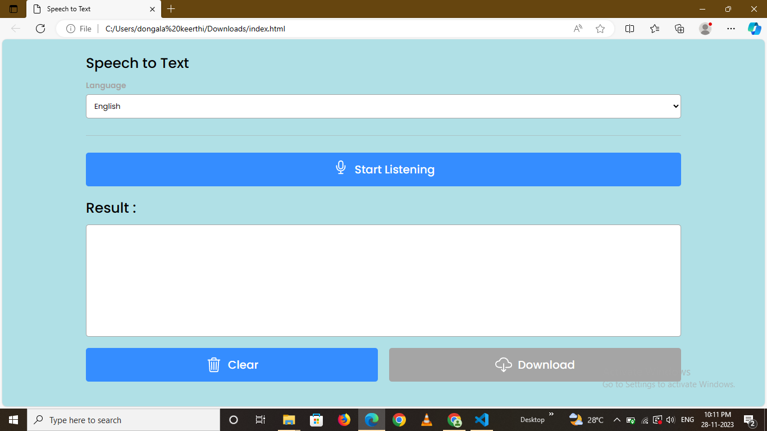

Slide 17
CONCLUSION
Manual note-taking can be difficult, especially while making documents, during meetings or lectures. It is a time consuming task for humans to make notes, prepare documents and writing the emails. To address this challenge, a Speech-Based Automated Note-Making System is proposed. The proposed system enables users to make notes using speech and it transcribes the input speech into equivalent text. This system has an user-friendly interface to make use of the system efficiently. We can also write emails and can edit text by adding features to the system. It can be useful for record meetings and generating meeting reports in future by making the necessary changes in the system.

Slide 18
REFERENCES
T. Kawahara, N. Katsumaru, Y. Akita, and S. Mori, “Classroom Notetaking System for Hearing Impaired Students using Automatic Speech Recognition Adapted to Lectures.” in Proc. of INTERSPEECH2010, pp. 626–629, 2010.
(APSIPA ASC 2010), pp. 490–493, 2010. [5] S. Natori, H. Nishizaki, and Y. Sekiguchi, “Japanese spoken term detection using syllable transition network derived from multiple speech recognizers’ outputs,” in Proc. of INTERSPEECH2010, pp. 681–684, 2010.
Dua, M.; Aggarwal, R.K.; Biswas, M. Optimizing Integrated Features for Hindi Automatic Speech Recognition System. J. Intell. Syst. 2019, 29, 959–976.

Slide 19
THANK YOU

