Slide 1
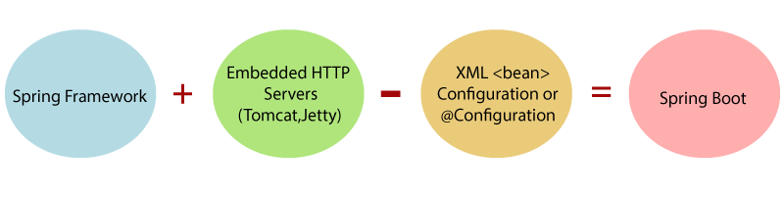
Introduction
Spring Boot is a project that is built on the top of the Spring Framework. It provides an easier and faster way to set up, configure, and run both simple and web-based applications.
It is a Spring module that provides the RAD (Rapid Application Development) feature to the Spring Framework

Slide 2
Spring Boot Features
Web Development
SpringApplication
Application events and listeners
Admin features
Externalized Configuration
Properties Files
YAML Support
Type-safe Configuration
Logging
Security

Slide 3
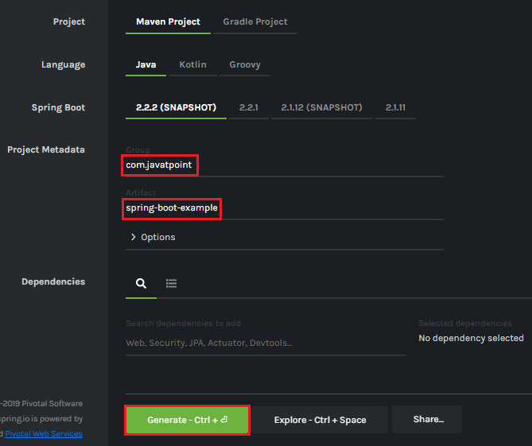
Creating a Spring Boot Project
Step 1: Open the Spring initializer https://start.spring.io.
Step 2: Provide the Group and Artifact name. We have provided Group name com.javat point and Artifact spring-boot-example.
Step 3: Now click on the Generate button.

Slide 4
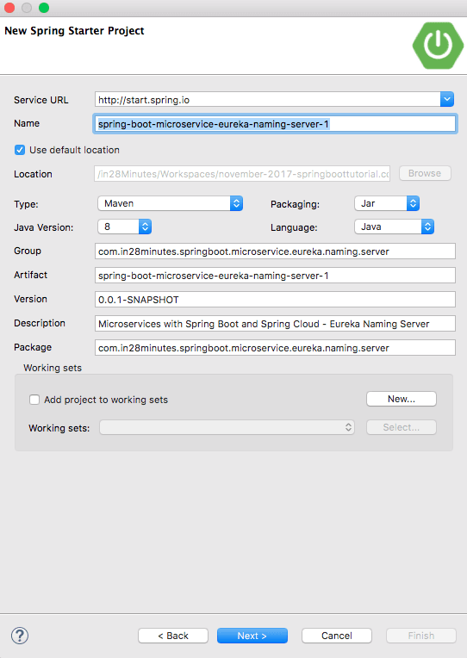
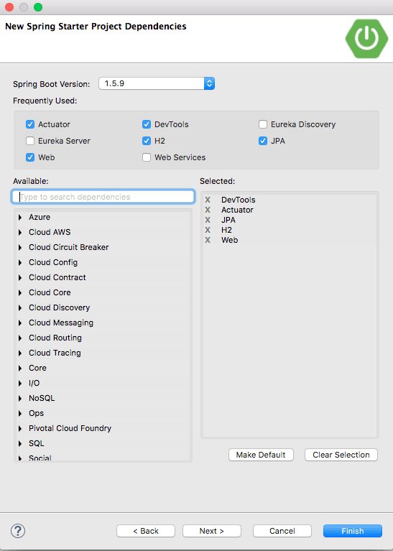

Slide 5
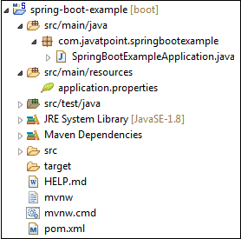
When we click on the Generate button, it starts packing the project in a .rar file and downloads the project.
Step 4: Extract the RAR file.
Step 5: Import the folder.
File -> Import -> Existing Maven Project -> Next -> Browse -> Select the project -> Finish
It takes some time to import the project. When the project imports successfully, we can see the project directory in the Package Explorer. The following image shows the project directory

Slide 6
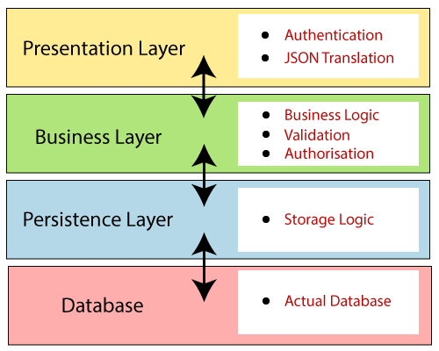
Spring Boot Architecture
There are four layers in Spring Boot are as follow
Presentation Layer
Business Layer
Persistence Layer
Database Layer

Slide 7
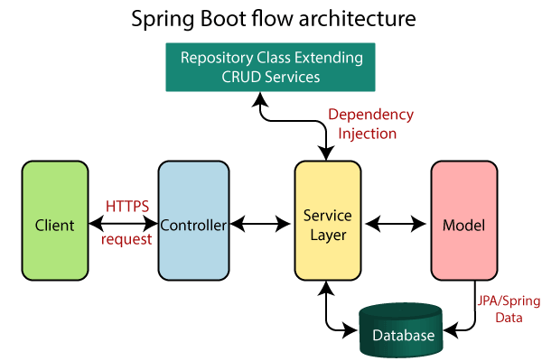

Slide 8
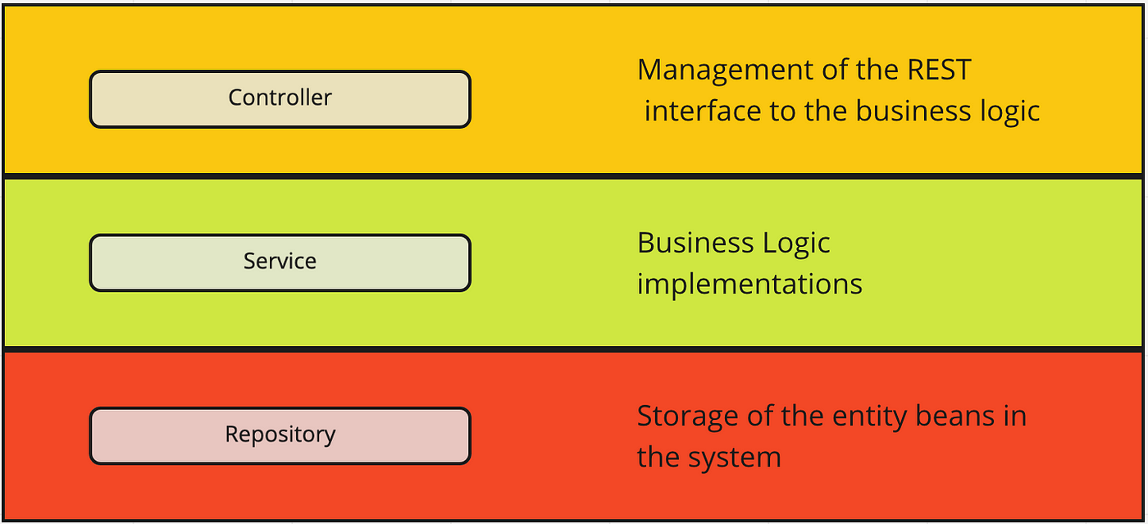

Slide 9
Spring MVC and REST Annotations
@GetMapping : use for retrieve the values
@PostMapping : use for insertion the values
@PutMapping: use for update the values
@DeleteMapping: use for deletion of values
@Controller : Controller is a specialized @Component marked as a controller in MVC architecture.
@RestController: It can be considered as a combination of @Controller and @ResponseBody annotations. The @RestController annotation is itself annotated with the @ResponseBody annotation.
@Bean: It is a method-level annotation. It is an alternative of XML <bean> tag. It tells the method to produce a bean to be managed by Spring Container.

Slide 10
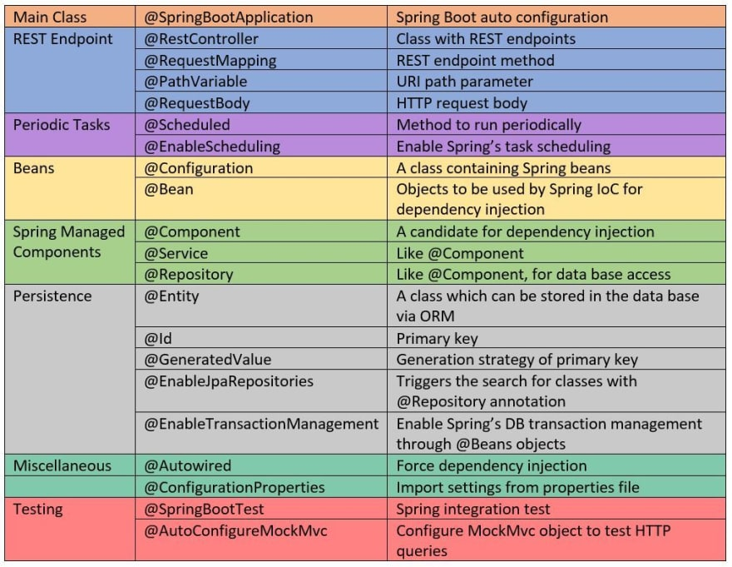

Slide 11
@RestController : The RestController allows to handle all REST APIs such as GET, POST, Delete, PUT requests
@RequestBody : The @RequestBody annotation indicates that Spring should deserialize a request body into an object.
@PathVariable : The @PathVariable annotation is used to extract the value from the URI.
@Entity : The @Entity annotation specifies that the class is an entity and is mapped to a database table.
@generatedvalue : This annotation is generally used in conjunction with @Id annotation to automatically generate unique values for primary key columns within our database tables
@JpaRepository : JpaRepository is a subinterface of CrudRepository and provides additional functionality beyond basic CRUD operations. Specifically, it adds support for JPA-specific operations, such as flushing the persistence context, deleting entities in a batch, and retrieving a single entity by its natural identifier.

Slide 12
THANK YOU

