Slide 1
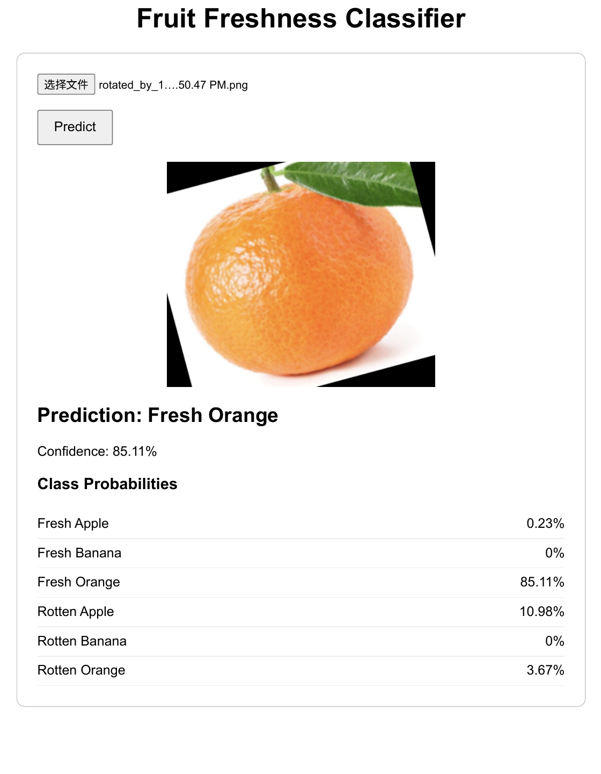
Fruit Freshness
Classifier
A PyTorch image classification project that predicts fruit type and freshness from uploaded images.
Image data
CNN
Web demo
Course-scope methods only: fully connected net + CNN + dropout + augmentation

Slide 2
1. Problem and Goal
Classify images by fruit type and freshness status
Business problem
Goal
Freshness is visible in color, texture, and surface spots.
Manual inspection is slow and inconsistent.
A simple image classifier can support a product demo for food quality screening.
Predict one of six classes from a fruit image:
Fresh Apple
Rotten Apple
Fresh Banana
Rotten Banana
Fresh Orange
Rotten Orange
Fruit Freshness Classifier | PyTorch CNN Project
02

Slide 3
2. Dataset Structure
High-dimensional image data organized into class folders
Dataset input
Apple
Banana
Orange
Images are stored by label so PyTorch can read the class names directly.
Fresh
Fresh
Fresh
Rotten
Rotten
Rotten
images
images
images
Fruit Freshness Classifier | PyTorch CNN Project
03

Slide 4
3. Why Deep Learning Fits
The useful information is spatial, not just tabular
A fruit image is a grid of pixels. Freshness may depend on local patterns such as dark spots, bruises, color changes, and texture.
CNNs build a hierarchy of visual features
Fully connected baseline
Pixels
Edges
spots
Texture
color
Class
Flattens pixels and loses spatial relationships.
CNN model
Learns local visual filters and keeps spatial structure.
Fruit Freshness Classifier | PyTorch CNN Project
04

Slide 5
4. Workflow
From images to a saved model and demo app
1
2
3
4
5
Load images
Preprocess
Train models
Evaluate
Deploy demo
ImageFolder reads labeled folders
Resize to 64 x 64 and convert to tensors
Baseline, CNN, and CNN + augmentation
Validation accuracy, test accuracy, confusion matrix
Saved model powers the web interface
The notebook keeps model development and evaluation in one place, while the web page demonstrates the trained model.
Fruit Freshness Classifier | PyTorch CNN Project
05

Slide 6
5. Model Design
Baseline first, then a simple CNN
Baseline fully connected network
Image
Flatten
Dense
ReLU
6 classes
CNN architecture
Image
Conv
ReLU
Max
Pool
Conv
ReLU
Max
Pool
Dropout
Dense
6 classes
Fruit Freshness Classifier | PyTorch CNN Project
06

Slide 7
6. Training and Evaluation
Optimize with cross-entropy and validate model choices
Training setup
Metrics reported
Use CrossEntropyLoss for six-class classification.
Use SGD to update weights through backpropagation.
Select the final model based on validation accuracy.
Validation accuracy: model selection
Test accuracy: final holdout performance
Confusion matrix: error patterns by class
Class probabilities: web demo output
Fruit Freshness Classifier | PyTorch CNN Project
07

Slide 8
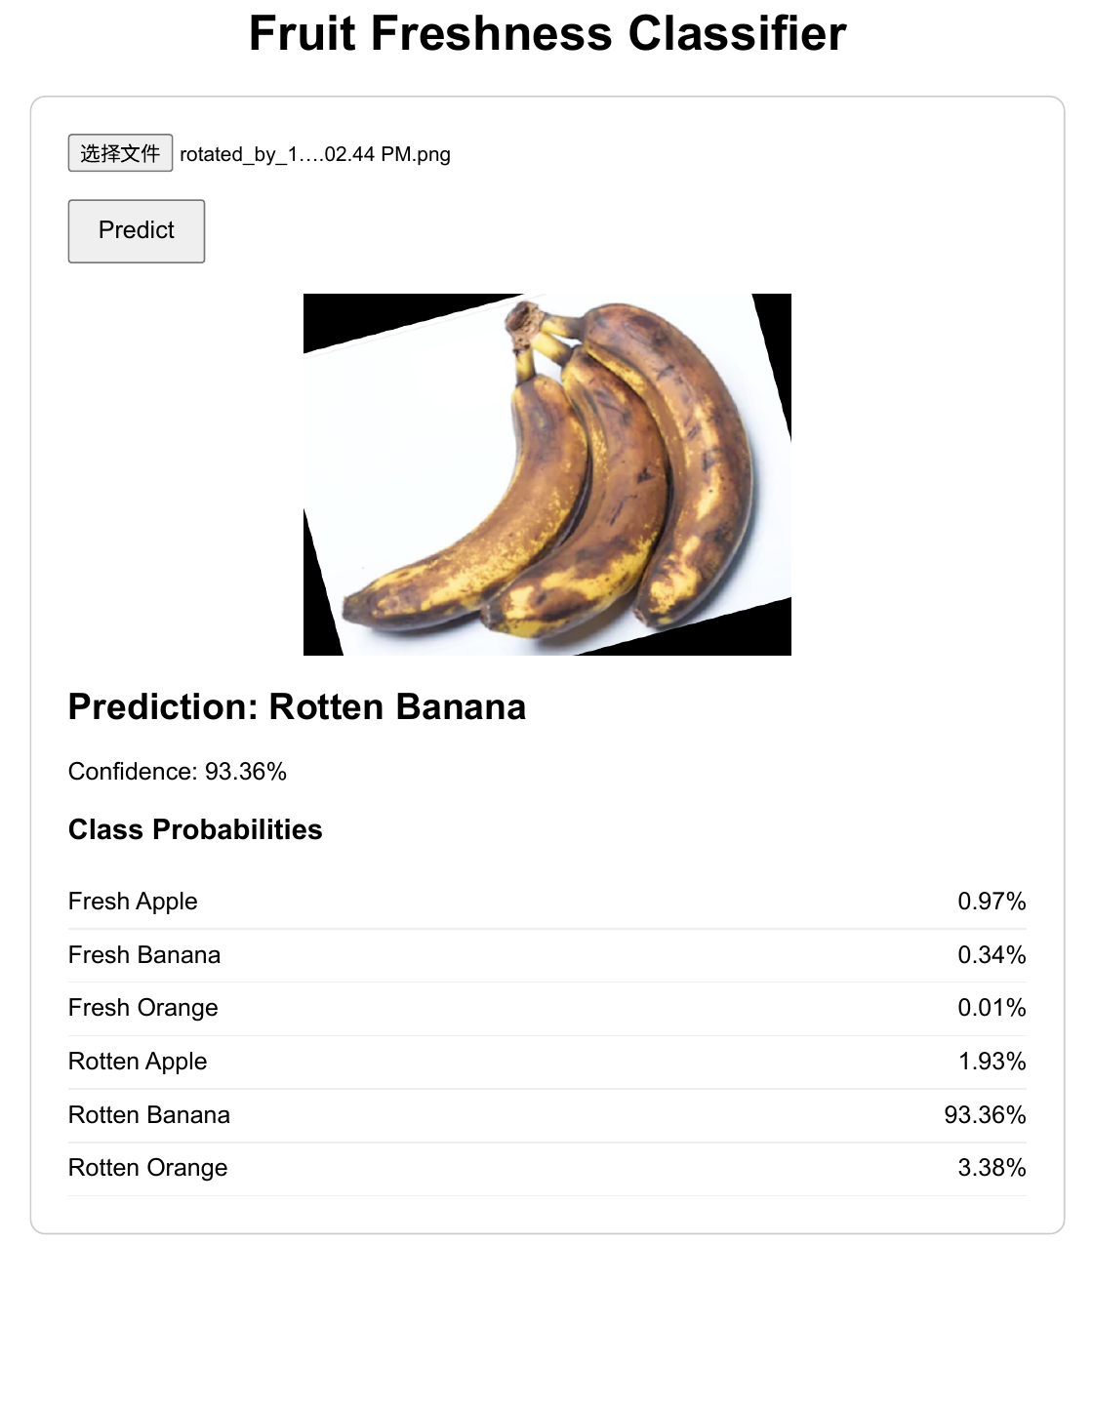
7. Web Interface
A simple local demo for uploaded fruit images
How it works
Upload image
The interface supports live demonstration without retraining. It loads the saved PyTorch checkpoint and returns the predicted class plus confidence scores.
Resize to 64 x 64
CNN prediction
Local web app
PyTorch model
Show probabilities
Fruit Freshness Classifier | PyTorch CNN Project
08

Slide 9
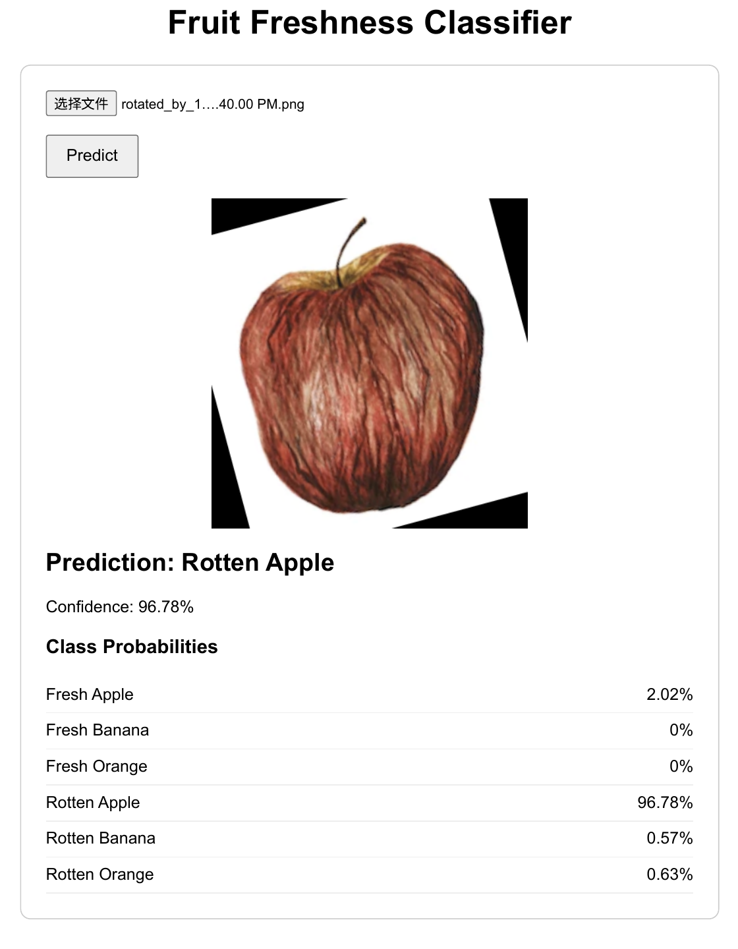
8. Demo Predictions
Example outputs from the local web interface
Confidence scores
The model is confident on several examples, but some rotated or dark-corner images can still confuse fruit type.
Fruit Freshness Classifier | PyTorch CNN Project
09

Slide 10
9. Findings and Next Steps
What worked and what we would improve
What worked
Next steps
CNN-based image classification is feasible for fruit freshness.
The web interface gives a clear demonstration of model use.
The project stays within course-scope deep learning methods.
Increase image size to preserve texture details.
Avoid black corners from rotation augmentation.
Train for more epochs and compare learning rates.
Keep GitHub commits separated by dataset, model, experiment, and web demo.
Fruit Freshness Classifier | PyTorch CNN Project
10

