Slide 1


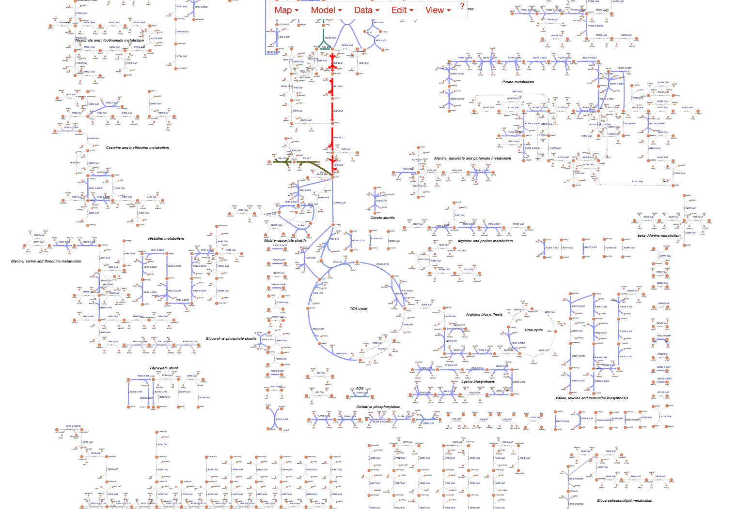
Metabolic Analysis 界面参考
Metabolic Analysis
Single Transcript Analysis
Dual Transcript Analysis
Notice
Submit a single transcript data, combined with an enzyme-constrained model, to predict the metabolic state of Myceliophthora thermophila under specific conditions.
Click on "Example" to obtain a sample file.
Click to Upload the Transcript data
Example
Submit
Metabolic Flux Visualization

Slide 2
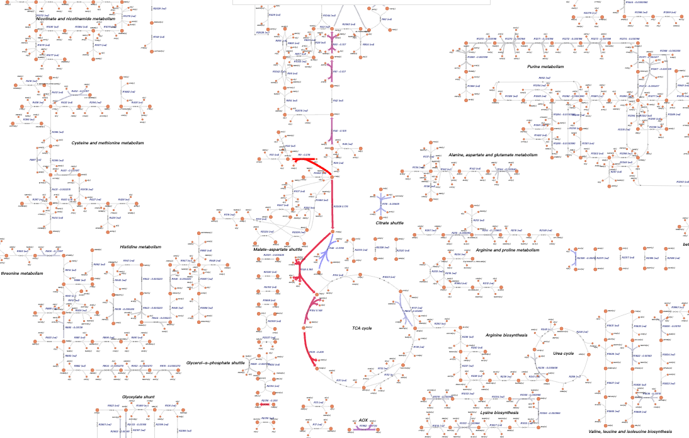
Metabolic Analysis 界面参考
Metabolic Analysis
Single Transcript Analysis
Dual Transcript Analysis
Notice
Submit a dual transcript data, combined with an enzyme-constrained model, to predict the metabolic state of Myceliophthora thermophila under specific conditions.
Click on "Example" to obtain a sample file.
Click to Upload the control sample
Click to Upload the treatment sample
Example
Submit
Metabolic Flux Visualization

Slide 3
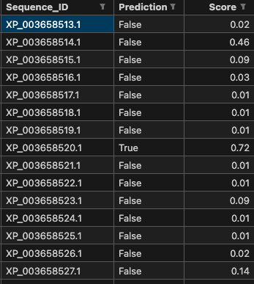
Tools -> TF Prediction 界面参考
Tools
TF Prediction
Blastp
MSA & Tree
Notice
Upload a protein sequence FASTA file for transcription factor prediction analysis based on DeepTFactor(https://doi.org/10.1073/pnas.2021171118).
Click on "Example" to obtain a sample file.
Click to Upload the protein sequence fasta file
Example
Submit
Metabolic Flux Visualization
展示预测结果表格即可

Slide 4
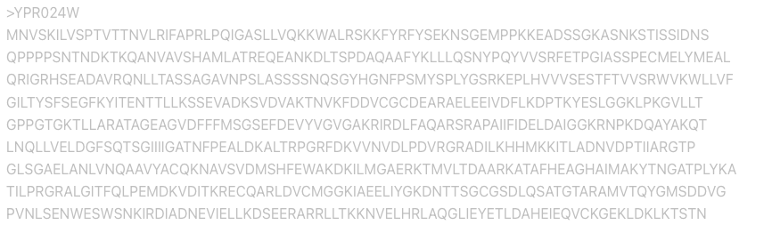

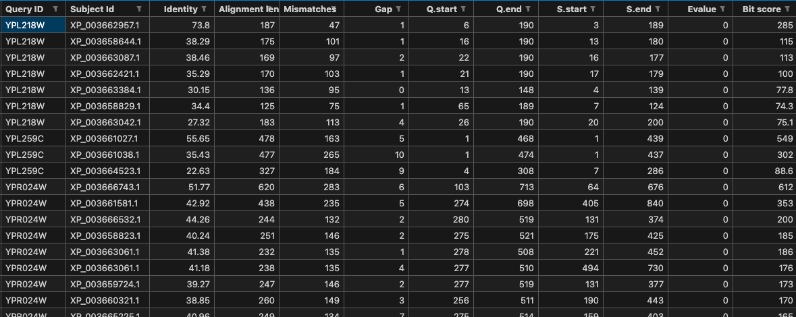
Tools -> Blastp 界面参考
Tools
TF Prediction
Blastp
MSA & Tree
Notice
Input a specific protein sequence for sequence alignment analysis with the Myceliophthora thermophila protein database.
After clicking the download button, you will be able to download the protein sequence information from the alignment analysis results.
最多输入20个序列
E-value：
1e-6
最多输入20个序列
见blast_input.txt
Example
Submit
Blast Result
blast_output.txt
Get Seq
获得blast_seq.fasta

Slide 5
Tools -> MSA & Tree 界面参考
Tools
TF Prediction
Blastp
MSA & Tree
Notice
Input a specific protein sequence for sequence alignment analysis with the Myceliophthora thermophila protein database.
After clicking the download button, you will be able to download the protein sequence information from the alignment analysis results.
Click to Upload the protein sequence fasta file
Phylogenetic Tree Construction Model：
lg
可选lg、jtt、wag
获得blast_seq.fasta
Example
Submit
不知道怎么展示，先就提供个下载功能吧（最好是直接用react-msaview展示结果，感觉不好实现）
Download
获得mafft_result.fasta，fasttree_result.nwk

