Slide 1


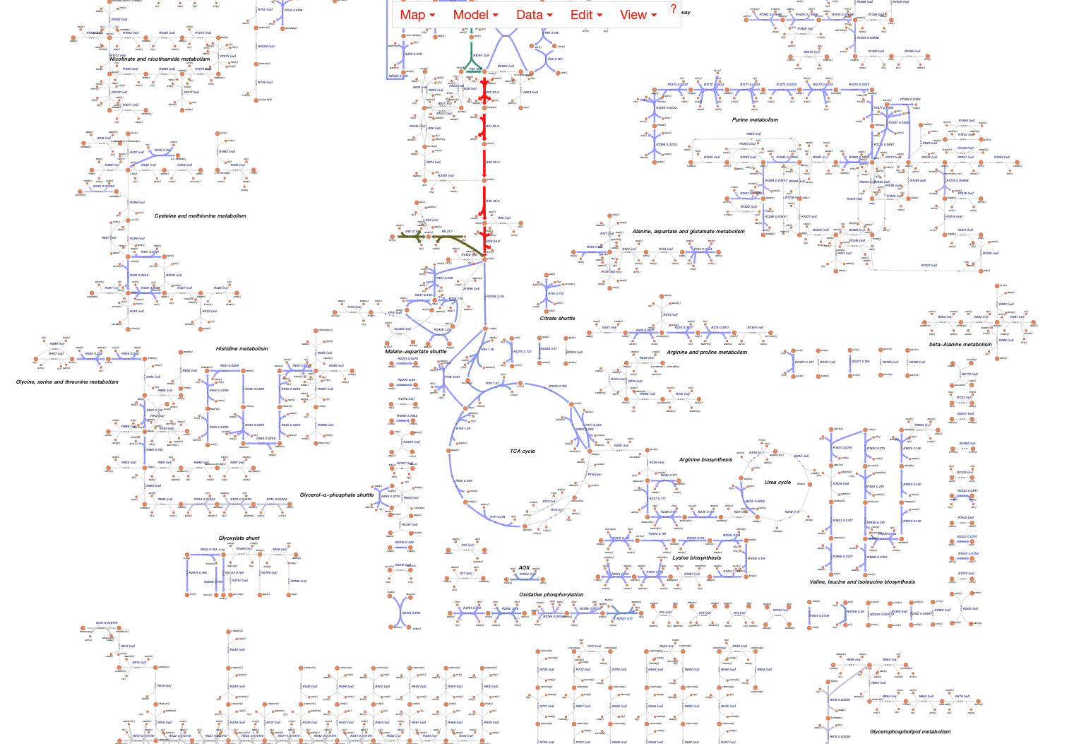
Metabolic Analysis 界面参考
Metabolic Analysis
Single Transcript Analysis
Dual Transcript Analysis
Notice
Submit a single transcript data, combined with an enzyme-constrained model, to predict the metabolic state of Myceliophthora thermophila under specific conditions.
Click on "Example" to obtain a sample file.
Click to Upload the data
Example
Submit
Metabolic Flux Visualization

Slide 2
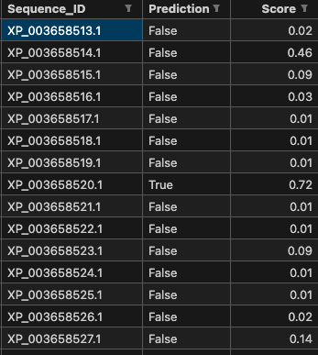
Tools -> TF Prediction 界面参考
Tools
TF Prediction
Tree
Blastp
MSA
Notice
Upload a protein sequence FASTA file for transcription factor prediction analysis based on DeepTFactor(https://doi.org/10.1073/pnas.2021171118).
Click on "Example" to obtain a sample file.
Click to Upload the data
Example
Submit
Metabolic Flux Visualization
展示预测结果表格即可

