Slide 1


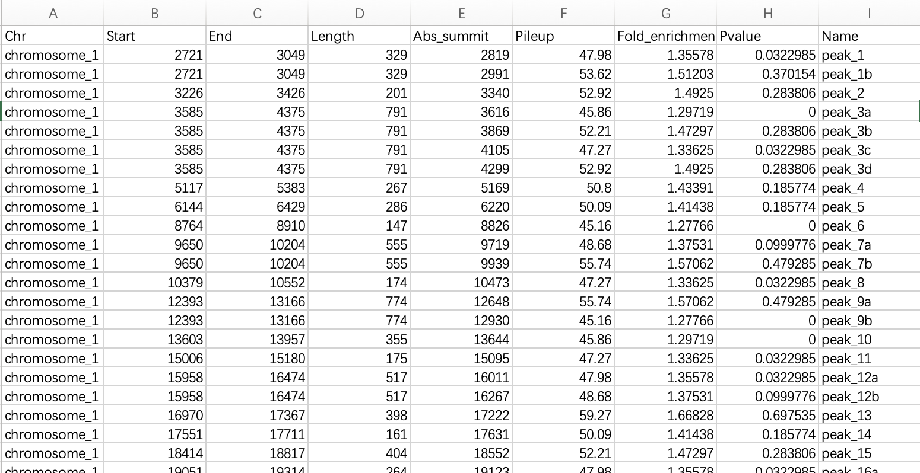
Search -> Epigenetics Data
Home
Search
Statistics
Omics Analysis
Metabolic Analysis
Tools
Tutorial
Download
Gene
Pathway
Gene list
Epigenetics Data
Species:
Myceliophthora thermophila
暂时只有一个数据集
Datasets：
Samples：
Submit
Chip-seq
Download

Slide 2
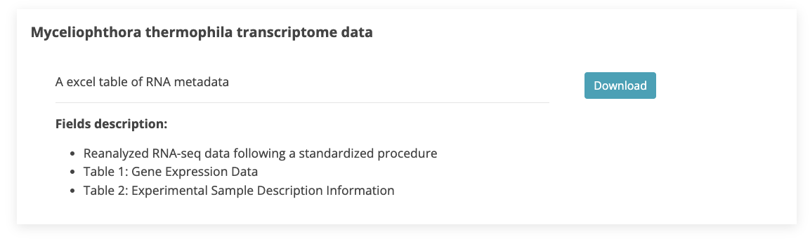
Download
Home
Search
Statistics
Omics Analysis
Metabolic Analysis
Tools
Tutorial
Download

