Slide 1


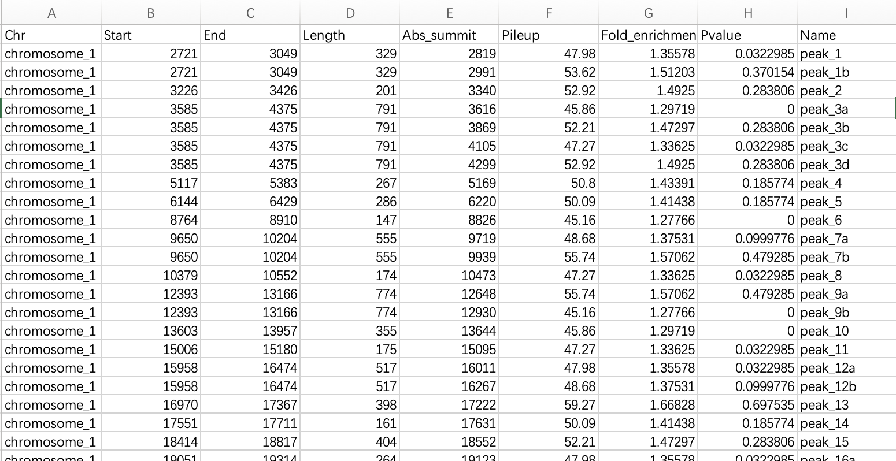
Search -> Epigenetics Data
Home
Search
Statistics
Omics Analysis
Metabolic Analysis
Tools
Tutorial
Download
Gene
Pathway
Gene list
Epigenetics Data
Species:
Myceliophthora thermophila
暂时只有一个数据集
Datasets：
Samples：
Submit
Chip-seq
Download

Slide 2
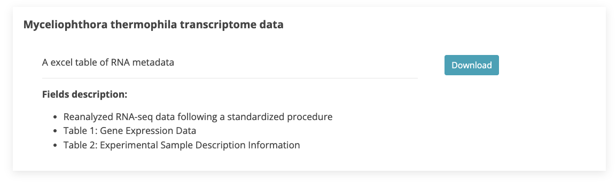
Download
Home
Search
Statistics
Omics Analysis
Metabolic Analysis
Tools
Tutorial
Download

Slide 3
Metabolic Analysis 新的页面参考
Metabolic Analysis
Metabolic model
Notice
Submit a single transcript data, combined with an enzyme-constrained model, to predict the metabolic state of Myceliophthora thermophila under specific conditions.
Click on "Example" to obtain a sample file.
Model
lg
Substrate
Submit
Result

