Slide 1
PS：设计内容供参考，如果有更好的或者现成的方式，可直接使用。
水平有限，肯定存在部分问题，麻烦师哥随时联系我，辛苦！

Slide 2



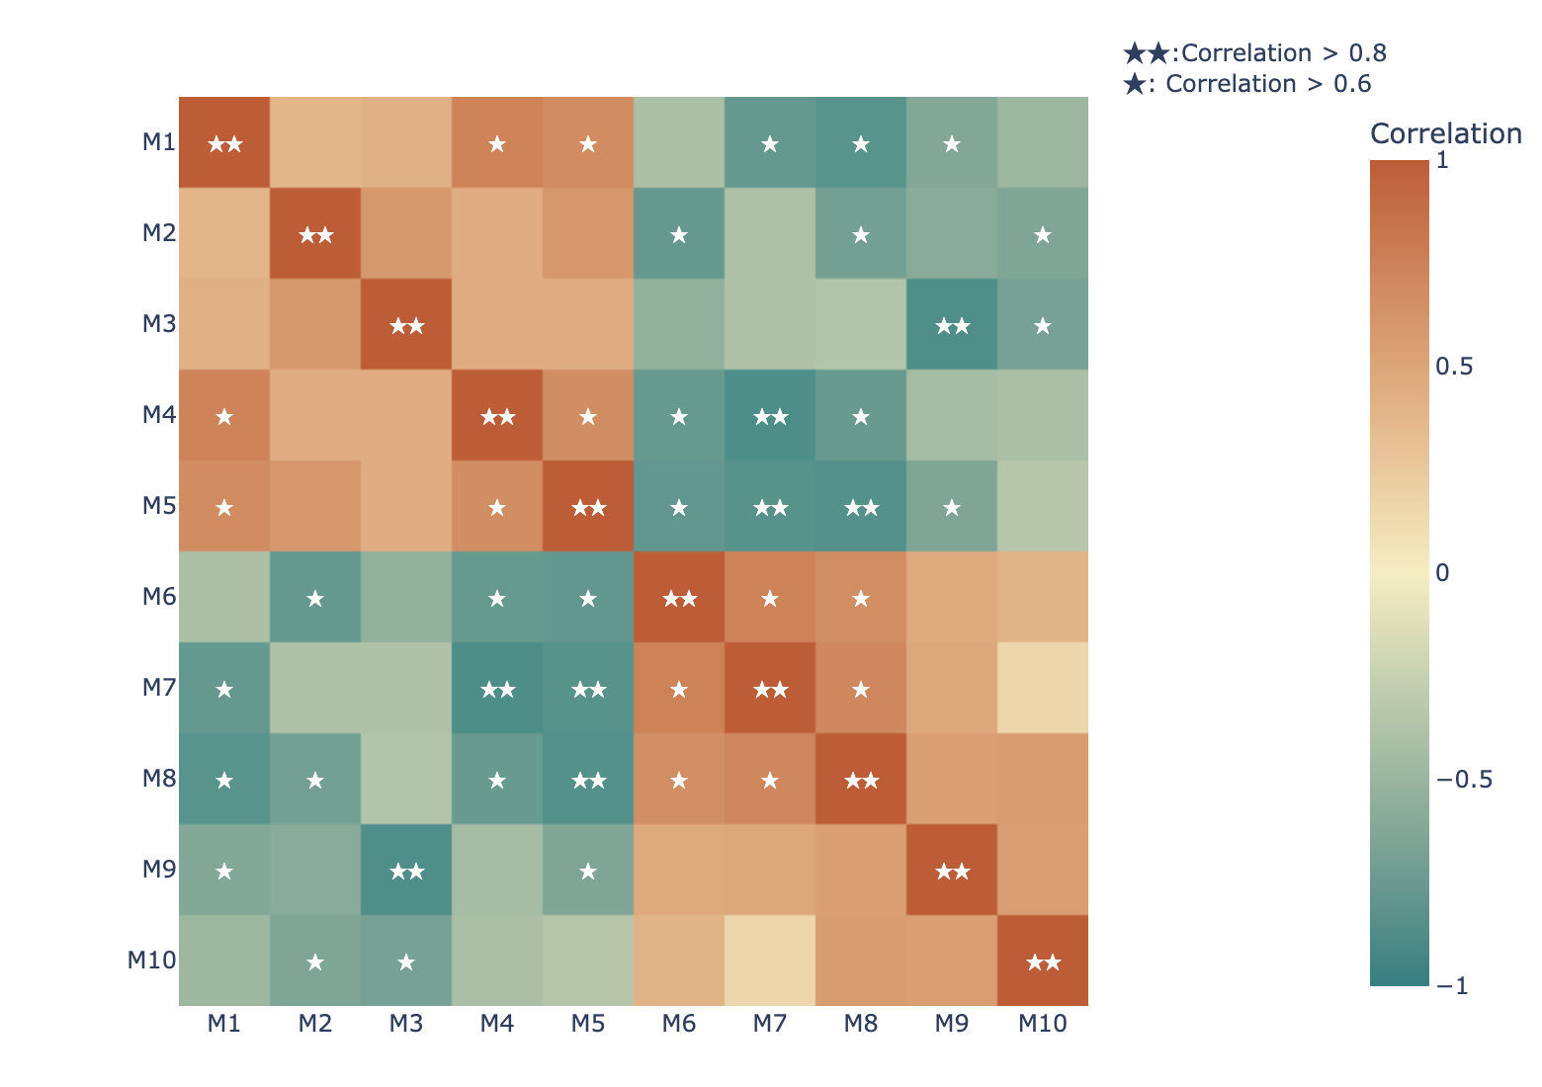
Omics Analysis -> Corrrelation 界面参考1
Home
Search
Datasets
Publication
Omics Analysis
Metabolic Analysis
Tools
Download
Corrrelation
Differential gene analysis
GO/KEGG Enrichment
Heatmap
PCA
Notice
Upload the matrix of gene expression levels standardized by RPKM, FPKM, TPM.
The display of the correlation heatmap is limited to a maximum of 30x30.
The correlation network diagram can display up to 100 genes at most.
Click on "Example" to obtain a sample file.
选择：见notion文档Plotly颜色
选择：pearson与spearman
Click to Upload the data
Method :
pearson
Color :
geyser
Width :
900
Height :
600
bubble_size :
4
threshold :
0.6
K value :
1.0
Iterations :
10
点击Example，获得示例文件
Example
Submit
点击Submit，陆续生成：样本相关性热图、基因相关性热图、
Sample Correlation Heatmap

Slide 3
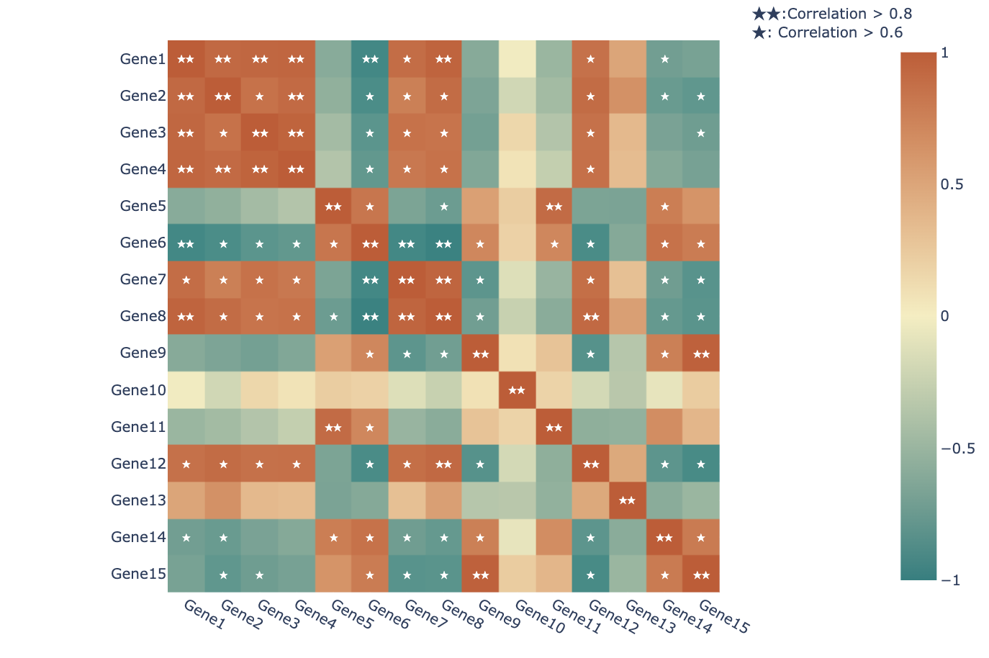
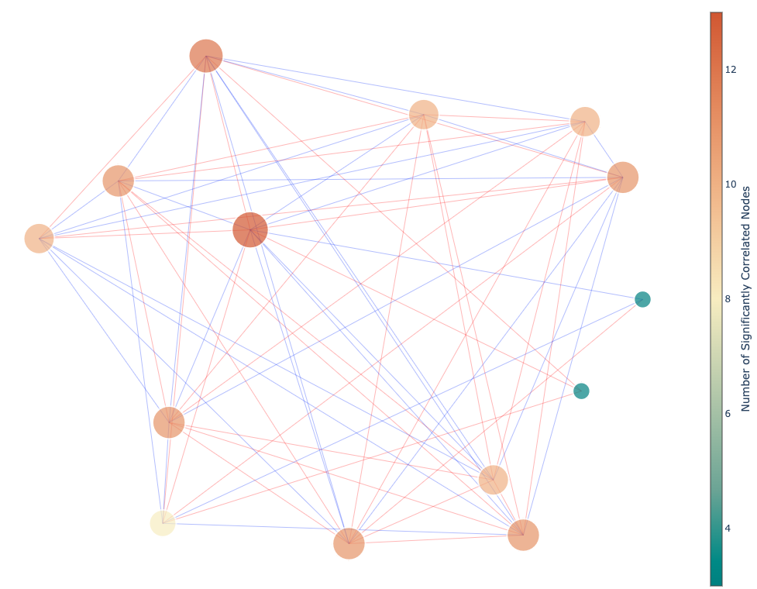
Omics Analysis -> Corrrelation 界面参考2
Home
Search
Datasets
Publication
Omics Analysis
Metabolic Analysis
Tools
Download
Gene Correlation Heatmap
Gene Correlation Network
Red lines represent significant positive correlations between two genes.
Blue lines represent significant negative correlations between two genes.
The more significant correlations a node has with other genes, the larger it is.
Using the correlation network diagram, it is easy to identify which genes are in a central position in the correlation analysis.
点击下载，获得
corr_gene.png，corr_sample.png，corr_gene_network.png
Download

Slide 4
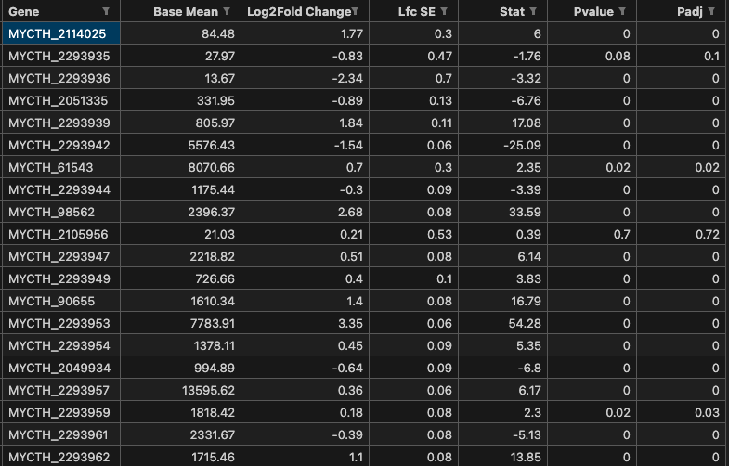
Omics Analysis -> Differential gene analysis 界面参考1
Home
Search
Datasets
Publication
Omics Analysis
Metabolic Analysis
Tools
Download
Corrrelation
Differential gene analysis
GO/KEGG Enrichment
Heatmap
PCA
Notice
Only two conditions of data can be uploaded, the front for the control group, the back for the experimental group.
Upload transcriptomic data And ensure that you upload a csv file.
Choose the number of parallels in your experiment.
Click on "Example" to obtain a sample file.
Click to Upload the data
选择：2，3，4
Number of parallel samples：
3
Example
Submit
点击Submit，生成表格
Difference analysis result
Download
Visualization
点击Visualization，按默认参数生成交互式可视化图

Slide 5
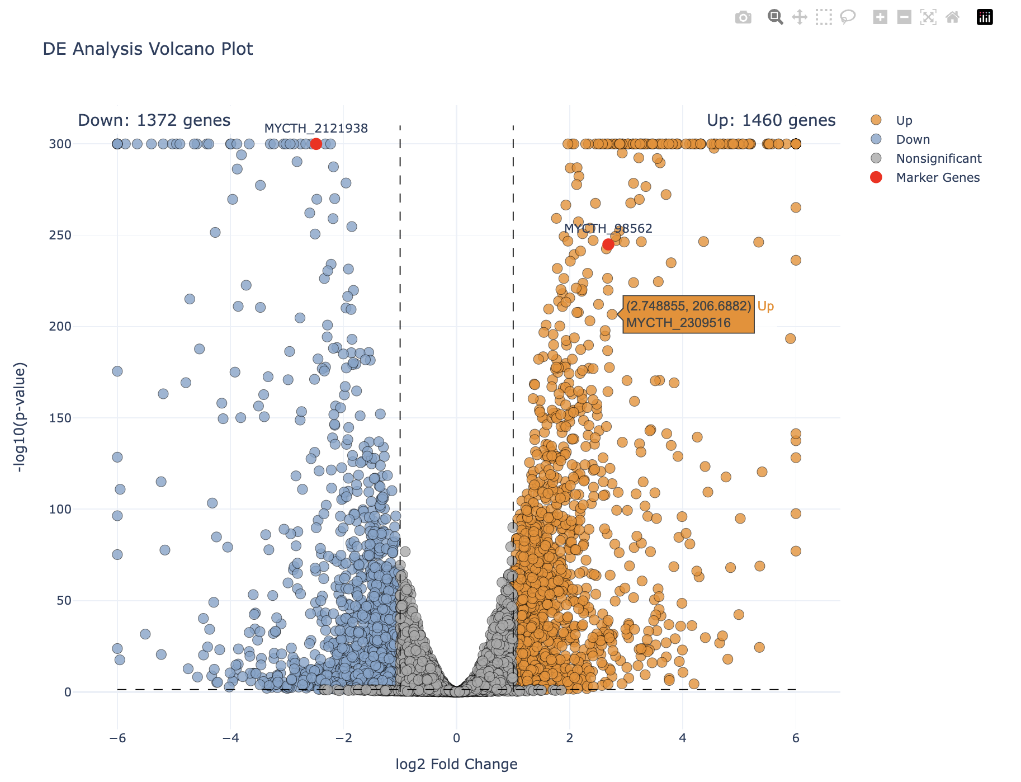
Omics Analysis -> Differential gene analysis 界面参考2
Home
Search
Datasets
Publication
Omics Analysis
Metabolic Analysis
Tools
Download
Volcano Plot
有4个设置好的颜色方案，1到4
True 与 False
Color Scheme ：
1
X fix：
False
Y fix ：
False
Width :
1200
Height :
900
Bubble Size :
5
P threshold :
0.05
LogFC_threshold :
1
Opacity :
0.8
Marker gene :
MYCTH_98562, MYCTH_2121938
Up donw info :
True
点击下载，获得对应png，上下调的genelist文件
Download
Submit
点击Submit，根据用户设置的参数重新出图
默认为空

Slide 6
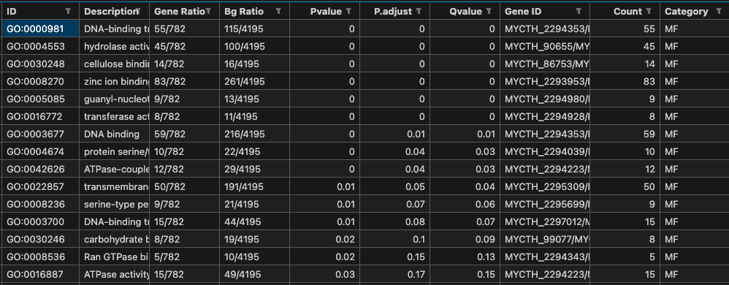
Omics Analysis -> GO/KEGG Enrichment 界面参考1
Home
Search
Datasets
Publication
Omics Analysis
Metabolic Analysis
Tools
Download
Corrrelation
Differential gene analysis
GO/KEGG Enrichment
Heatmap
PCA
Notice
Please Upload the gene list text file.
The gene identifiers should be in NCBI RefSeq format.
Click on "Example" to obtain a sample file.
Click to Upload the data
Species:
Myceliophthora thermophila
有GO、KEGG两个选择
Type：
GO
P adjust :
0.05
Example
Submit
点击Submit，加载差异分析结果
Enrichment Analysis Results
Download
Visualization
点击Visualization，按默认参数生成交互式可视化图

Slide 7
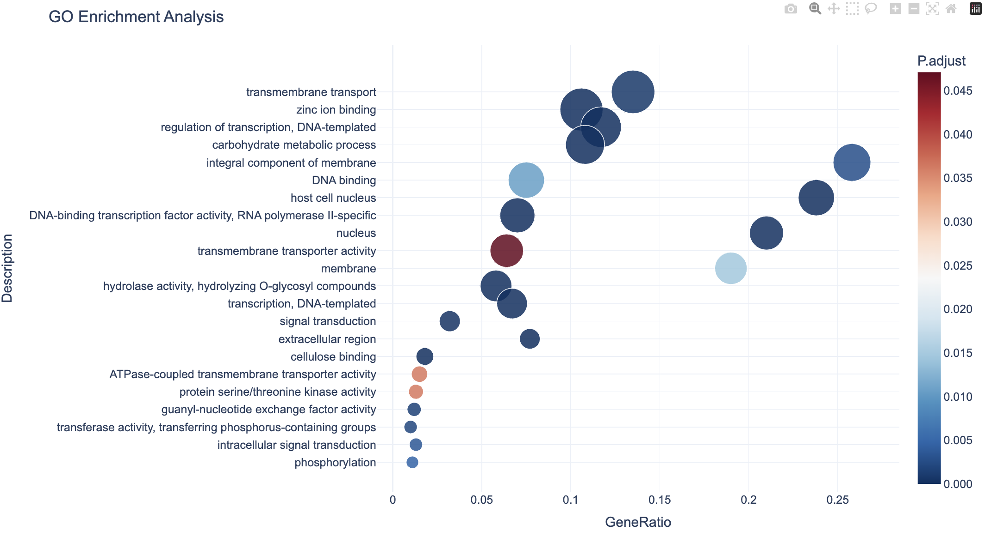
Omics Analysis -> GO/KEGG Enrichment 界面参考2
Home
Search
Datasets
Publication
Omics Analysis
Metabolic Analysis
Tools
Download
Functional Enrichment of Genes
选择：见notion文档Plotly颜色
有bubble与bar两个选择
有All、BP、CC、MF
四个选择
Color ：
rdbu_r
Pic Type ：
bubble
Type ：
All
Width :
1280
Height :
720
Chat Size :
30
P adjust :
0.05
Font Size
15
Chart Num:
30
点击下载，获得对应png
Download
Submit
点击Submit，根据用户设置的参数重新出图

Slide 8
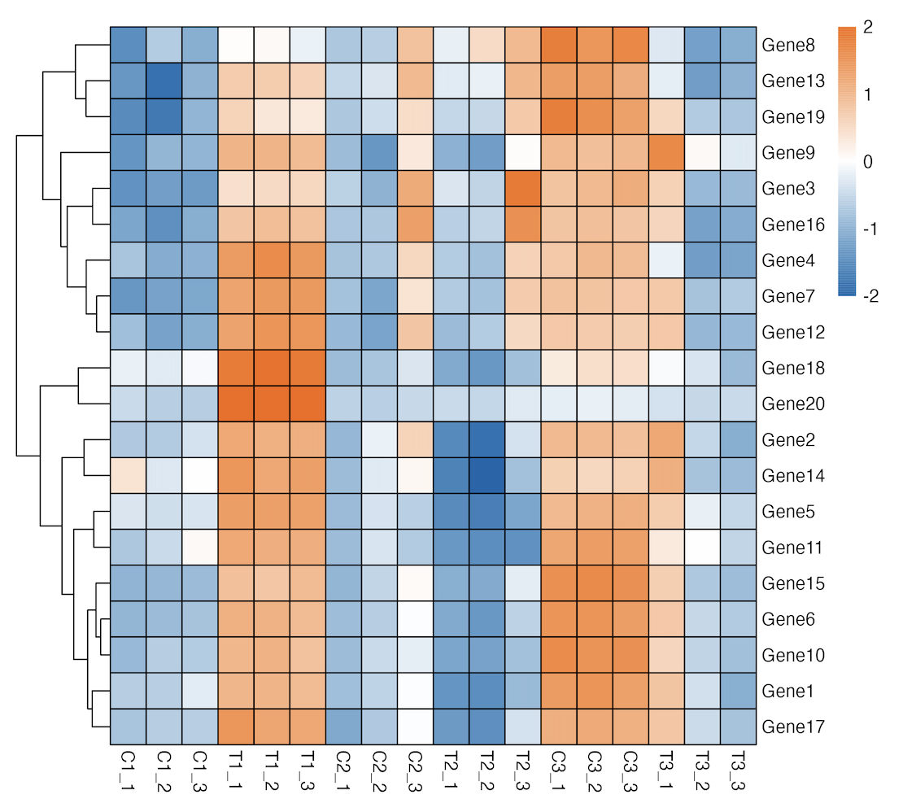
Omics Analysis -> Heatmap 界面参考
Home
Search
Datasets
Publication
Omics Analysis
Metabolic Analysis
Tools
Download
Corrrelation
Differential gene analysis
GO/KEGG Enrichment
Heatmap
PCA
Notice
Upload transcriptome data csv file to generate a heatmap.
Click on "Example" to obtain a sample file.
Color up input box can be entered hexadecimal color code,
有log2与z-score
Click to Upload the data
有True与False
Show border :
True
Scale :
log
Cluster rows :
True
Cluster_cols ：
False
Cellwidth :
20
cellheight :
20
font Size :
10
Color up :
default
Color down :
default
Color mid :
default
Example
Submit
Heatmap
点击Submit，生成Heatmap图
点击下载，获得heatmap.png
Download

Slide 9
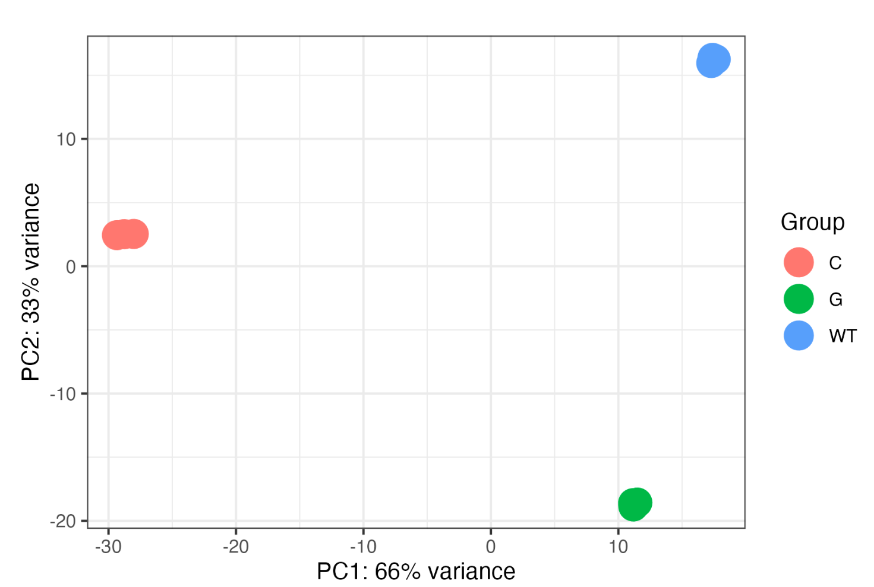
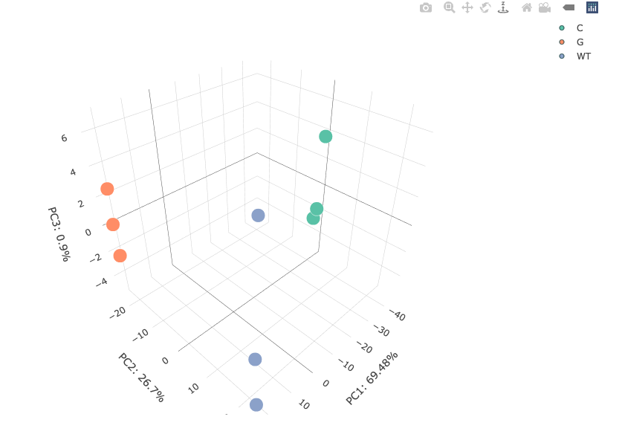
Omics Analysis -> PCA 界面参考
Home
Search
Datasets
Publication
Omics Analysis
Metabolic Analysis
Tools
Download
Corrrelation
Differential gene analysis
GO/KEGG Enrichment
Heatmap
PCA
Notice
Upload the transcriptome data and the CSV file containing sample grouping.
Click on "Example" to obtain a sample file.
Click to Upload the Transcriptome data
Click to Upload the Sample Group
Example
Submit
点击Submit，生成3D PCA图
PCA Analysis
3DPCA Analysis
点击下载，获得pca.png
Download

