Slide 1



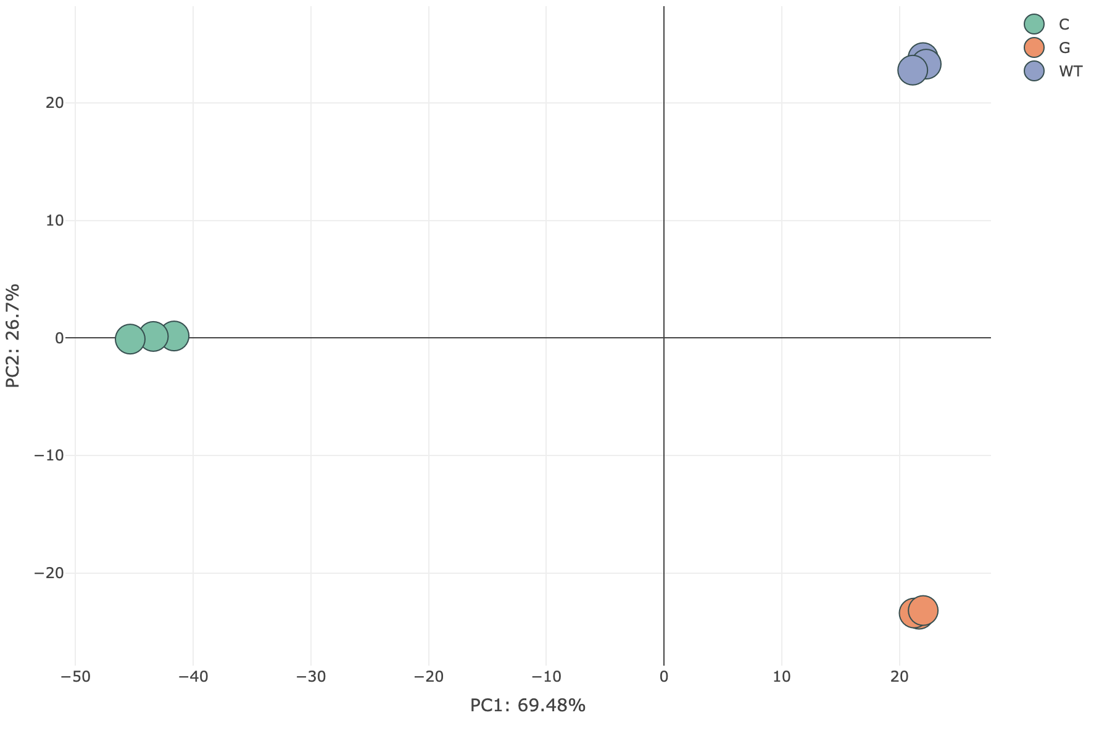
Omics Analysis -> PCA 界面参考
Home
Search
Datasets
Publication
Omics Analysis
Metabolic Analysis
Tools
Download
Corrrelation
Differential gene analysis
GO/KEGG Enrichment
Heatmap
PCA
Notice
Upload the transcriptome data and the CSV file containing sample grouping.
Click on "Example" to obtain a sample file.
Click to Upload the Transcriptome data
Click to Upload the Sample Group
Example
Submit

Slide 2

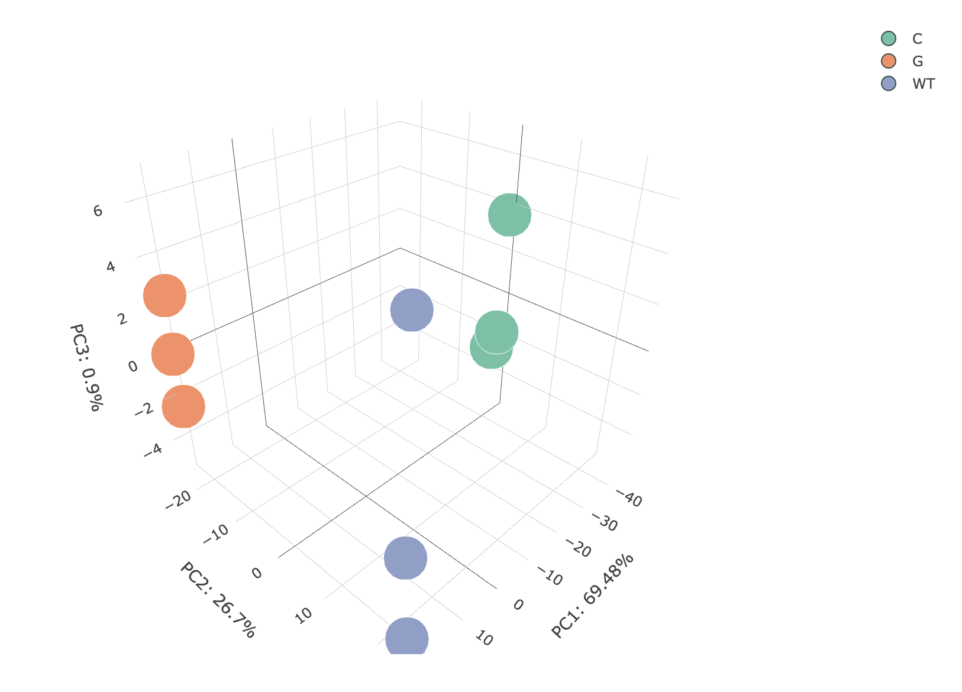
Omics Analysis -> PCA 界面参考
Home
Search
Datasets
Publication
Omics Analysis
Metabolic Analysis
Tools
Download
Corrrelation
Differential gene analysis
GO/KEGG Enrichment
Heatmap
PCA
Notice
Upload the transcriptome data and the CSV file containing sample grouping.
Click on "Example" to obtain a sample file.
Click to Upload the Transcriptome data
Click to Upload the Sample Group
Example
Submit

