Slide 1
Tower Defence Game
SOEN6441 Project Build2
Team11 member:

Slide 2
OUTLINE
Goal
Architecture Design
Demonstration

Slide 3
Goal
We use MVC and designed pattern to improve some part of our project , including create map and editing and game play.

Slide 4
Architecture Design

Slide 5
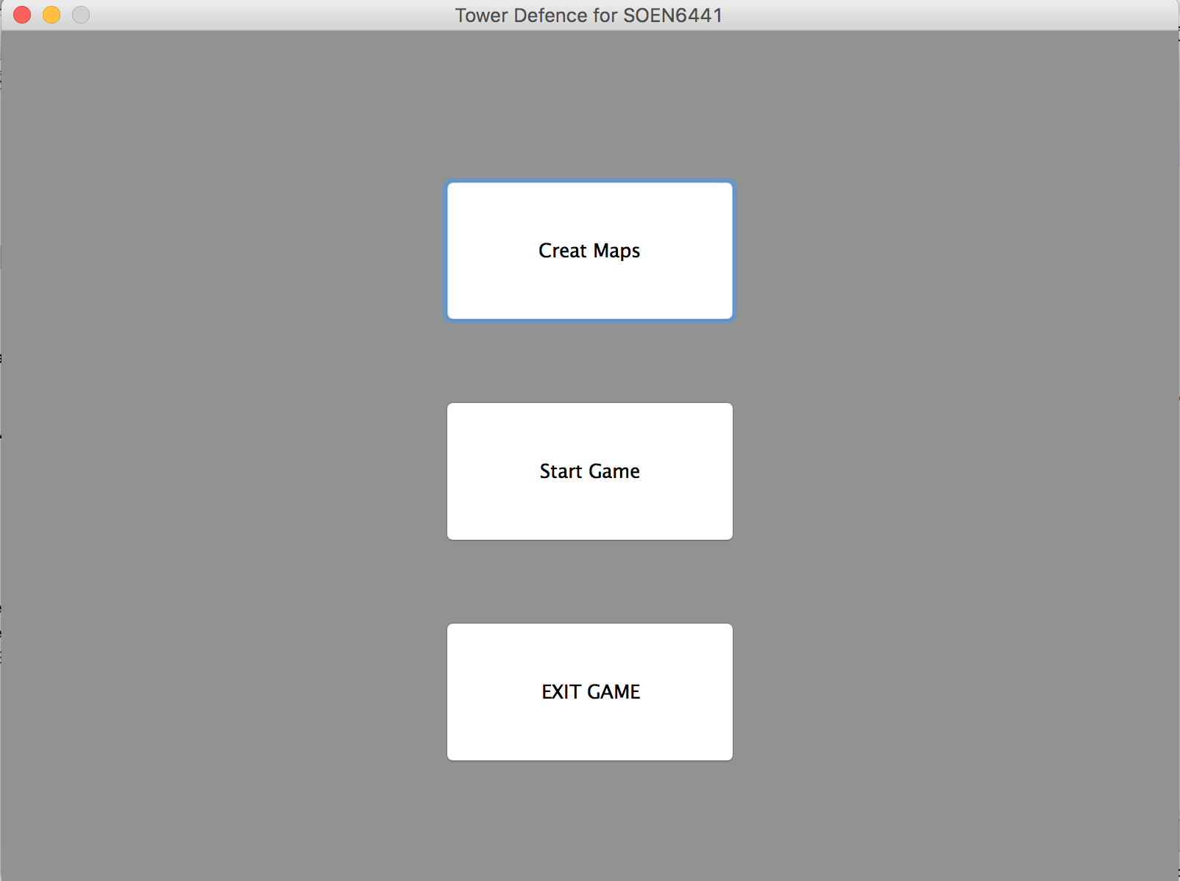
First singleton

