Slide 1
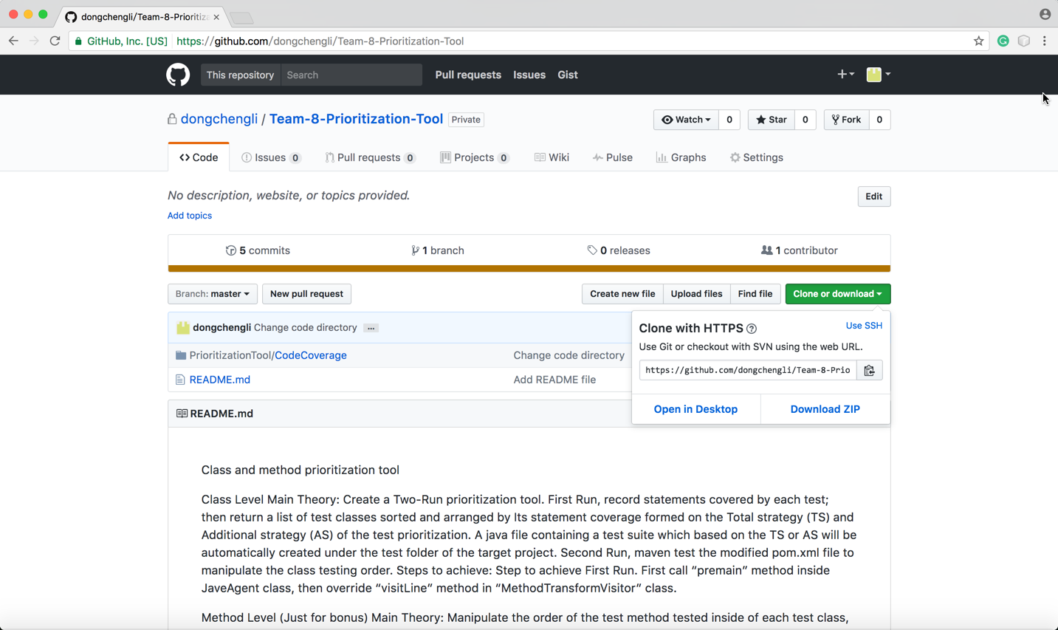
Download Prioritization Tool from the GitHub repository, https://github.com/dongchengli/Team-8-Prioritization-Tool

Slide 2
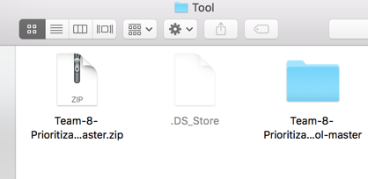
Put Downloaded Team-8-Prioritization-Tool-master.zip file inside a new directory or any directory (Directory named simple and with no space between words is recommended, such as Tool), and extract the zip file.

Slide 3
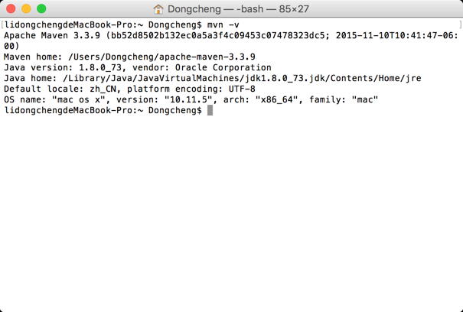
From the commend line, first check the maven, type mvn –v, if no maven installed, it need to be installed

Slide 4
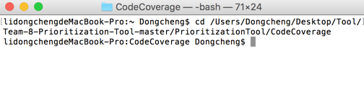
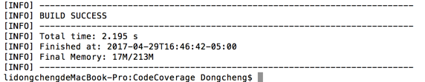
In the Commend Line Direct to the directory of the CodeCoverage folder inside of the Team-8-Prioritization-Tool-master folder, type cd /yourfolderpath/
Then press mvn install, and it will show build successfully

Slide 5
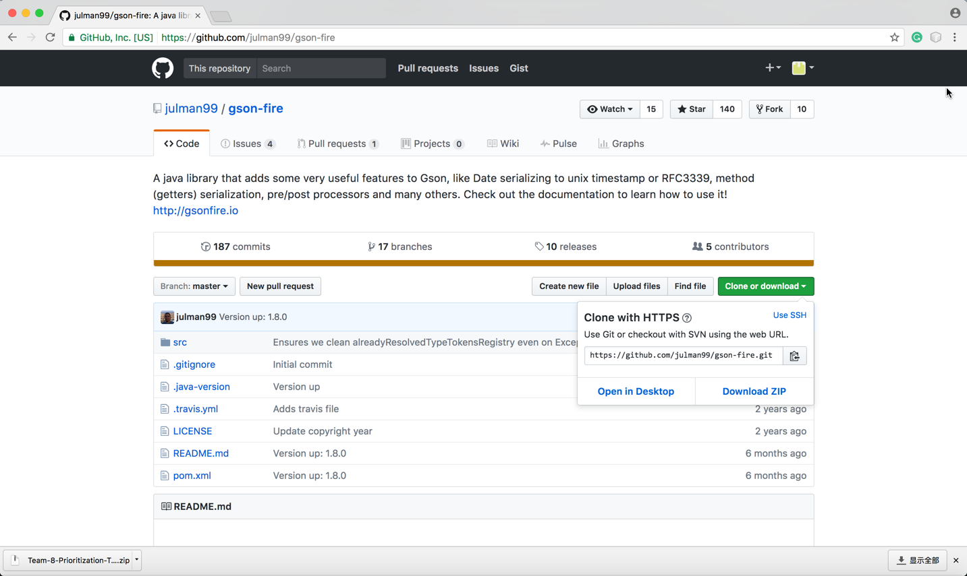
Go to https://github.com/julman99/gson-fire, then download this real world Github project for testing purpose.

Slide 6
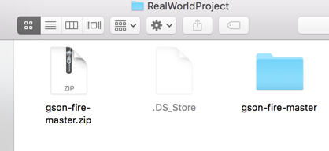
Put Downloaded gson-fire-master.zip file inside a new directory or any directory (Directory named simple and with no space between words is recommended, such as RealWorldProject), and extract the zip file.

Slide 7
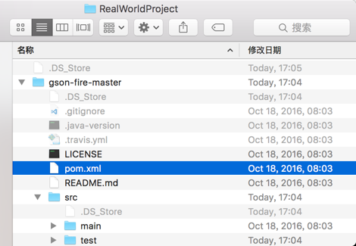
Open the pom.xml file in the root directory of the project

Slide 8
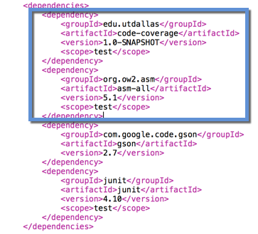
First you need to add dependencies
Such as in the example
<dependency>
<groupId>edu.utdallas</groupId>
<artifactId>code-coverage</artifactId>
<version>1.0-SNAPSHOT</version>
<scope>test</scope>
</dependency>
<dependency>
<groupId>org.ow2.asm</groupId>
<artifactId>asm-all</artifactId>
<version>5.1</version>
<scope>test</scope>
</dependency>
(Note: copy and paste only under the .pptx format, copy and paste from other file format, such as pdf may cause program error, there is also a README_Material.txt for copy)

Slide 9
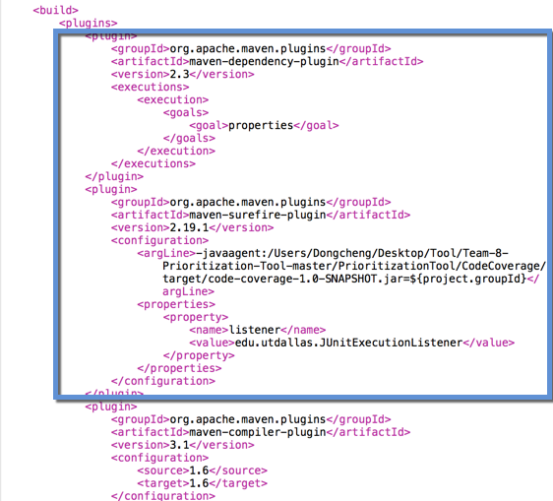
Next you need to add the plugins
Such as in the example
<plugin>
<groupId>org.apache.maven.plugins</groupId>
<artifactId>maven-dependency-plugin</artifactId>
<version>2.3</version>
<executions>
<execution>
<goals>
<goal>properties</goal>
</goals>
</execution>
</executions>
</plugin>
<plugin>
<groupId>org.apache.maven.plugins</groupId>
<artifactId>maven-surefire-plugin</artifactId>
<version>2.19.1</version>
<configuration>
<argLine>-javaagent:/YourPath/code-coverage-1.0-SNAPSHOT.jar=${project.groupId}</argLine>
<properties>
<property>
<name>listener</name>
<value>edu.utdallas.JUnitExecutionListener</value>
</property>
</properties>
</configuration>
</plugin>
(Note: copy and paste only under the .pptx format, copy and paste from other file format, such as pdf may cause program error, there is also a README_Material.txt for copy)

Slide 10
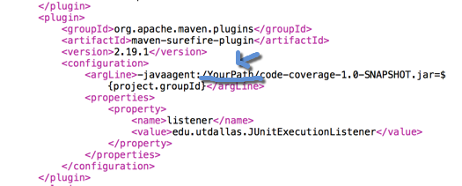
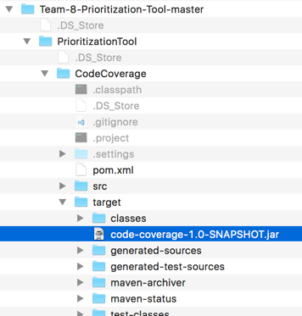
The YourPath here, is the path of the code-coverage-1.0-SNAPSHOT.jar file, which we generated by mvn install the PrioritizationTool, this jar file is created under the target directory of the CodeCoverage
For example, in the example project the YourPath is “/Users/Dongcheng/Desktop/Tool/Team-8-Prioritization-Tool-master/PrioritizationTool/CodeCoverage/target/”.

Slide 11

First Run
In the Commend Line, Direct to the directory of the pom.xml file inside of the test program, then mvn clean, after that, mvn test
In the console it will output the default class execution order and calculated total and additional prioritizations for the each test method
Then it will show build success

Slide 12
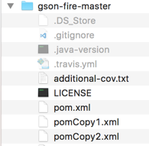
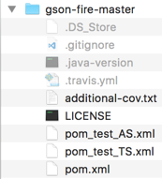
Second Run
First make two copies of the pom.xml file, one for Total Strategy and one for Additional strategy, rename them according to the Prioritization strategy they’re using
For example, we named pom_test_AS.xml for test program using Additional strategy, and pom_test_TS.xml for test program using Total strategy.

Slide 13
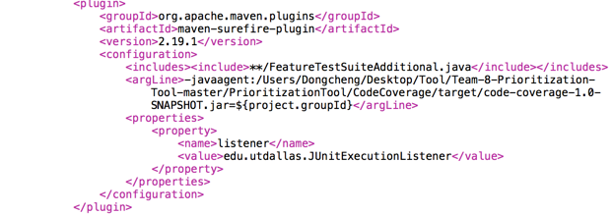
Then we add “Includes” after the beginning of the <configuration> tag or right before the <argLine> tag, inside of the “maven-surefire-plugin”, add to the pom file according to the strategy its using
If using total strategy, add:
<includes><include>**/FeatureTestSuite.java</include></includes>
If using additional strategy, add:
<includes><include>**/FeatureTestSuiteAdditional.java</include></includes>
Such as in the test program, we add
<includes><include>**/FeatureTestSuite.java</include></includes>
In the pom_test_TS.xml, and we add
<includes><include>**/FeatureTestSuite.java</include></includes>
In the pom_test_TS.xml

Slide 14
Finally, if we want to test program using Total strategy, under the directory of the test program, we just type mvn test -f pom_test_TS.xml or if we want to test program using Additional strategy we just type mvn test -f pom_test_AS.xml
In the console it will output the manipulated class execution order using the choice of user

Slide 15
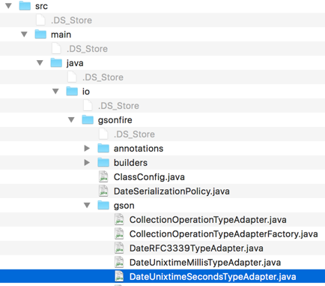
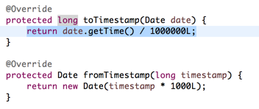
To compare the time to detect the first bug of the original execution and the prioritized execution. First, we manually create bug for the test program.
Such as in the test program, gson-fire, under src/main/java/io/gsonfire/gson in the DateUnixtimeSecondsTypeAdapter class, we increase the value of the denominator of the return value from 1000L to 1000000L. It causes one failure during the program execution.
Then, just run the program with
mvn test , for the original execution
mvn test -f pom_test_TS.xml , or
mvn test -f pom_test_TS.xml , for the prioritized execution.

