Slide 1

Living in the U.S.
Team Petadata A++

Slide 2
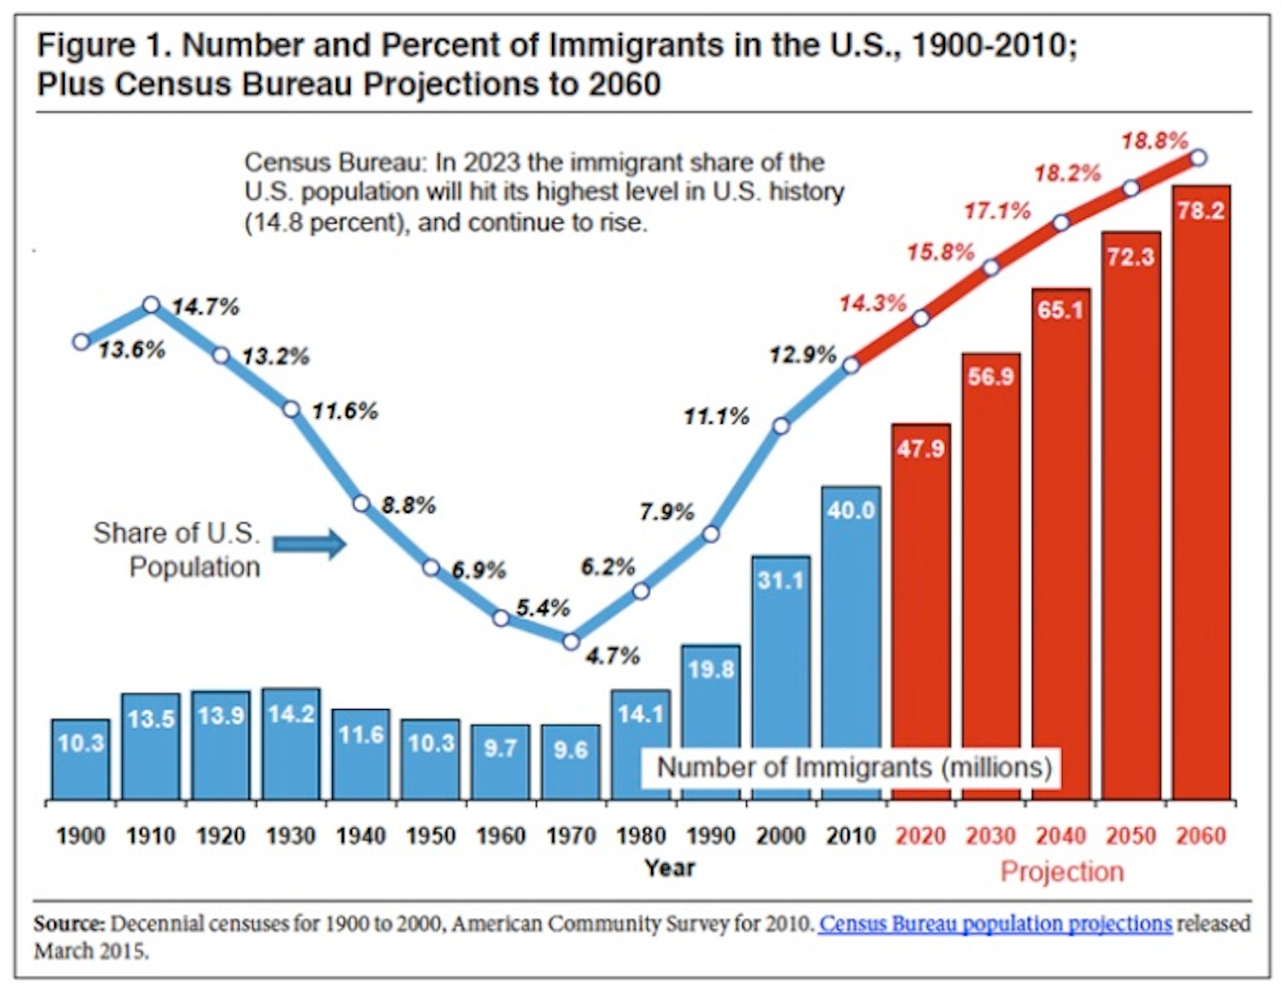
Immigration is on the rise
US Immigration is projected to hit an all-time high within the next 10 years
Image source: http://www.washingtonexaminer.com/census-record-51-million-immigrants-in-8-years-will-account-for-82-of-u.s.-growth/article/2563463

Slide 3



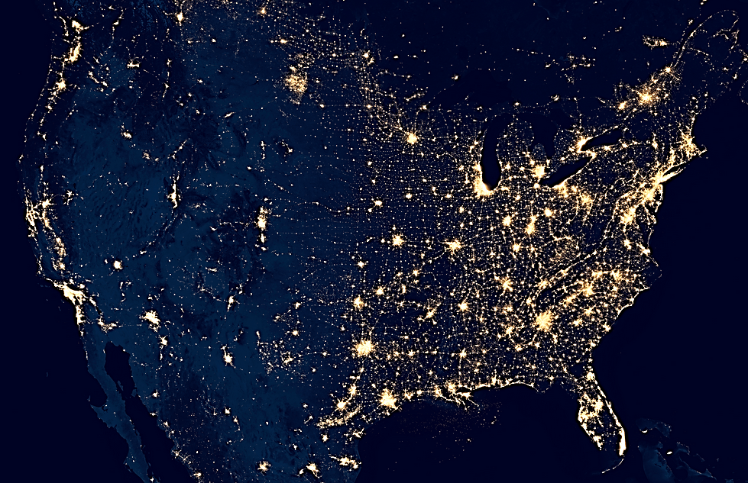
Crime Rate
Washington
New York
California
Illinois
http://www.worldwideweirdnews.com/2014/10/01-n34597.html
Notes:
California -0.28
Washington State 0.18
Il
ny
<number>

Slide 4
Unemployment Rate
California
Illinois
New York
Washington

Slide 5
The Algorithm
Step I: Attribute & Gather Data
Step II: Standardize & Weigh
Step III: Aggregate
Step V: Future Considerations
Determine factors Acquire data sets | Standardize data distributions Assign weights based on Google search data | Aggregate weights & data sets into overarching algorithm Index regions based on factors | Implement web scraping algorithm Incorporate live feed from Twitter
Notes:
http://adage.com/article/digital/snapchat-hires-google-exec-run-political-ad-sales/298558/
Local ad targeting, however, is an option. Snapchat has been tweaking its ad-supported "Live Story" feeds to backdoor its way into letting advertisers target people in certain locations. Snapchat has been pitching advertisers on running ads within its localized Live Stories that are tied to a specific city or college campus. Those local ads can be had for $50,000 a pop while ads within the national "Live Story" feeds start at $100,000 per ad.
$750,000 a day
20/dollars per 1000 views
http://adage.com/article/digital/snapchat-tweaking-story-ad-sales-strategy/298082/
All of which explains why Snapchat is able to command big bucks for Live Story ads. Snapchat is asking marketers to pay between $400,000 and $500,000 for a full takeover of a Live Story feed, which would include a brand mention on the opening title card, as well as branded snaps interspersed throughout the feed, the executives said. But Snapchat is also offering a lower-priced option in which a brand can pay $100,000 for a single branded snap that can run for up to 10 seconds.
. That may have to do with more adults using the app. Snapchat is considered the hot mobile app to get in front of teens, but 70% of its users are actually 18-years-old or older.
http://recode.net/2015/03/12/snapchats-ad-rates-for-its-discover-feature-are-really-high/
750,000 for 24 hours
Snapchat apparently commands $400,000 to $500,000 for sponsorship rights on each Our Story feed, and around $100,000 for a single snap which will appear for up to ten seconds.
All candidates once a month until 6 months until the end of april
3 14
10 candidates will dro pout
May june july 7 candidates will do it once a week, these metrics will provide for the parties
August september october - once a week
Novemebr, two week
Last month october 8Th – November 8th, both candidates will want the feed the entire month so yeah
<number>

Slide 6
The Algorithm
Step I: Attribute & Gather Data
Step II: Standardize & Weigh
Step III: Aggregate
Step IV: Future Considerations
Factors
Safety Accidents Crime Rates Natural Disasters | Economic Opportunities Housing Prices Income Tax Rates Unemployment Rates | Quality of Life Depression Treatment Divorce Rates
Notes:
http://adage.com/article/digital/snapchat-hires-google-exec-run-political-ad-sales/298558/
Local ad targeting, however, is an option. Snapchat has been tweaking its ad-supported "Live Story" feeds to backdoor its way into letting advertisers target people in certain locations. Snapchat has been pitching advertisers on running ads within its localized Live Stories that are tied to a specific city or college campus. Those local ads can be had for $50,000 a pop while ads within the national "Live Story" feeds start at $100,000 per ad.
$750,000 a day
20/dollars per 1000 views
http://adage.com/article/digital/snapchat-tweaking-story-ad-sales-strategy/298082/
All of which explains why Snapchat is able to command big bucks for Live Story ads. Snapchat is asking marketers to pay between $400,000 and $500,000 for a full takeover of a Live Story feed, which would include a brand mention on the opening title card, as well as branded snaps interspersed throughout the feed, the executives said. But Snapchat is also offering a lower-priced option in which a brand can pay $100,000 for a single branded snap that can run for up to 10 seconds.
. That may have to do with more adults using the app. Snapchat is considered the hot mobile app to get in front of teens, but 70% of its users are actually 18-years-old or older.
http://recode.net/2015/03/12/snapchats-ad-rates-for-its-discover-feature-are-really-high/
750,000 for 24 hours
Snapchat apparently commands $400,000 to $500,000 for sponsorship rights on each Our Story feed, and around $100,000 for a single snap which will appear for up to ten seconds.
All candidates once a month until 6 months until the end of april
3 14
10 candidates will dro pout
May june july 7 candidates will do it once a week, these metrics will provide for the parties
August september october - once a week
Novemebr, two week
Last month october 8Th – November 8th, both candidates will want the feed the entire month so yeah
<number>

Slide 7
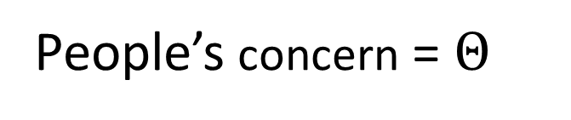
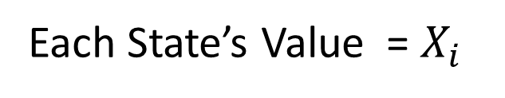
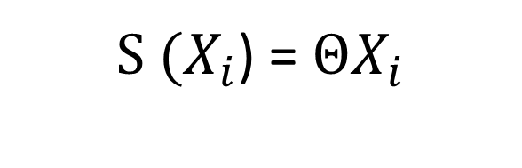
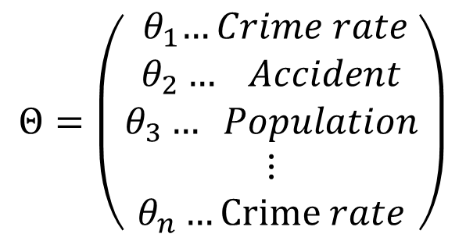
California Weighted Value
Google Trend
Algorithm
Unemployment
People’s concern =
Education
Each State’s Value =
Collision
Crime Rate
) =
Earthquake
Wage
Divorce
Housing price
Depression
Disaster

Slide 8
The Algorithm
Step I: Attribute & Gather Data
Step II: Standardize & weigh
Step III: Aggregate
Step IV: Future Considerations
Scalability
Standardize Standardize using Z scores Indicator (+, -) | Weigh Google Trends Infer model coefficients based on consumer desire Crime rates > natural disasters
Notes:
http://adage.com/article/digital/snapchat-hires-google-exec-run-political-ad-sales/298558/
Local ad targeting, however, is an option. Snapchat has been tweaking its ad-supported "Live Story" feeds to backdoor its way into letting advertisers target people in certain locations. Snapchat has been pitching advertisers on running ads within its localized Live Stories that are tied to a specific city or college campus. Those local ads can be had for $50,000 a pop while ads within the national "Live Story" feeds start at $100,000 per ad.
$750,000 a day
20/dollars per 1000 views
http://adage.com/article/digital/snapchat-tweaking-story-ad-sales-strategy/298082/
All of which explains why Snapchat is able to command big bucks for Live Story ads. Snapchat is asking marketers to pay between $400,000 and $500,000 for a full takeover of a Live Story feed, which would include a brand mention on the opening title card, as well as branded snaps interspersed throughout the feed, the executives said. But Snapchat is also offering a lower-priced option in which a brand can pay $100,000 for a single branded snap that can run for up to 10 seconds.
. That may have to do with more adults using the app. Snapchat is considered the hot mobile app to get in front of teens, but 70% of its users are actually 18-years-old or older.
http://recode.net/2015/03/12/snapchats-ad-rates-for-its-discover-feature-are-really-high/
750,000 for 24 hours
Snapchat apparently commands $400,000 to $500,000 for sponsorship rights on each Our Story feed, and around $100,000 for a single snap which will appear for up to ten seconds.
All candidates once a month until 6 months until the end of april
3 14
10 candidates will dro pout
May june july 7 candidates will do it once a week, these metrics will provide for the parties
August september october - once a week
Novemebr, two week
Last month october 8Th – November 8th, both candidates will want the feed the entire month so yeah
<number>

Slide 9
The Algorithm
Step I: Attribute & Gather Data
Step II: Standardize & Weigh
Step III: Aggregate
Step IV: Future Considerations
The Model
Index regions based on factors people find significant
Notes:
http://adage.com/article/digital/snapchat-hires-google-exec-run-political-ad-sales/298558/
Local ad targeting, however, is an option. Snapchat has been tweaking its ad-supported "Live Story" feeds to backdoor its way into letting advertisers target people in certain locations. Snapchat has been pitching advertisers on running ads within its localized Live Stories that are tied to a specific city or college campus. Those local ads can be had for $50,000 a pop while ads within the national "Live Story" feeds start at $100,000 per ad.
$750,000 a day
20/dollars per 1000 views
http://adage.com/article/digital/snapchat-tweaking-story-ad-sales-strategy/298082/
All of which explains why Snapchat is able to command big bucks for Live Story ads. Snapchat is asking marketers to pay between $400,000 and $500,000 for a full takeover of a Live Story feed, which would include a brand mention on the opening title card, as well as branded snaps interspersed throughout the feed, the executives said. But Snapchat is also offering a lower-priced option in which a brand can pay $100,000 for a single branded snap that can run for up to 10 seconds.
. That may have to do with more adults using the app. Snapchat is considered the hot mobile app to get in front of teens, but 70% of its users are actually 18-years-old or older.
http://recode.net/2015/03/12/snapchats-ad-rates-for-its-discover-feature-are-really-high/
750,000 for 24 hours
Snapchat apparently commands $400,000 to $500,000 for sponsorship rights on each Our Story feed, and around $100,000 for a single snap which will appear for up to ten seconds.
All candidates once a month until 6 months until the end of april
3 14
10 candidates will dro pout
May june july 7 candidates will do it once a week, these metrics will provide for the parties
August september october - once a week
Novemebr, two week
Last month october 8Th – November 8th, both candidates will want the feed the entire month so yeah
<number>

Slide 10
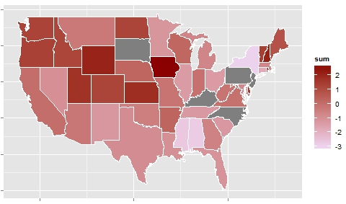

Slide 11
The Algorithm
Step I: Attribute & Gather Data
Step II: Standardize & Weigh
Step III: Aggregate
Step IV: Future Considerations
Next Steps
City specific analysis Implement web scraping algorithm Incorporate live feed from Twitter
Notes:
http://adage.com/article/digital/snapchat-hires-google-exec-run-political-ad-sales/298558/
Local ad targeting, however, is an option. Snapchat has been tweaking its ad-supported "Live Story" feeds to backdoor its way into letting advertisers target people in certain locations. Snapchat has been pitching advertisers on running ads within its localized Live Stories that are tied to a specific city or college campus. Those local ads can be had for $50,000 a pop while ads within the national "Live Story" feeds start at $100,000 per ad.
$750,000 a day
20/dollars per 1000 views
http://adage.com/article/digital/snapchat-tweaking-story-ad-sales-strategy/298082/
All of which explains why Snapchat is able to command big bucks for Live Story ads. Snapchat is asking marketers to pay between $400,000 and $500,000 for a full takeover of a Live Story feed, which would include a brand mention on the opening title card, as well as branded snaps interspersed throughout the feed, the executives said. But Snapchat is also offering a lower-priced option in which a brand can pay $100,000 for a single branded snap that can run for up to 10 seconds.
. That may have to do with more adults using the app. Snapchat is considered the hot mobile app to get in front of teens, but 70% of its users are actually 18-years-old or older.
http://recode.net/2015/03/12/snapchats-ad-rates-for-its-discover-feature-are-really-high/
750,000 for 24 hours
Snapchat apparently commands $400,000 to $500,000 for sponsorship rights on each Our Story feed, and around $100,000 for a single snap which will appear for up to ten seconds.
All candidates once a month until 6 months until the end of april
3 14
10 candidates will dro pout
May june july 7 candidates will do it once a week, these metrics will provide for the parties
August september october - once a week
Novemebr, two week
Last month october 8Th – November 8th, both candidates will want the feed the entire month so yeah
<number>

Slide 12
