Slide 1
CANopen
발표자 : 박병훈

Slide 2
순서
- CAN
. CAN통신 소개
CANopen
. CANopen 소개
. CANopen 응용분야
. Object Dictionary

Slide 3
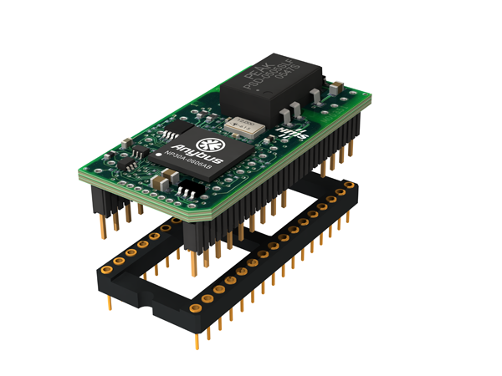
Anybus-IC Overview
integrated galvanic isolation
Anybus NP30 microcontroller including network ASIC, RAM & Flash memory
network interface pins
single 5 Volt supply
application interface pins SSC, MIF, SCI
DIL-32 chip socket (not included in delivery)
Dimensions: 42 x 21 x 15 mm (L x W x H)

Slide 4
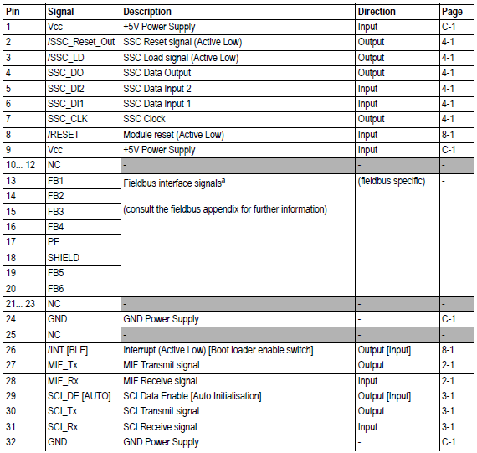

Slide 5

The hardware interface consists of two asynchronous serial ports, a synchronous interface for direct I/O and the network interface
DI1
Direct IO Interface (SSI)
Synchronous Serial Interface (TTL Signal Levels)
DI2
LD
CLK
DO
Network Interface (function depending on specific network type)
Reset
UART Interface (SCI)
Serial Communication Interface
(TTL Signal Levels)
RX
TX
UART Interface (MIF)
Monitor & Configuration Interface (TTL Signal Levels)
RX
TX
Anybus-IC
Power Supply 5 Volt
5V
GND

Slide 6
Via its synchronous SSC interface, the Anybus-IC can control up to 128 bit direct Inputs and max 128 bit direct Outputs
Network independent
device electronics
Network specific
interface
Analog Input
A
D
Digital Input
Node Address
Shift Register
Shift Register
Shift Register
DI
LD
CLK
Shift Register
Shift Register
Shift Register
DO
D
A
Digital Output
Diag LED´s
Analog Output
Serial UART Interface
Anybus-IC
Serial Configuration Interface
5 Volt Supply

Slide 7
The software interface is based on a subset of the serial Modbus-RTU communication protocol
Modbus-RTU Master
Modbus-RTU Slave
request frame
Host microcontroller
response frame
SCI Interface
Anybus-IC
Each Sequence:
consists of a request and a response frame
is time controlled with a watchdog function
Network Interface
Each frame:
contains a function code, address, data, parameter
contains a CRC checksum (can be switched off)

Slide 8
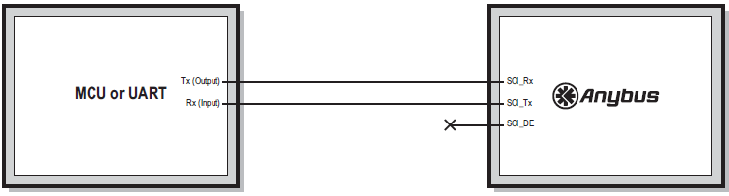
SCI 인터페이스
통신 프로토콜 : MODBUS-RTU
SCI_TX : PIN 30
SCI_RX : PIN 31
SCI_DE : PIN29(for 485)

Slide 9
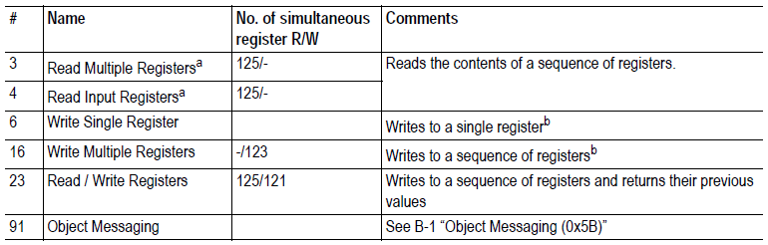
Function code

Slide 10
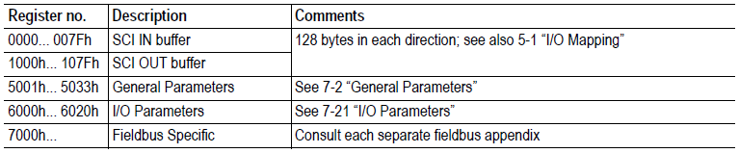
Register Map

Slide 11
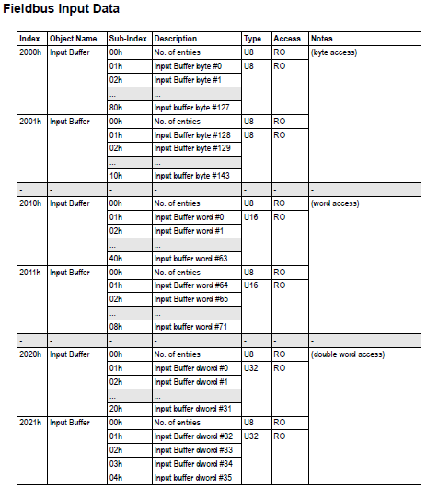
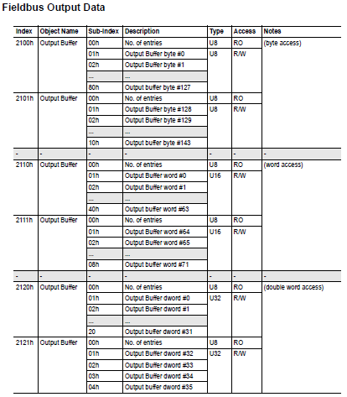
Data Exchange(2000h~5FFFh)

