Slide 1
Real Estate Price Prediction
Can predictive modeling outperform simple valuation heuristics for home prices?
1,879 residential sales · 3 models compared · Random Forest deployed
Donghwan Won | Dylan H. Won
Python · pandas · scikit-learn · matplotlib · Streamlit

Slide 2
Summary
1
Business needs
2
Data engineering
Can predictive modeling outperform simple valuation heuristics for home prices?
1,879 residential sales, 11 fields; no missing values
property_type one-hot encoded → 11 model features
80/20 stratified train/test split (random_state = 42)
3
Machine learning model
4
BI intelligence
Compared 3 kinds of regression models: Linear Regression, Random Forest, Gradient Boosting
Random Forest is the best one on test: MAE $43,795 · R² 0.834
Deploy Random Forest for valuation support; flag large model-vs-actual gaps
Regardless of bungalow or condo type, insurance, year sold, and property tax are the top drivers, indicating that carrying costs and market timing dominate.

Slide 3
Business needs
Can predictive modeling outperform simple valuation heuristics for home prices?
Why it matters
Agents typically price with rules of thumb: average $/sqft, or the average sale price of the property type.
Heuristics ignore quality, timing, and carrying costs — leading to systematic over/under-pricing.
A model with lower average error creates a defensible pricing guideline and flags outlier listings.
1,879
residential sales (Condo / Bungalow)
$423K
mean sale price · range $200K–$800K
11
candidate features per property

Slide 4
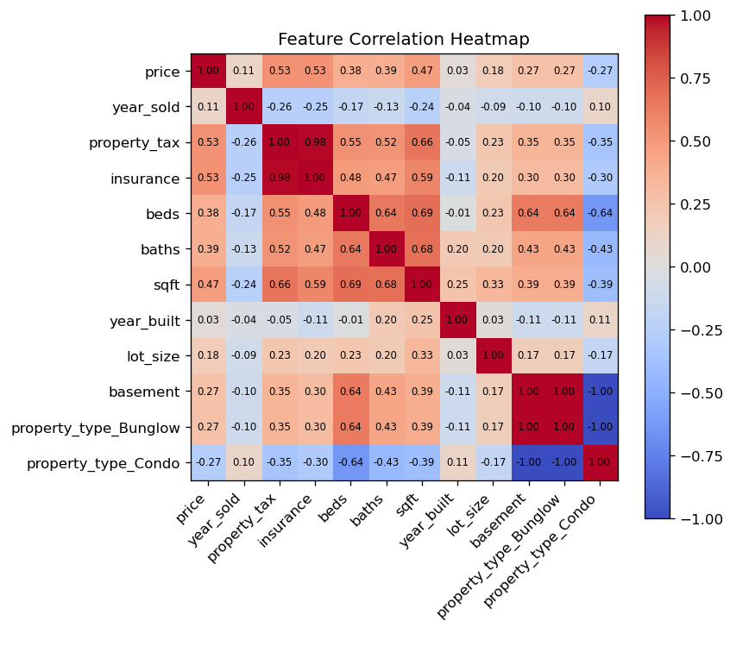
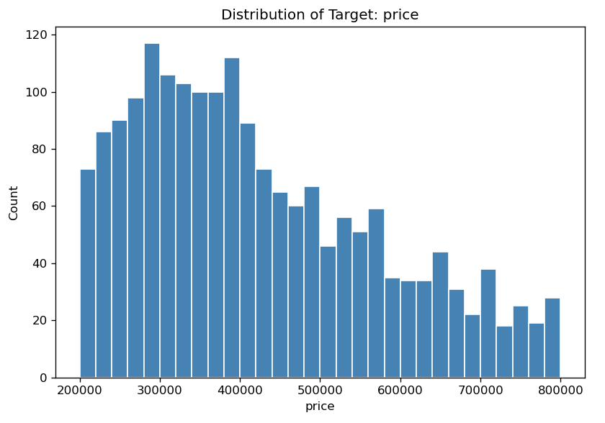
Data processing
Dataset
1,879 rows × 11 columns; zero missing values
Target: price — mean $423,055, std $151,538
Feature engineering
property_type one-hot encoded (Condo / Bungalow) → 11 features, none dropped
Top correlations with price
property_tax 0.53 · insurance 0.53 · sqft 0.47
baths 0.39 · beds 0.38 · basement 0.27
Right-skewed price distribution;
costs (tax, insurance) correlate
most strongly with price.

Slide 5
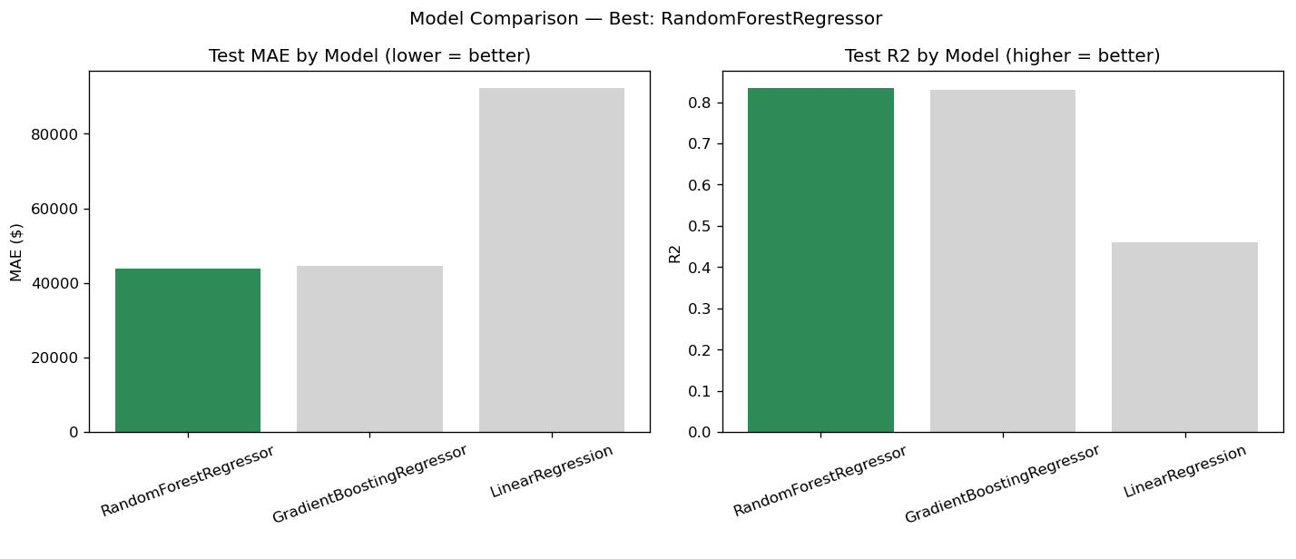
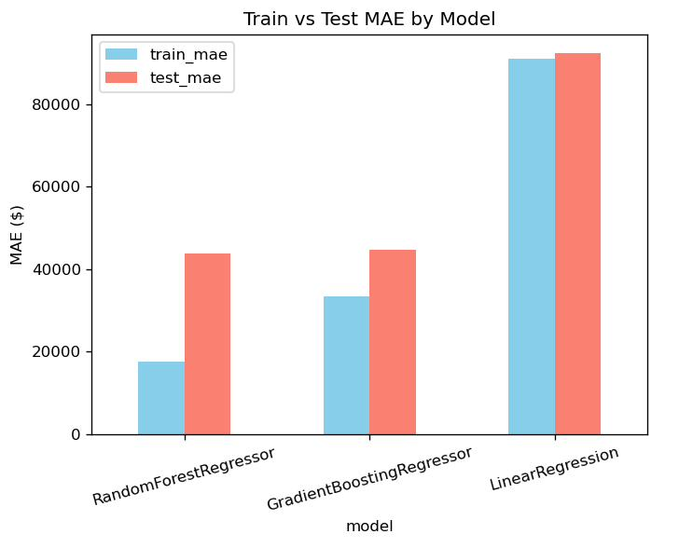
Modelling
Model | Train MAE | Test MAE | Test RMSE | Test R²
Random Forest | $17,619 | $43,795 | $64,424 | 0.834
Gradient Boosting | $33,336 | $44,611 | $65,024 | 0.831
Linear Regression | $91,017 | $92,220 | $116,262 | 0.459
Same 80/20 stratified split shared by all models (fair comparison).
Selection criterion: lowest test MAE → Random Forest (200 trees, absolute-error criterion).
Nonlinear ensembles halve the error of Linear Regression — price drivers interact nonlinearly.

Slide 6
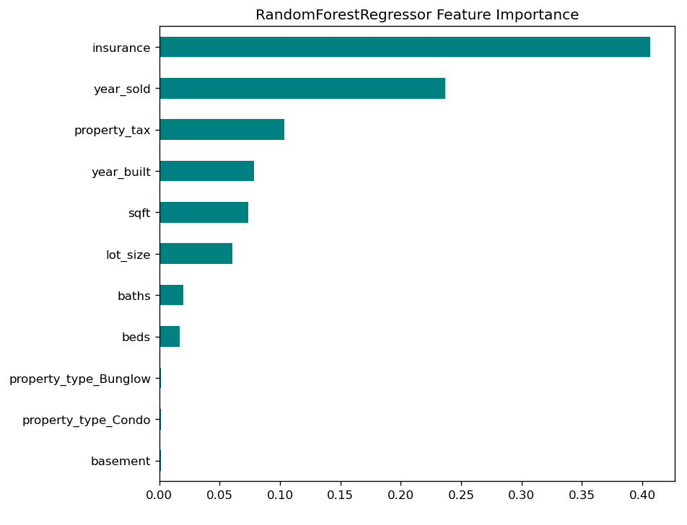
Business intelligence
Insight
Top drivers: insurance (0.41), year_sold (0.24), property_tax (0.10) — carrying costs and market timing dominate.
Raw size (sqft 0.07) and bed/bath counts matter far less than heuristics assume.
Property type and basement add almost nothing once costs are known.
What to do
Anchor pricing guidelines on the top cost/timing factors, not $/sqft alone.
Flag listings where |actual − predicted| is large (≈ > $44K MAE) for manual review.
Serve predictions through the Streamlit app next to both heuristics for transparency.

Slide 7
Caveats
Overfitting gap
Proxy features
The Random Forest achieved a much lower MAE on the training data ($17.6K) than on the test data ($43.8K), showing that it fits the training observations well but does not generalize equally well to unseen cases. This large performance gap provides evidence of overfitting, meaning the ensemble has learned not only meaningful patterns but also noise specific to the training set. Therefore, although the training result appe
In heatmap, property_tax and insurance correlate 0.98 and are partly consequences of value — useful for valuation review, risky for pure forecasting.
No location data
Static snapshot
The model excludes neighborhood, school, geographic, and urban–remote location features, leaving a substantial share of real-estate price variation unexplained and limiting its pricing accuracy.
Because sales span multiple years without inflation adjustment, the model should be redesigned to incorporate these conditions and retrained as market conditions change

