Slide 1
Real Estate Price Prediction
Can predictive modeling outperform simple valuation heuristics for home prices?
1,879 residential sales · 3 models compared · Random Forest deployed
Donghwan Won | Dylan H. Won
Python · pandas · scikit-learn · matplotlib · Streamlit
Notes:
Hello, everyone. Today I will present our real-estate price prediction project.
The central question is whether predictive modeling can outperform the simple rules of thumb commonly used to price homes. Using 1,879 residential sales, we compared three regression models and selected Random Forest for deployment. The purpose is not simply to produce another price estimate. It is to provide a more consistent valuation-support tool that can be compared transparently with traditional heuristics.

Slide 2
Summary
1
Business needs
2
Data engineering
Can predictive modeling outperform simple valuation heuristics for home prices?
1,879 residential sales, 11 fields; no missing values
property_type one-hot encoded → 11 model features
80/20 stratified train/test split (random_state = 42)
3
Machine learning model
4
BI intelligence
Compared 3 kinds of regression models: Linear Regression, Random Forest, Gradient Boosting
Random Forest is the best one on test: MAE $43,795 · R² 0.834
Deploy Random Forest for valuation support; flag large model-vs-actual gaps
Regardless of bungalow or condo type, insurance, year sold, and property tax are the top drivers, indicating that carrying costs and market timing dominate.
Notes:
This project follows four main stages.
First, we defined the business need: determining whether predictive modeling can improve on simple valuation heuristics.
Second, we prepared 1,879 complete sales records, encoded property type, and created a consistent eighty-twenty train-and-test split.
Third, we compared Linear Regression, Random Forest, and Gradient Boosting on the same held-out test data. Random Forest produced the lowest test MAE, at approximately forty-three thousand eight hundred dollars, with an R-squared of 0.834.
Finally, we translated the model into a business tool that supports valuation review, identifies large pricing gaps, and explains the major drivers behind each estimate.

Slide 3
Business needs
Can predictive modeling outperform simple valuation heuristics for home prices?
Why it matters
Agents typically price with rules of thumb: average $/sqft, or the average sale price of the property type.
Heuristics ignore quality, timing, and carrying costs — leading to systematic over/under-pricing.
A model with lower average error creates a defensible pricing guideline and flags outlier listings.
1,879
residential sales (Condo / Bungalow)
$423K
mean sale price · range $200K–$800K
11
candidate features per property
Notes:
The business problem begins with the way properties are often priced. Agents commonly rely on average price per square foot or the average sale price for a property type. These methods are fast and easy to explain, but they can miss differences in quality, timing, and carrying costs, which may lead to systematic overpricing or underpricing. Our dataset contains 1,879 condo and bungalow sales, with an average sale price of about four hundred twenty-three thousand dollars and a range from two hundred thousand to eight hundred thousand dollars. Using eleven candidate features, our goal is to reduce average pricing error, create a more defensible guideline, and flag unusual listings for further review.

Slide 4
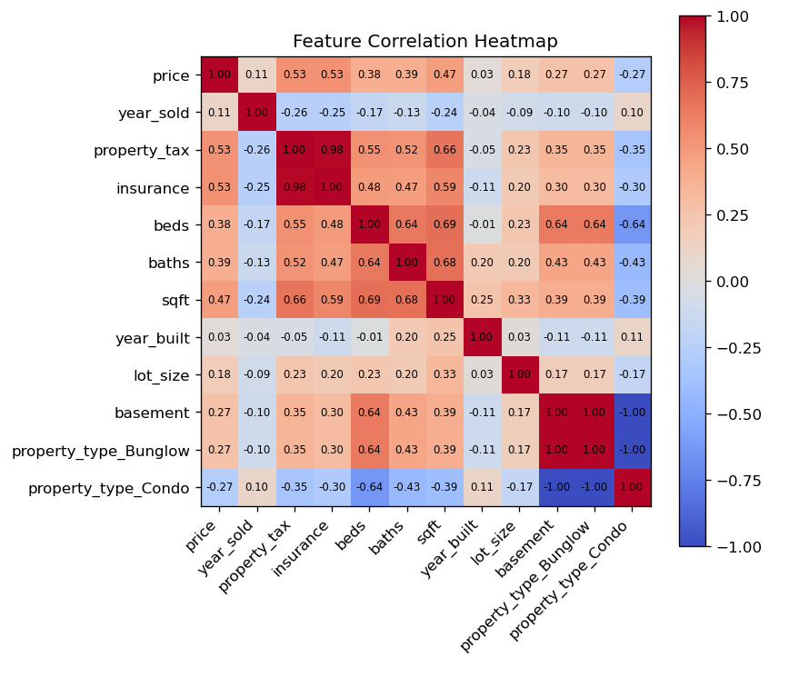
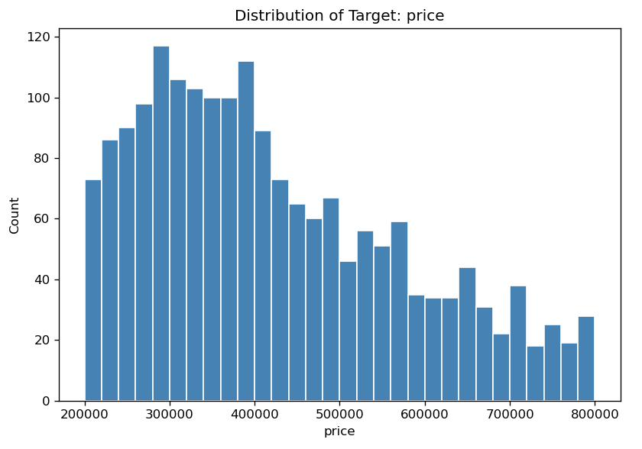
Data processing
Dataset
1,879 rows × 11 columns; zero missing values
Target: price — mean $423,055, std $151,538
Feature engineering
property_type one-hot encoded (Condo / Bungalow) → 11 features, none dropped
Top correlations with price
property_tax 0.53 · insurance 0.53 · sqft 0.47
baths 0.39 · beds 0.38 · basement 0.27
Right-skewed price distribution;
costs (tax, insurance) correlate
most strongly with price.
Notes:
For data preparation, we used 1,879 observations and eleven original fields, with no missing values. The target variable is sale price, with a mean of four hundred twenty-three thousand fifty-five dollars and a standard deviation of approximately one hundred fifty-one thousand five hundred dollars. Property type was one-hot encoded for condo and bungalow, resulting in eleven model features. The heatmap shows that property tax and insurance each have a correlation of 0.53 with price, followed by square footage at 0.47, bathrooms at 0.39, beds at 0.38, and basement at 0.27. The price distribution is right-skewed, so a smaller number of expensive homes extends the upper tail. These relationships are useful for prediction, but correlation alone does not establish causation, which becomes important when we discuss the model's limitations.

Slide 5
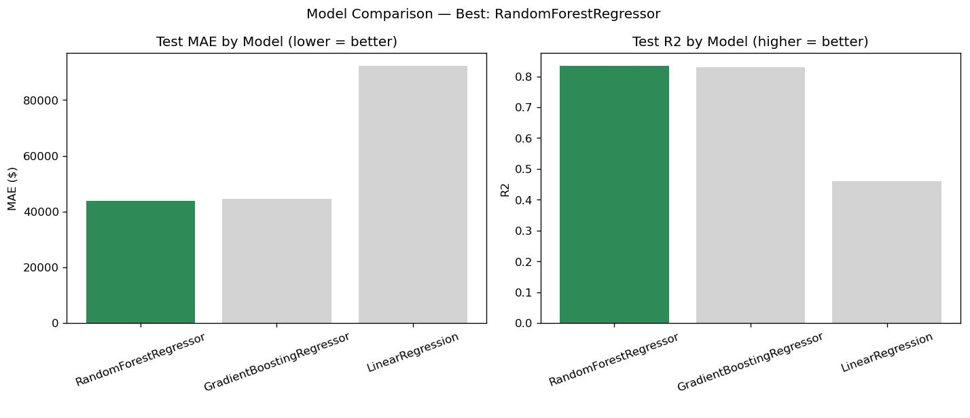
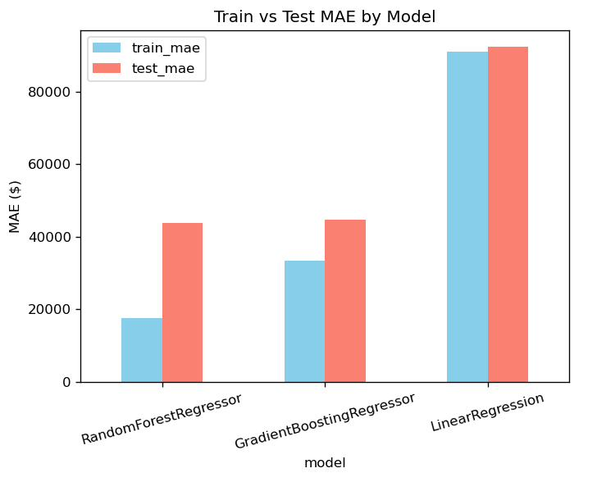
Modelling
Model | Train MAE | Test MAE | Test RMSE | Test R²
Random Forest | $17,619 | $43,795 | $64,424 | 0.834
Gradient Boosting | $33,336 | $44,611 | $65,024 | 0.831
Linear Regression | $91,017 | $92,220 | $116,262 | 0.459
Same 80/20 stratified split shared by all models (fair comparison).
Selection criterion: lowest test MAE → Random Forest (200 trees, absolute-error criterion).
Nonlinear ensembles halve the error of Linear Regression — price drivers interact nonlinearly.
Notes:
We evaluated all three models using the same stratified eighty-twenty split so that the comparison would be fair. Random Forest achieved the lowest test MAE at forty-three thousand seven hundred ninety-five dollars and a test R-squared of 0.834. Gradient Boosting was very close, with a test MAE of forty-four thousand six hundred eleven dollars and an R-squared of 0.831. Linear Regression performed substantially worse, with a test MAE above ninety-two thousand dollars and an R-squared of 0.459. We therefore selected Random Forest using the held-out test MAE as the primary criterion. The result suggests that nonlinear ensemble methods capture interactions among the price drivers that a linear model misses. However, the lower training error also signals possible overfitting, which I will address in the caveats.

Slide 6
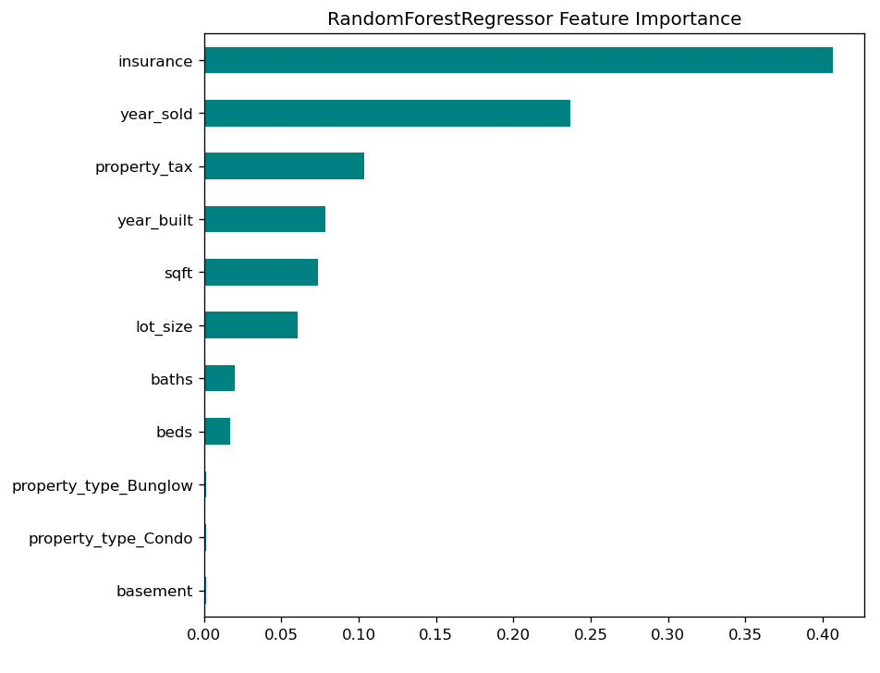
Business intelligence
Insight
Top drivers: insurance (0.41), year_sold (0.24), property_tax (0.10) — carrying costs and market timing dominate.
Raw size (sqft 0.07) and bed/bath counts matter far less than heuristics assume.
Property type and basement add almost nothing once costs are known.
What to do
Anchor pricing guidelines on the top cost/timing factors, not $/sqft alone.
Flag listings where |actual − predicted| is large (≈ > $44K MAE) for manual review.
Serve predictions through the Streamlit app next to both heuristics for transparency.
Notes:
The feature-importance results provide the business interpretation. Insurance is the largest model driver, followed by year sold and property tax. This suggests that carrying costs and market timing dominate the prediction more than property type alone. Square footage, bedroom count, and bathroom count contribute less than conventional pricing heuristics might imply, while condo-versus-bungalow type and basement status add little once the other cost-related information is known. Operationally, the model should support three actions: anchor pricing guidelines on the strongest cost and timing factors rather than price per square foot alone; flag listings whose actual and predicted prices differ by roughly one MAE, or about forty-four thousand dollars, for manual review; and display the model estimate beside both heuristic estimates in the Streamlit application so that users can understand and challenge the recommendation. Feature importance describes predictive influence, not necessarily causation.

Slide 7
Caveats
Overfitting gap
Proxy features
The Random Forest achieved a much lower MAE on the training data ($17.6K) than on the test data ($43.8K), showing that it fits the training observations well but does not generalize equally well to unseen cases. This large performance gap provides evidence of overfitting, meaning the ensemble has learned not only meaningful patterns but also noise specific to the training set. Therefore, although the training result appe
In heatmap, property_tax and insurance correlate 0.98 and are partly consequences of value — useful for valuation review, risky for pure forecasting.
No location data
Static snapshot
The model excludes neighborhood, school, geographic, and urban–remote location features, leaving a substantial share of real-estate price variation unexplained and limiting its pricing accuracy.
Because sales span multiple years without inflation adjustment, the model should be redesigned to incorporate these conditions and retrained as market conditions change
Notes:
Four caveats qualify the results. First, Random Forest has a clear overfitting gap: its training MAE is about seventeen thousand six hundred dollars, compared with forty-three thousand eight hundred dollars on the test data. Therefore, the test result is the more honest measure of expected performance on unseen properties. Second, property tax and insurance are highly correlated with each other and may partly result from assessed property value. Their predictive strength therefore introduces circularity, making the model more suitable for valuation review than pure advance forecasting. Third, the dataset does not include neighborhood, school district, coordinates, or urban-versus-remote location, leaving important real-estate variation unmodeled. Fourth, the sales cover multiple years without inflation adjustment, so the model represents a static market snapshot. The next version should incorporate location and time-sensitive economic features, be validated on new data, and be retrained as market conditions change. In conclusion, this model is a decision-support tool, not a replacement for professional judgment.

