Slide 1
UCLA - Admission Prediction
Can we predict a graduate applicant's admission likelihood — and which neural-network architecture classifies best?
500 applicants · 3 MLP architectures compared · MLP_deep_8_4 deployed
Python · pandas · scikit-learn · matplotlib · seaborn · Streamlit

Slide 2
Summary
1
Business needs
2
Data engineering
Can a graduate applicant's admission outcome be predicted from GRE, TOEFL, CGPA, SOP/LOR, university rating, and research experience — well enough to flag likely-admitted applicants for review?
500 applicants, 8 fields after Serial_No dropped; no missing values; target binarized at Admit_Chance ≥ 0.8 (31% positive)
University_Rating / Research one-hot encoded → 12 model features; 80/20 stratified split; MinMaxScaler fit on train only
3
Statistics & ML
4
BI intelligence
Compared 3 MLPClassifier architectures — relu(3,), tanh(3,), deep(8,4) — on the same split, selected by held-out test accuracy, 5-fold stratified CV as the stability check
MLP_deep_8_4 best: test accuracy 0.920 (train 0.935, gap +0.015)
CGPA, TOEFL, and GRE are the strongest correlates of admission (r = 0.74 / 0.70 / 0.68)
Deploy MLP_deep_8_4 as a screening aid: surface predicted likelihood next to top factors, route borderline cases to human review

Slide 3
Business needs
Given an applicant's GRE, TOEFL, CGPA, SOP/LOR, rating, and research profile, can we predict whether they're likely admitted — and which factors matter most?
Why it matters
500
graduate applicants (dataset)
Admissions committees review hundreds of applications per cycle under time pressure, risking inconsistent screening.
A single GPA or GRE cutoff ignores how SOP/LOR strength and research experience interact with test scores.
A model-based screen lets reviewers focus attention on borderline applicants instead of re-reading every file equally.
3
MLP architectures compared
0.920
test accuracy of deployed model (MLP_deep_8_4)

Slide 4
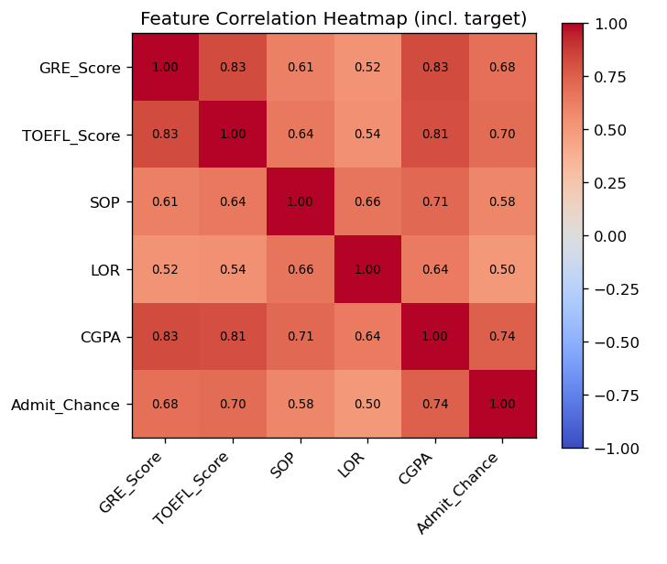
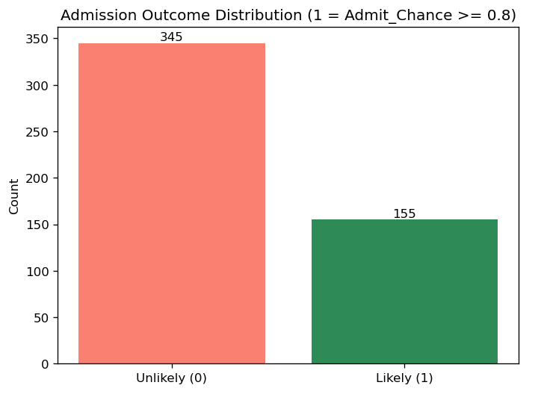
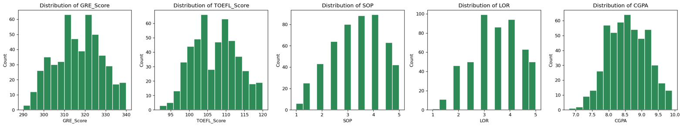
Data processing
Dataset
500 applicants, 9 raw fields; zero missing values
Target Admit_Chance is a continuous estimated probability, binarized at ≥ 0.8 → “likely admitted” (31% positive)
Feature engineering
Serial_No dropped; University_Rating (1–5) and Research (0/1) cast to category and one-hot encoded
MinMaxScaler fit on the training split only (leakage-safe) → 12 model features; 80/20 stratified split
31% of applicants are labeled “likely admitted.”
Notable correlations
CGPA vs. Admit_Chance: r = 0.742 — the single strongest academic predictor
TOEFL_Score: r = 0.699; GRE_Score: r = 0.684 — both close behind CGPA

Slide 5
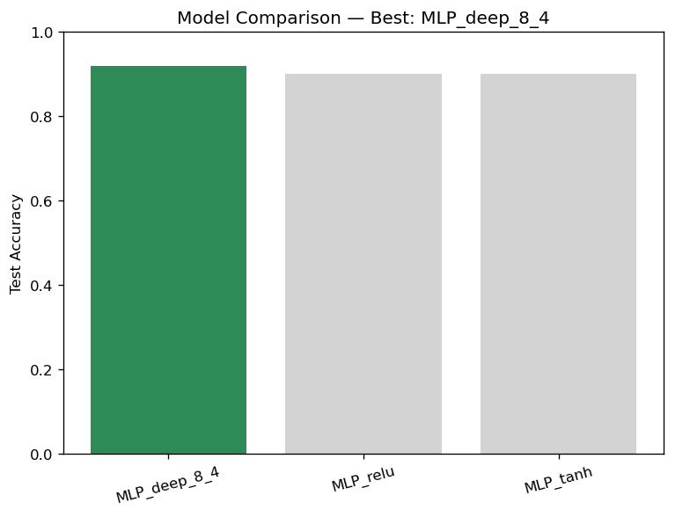
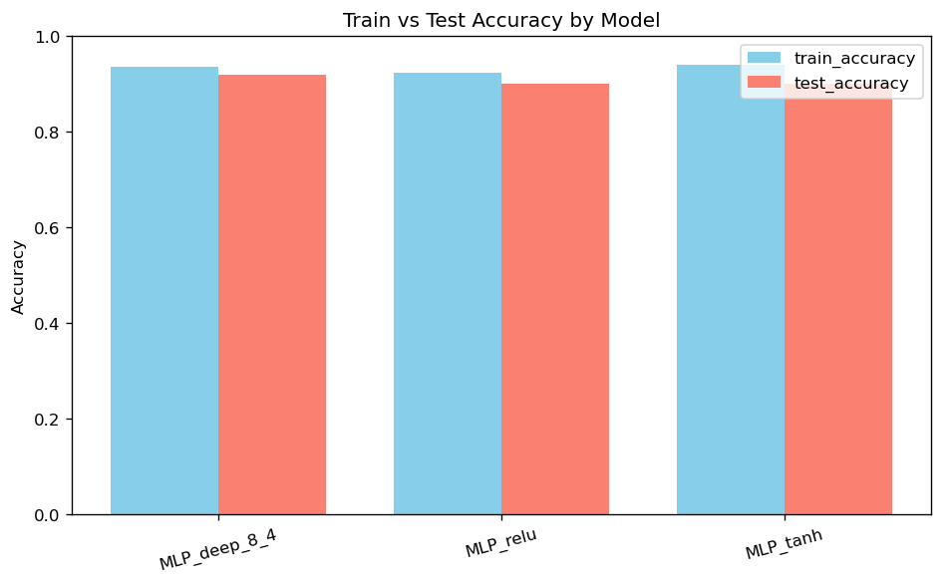
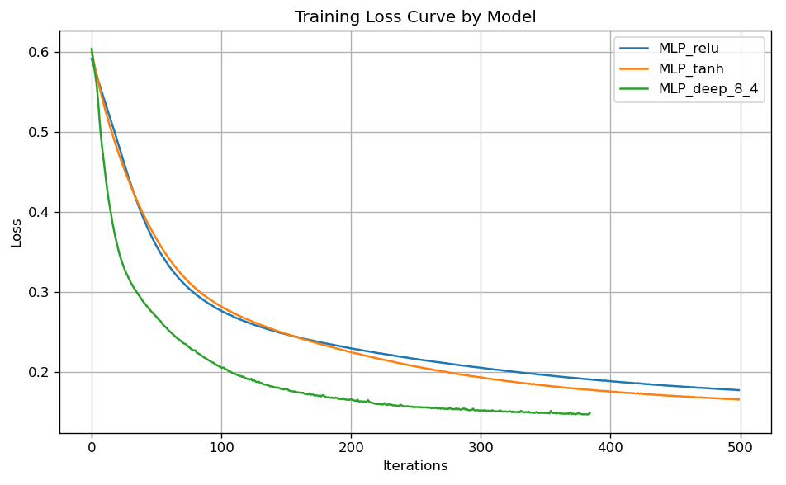
Modelling
Model | Train Acc | Test Acc | CV Mean
MLP_deep_8_4 | 0.935 | 0.920 | 0.9225
MLP_relu | 0.9225 | 0.900 | 0.9125
MLP_tanh | 0.940 | 0.900 | 0.9150
All three architectures share batch_size=50, random_state=123; only hidden-layer shape/activation differ — relu(3,), tanh(3,), deep(8,4)
Selection criterion: highest held-out test accuracy → MLP_deep_8_4 (0.920)
Stability check (5-fold CV): MLP_deep_8_4 also has the highest, most stable CV mean (0.9225, std 0.0215) vs. relu (0.9125, std 0.0274) and tanh (0.9150, std 0.0215)

Slide 6
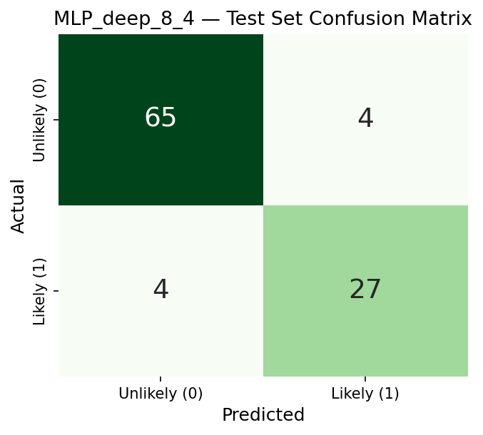
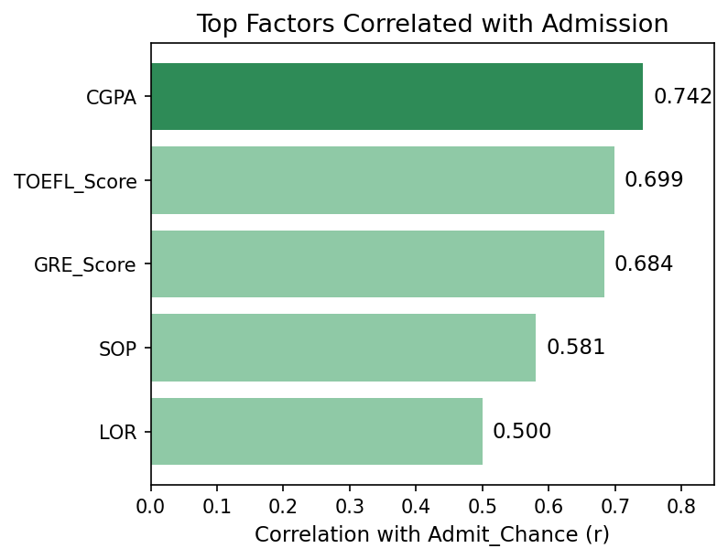
Business intelligence
Insight
The deployed model, MLP_deep_8_4, correctly classifies 92 of 100 held-out applicants (test accuracy 0.920), with balanced precision/recall on both classes (0.94/0.94 unlikely, 0.87/0.87 likely admitted).
CGPA, TOEFL, and GRE are the top correlates of admission (r = 0.74 / 0.70 / 0.68) — SOP and LOR matter but less.
Train–test gap is only +0.015, so the model is not meaningfully overfit despite the modest dataset (500 applicants).
What to do
Use MLP_deep_8_4's predicted probability as a screening aid, not a final decision — surface it next to the applicant's CGPA/GRE/TOEFL.
Route borderline predictions (probability near the 0.8 cutoff) to human review rather than auto-accepting or rejecting.
Advise applicants that raising CGPA, TOEFL, or GRE moves their predicted outcome the most among the six inputs.
Serve live predictions through the Streamlit Business Intelligence tab so any advisor can enter a profile and get an instant, single-model call.

Slide 7
Caveats
Admit_Chance is a proxy, not a decision
Correlation isn't the full picture
The target is the original dataset's estimated admission probability, not a confirmed admissions outcome, and the 0.8 cutoff for “likely admitted” is a modeling choice, not an official threshold.
CGPA/TOEFL/GRE correlate most with admission, but the MLP combines all six inputs nonlinearly — the correlation ranking is a simplification of what the network actually uses.
Modest, imbalanced test set
No causal claim
Only 100 applicants are held out, and just 31 are labeled “likely admitted” — per-class metrics like recall on the minority class carry real sampling uncertainty.
A high predicted probability reflects historical association with Admit_Chance, not a guarantee that raising a score causes admission — confounds such as recommendation strength are not captured.

