Slide 1
UCLA ADMISSION PREDICTION
Will You Get In?
Three Networks Disagree.
500 graduate applicants, six numbers each — and a neural network deciding who deserves a second read.
500
3
0.920
applicants
networks compared
test accuracy
Python · pandas · scikit-learn · matplotlib · seaborn · Streamlit
Notes:
Quick question for the room: you're on an admissions committee, it's 2 a.m., and you have 500 files left. Six numbers per applicant — GRE, TOEFL, CGPA, statement, letters, research. Could a machine tell you which ones deserve your attention first? That's today's project. We trained three neural networks on 500 real graduate applicants, made them compete, and the winner gets 92 out of 100 right. But the interesting part isn't the accuracy — it's which network won, and why that surprised us.

Slide 2
THE OLD WAY
One Cutoff, Hundreds of Files,
and Nobody Agrees.
— the same applicant can pass with one reviewer and fail with the next.
📚
Committees review hundreds of applications per cycle under time pressure — screening drifts from file to file.
✂️
A single GPA or GRE cutoff ignores how statement and letter strength interact with test scores.
🎯
A model-based screen lets reviewers spend attention on the borderline cases instead of re-reading every file equally.
02
Notes:
Here's the problem we started from. Admissions committees read hundreds of applications per cycle under real time pressure, and when you're tired, your standards drift — the same file can get a different call depending on who opens it and when. The usual fix is a hard cutoff: minimum GPA, minimum GRE. That's consistent, but it's blunt. It can't see that a modest test score sitting next to strong letters and real research experience is a different applicant than the same score alone. What we wanted wasn't a machine that decides — it was a machine that tells reviewers where to look first.

Slide 3
THE DATA
500 Applicants, One Fuzzy Target
Nobody handed us a yes/no label — we had to draw the line ourselves.
31%
🎓 GRE · TOEFL · CGPA
📝 SOP · LOR · Rating
🔬 Research (yes / no)
of applicants are labeled “likely admitted”
9 raw fields → Serial_No dropped, rating and research one-hot encoded → 12 model features. Zero missing values.
155 of 500. Admit_Chance is a continuous probability, so we binarized it at ≥ 0.8 — that cutoff is our modeling choice, not an official one.
03
Notes:
500 graduate applicants, nine raw fields, and — refreshingly — zero missing values. But there's a catch in the target. The dataset doesn't say 'admitted' or 'rejected'; it gives Admit_Chance, a continuous estimated probability. To turn this into a classification problem we had to pick a line, and we picked 0.8. That leaves 155 of 500 applicants — 31 percent — labeled likely admitted. I want to flag that clearly: the 0.8 is our decision, not the university's. Move it and every number in this deck moves with it. From there it's routine engineering: drop the serial number, one-hot encode university rating and research, and we land on 12 model features. Split 80/20, stratified, and MinMaxScaler is fit on the training split only — so the test set stays genuinely unseen.

Slide 4
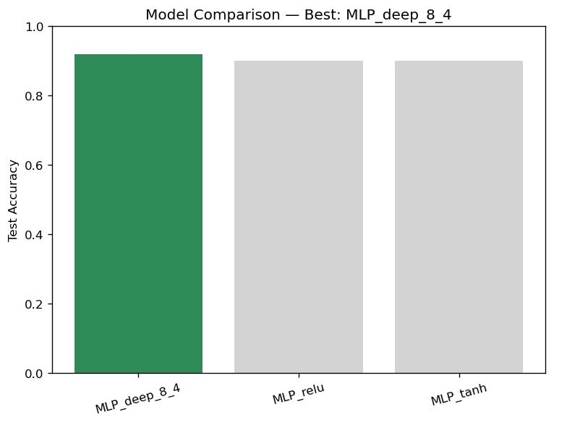
THE CONTEST
Three Networks Walk Into an Admissions Office…
Same data, same split, same seed. Only the hidden layers change.
MLP_deep_8_4 (8 → 4 hidden units) wins — test accuracy 0.920
04
Notes:
Three MLP classifiers, one bake-off. All three share the same 80/20 split, the same batch_size of 50 and the same random_state of 123 — the only thing that changes is the shape of the hidden layers. Number one: a single layer of three neurons with ReLU. Number two: the same three neurons with tanh. Number three, which we call deep_8_4: two layers, eight neurons then four. Selection criterion is held-out test accuracy, and deep_8_4 takes it at 0.920 against 0.900 for both of the others. Now, be honest about that margin — 0.920 versus 0.900 on a 100-applicant test set is two applicants. So we don't rest on test accuracy alone; we run five-fold cross-validation as a stability check, and deep_8_4 wins there too with the highest mean at 0.9225 with a standard deviation of 0.0215, against 0.9125 plus or minus 0.0274 for ReLU and 0.9150 plus or minus 0.0215 for tanh — so it is both the best and the steadiest. Two independent checks agreeing is what makes this a decision rather than a coin flip.

Slide 5
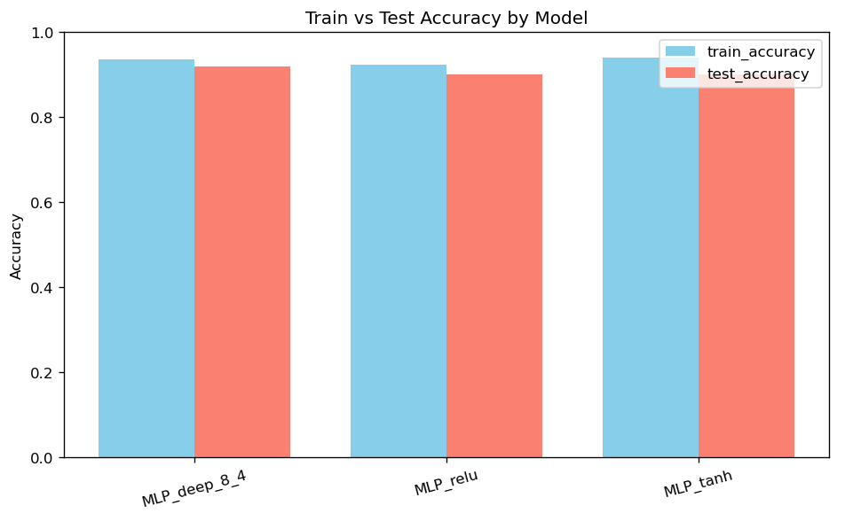
THE TWIST
The Biggest Network Overfit the Least
tanh memorized the training set best — and still lost.
Model | Train | Test | CV Mean
MLP_deep_8_4 | 0.935 | 0.920 | 0.9225
MLP_relu | 0.9225 | 0.900 | 0.9125
MLP_tanh | 0.940 | 0.900 | 0.9150
Bonus twist: tanh has the highest train accuracy of the three (0.940) and the worst test accuracy (0.900). deep_8_4 is the largest network, yet its train–test gap is the smallest at just +0.015 — more capacity, less memorizing.
05
Notes:
This is the part I did not expect. Look at the train column. tanh is the best student in the room — 0.940 on data it has already seen, the highest of the three. And it finishes last on the test set at 0.900. Meanwhile deep_8_4, the biggest network with two layers instead of one, has a train–test gap of only +0.015. The textbook worry is that more capacity means more overfitting; here the deeper network generalized best and the shallow tanh network memorized hardest. Two takeaways. First, never rank models on training accuracy — it rewards memorization. Second, 'deep equals overfit' is a rule of thumb, not a law; at eight and four neurons on 12 features, deep_8_4 still isn't big enough to memorize 400 training rows, so the extra layer bought us real structure instead of noise.

Slide 6
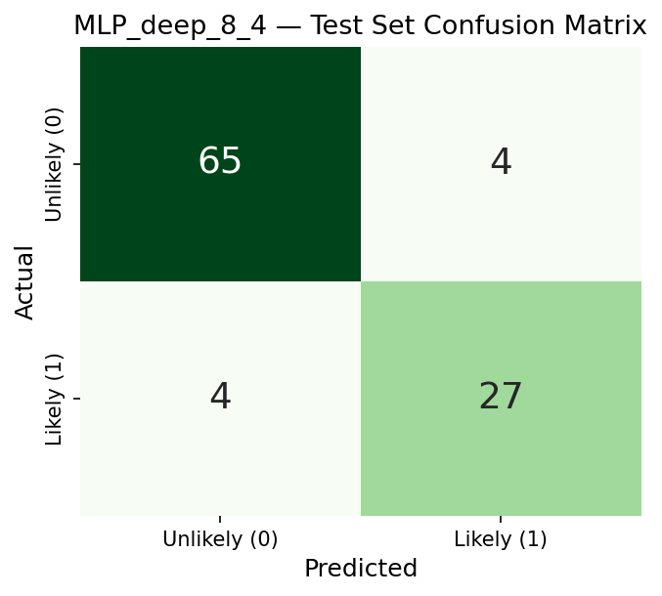
THE BIG REVEAL
92 out of 100. And Both Sides Hold Up.
Four false alarms, four missed admits — the errors are symmetric.
Precision / recall 0.94 / 0.94 unlikely 0.87 / 0.87 likely admitted
What the matrix says
65 correctly flagged unlikely, 27 correctly flagged likely admitted.
4 false alarms — flagged likely, actually not.
4 missed admits — the costlier error for an applicant.
Balanced errors mean no hidden bias toward either verdict.
CGPA r = 0.74 TOEFL r = 0.70 GRE r = 0.68
SOP and LOR matter, but less. Train–test gap +0.015 — not meaningfully overfit.
06
Notes:
Here's the scoreboard. On 100 held-out applicants the deployed model gets 92 right. Read the matrix: 65 correctly identified as unlikely, 27 correctly identified as likely admitted, and the eight errors split evenly — four false alarms and four missed admits. That symmetry matters. A 92 percent model that got there by always saying 'unlikely' would score well on a dataset that's only 31 percent positive, and it would be useless. Ours doesn't do that: precision and recall are 0.94 and 0.94 on the unlikely class and 0.87 and 0.87 on the likely class, so it's competent on both sides. On what drives admission, CGPA leads at 0.742, then TOEFL at 0.699 and GRE at 0.684 — statement and letters correlate too, just less. And the train–test gap of 0.015 tells us this performance should survive contact with new applicants.

Slide 7
THE FINE PRINT
Four Things This Model Is Not
Everything above is true. Here is exactly how far it goes.
🏷️
Not a decision. Admit_Chance is the dataset's estimated probability, and 0.8 is our cutoff — not an official threshold.
🔀
Not the whole story. The MLP combines all six inputs nonlinearly; the correlation ranking is a simplification of what it actually uses.
📉
Not a big test set. 100 applicants held out, only 31 labeled likely admitted — minority-class recall carries real sampling uncertainty.
🚫
Not causal. A high predicted probability reflects historical association, not proof that raising a score causes admission.
07
Notes:
Four honest limits, quickly. One: the target is a proxy. Admit_Chance is the dataset's own estimated probability, not a confirmed outcome, and the 0.8 line is ours — so 'likely admitted' means likely by our definition. Two: the correlation ranking is a simplification. CGPA leads at 0.74, but the network combines all six inputs nonlinearly, so that list describes the data, not the model's internal reasoning. Three: the test set is small and lopsided — 100 applicants, only 31 positive — which means the 0.87 recall on the likely class rests on 31 cases and would move if we resampled. Four: nothing here is causal. The model learned historical association, so telling an applicant that a higher CGPA will get them in overstates what we know — confounds like recommendation strength were never measured.

Slide 8
PUTTING IT TO WORK
A Second Reader,
Not a Verdict.
🧭
Screening aid. Show the predicted probability beside the applicant's CGPA, GRE and TOEFL — never on its own.
🤝
Borderline goes to a human. Predictions near the 0.8 cutoff route to manual review — no auto-accept, no auto-reject.
📈
Advising applicants. Among the six inputs, CGPA, TOEFL and GRE move the predicted outcome most.
🔗
Try it yourself. Live in the Streamlit BI tab — enter a profile, get an instant call.
08
Notes:
So what do we actually do with it? Four things. First, it's a screening aid, not a decision — the predicted probability appears next to the applicant's CGPA, GRE and TOEFL so a reviewer always sees the evidence, never just the verdict. Second, anything near the 0.8 cutoff goes to a human; those are precisely the cases where the model is least sure, so no auto-accepts and no auto-rejects. Third, for advising: of the six inputs, CGPA, TOEFL and GRE move the predicted outcome most — worth knowing, with the caveat from the last slide that association isn't causation. And fourth, all of this runs live in the Streamlit app — type in an applicant's profile, get the call instantly. Three networks argued, the deepest one won by generalizing instead of memorizing, and it gets 92 out of 100 right. Thanks, everyone!

