Slide 1
Extending Starfish to Support the Growing Hadoop Ecosystem
Fei Dong
Duke University
April 6, 2012
Notes:
Welcome to come my defense. I am Fei Dong from computer science department
My project title is to extend starfish to support the growing hadoop ecosystem
In the background, you see elephant and starfish. It seems little connection in biology. We will figure out some magic connection in my lecture

Slide 2
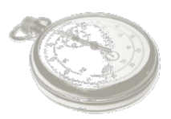
Agenda
Introduction
Optimizing Multi-Job Workflows
Optimizing Iterative Workflows
Optimizing Key-Value Stores
Alidade: A Real-Life Application
Summary
Questions and Answers

Slide 3
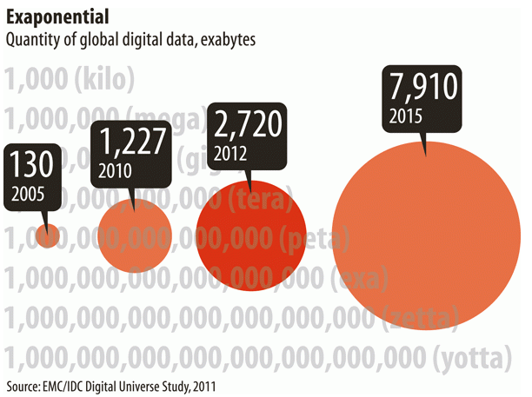
Introduction – Big Data
Notes:
Data is growing so fast, from kb -> pb
Lots of company meet the big data problem and challenges, scalibility, relibility, performance
How to store the data , and retrieve data efficiently

Slide 4
Hadoop Ecosystem
Typical Hadoop Stack
New Software and Model
Oozie
Sqoop
Jaql
High Level
MapReduce Programs(Java)
Hadoop Streaming (Python, Ruby)
Pig
Hive
Cascading
Hadoop Core
MapReduce Execution Engine
Iterative Model
EMR
MRv2
Distributed File System
HBase
ElephantDB
Physical Level
Physical Machine
SATA
Disk
Virtual Machine
SSD
CPU
EC2 Unit
4/3/12
4
Starfish-E
Notes:
Hadoop history: started from nutch, by Doug Cutting, growing in Yahoo, cloudera and hortonworks focus on this.
A large scale batch data processing platform
Some ideas from Google published papers, GFS, MapReduce
Open Source top project of Apache

Slide 5

Starfish, a Self-Tuning System on Hadoop
Optimizers
Search through space of tuning choices
Cluster
Job
Data layout
Profiler
What-if Engine
Workflow
Collects concise
summaries of
execution
Estimates impact of hypothetical changes on execution
Workload
Starfish limitation: focus on individual MapReduce jobs on Hadoop
Notes:
How to use Hadoop? You can follow some turtuals, but we also care about performance
However, there are more than 190 parameters. hard to tune manually to get good performance,
Starfish is a research project led by Prof. Shivnath Babu
Have some impact on academic

Slide 6
Starfish-Extended

Slide 7
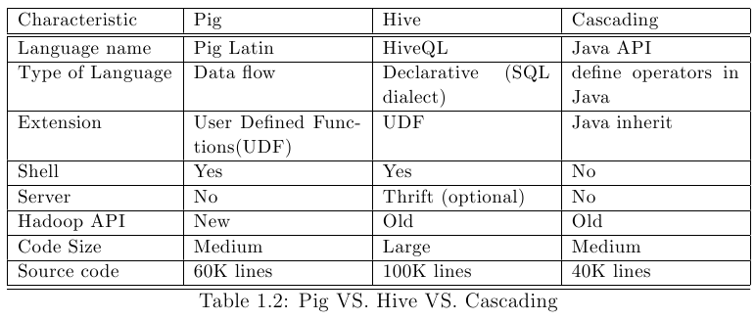
Extension 1: MapReduce Workflows
High-level layers have evolved over Hadoop to support comprehensive workflows, such as Pig, Hive, Cascading.
Can we optimize such workflows with Starfish?
Notes:
Main difference from Cascading is JAVA API, so users can easily pick up without any burden

Slide 8
Extension 2: Iterative Jobs
Data is processed iteratively.
MapReduce framework does not directly support iterations.
Can we support iterative execution in a workflow?
Loop: n
Input
Output3/Input2
J1
J2
J3
Output1/Input2
Output2/Input3
J4
Output
Notes:
e.g.: pagerank, kmeans algorithms

Slide 9
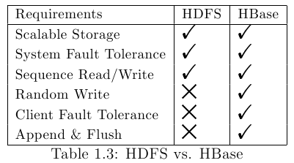
Extension 3: Key-Value Stores
HDFS: Replication, Fault tolerance, Scalability
HBase: Host very large tables – billions of rows X millions of columns.
Can we optimize storage system like HBase?
Notes:
BigTable
Think about database, while not scalable, Hbase is one NOSQL, scale out, auto sharding

Slide 10
Rule-Based Vs. Cost-Based Optimization
Rule Based Optimization (RBO)
Use a set of rules to determine how to execute a plan.
Cost Based Optimization
Cheapest plan use the least amount of resource.
Starfish employ CBO approach to MapReduce programs.
Can we put RBO + CBO together ?
Notes:
Elg: cloudera suggest you can set the number of reduces close to the reduce slots the cluster own
Cost model

Slide 11
Contribution
MapReduce Workflow Optimizer in Cascading
Iterative Workflow Optimizer
Key-Value Stores Optimizer using Rule-based technology

Slide 12
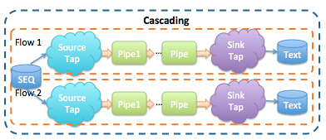
Optimizing Multi-job Workflows
Cascading
Data processing API on Hadoop
Flow of operation, not jobs
Notes:
Encapsulate Abstract Operation on Data
Each, GroupBy, …
Connected by a Pipe

Slide 13
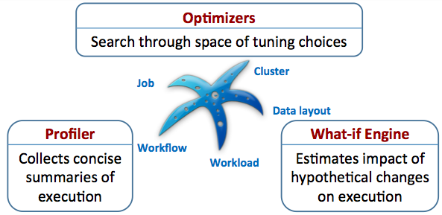
Cascading on Starfish
Replace Hadoop Old API with New API
Cascading Profiler
Job Graph + Conf Graph to represent a workflow
Cascading What-if Engine
Cascading Optimizer
Notes:
DAG, direct acyclic graph

Slide 14
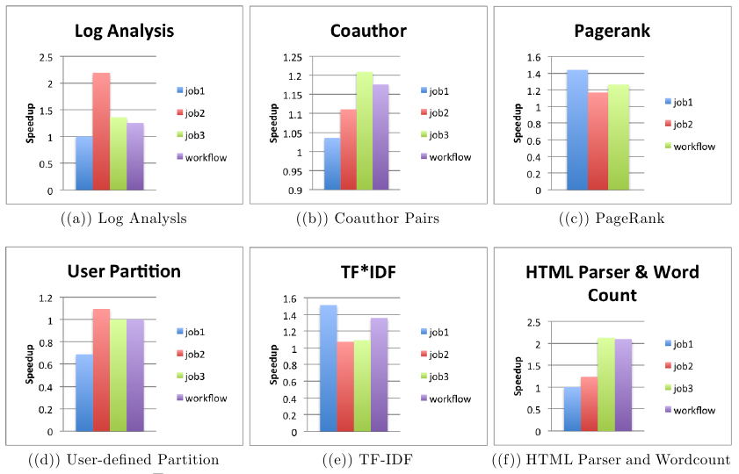
Cascading Evaluation -- Speedup

Slide 15
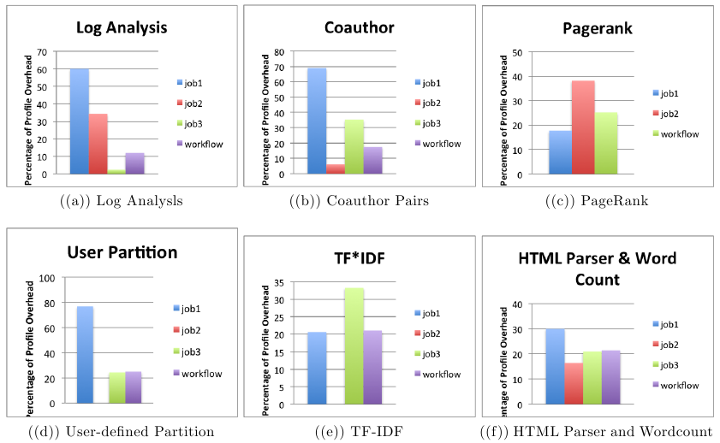
Cascading Evaluation -- Overhead

Slide 16
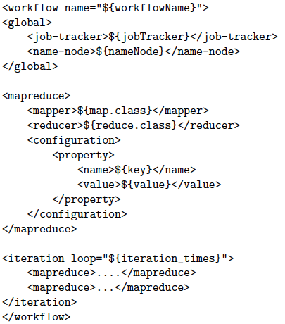
Optimizing Iterative Workflows
The jobs have the same execution behavior across iterations → we can use a single “iterative” profile.
Combine MapReduce jobs into a logical unit of work (inspired by Oozie)

Slide 17
Iterative Workflow Evaluation
PageRank: 10G page graphs

Slide 18
Optimizing Key-Value Stores
5. HBase Process e.g. splits, compactions
High
4. HBase Schema e.g. compression, bloom filter
3. HBase Configuration e.g. garbage collection, heap
2. Hadoop Configuration e.g. xciever, handlers
1. Operating System e.g. ulimit, nproc
Low
Notes:
Hbase often has more concurrent clients : increase dfs.datanode.max.xcievers 256->1024
Uproc: maximum number of processes
Handlers: io thread number
Xciever: an upper bound on the number of files that it will serve at any one time

Slide 19
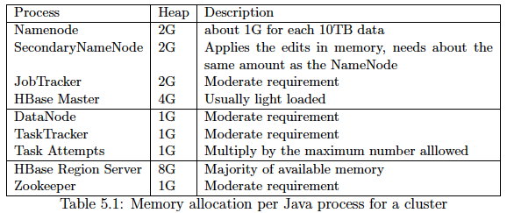
HBase Memory
JVM Settings:
"-server -XX:+UseParallelGC -XX:ParallelGCThraed=8 -XX:+AggressivHeap -XX:+HeapDumpOnOutOfMemoryError".
The parallel GC leverages multiple CPUs.

Slide 20
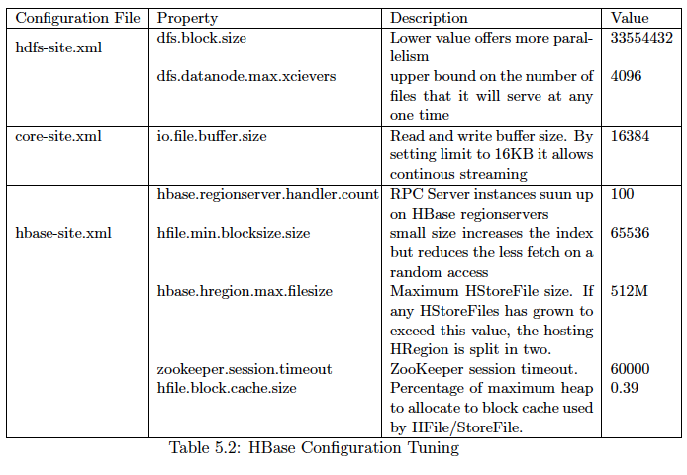
HBase Configuration

Slide 21
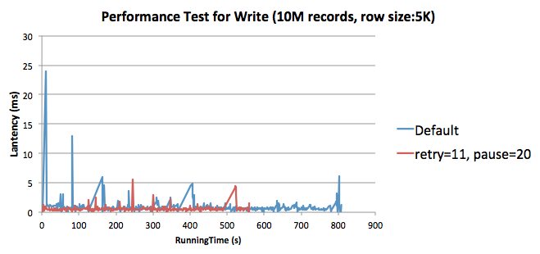
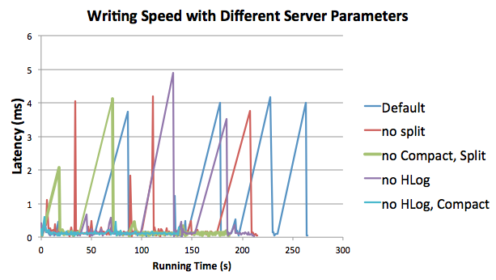
HBase Writing

Slide 22
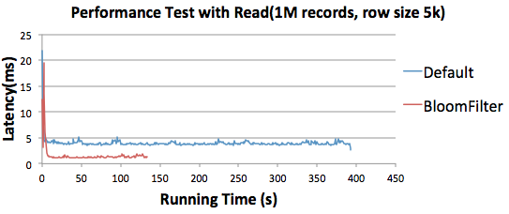
HBase Reading
Notes:
A lot of miss during reads.
Speed up reads by cutting down internal lookups

Slide 23
Best Practice for HBase
Recommend c1.xlarge, m2.xlarge to run HBase.
Isolate HBase cluster to avoid memory competition with other services.
Factors to affect writing: HLog > Split> Compact.
If applications do not require strict data durability, closing HLog can get 2X speedup.
Compression can save space on storage. Snappy provide high speeds and reasonable compression.
In a read-busy system, using bloom filters with the matching update or read patterns can save a huge amount of IO.
…

Slide 24
Alidade: A Real-life Workflow
Alidade is constraint-based geolocation system.
Alidade has two phases.
Preprocessing data
Iterative geolocation

Slide 25
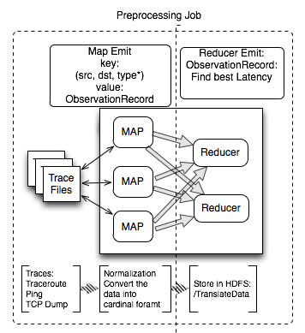
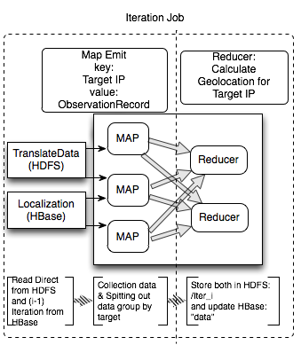
Alidade Workflow

Slide 26
Alidade Challenges
Iterative Model
Heavy Computation
Represent polygon in a spherical surface.
Calculate Intersection of polygons
Large Scale Data
Limited Resource Allocation
Depend on many services such as HDFS, JobTrackers, TaskTracker, HBase, etc.

Slide 27
Evaluation Environment
Hadoop CDH3U3 based on 0.20.2
HBase CDH3U3 based on 0.90.4
11 m1.large nodes, 11 m2.xlarge nodes
30 map slots and 20 reduce slots
Workflow:
YCSB generates 10M records and some workloads on read/write.
Alidade generates 70M records after translating.
Notes:
Slots: capacity, concurrent running processes

Slide 28
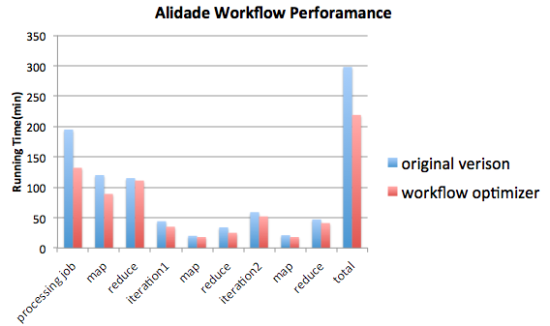
Alidade Evaluation (1)

Slide 29
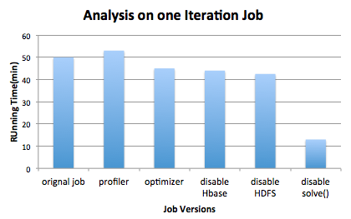
Alidade Evaluation (2)

Slide 30
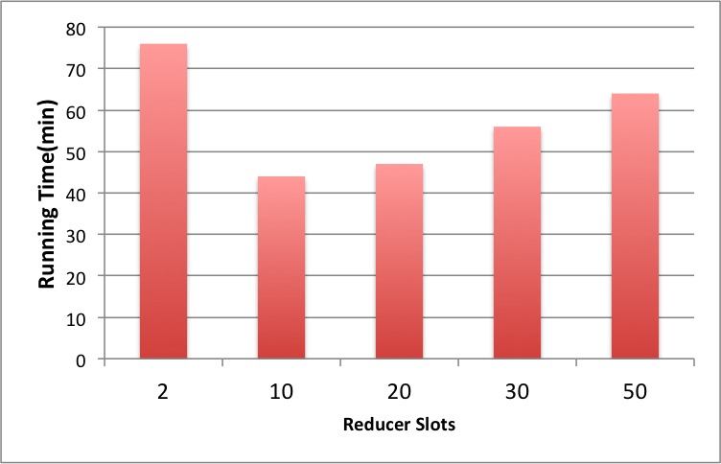
Alidade Evaluation (3)
Notes:
Not always good to increase reduce slots, due to Server bottleneck

Slide 31
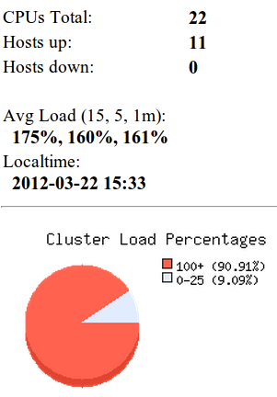
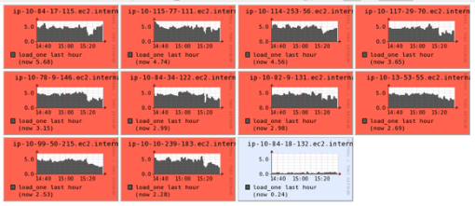
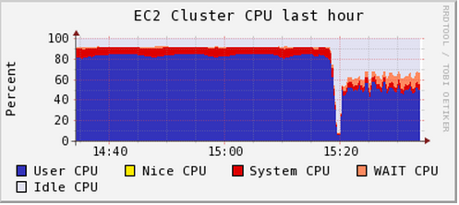
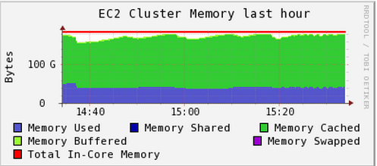
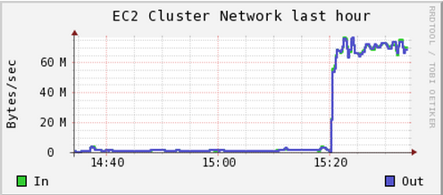
Alidade Cluster Load
Notes:
Synchronized time

Slide 32

Time is Money!
 | 11 m1.large | 21 m1.large | 11 m2.xlarge
Write Capacity | 43593/s | 87012/s | 58273/s
CPU | 44 | 88 | 72
Storage Capacity | 8.5T | 17T | 17T
Nodes cost per hour | $3.5 | $7.1 | $5.0
Traffic Cost | $4 | $8 | $4
Setup Duration | 2hr | 2hr | 2hr
AWS Billed Duration | 19hr | 11hr | 12hr
Total Cost | $68.6 | $82.8 | $68.8

Slide 33
Alidade Workflow Observation
Alidade is a CPU-intensive job. The “IntersectionWritable.solve” contributes most of executing time (> 70%).
Currently, Starfish Optimizer is better fitted for I/O intensive jobs
Alidade helped Starfish improve Profiling. (reduce overhead for “sequencefiles”)
Memory issue for HBase

Slide 34
Summary
Extended Starfish to support the evolving Hadoop system
Automatic tuning of Cascading workflow. We can boost performance by 20% to 200%.
Support iterative workflow using simple syntax.
Optimize Key-Value Stores in Hadoop
Leveraged cost-based optimizer and rule-base optimizer to get good performance in a complex real-life workflow.

Slide 35

Q & A
Any
Questions

Slide 36

Thanks
☺

Slide 37


