Slide 1
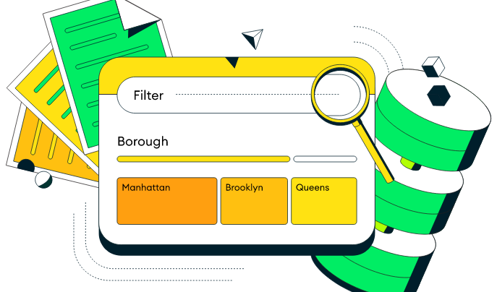
MongoDB CRUD
Create Operations
Read Operations
Update Operations
Delete Operations

Slide 3
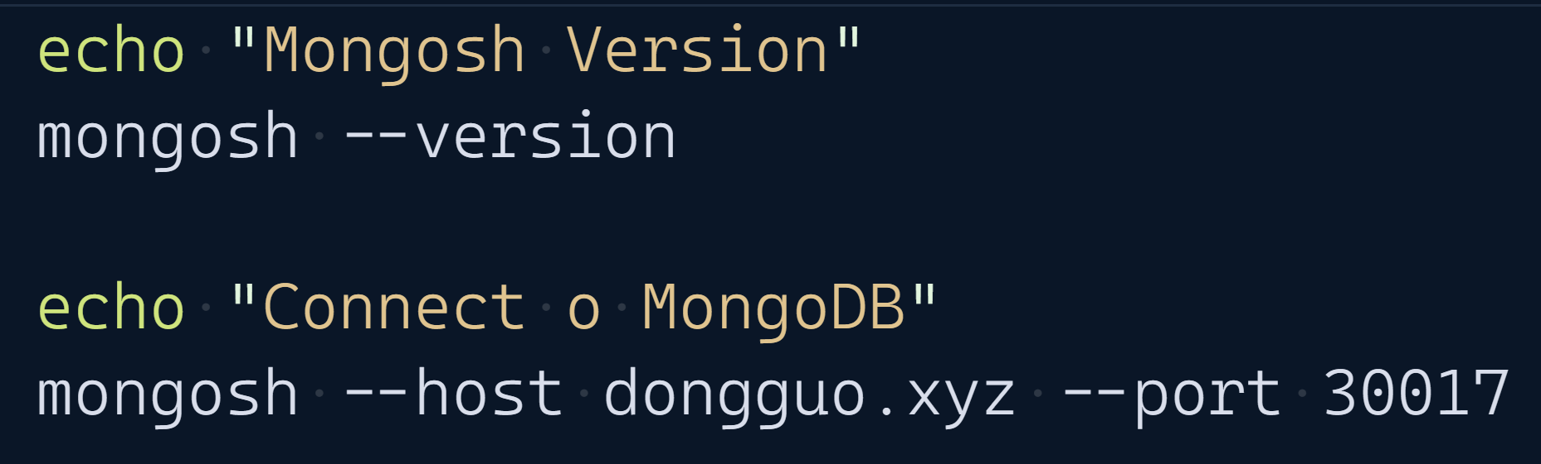
MongoDB Shell

Slide 4
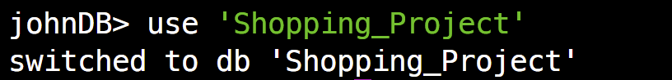
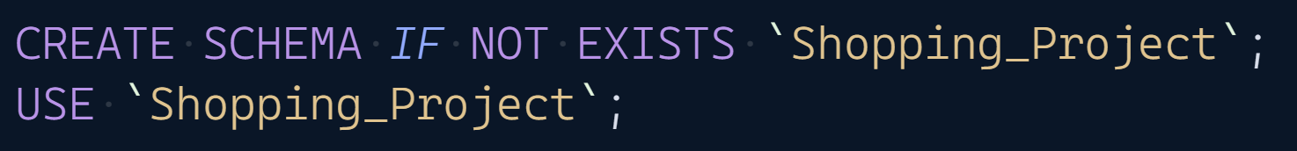
Create And Use database
If a database does not exist, MongoDB creates the database when you first store data for that database
MongoDB
SQL
List database
MongoDB
SQL

Slide 5

Create a Collection (Table)
If the collection does not currently exist, insert operations will create the collection.
MongoDB | Don not need.
SQL
List collections
MongoDB
SQL

Slide 6
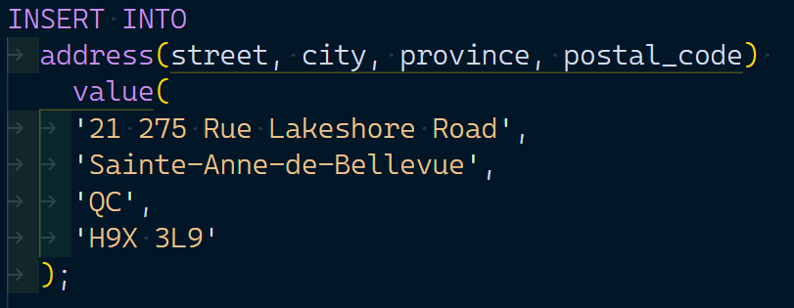
Insert Documents(Rows)
If the collection does not currently exist, insert operations will create the collection.
MongoDB
SQL

Slide 7
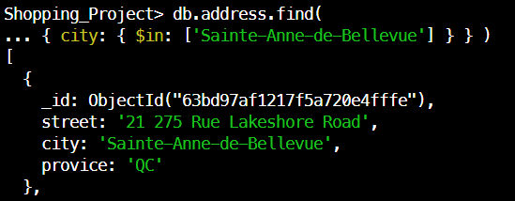
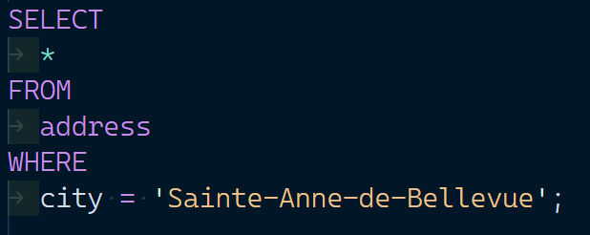
Query Documents
If the collection does not currently exist, insert operations will create the collection.
MongoDB
SQL

Slide 8
Update Documents
MongoDB
SQL | need to modify the table structure.

Slide 9
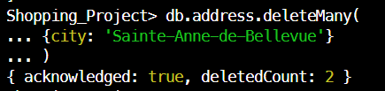
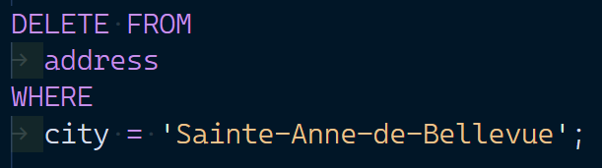
Delete Documents
MongoDB
SQL

