Slide 1
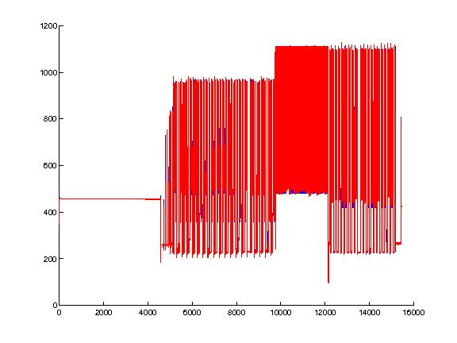
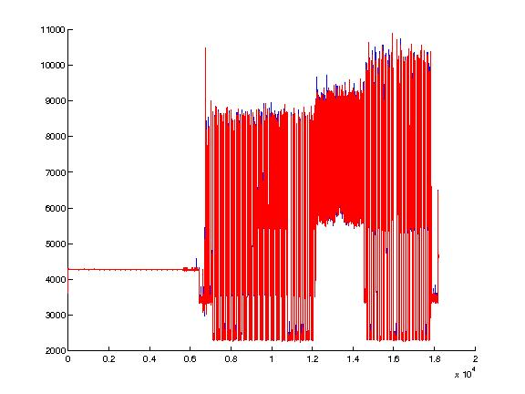
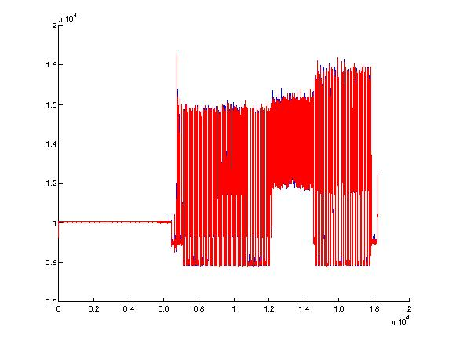
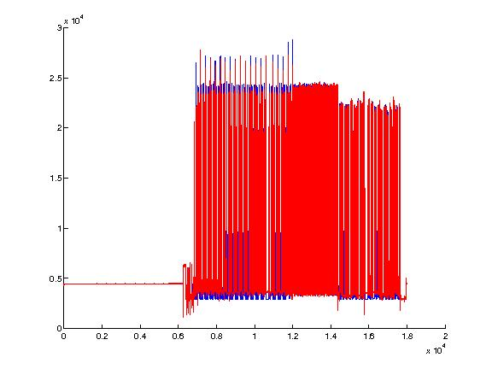
FPGA Power Modeling
Donggyu Kim
Motivation
Linear Power Modeling
LMS Algorithm with Cost Function
Power dissipation is a major concern in computer system
Existing power analysis method
RTL / gate-level simulation: extremely slow
Cycle accurate software simulation: still slow
Analytic modeling: not accurate
Goal: fast and accurate power analysis
Solution: FPGA-accelerated power analysis
Generate the power model of selected signals
Add counters for the selected signals
Analyze the system’s power using signal activities from FPGA simulation
Given a sample (A, y), solve y = Ac where A = [x₁ x₂ … x_{n}]^{T}: transition matrix x_{t} : switching activity vector at time t y = [e₁ e₂ … e_{n}]: energy vector y_{t} : power consumption at time t
Linear regression with the LMS algorithm
Problem
Switching vectors are not independent
Need to reduce the model’s dimension (signal numbers to be watched)
Assign the cost functions for the signals
Select signals with the highest cost
Algorithm
Let f(i) be the cost function of i’th signal
Initialize f(i) = 0 and c^{(l)} = 0
Update f(i) = f(i) + [(Θ^{(l)})_{i} * (x_{t})_{i}]
Update c^{(l+1)} = c^{(l)} + ρ(y_{t} – Θ^{(l)T}x_{t})
Modeling Results
Graphical Representation for Linear Power Modeling
X_{t}
Control Unit
Data Unit
Tool Flow
Y_{t}
Chisel
Design
T
Power Model Generation
FPGA simulation
I-Cache
D-Cache
Chisel Verilog
Backend
Backannotation
RTL
DC & ICC
Test-harness
Counter Structure Generator
Gate-level design
Gate-level
simulation
RTL
simulation
Design with Activity Counters
Future Work
PrimeTime PX
Gate-level Switching Activities
RTL Switching Activities
FPGA simulation
Evaluate the power model for various benchmark
Develop the DRAM power model with counters in DRAM controller
Generate the counter structure
Evaluate FPGA simulation’s speed and accuracy
Gate-level Power Estimation
Power Model Generator
Power Model
Power Analysis
Notes:
Please put in notes here to explain poster so that someone else could summarize what your poster is about

