Slide 1
3D Neuron Reconstruction from Multi-Modal Optical Microscopy Images
Donghao Zhang | Master Student
Weidong (Tom) Cai |Associate Professor
Biomedical & Multimedia Info. Tech. (BMIT) Research Group
School of Information Technologies
Notes:
<number>

Slide 2
Importance of 3D Neuron Reconstruction
Problem Statement: Challenges of 3D Neuron Reconstruction
Image Processing
Adjustable Binarization
K-means
Soma Detection
Tree Segmentation
Simulation and Analysis of Digital Reconstruction
Conclusion
<number>

Slide 3
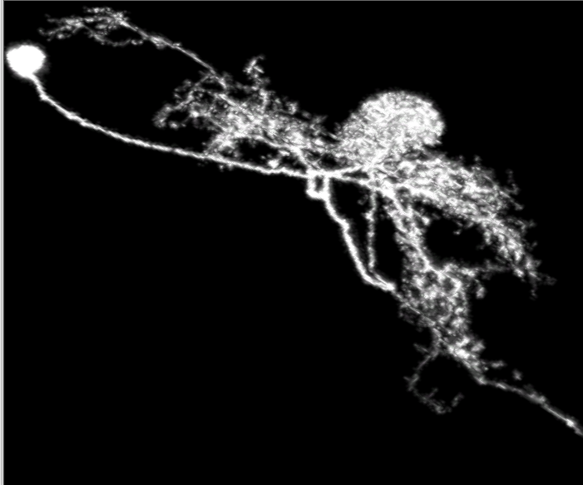
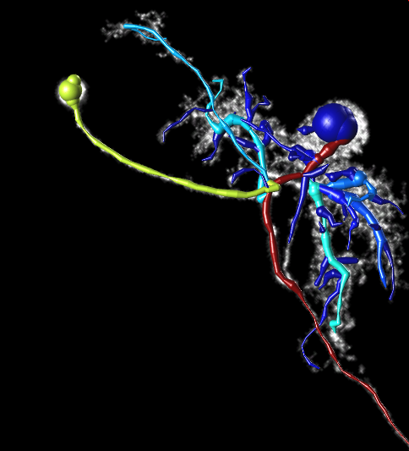
Problem Statement
?
Digital
Reconstruction
Algorithm
<number>

Slide 4
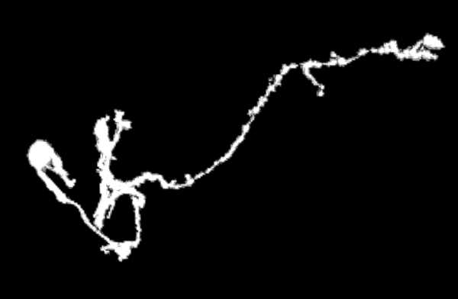
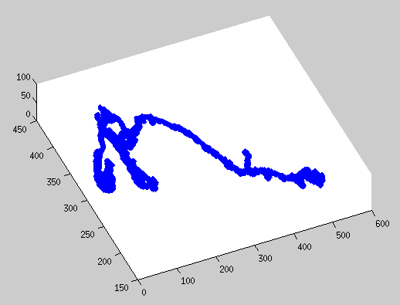
Image Processing
Grayscale 3D Neuron
Adjustable Binarized 3D Neuron using KNN
<number>

Slide 5
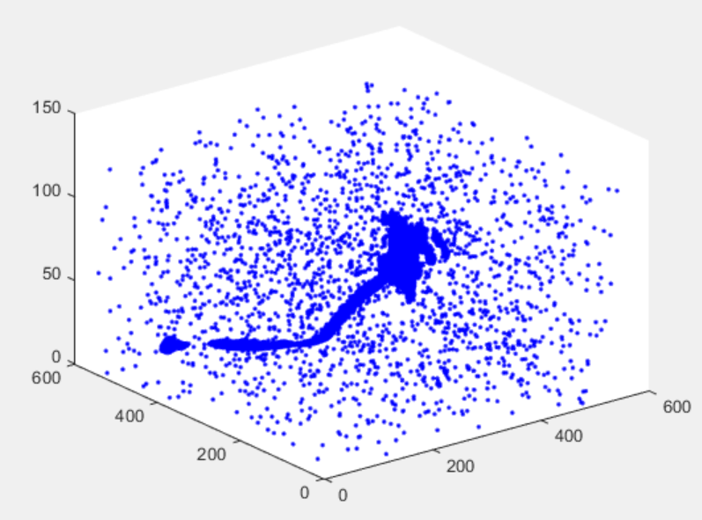
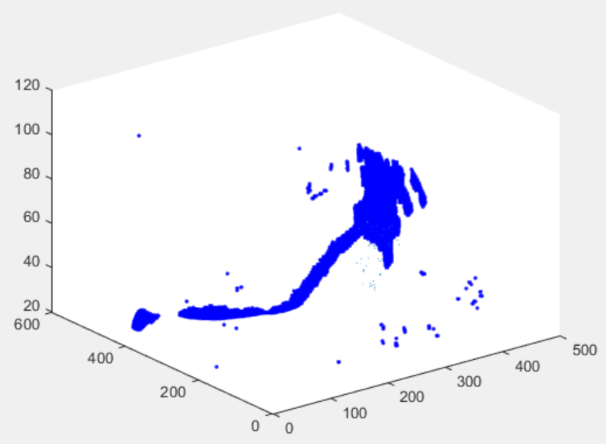
Image Processing (Cont.)
3D Neuron before Noise Reduction
3D Neuron after Noise Reduction
<number>

Slide 6
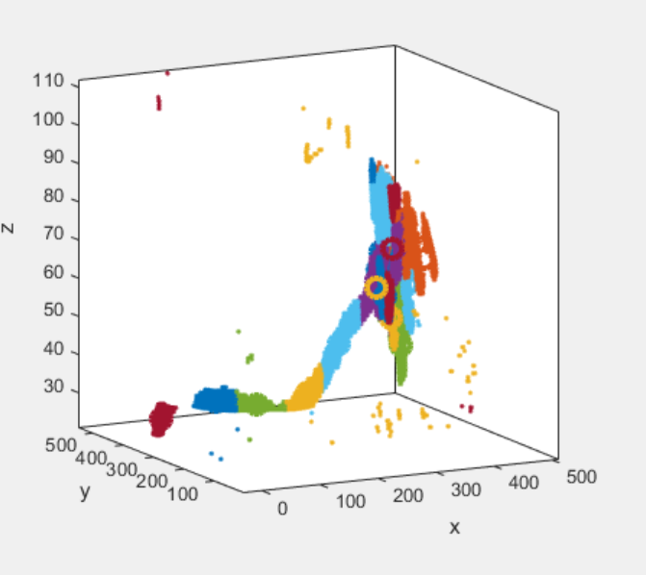
Soma Detection
3D Neuron shown by threshold
Clustering Result of k-means
<number>

Slide 7
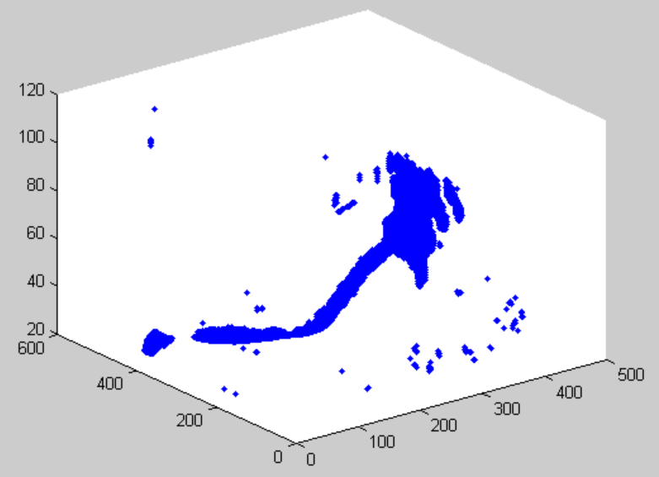
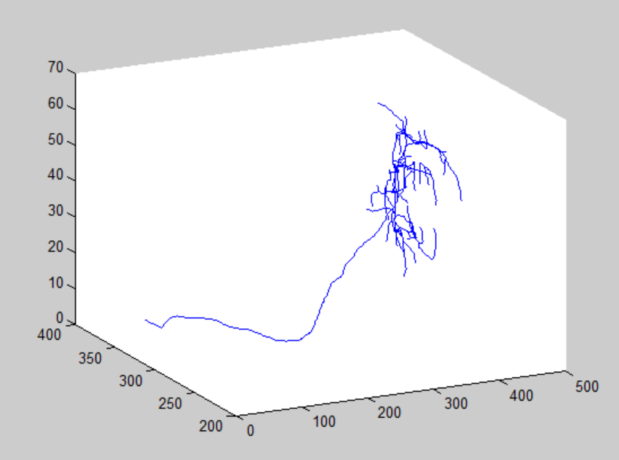
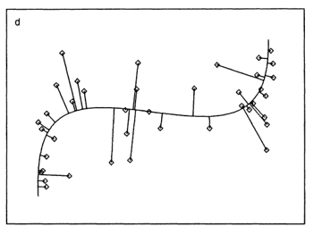
Tree Segmentation
Binarized(or Grayscale) 3D Neuron
Skeleton of 3D Neuron
Principal Curve
<number>

Slide 8
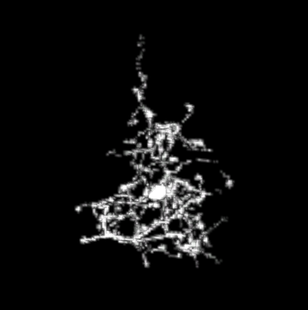
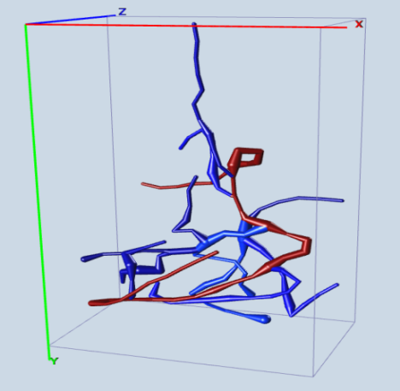
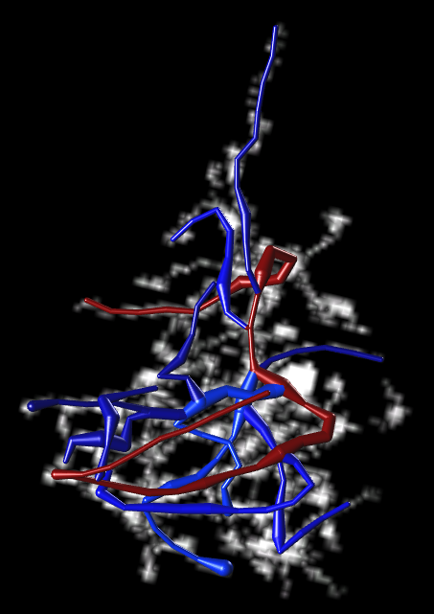
Simulation and Analysis of Digital Reconstruction
Grayscale 3D Neuron
Estimation of radius of skeleton
Simulation of Digital Reconstruction
<number>

Slide 9
Data and Evaluation
Dataset used for Evaluation
OP 1 image stacks from Diadem Challenge
Chiang fly
Image Stacks from Dragonfly C147 to Dragonfly C194
SWC Parameter Explanation
N : node index
Type : neuron type
X, Y, Z : the location of node
Radius : the estimated radius used for Reconstruction
Parind : parent node index
<number>

Slide 10
Simulation and Analysis of Digital Reconstruction (cont.)
 | 18% | 36% | 54% | 72% | 90%
SD | 1.9 | 2.3 | 7.6 | 26.1 | 55 | DNR
SSD | 2.1 | 2.5 | 5.3 | 35 | 63
SSD% | 26% | 31% | 37.2% | 54% | 72%
SD | 2.0 | 3.1 | 8.9 | 28.4 | 76 | APP2
SSD | 2.1 | 3.4 | 9.2 | 37.7 | 66.8
SSD% | 29% | 33% | 40.3% | 67% | 80.2%
SD : Voxel Spatial Distance between Ground Truth and 3D Reconstruction
SSD : Voxel Substantial Spatial Distance
SSD% : Probability of SSD node pairs.
<number>

Slide 11
Conclusion
The image quality is improved by image processing techniques such as noise reduction, deconvolution and shade correction.
The k-means algorithm is optimized with KNN. The clustering result of k-means is valuable information for soma detection and tree segmentation.
Tree segmentation can be achieved by the principal curve starting from different centroids.
Our model is quite robust even when most of neuron signal is deleted.
<number>

Slide 12
THANK YOU
Questions
<number>

