Slide 1
3D Neuron Reconstruction from Multi-Modal Optical Microscopy Images
Donghao Zhang | Master Student
Weidong (Tom) Cai Associate Professor
Biomedical & Multimedia Info. Tech. (BMIT) Research Group
School of Information Technologies

Slide 2
Importance of 3D Neuron Reconstruction
Problem Statements: Challenges of 3D Neuron Reconstruction
Soma Segmentation
Image Processing
K-means
Tree Segmentation
Binarization
Skeletonization
Stimulation and Analysis of Digital Construction
Conclusion

Slide 3
Problem Statement

Slide 4
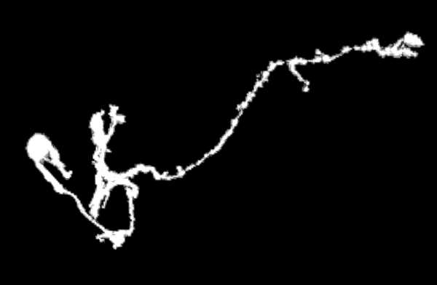
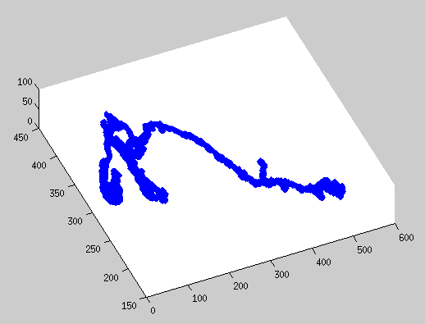
Tree Segmentation
Grayscale 3D Neuron
Adjustable Binarized 3D Neuron using KNN

Slide 5
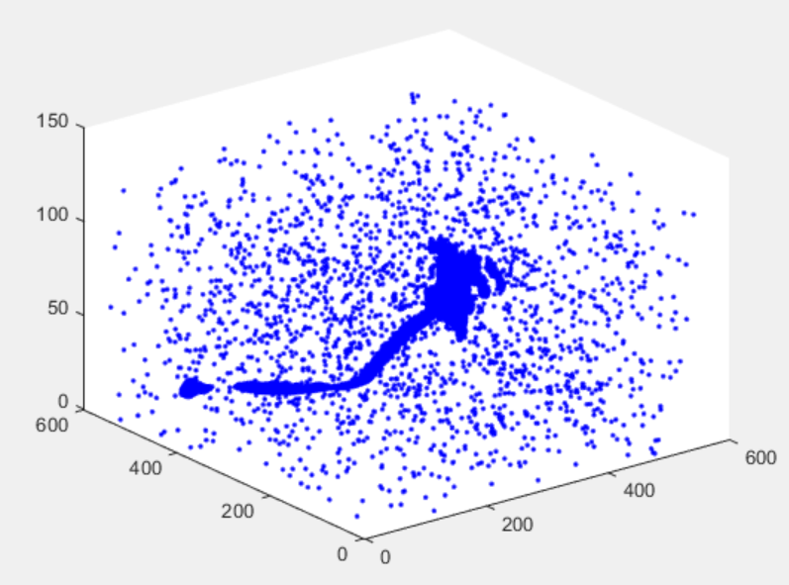
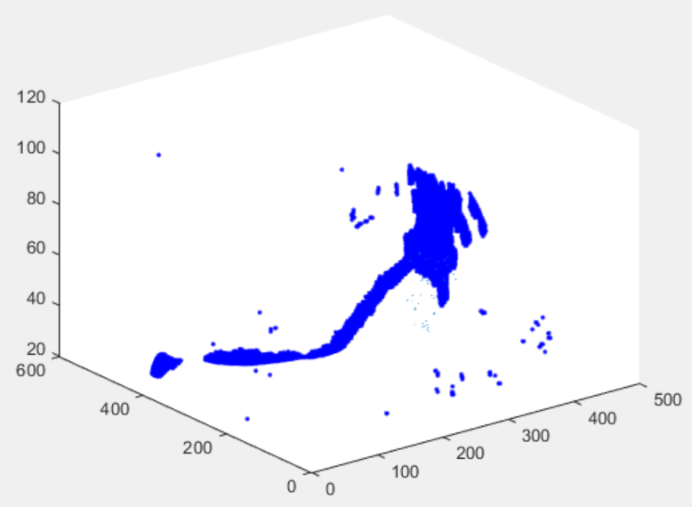
Soma Segmentation
3D Neuron before Noise Reduction
3D Neuron after Noise Reduction

Slide 6
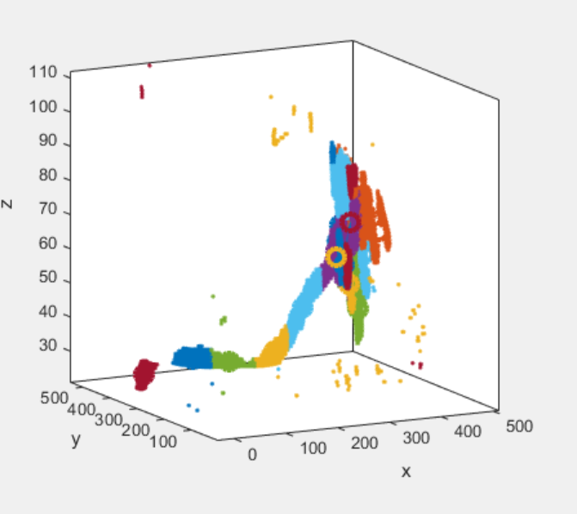
Soma Segmentation
3D Neuron shown by threshold
Clustering Result of k-means

Slide 7
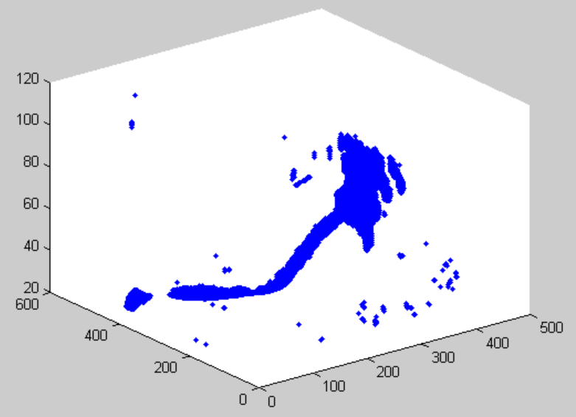
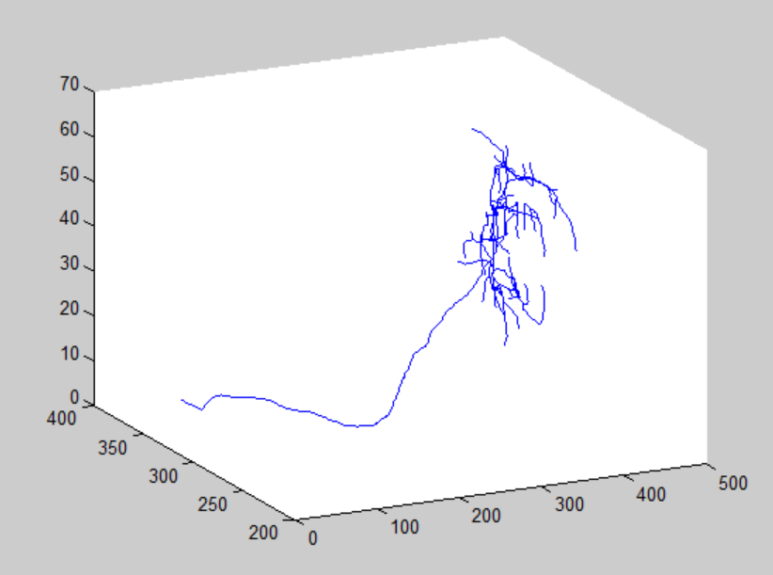
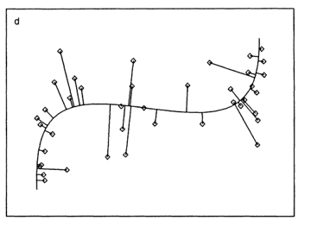
Tree Segmentation
Binarized(or Grayscale) 3D Neuron
Skeleton of 3D Neuron
Principal Curve

Slide 8
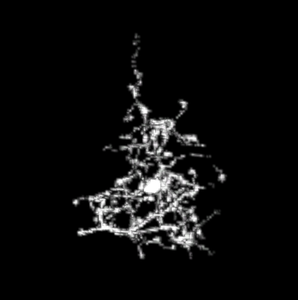
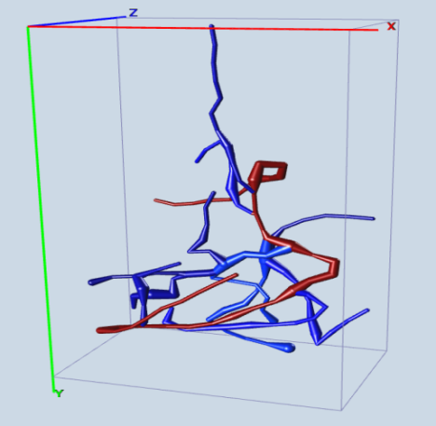
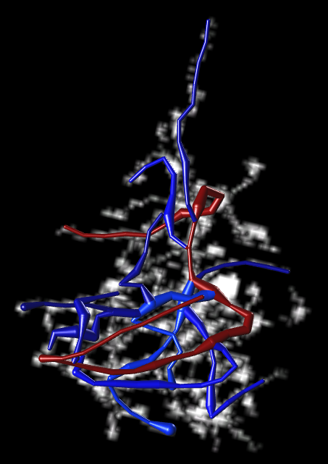
Stimulation and Analysis of Digital Reconstruction (Cont.)
Grayscale 3D Neuron
Estimation of radius of skeleton
Stimulation of Digital Reconstruction

Slide 9
Stimulation and Analysis of Digital Reconstruction (cont.)
 | 18% | 36% | 54% | 72% | 90%
SD | 1.9 | 2.3 | 7.6 | 26.1 | 55 | DNR
SSD | 2.1 | 2.5 | 5.3 | 35 | 63
SSD% | 26% | 31% | 37.2% | 54% | 72%
SD | 2.0 | 3.1 | 8.9 | 28.4 | 76 | APP2
SSD | 2.1 | 3.4 | 9.2 | 37.7 | 66.8
SSD% | 29% | 33% | 40.3% | 67% | 80.2%
SD : Voxel Spatial Distance between Ground Truth and 3D Reconstruction
SSD : Voxel Substantial Spatial Distance
SSD% : Probability of SSD node pairs.

Slide 10
Conclusion
GA-ParFnt was effective in finding the Pareto Front of executing jobs vs Transfer time of Datafiles in Grids
Such Pareto Front could be estimated by exponential funcitons
Many scheduling algorithms are not optimal, despite their claim.

Slide 11
THANK YOU

