Slide 1
HW8
Dongho Kim
2024.07.03

Slide 2
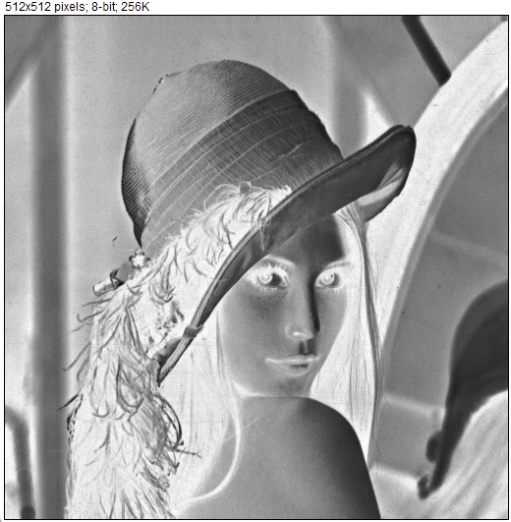

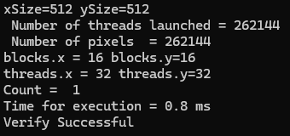
Invert

Slide 3


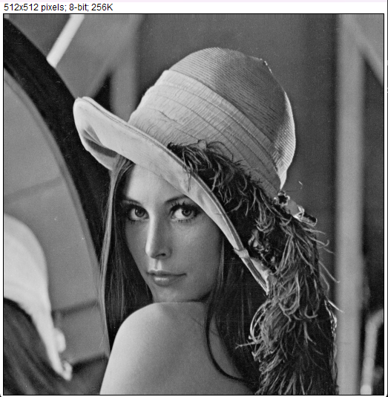

1 thread, 1 block

Slide 4

1024 thread, 1 block

Slide 5

Y Blocks 1 thread/block
Y Blocks
= xSize * ySize

Slide 6

Z blocks, xSize threads/block
Z Block
= ySize

Slide 7

M blocks, 32x32/block
M Block.x = xSize/32
M block.y = ySize/32

Slide 8
Performance Reporting
Module/Block | Flipx | Flipy | Add (Version 3)
1 thread, 1 block | 92.9 ms | 96.0 ms | 154.4 ms
1024 thread/block, 1 block | 1.1 ms | 1.1 ms | 0.9 ms
Y blocks, 1 thread/block | 1.0 ms | 1.0 ms | 0.9 ms
Z blocks, xSize threads/block | 0.5 ms | 0.4 ms | 0.5 ms
M blocks, 32x32/block | 0.6 ms | 0.5 ms | 0.7 ms

