Slide 1
HW4
Dongho Kim
07.01.2024

Slide 2
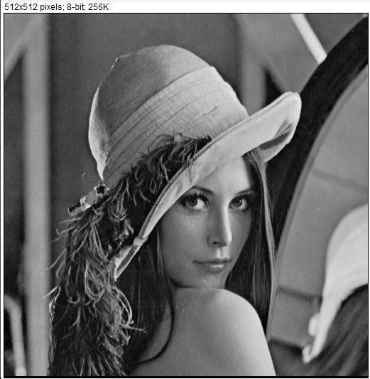
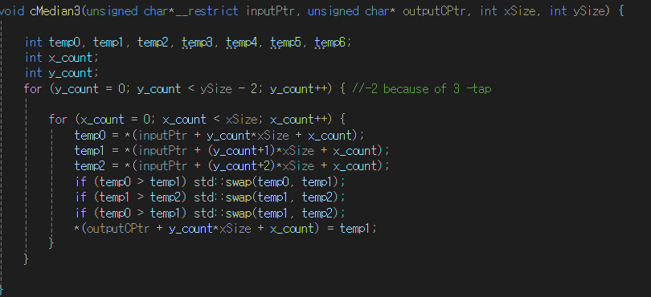
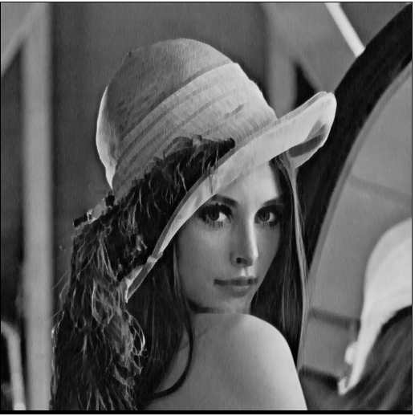
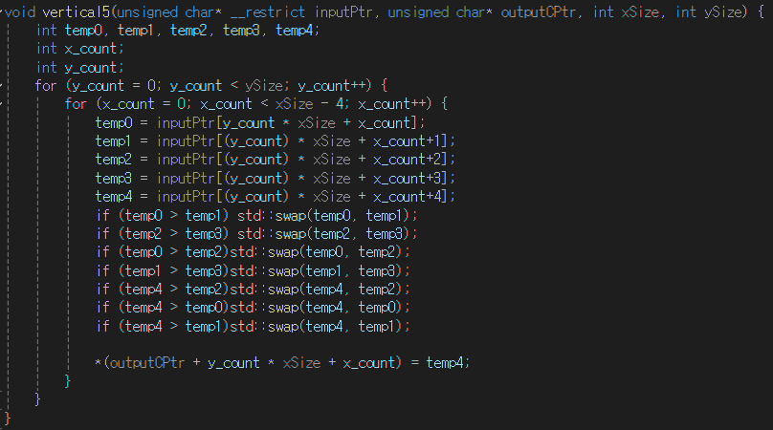

Vertical

Slide 3
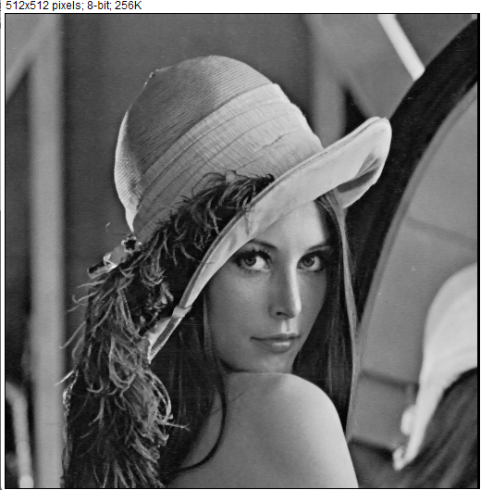
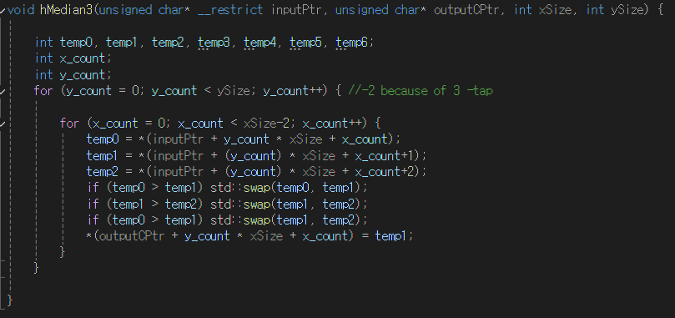


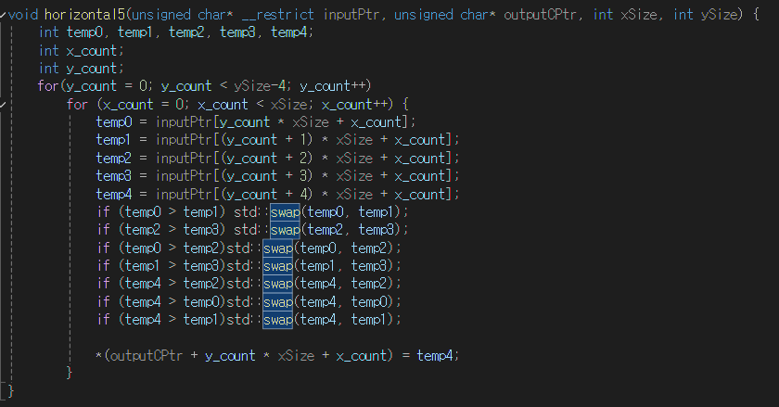

Horizontal

Slide 4
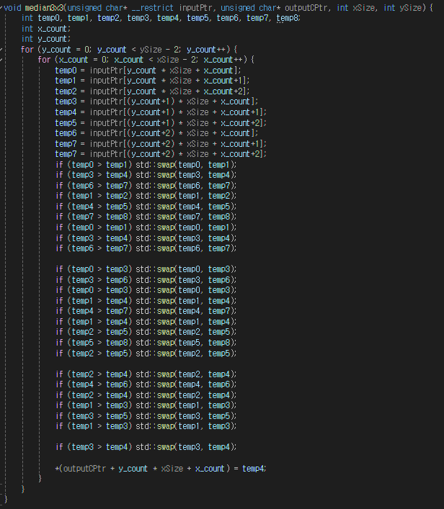
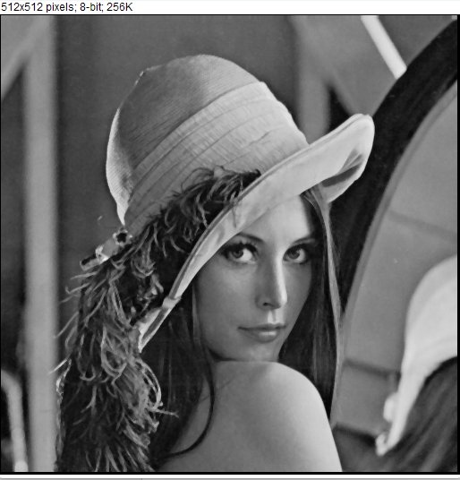

3x3

Slide 5
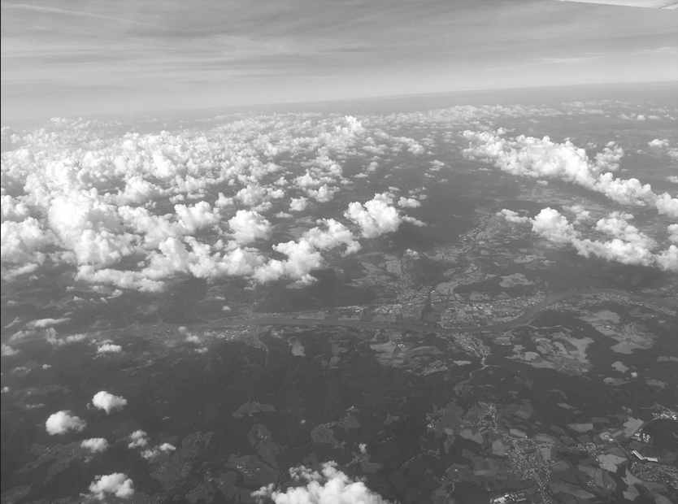
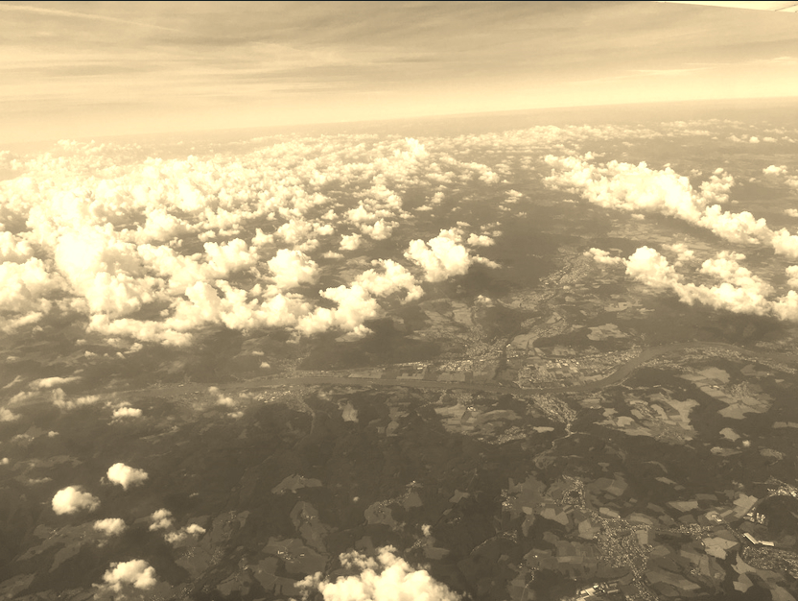
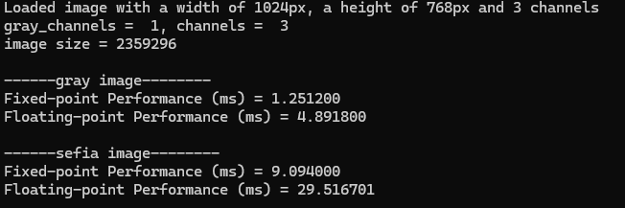
Fixed-point

Slide 6
Report Performance
Module | Fixed-point | Floating-point
hsi2rgb | 9.094000 | 29.516701
Median filter | Performance
3-tap horizontal | 0.095300
3-tap vertical | 0.063100
5-tap horizontal | 0.086800
5-tap vertical | 0.072500
3x3 | 1.949300

