Slide 1
Modules

Slide 2
HW
C-Programming
2D convolution
Convert to fixed point
5x5, 7x7, 9x9, 13x13, 15x15
Zero padding 🡪 Zero padding (2D)
Boundary extension
Reflection
Sobel edge detection
SQRT and absolute summation
Boxcar filtering
SIMD Implementation
Add, flipx, flipy, median 3-tap

Slide 3
Convolution
Convolution
Is widely used in signal, image and video processing
Some filters smooth out the signal values so that one can see the big-picture trend
Others like Gaussian filters can be used to sharpen boundaries and edges of objects in images..
Important techniques
Taking advance of cache memories

Slide 4
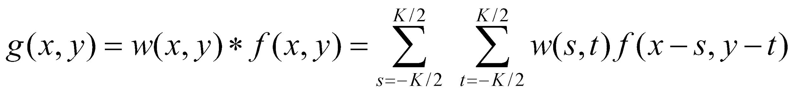
Convolution
Filtered output is
w is a filtering kernel
f(x, y) is input image

Slide 5
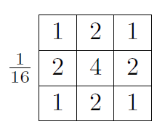
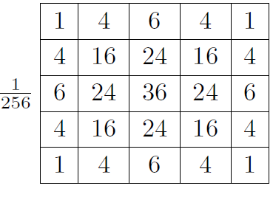
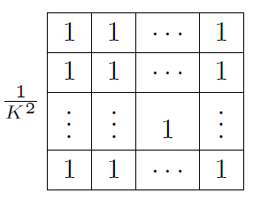
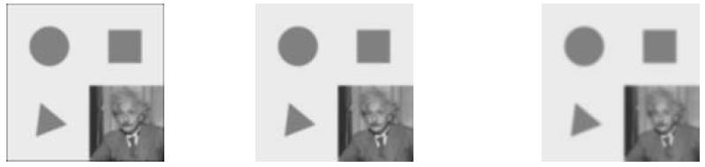
Linear Filter
Smoothing
Box, Bilinear, Gaussian

Slide 6



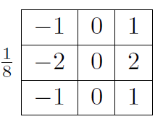

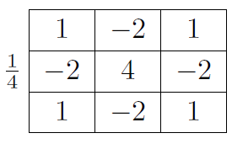
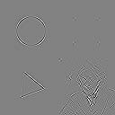
Linear Filter
Smoothing
Box, Bilinear, Gaussian
Edge
Sobel
Corner

Slide 7
2D Convolution – Boundary pixels
0
0
0
0
0
N
P
0
3
4
5
6
0
2
3
4
5
0
3
5
6
7
179
0
1
1
3
1
0
0
0
0
0
1
2
3
2
1
0
9
16
15
12
0
ghost cells
2
3
4
3
2
3
4
5
4
3
0
8
15
16
15
(apron cells, halo cells)
M
2
3
4
3
2
0
9
20
18
14
1
2
3
2
1
0
2
3
6
1

Slide 8
2D Convolution
N
P
1
2
3
4
5
6
7
1
2
3
4
5
2
3
4
5
6
7
8
2
3
4
5
6
3
4
5
6
7
8
9
3
4
321
6
7
4
5
6
7
8
5
6
4
5
6
7
8
5
6
7
8
5
6
7
5
6
7
8
5
6
7
8
9
0
1
2
7
8
9
0
1
2
3
M
1
4
9
8
5
1
2
3
2
1
4
9
16
15
12
2
3
4
3
2
*
3
4
5
4
3
9
16
25
24
21
2
3
4
3
2
8
15
24
21
16
1
2
3
2
1
5
12
21
16
5

Slide 9
2D Convolution Boundary Condition
N
P
1
2
3
4
5
6
7
1
2
3
4
5
2
3
4
5
6
7
8
112
3
4
5
6
3
4
5
6
7
8
9
3
4
5
6
7
4
5
6
7
8
5
6
4
5
6
7
8
5
6
7
8
5
6
7
5
6
7
8
5
6
7
8
9
0
1
2
7
8
9
0
1
2
3
M
0
0
0
0
0
1
2
3
2
1
0
0
4
6
6
2
3
4
3
2
3
4
5
4
3
0
0
10
12
12
2
3
4
3
2
0
0
12
12
10
1
2
3
2
1
0
0
12
10
6

Slide 10
2D Convolution Boundary : Extension
1
1
1
2
3
N
P
1
1
1
2
3
4
5
6
7
1
2
3
4
5
2
2
2
3
4
5
6
7
8
112
3
4
5
6
3
3
3
4
5
6
7
8
9
3
4
5
6
7
4
4
4
5
6
7
8
5
6
4
5
6
7
8
5
6
7
8
5
6
7
5
6
7
8
5
6
7
8
9
0
1
2
7
8
9
0
1
2
3
M
1
2
3
2
1
2
3
4
3
2
3
4
5
4
3
2
3
4
3
2
1
2
3
2
1

Slide 11
2D Convolution Boundary : Reflection
1
1
1
2
3
N
P
3
2
1
2
3
4
5
6
7
1
2
3
4
5
4
3
2
3
4
5
6
7
8
112
3
4
5
6
4
3
3
4
5
6
7
8
9
3
4
5
6
7
5
4
4
5
6
7
8
5
6
4
5
6
7
8
5
6
7
8
5
6
7
5
6
7
8
5
6
7
8
9
0
1
2
7
8
9
0
1
2
3
M
1
2
3
2
1
2
3
4
3
2
3
4
5
4
3
2
3
4
3
2
1
2
3
2
1

Slide 12
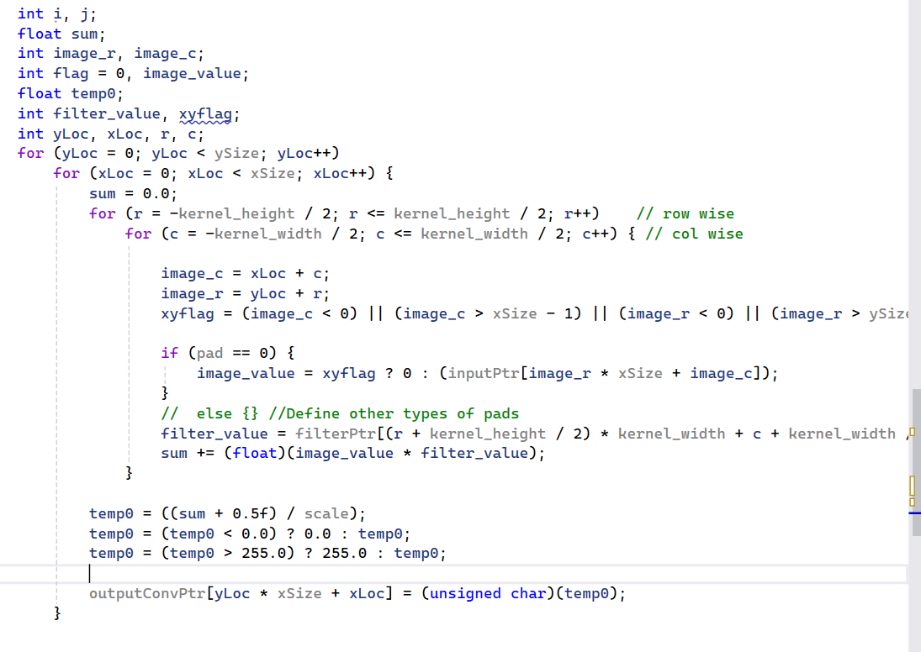

Slide 13
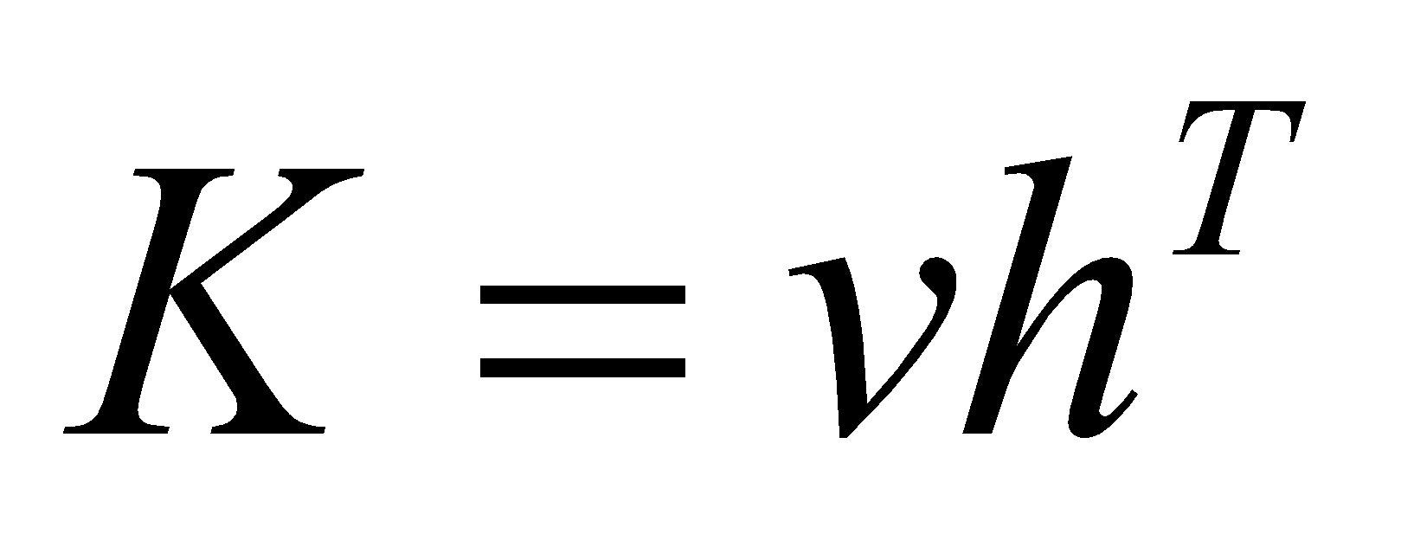
Separable Filter
Convolution of K-size kernel requires K² operations
Can be sped up to 2K operations by
First performing a 1D horizontal convolution
Followed by a 1D vertical convolution

Slide 14
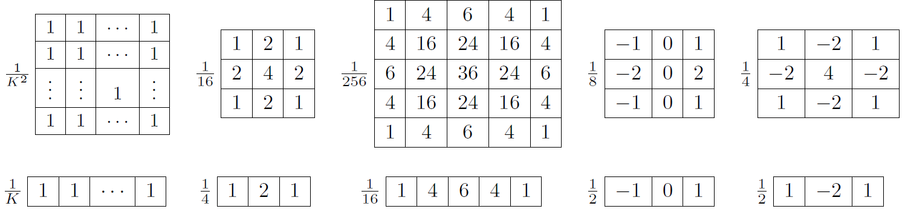
Separable Filter
FIR along X followed by FIR along y…

Slide 15
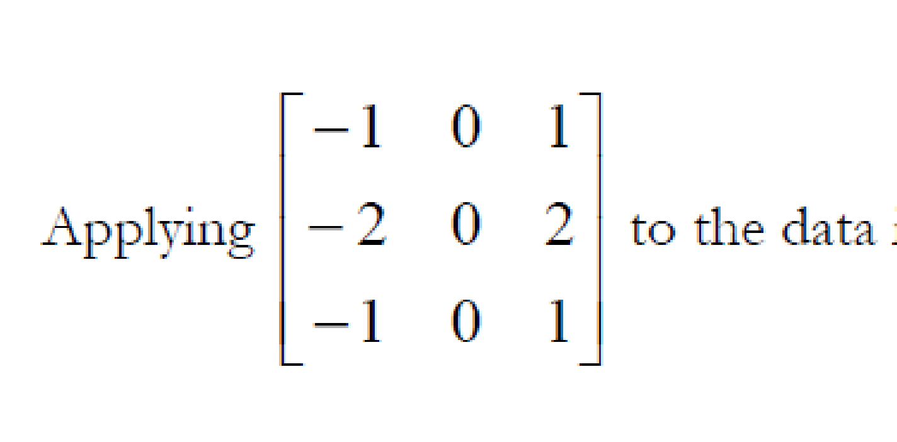
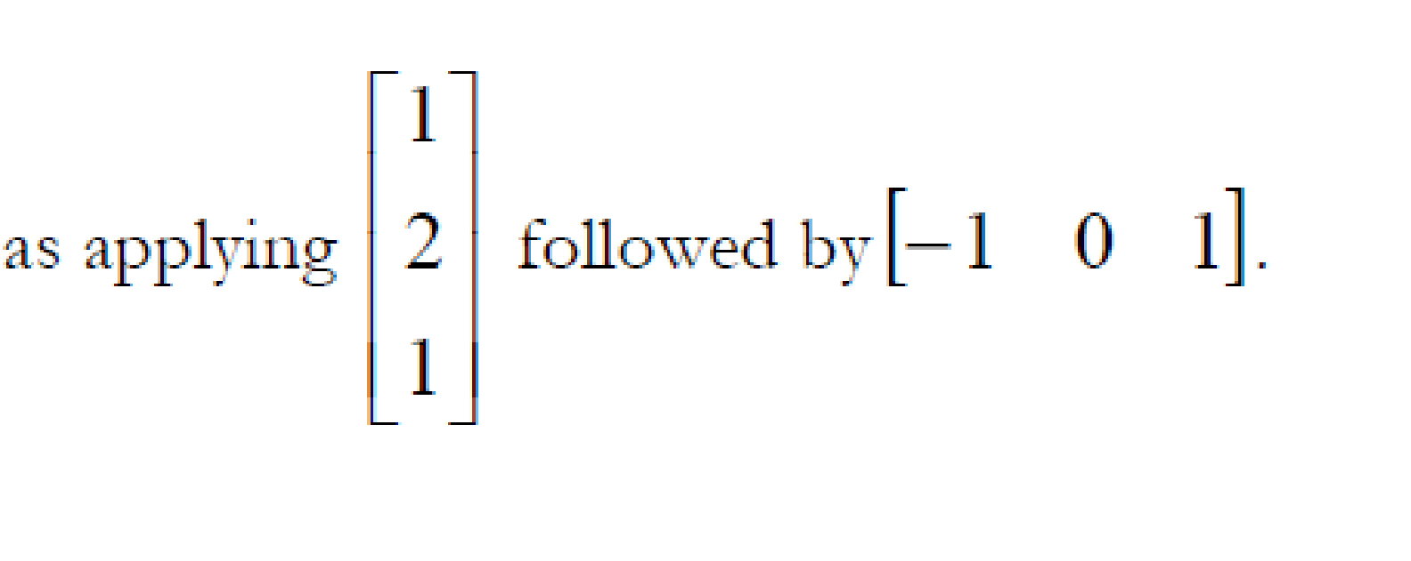
Separable convolution
1D FIR along y followed by 1D fir along x
1D FIR along y 🡪 1D FIR along x

Slide 16
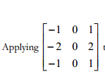
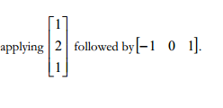
Separable filter
Row-wise filter followed by column wise filter
Computations here?
Computations here?
Implement 2D convolution using two 1D FIR
FIR 🡪 Transpose 🡪 FIR 🡪 Transpose

Slide 17

Boxcar Filter
Boxcar filter : Average filter
25
Can be implemented 3 ways:
Direct convolution
Separable convolution
Most optimized?

Slide 18
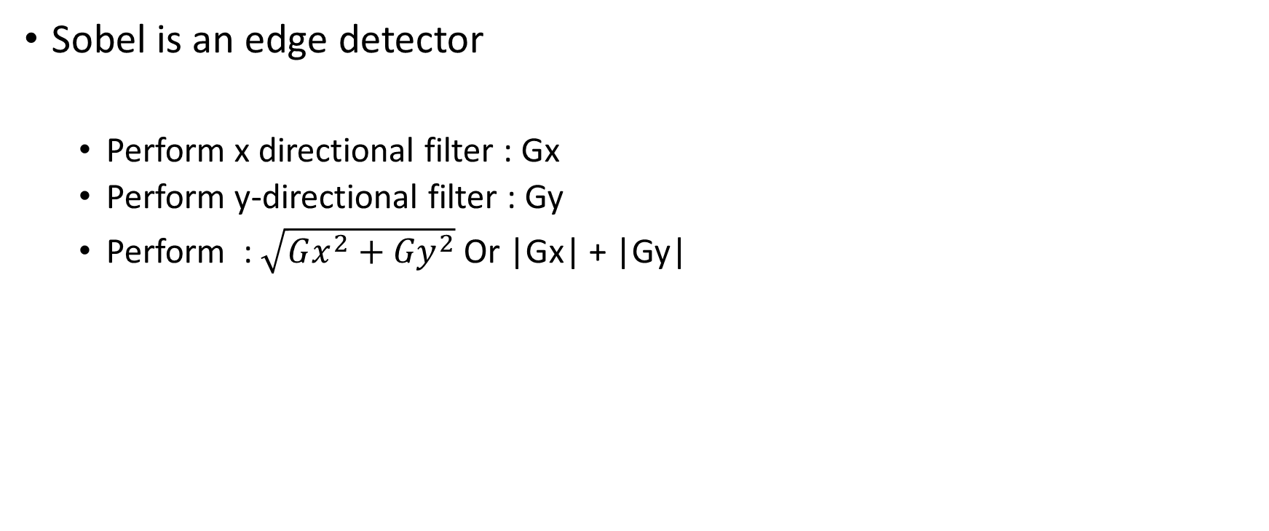
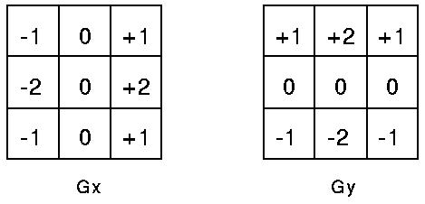
Sobel Edge Detector

Slide 19
Add Module using SSE instructions
I will provide add8 - > Version 1

Slide 20
Add two images
Implement Version2 and 3
Add two images : Output = (input0 + input1)
Three options:
Add two 8-bit images and store 8-bit result : output = (input0 + input1)/2
Unsigned char *image0;
Unisgned char *image1;
Unsigned char*outimage;
For(i=0;i<imagesize;i++{
Outimage[i]=(image0[i] + image[1[i])/2;
}
2. Add two 8-bit images. Output is 16-bit image
Output = (input0 + input1)
Unsigned char *image0;
Unsigned char *image1;
Unsigned short *outimage;
For(i=0;i<imagesize;i++{
Outimage[i]=image0[i] + image[1[i];
}
Using partitioned operations
Will provide this
Implement VERSION 3
3. Add two 8-bit images. Output is 8-bit image
Output = (input0 + input1)
Unsigned char *image0;
Unisgned char *image1;
Unsigned char *outimage;
Unsigned int temp;
For(i=0;i<imagesize;i++{
temp = image0[i] + image[1[i];
outimage [i] = if (temp > 255) ? 255 : temp;
}

Slide 21
Add8 : Version 3
Instructions to use : 128 bit instructions
_mm_unpacklo_epi8
_mm_unpackhi_epi8
_mm_add_epi16
_mm_packus_epi16
input128_1 = *(src128_ptr1++);
input128_2 = *(src128_ptr2++);
i1_high = _mm_unpackhi_epi8(input128_1, _mm_setzero_si128());
i1_low = _mm_unpacklo_epi8(input128_1, _mm_setzero_si128());
i2_high = _mm_unpackhi_epi8(input128_2, _mm_setzero_si128());
i2_low = _mm_unpacklo_epi8(input128_2, _mm_setzero_si128());
temp128_0 = _mm_add_epi16(i1_low, i2_low);
temp128_1 = _mm_add_epi16(i1_high, i2_high);
temp128_0 = _mm_packus_epi16(temp128_0, temp128_1);

Slide 22
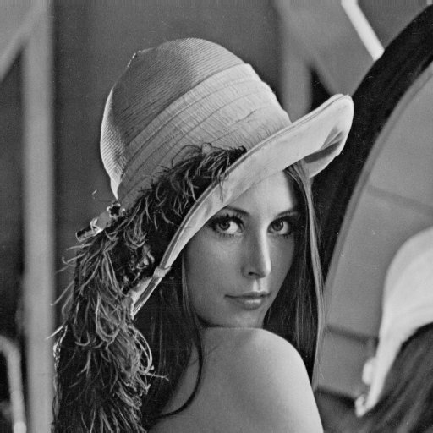
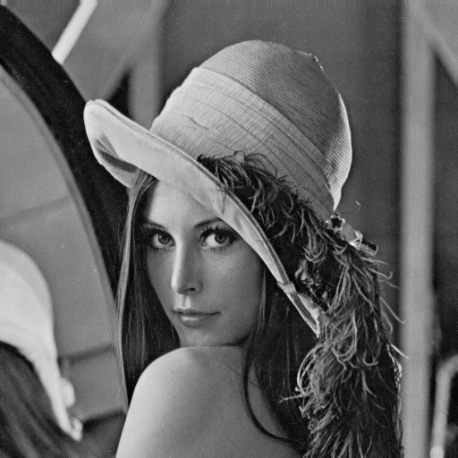

Flip along y-axis
Out(width-i,j) = in(I,j)
What if AVX?
using SSE : 128-bit register
mask = _mm_set_epi8(0, 1, 2,3, 4, 5, 6, 7, 8, 9, 10, 11, 12, 13, 14, 15);
_mm_shuffle_epi8(a, mask);

Slide 23
FlipY using AVX? 🡪 Bonus points ;)
_mm256_permute4x64_epi64(data256, _MM_SHUFFLE(0, 1, 2, 3));
_mm256_shuffle_epi8(temp2560, mask0256[0]);

Slide 24
HW
C-Programming
2D convolution and separable convolution (Use boxcar filter)
5x5, 7x7, 9x9, 13x13, 15x15
Zero padding 🡪 Provided
Implement one of the following
Boundary extension
Reflection
Sobel edge detection
X-edge filter, Y-edge filter
SQRT
absolute summation
SIMD Implementation
Add : Implement version 3
flipx, flipy 🡪 SSE3. If implemented using AVX : Bonus
Median filter – 3 tap 🡪 Try

Slide 25
Performance Reporting
Provide images also!!
Convolution
Edge Detector
Modul | 3x3 | 5x5 | 7x7 | 11x11 | 15x15
2D Convolution
Boxcar filtering (Separable)
Edge detector
SQRT
Absolute sum

Slide 26
Performance Reporting

