Slide 1
HW5
Dongho Kim
2024.07.02

Slide 2
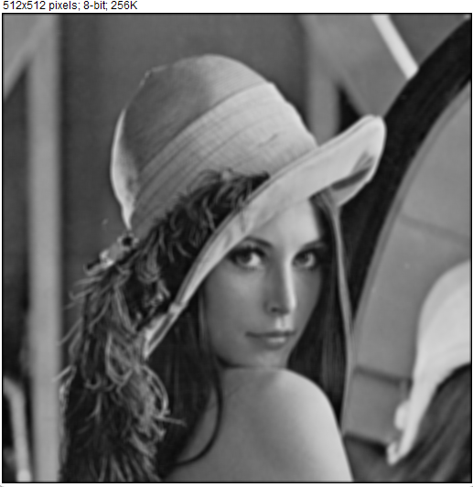
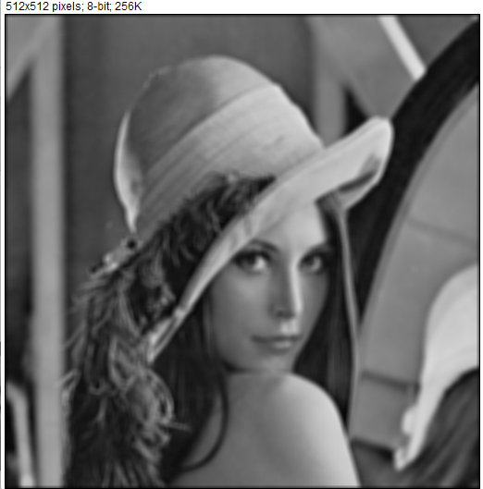
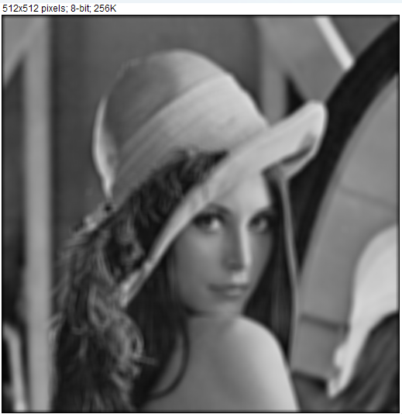
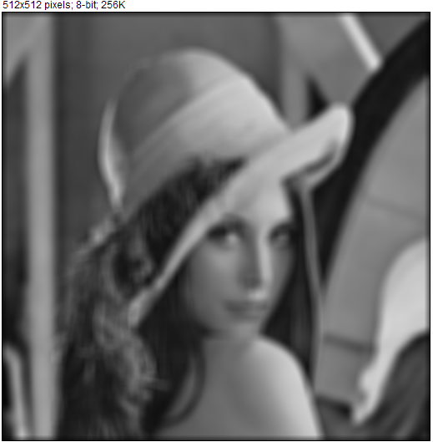






2D Convolution
3x3 6x6 9x9 13x13 15x15

Slide 3





2D Convolution, separable convolution
Boxcar filter
3x3 6x6 9x9 13x13 15x15

Slide 4
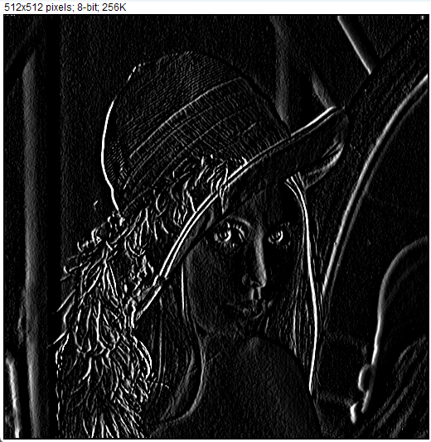
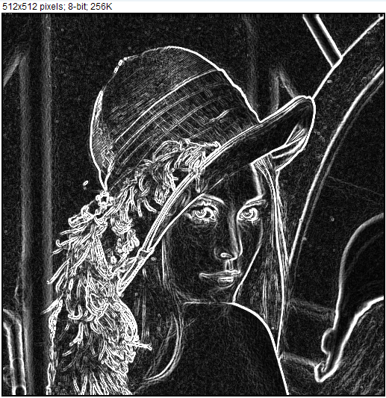
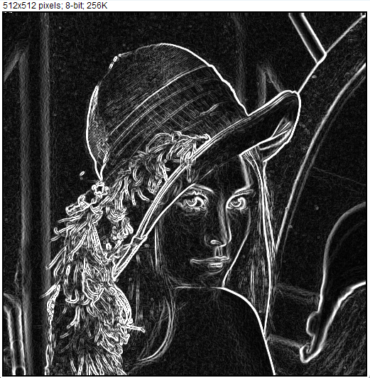

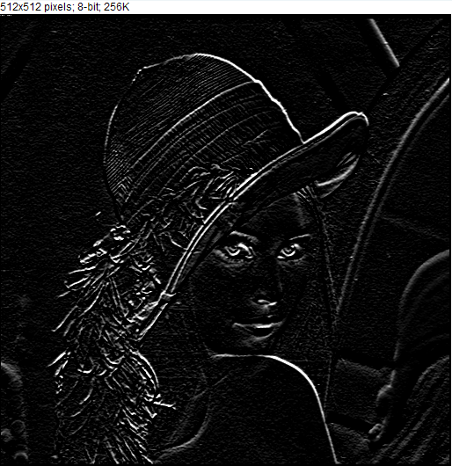
Edge Detector
3x3 sobel filter
X axis
Y axis

Slide 5
Performance Reporting
Convolution
Module | 3x3 | 5x5 | 7x7 | 11x11 | 15x15
2D Convolution | 4.462 | 8.926 | 14.697 | 31.677 | 42.052
Boxcar filtering (Seperable) | 0.839 | 1.311 | 1.659 | 2.313 | 2.572
Edge Detector
Edge Detector
SQRT | 0.247
Absolute Sum | 0.242

Slide 6
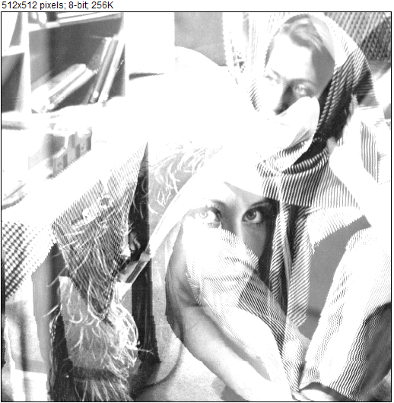
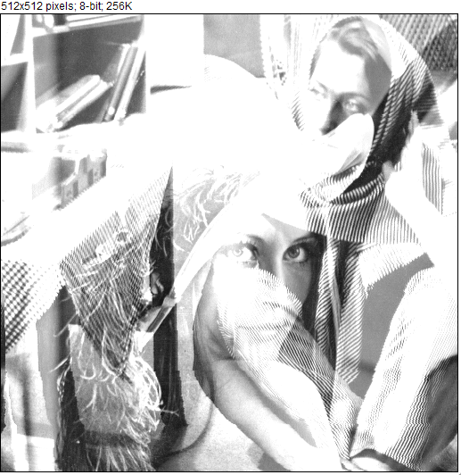

SIMD Implementation
Add8 C
SIMD – 8bit

