Slide 1
HW6
Dongho Kim
2024.07.03

Slide 2
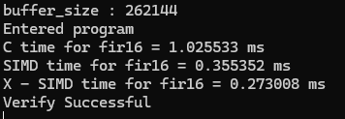
Vertical FIR 16-tap

Slide 3
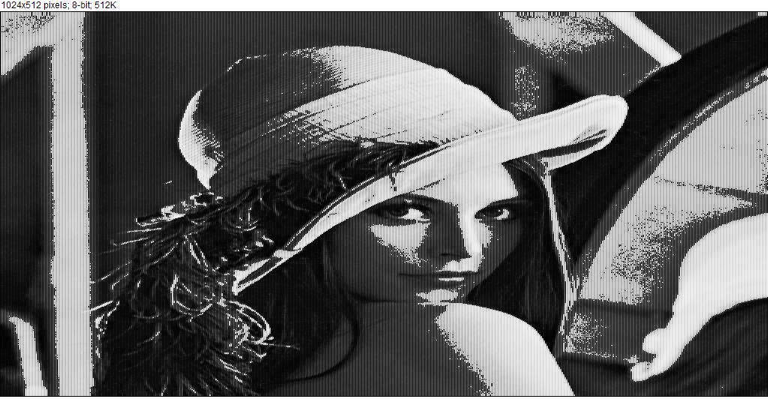
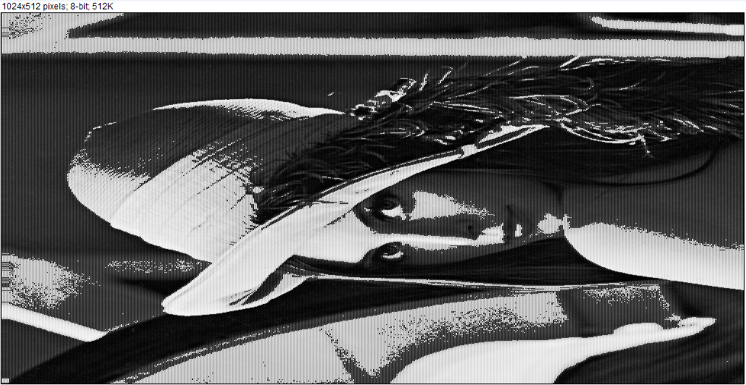

Transpose for 16-bit image
original
transpose_C
transpose_SIMD

Slide 4
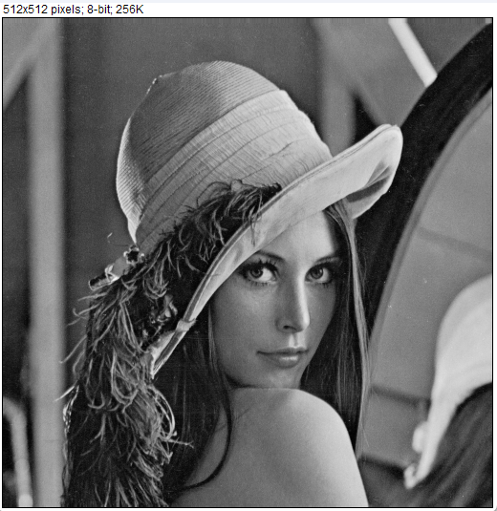
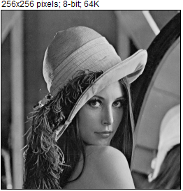

AVG Pool
Original
Average Pooling

Slide 5

Maxpool
Original
Max Pooling

Slide 6
Performance
Matrix Multiply
Performance Comparison
 | Simple | Transpose | ACCM | SSE
A (256x256) * B(256x256) | 2.140 | 0.699 | 0.850 | 1.878
A (128x128) * B(128x128) | 0.282 | 0.096 | 0.106 | 0.251
A (64x64) * B(64x64) | 0.035 | 0.015 | 0.014 | 0.034
A (32x32) * B(32x32) | 0.005 | 0.002 | 0.006 | 0.005
A (512x512) * B (512*512) | 17.125 | 5.143 | 6.836 | 14.173

