Slide 1
HW-2
Image transpose
Flipx, Flipy
Report performance in ms
Do not worry about Bandwidth column for now
Upload excel as well as your code to the folder

Slide 2


Transpose

Slide 3
Transpose C
void transpose8(unsigned char *inputPtr, unsigned char *outputPtr, int xSize, int ySize){
int i, j;
unsigned char inData, outData;
for ( i=0;i<ySize;i++)
for ( j=0;j<xSize;j++){
dst_ptr[j]i]= dst[i][j];
}
}

Slide 4
Transpose : Block x block

Slide 5
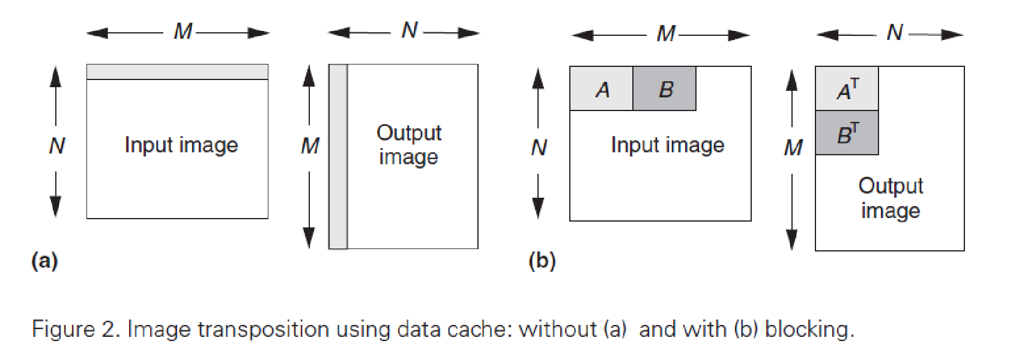
Transpose
Out(I,j) = in (j,i)

Slide 6
Transpose : Block x Block
void transpose_block(unsigned char *inputPtr, unsigned char *outputPtr, int xSize, int ySize)
{
int i, j,k,l;
int blockSize = 8;
int xCounter, yCounter;
unsigned char inData, outData;
xCounter = xSize/blockSize;
yCounter= ySize/blockSize;
for ( i=0;i<ySize;i+=blockSize)
for ( j=0;j<xSize;j+=blockSize)
for ( k=0;k<blockSize;k++)
for ( l=0;l<blockSize;l++){
}
}

Slide 7
Transpose
512x512 image
Use different block sizes
8x8, 16x16, 32x32, 64x64, 128x128
Check images of different sizes
512x512, 256x256, 128x128

Slide 8


Flip along y-axis
Out(width-i,j) = in(I,j)

Slide 9


Flip along X

Slide 10
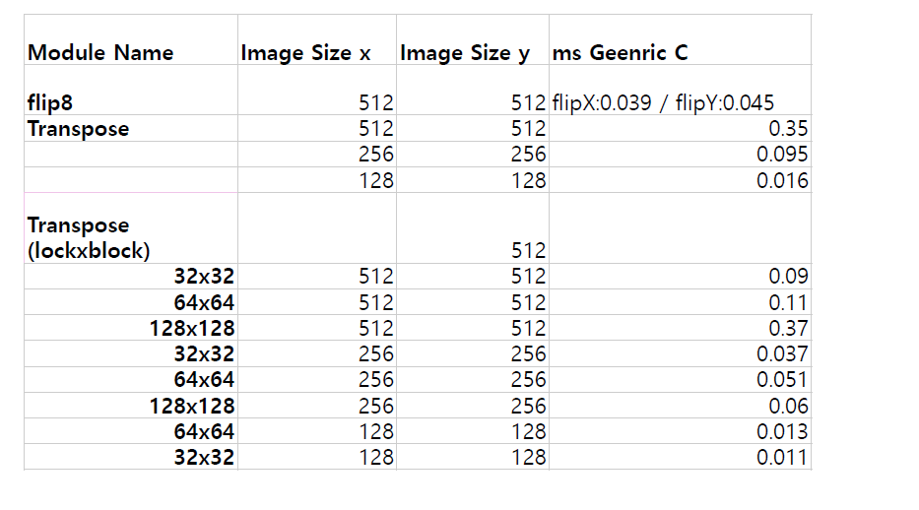
Reporting
Performance reporting – Excel sheet
All the projects – working project

