Slide 1
Home work : 10
2D convolution using CUDA
Zero pad, boundary pad, mirror
Input : 512x512, output : 512x512
Image is 8-bit, filters: floating
Convolution filters: 5x5, 7x7x, 3x3, 11x11, 13x13, 15x15
Create filers of different size using boxcar filter
Using shared memory
Compare performance using Gaussian and Boxcar (Separabale)
Due date is 7/10 mid night

Slide 2
Convolution using CUDA
Filtered output is
w is a filtering kernel
f(x, y) is input image

Slide 3
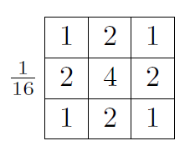
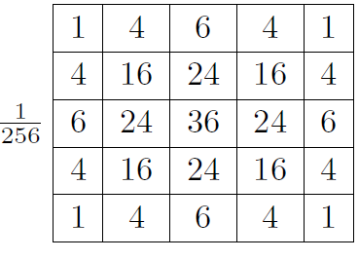
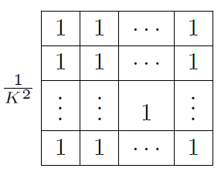
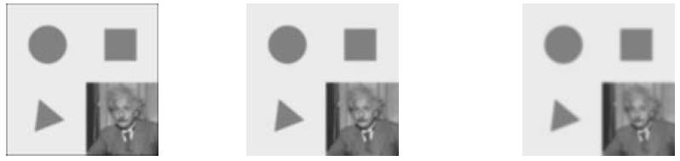
Linear Filter
Smoothing
Box, Bilinear, Gaussian

Slide 4

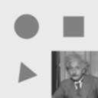

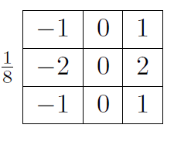

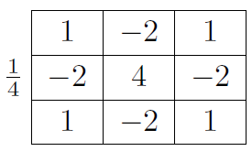
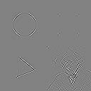
Linear Filter
Smoothing
Box, Bilinear, Gaussian
Edge
Sobel
Corner

Slide 5
2D Convolution
N
P
1
2
3
4
5
6
7
1
2
3
4
5
2
3
4
5
6
7
8
2
3
4
5
6
3
4
5
6
7
8
9
3
4
321
6
7
4
5
6
7
8
5
6
4
5
6
7
8
5
6
7
8
5
6
7
5
6
7
8
5
6
7
8
9
0
1
2
7
8
9
0
1
2
3
M
1
4
9
8
5
1
2
3
2
1
4
9
16
15
12
2
3
4
3
2
*
3
4
5
4
3
9
16
25
24
21
2
3
4
3
2
8
15
24
21
16
1
2
3
2
1
5
12
21
16
5

Slide 6
2D Convolution Boundary Condition input 512 , output 512x512
N
P
1
2
3
4
5
6
7
1
2
3
4
5
2
3
4
5
6
7
8
112
3
4
5
6
3
4
5
6
7
8
9
3
4
5
6
7
4
5
6
7
8
5
6
4
5
6
7
8
5
6
7
8
5
6
7
5
6
7
8
5
6
7
8
9
0
1
2
7
8
9
0
1
2
3
M
0
0
0
0
0
1
2
3
2
1
0
0
4
6
6
2
3
4
3
2
3
4
5
4
3
0
0
10
12
12
2
3
4
3
2
0
0
12
12
10
1
2
3
2
1
0
0
12
10
6

Slide 7
2D Convolution – Boundary pixels
0
0
0
0
0
N
P
0
3
4
5
6
0
2
3
4
5
0
3
5
6
7
179
0
1
1
3
1
0
0
0
0
0
1
2
3
2
1
0
9
16
15
12
0
ghost cells
2
3
4
3
2
3
4
5
4
3
0
8
15
16
15
(apron cells, halo cells)
M
2
3
4
3
2
0
9
20
18
14
1
2
3
2
1
0
2
3
6
1

Slide 8
2D Convolution – Boundary pixels
0
0
0
0
0
N
P
0
3
4
5
6
0
2
3
4
5
0
3
5
6
7
179
0
1
1
3
1
0
0
0
0
0
1
2
3
2
1
0
9
16
15
12
0
ghost cells
2
3
4
3
2
3
4
5
4
3
0
8
15
16
15
(apron cells, halo cells)
M
2
3
4
3
2
0
9
20
18
14
1
2
3
2
1
0
2
3
6
1

Slide 9
Separable convolution
Instead of 2D
You can do 1D horizontal followed by 1D vertical filtering
E.g., 15x15 boxcar filter
1x15 filter → result → 15x1 filte → result

Slide 10
Generic conv()
void conv( unsigned char *src_ptr, unsigned char *dst_ptr, float *kernel_ptr, int image width,
int image_height, int kernel_width, int kernel_height, float scale)
{
int i, j, k, l;
float temp;
int image_width_in, image_height_in;
image_width_in = image_width + kernel_width -1;
for (i=0;i<image_height;i++){
for (j=0;j<image_width;j++){
temp=0;
for(k=0;k<kernel_height;k++){
for(l=0;l<kernel_width;l++){
temp+=src_ptr[(i+k)*image_width_in+j+l]
*kernel_ptr[k*kernel_width_in+l];
} /* end for l… */
} /* end for k… */
/* scale to 8-bit representation and store the result */
dst_ptr[i*image_width+j] = (unsigned char) (temp/scale);
} /* end for j… */
} /* end for i… */
} /* end conv() */

Slide 11
Separable Filter
Convolution of K-size kernel requires K² operations
Can be sped up to 2K operations by
First performing a 1D horizontal convolution
Followed by a 1D vertical convolution

Slide 12
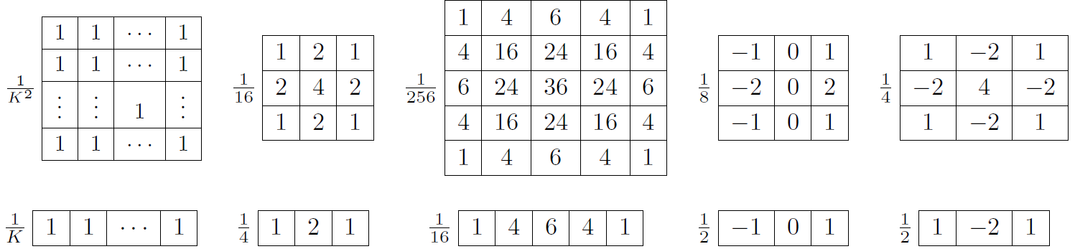
Separable Filter
FIR along X followed by FIR along y…

Slide 13
Separable convolution
1D FIR along y followed by 1D fir along x
1D FIR along y → 1D FIR along x

Slide 14
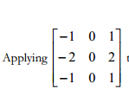
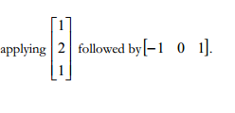
Separable filter
Row-wise filter followed by column wise filter
Computations here?
Computations here?
Implement 2D convolution using two 1D FIR
X-tap FIR → y-tap FIR

Slide 15

Boxcar Filter
15x15 Boxcar : All ement are one. Toal is divided by 15x15
$$\left[\begin{aligned}1 1 1 1 1 \\ 1 1 1 1 1 \\ 1 1 1 1 1 \\ 1 1 1 1 1 \\ 1 1 1 1 1\end{aligned}1 1 1 1 1 1 1 1\right]$$
Boxcar filter : Average filter
25
Can be implemented 3 ways:
Direct convolution
Separable convolution
Most optimized?

Slide 16

Boxcar Filter
$$\left[\begin{aligned}1 1 1 1 1 \\ 1 1 1 1 1 \\ 1 1 1 1 1 \\ 1 1 1 1 1 \\ 1 1 1 1 1\end{aligned}\right]$$
Boxcar filter : Average filter
25
Can be implemented 3 ways:
Direct convolution
Separable convolution
Most optimized?

Slide 17
Performance Evaluation
Input 512x512, 8-bit image
Output 512x512, 8-bit image
2D convolution : 5x5, 7x7, 9x9, 11x11, 13x13, 15x15
Separable:
5x5, 7x7, 9x9, 11x11, 13x13, 15x15

