Slide 1
HW12
2024.07.12
Dongho Kim

Slide 2
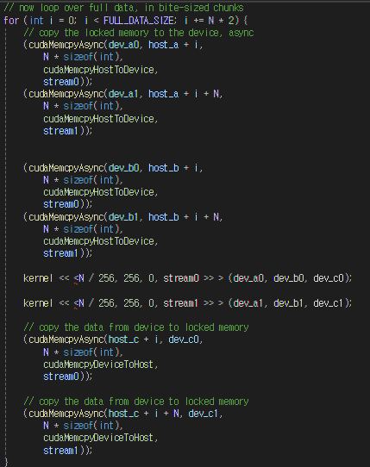
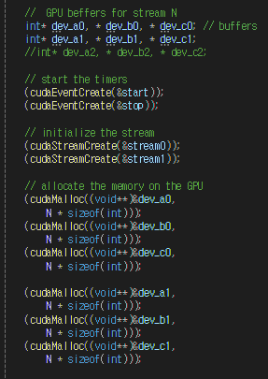


Streams
Double Stream Code
single
double

Slide 3
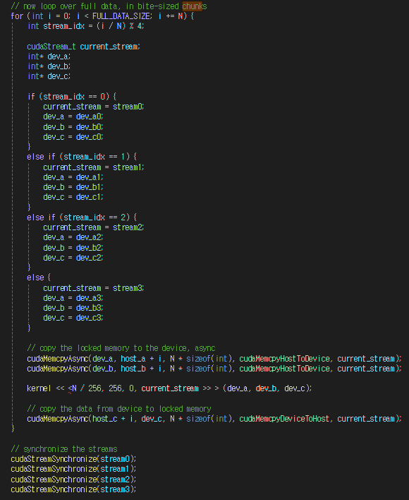
Streams
Quadruple Stream Code
single
quadruple
Performance did not impore compared to before

Slide 4
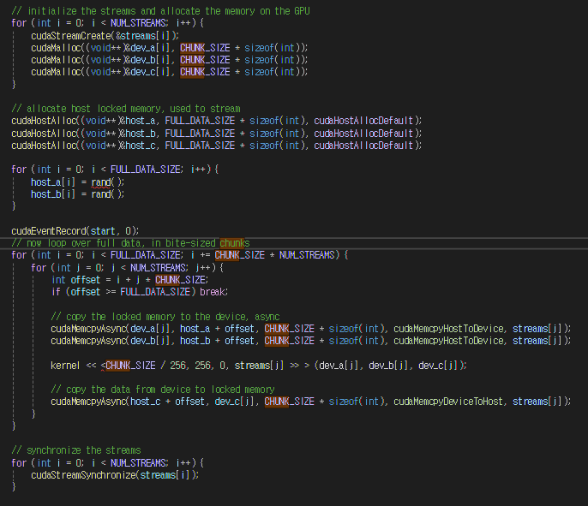
Streams
128 Stream Code
single
128
Performance did not impore compared to before as well

