Slide 1
HW9
Dongho Kim
2024.07.05

Slide 2
HW 9: CUDA programming
Implement transpose
With and without 2D block mechanism
2D thread Blocksize can be : 32x32, 16x16, 8x8
Imagesize : 128x128, 256x256, 1024x1024, 512x512
Implement maxpool using CUDA
512x512 output 256x256
Utilize 2D thread block
2D thread Blocksize can be : 32x32, 16x16, 8x8
Implement median filter using CUDA
3x3 median filter
5-tap median filter
With and without shared memory

Slide 3
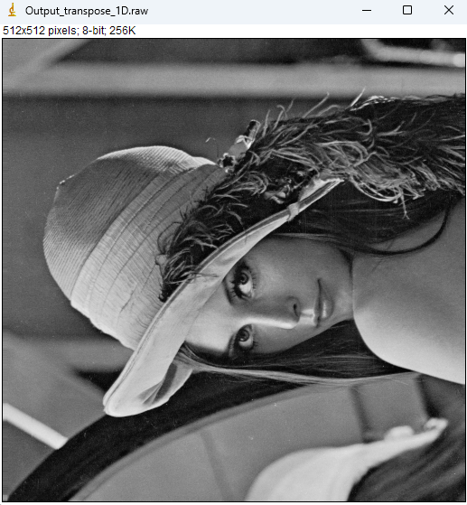
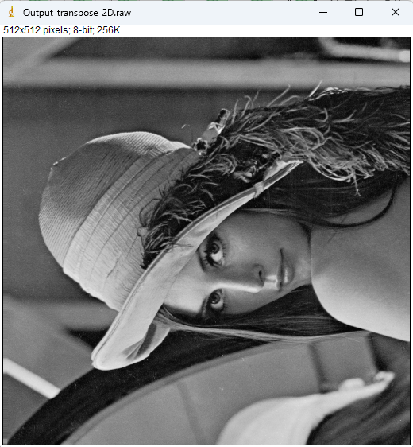

Transpose
Example of Transpose
Execution for 512x512 image & 32 block size

Slide 4
Transpose
Without 2D block mechanism
 | 128 x 128 | 256 x 256 | 512 x 512 | 1024 x 1024
8 x 8 | 0.5ms | 1.1ms | 4.5ms | 29.1ms
16 x 16 | 0.5ms | 1.2ms | 5.0ms | 38.1ms
32 x 32 | 0.7ms | 1.6ms | 9.5ms | 69.8ms
With 2D block mechanism
 | 128 x 128 | 256 x 256 | 512 x 512 | 1024 x 1024
8 x 8 | 0.5ms | 0.4ms | 0.5ms | 0.8ms
16 x 16 | 0.6ms | 0.4ms | 0.6ms | 0.9ms
32 x 32 | 0.3ms | 0.4ms | 0.5ms | 0.8ms

Slide 5
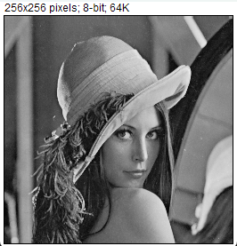
Maxpool
With 2D thread block
512x512 output 256x256
Utilize 2D thread block
2D thread Blocksize can be : 32x32, 16x16, 8x8
BlockSize = 32x32

Slide 6


Median Filter – 3x3
Without shared memory
With shared memory

Slide 7
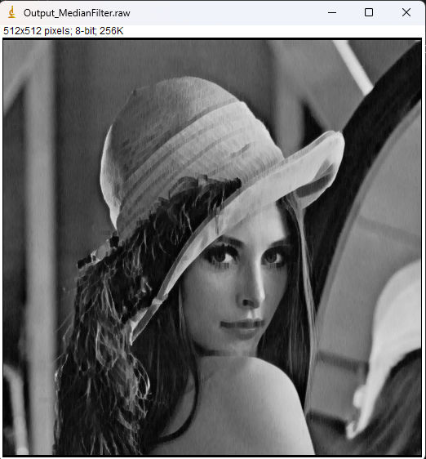
Median Filter – 5 tap (vertical)
Without shared memory
With shared memory

