Slide 1
HW1
Dongho Kim
06.27.2024

Slide 2
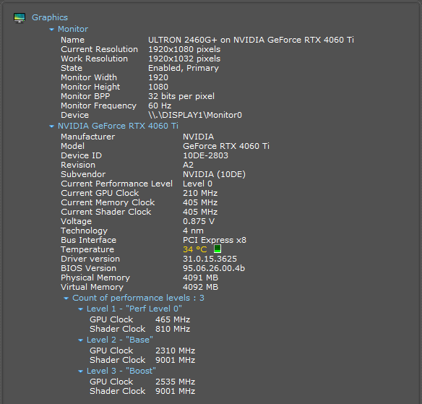
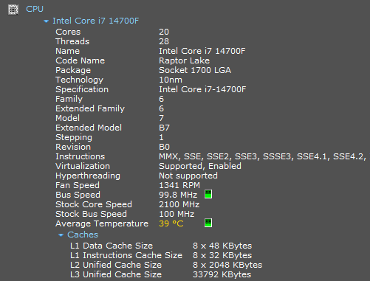
Software & Hardware
- Working Conditions on My Desktop
Visual Studio 2022
Intel’s OneAPI Working
Cuda 12.2 Working
ImageJ installed
CPU & GPU condition

Slide 3

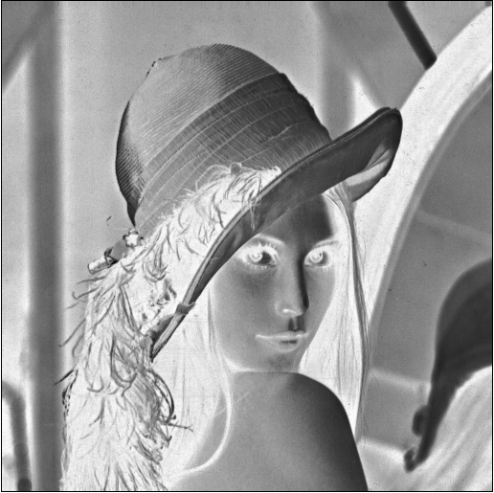


Software & Hardware
Inverted image
invert8c
InvertSSE
invertCuda

Slide 4
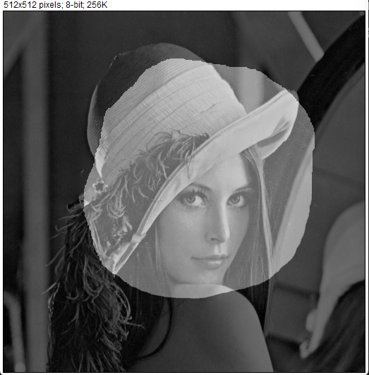
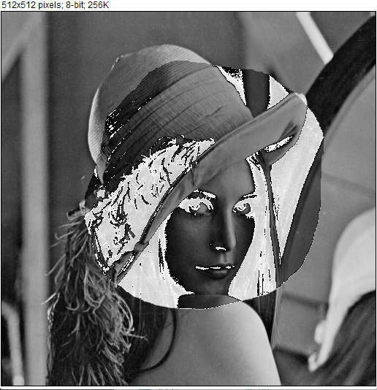




C : Add
Option1
Option2
Option3

